Slide 1
Function Annotation By Context
-- human
2006-10-03
Yu Huang

Slide 2
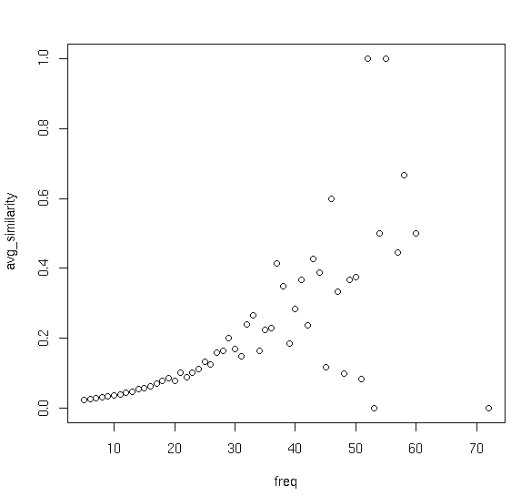
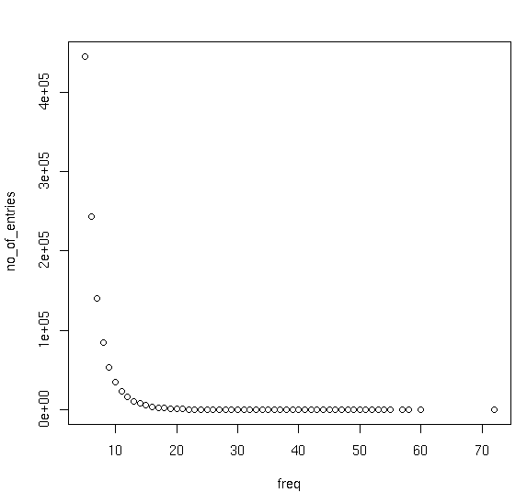
Funcion Homogeneity vs. Recurrence

Slide 3
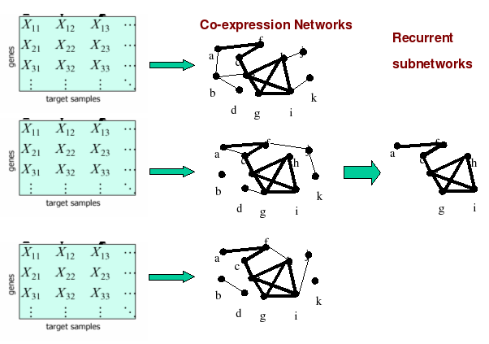
Microarray Dataset => Graph
65 datasets 65 graphs 179923 patterns

Slide 4
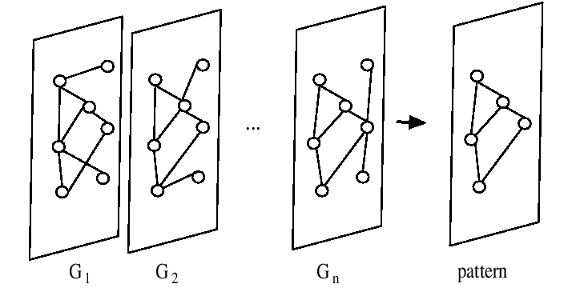
FIM (Frequent Itemset Mining)
Grahne,Gosta; Zhu,Jianfei(2003) Efficiently Using Prefix-trees in Mining Frequent Itemsets

Slide 5
Pattern Post-processing (Haifeng Li)
Remove Redundant Patterns
Merge Similar Patterns
Biclustering (simulated annealing)
Get Connected Components

Slide 6
Function Prediction Based on Distance (Haifeng Li)

Slide 7
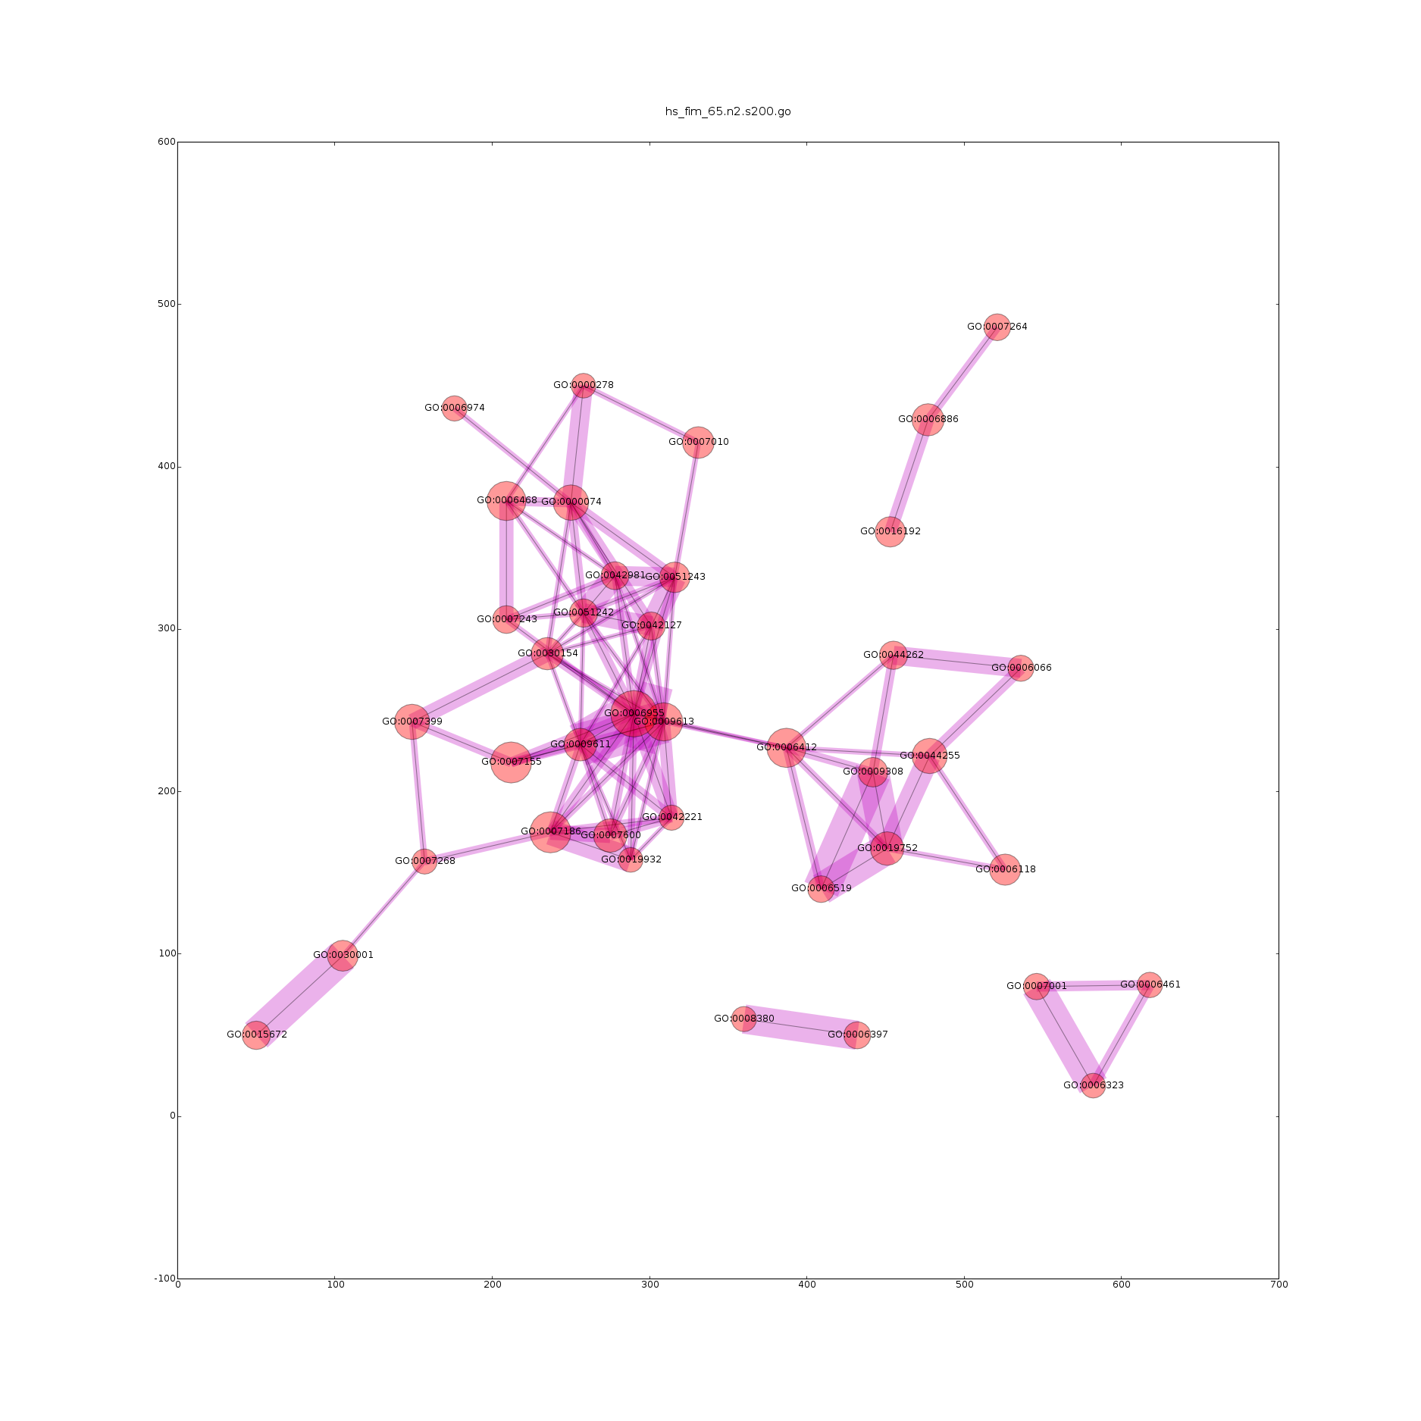
GeneOntology Categories

Slide 8
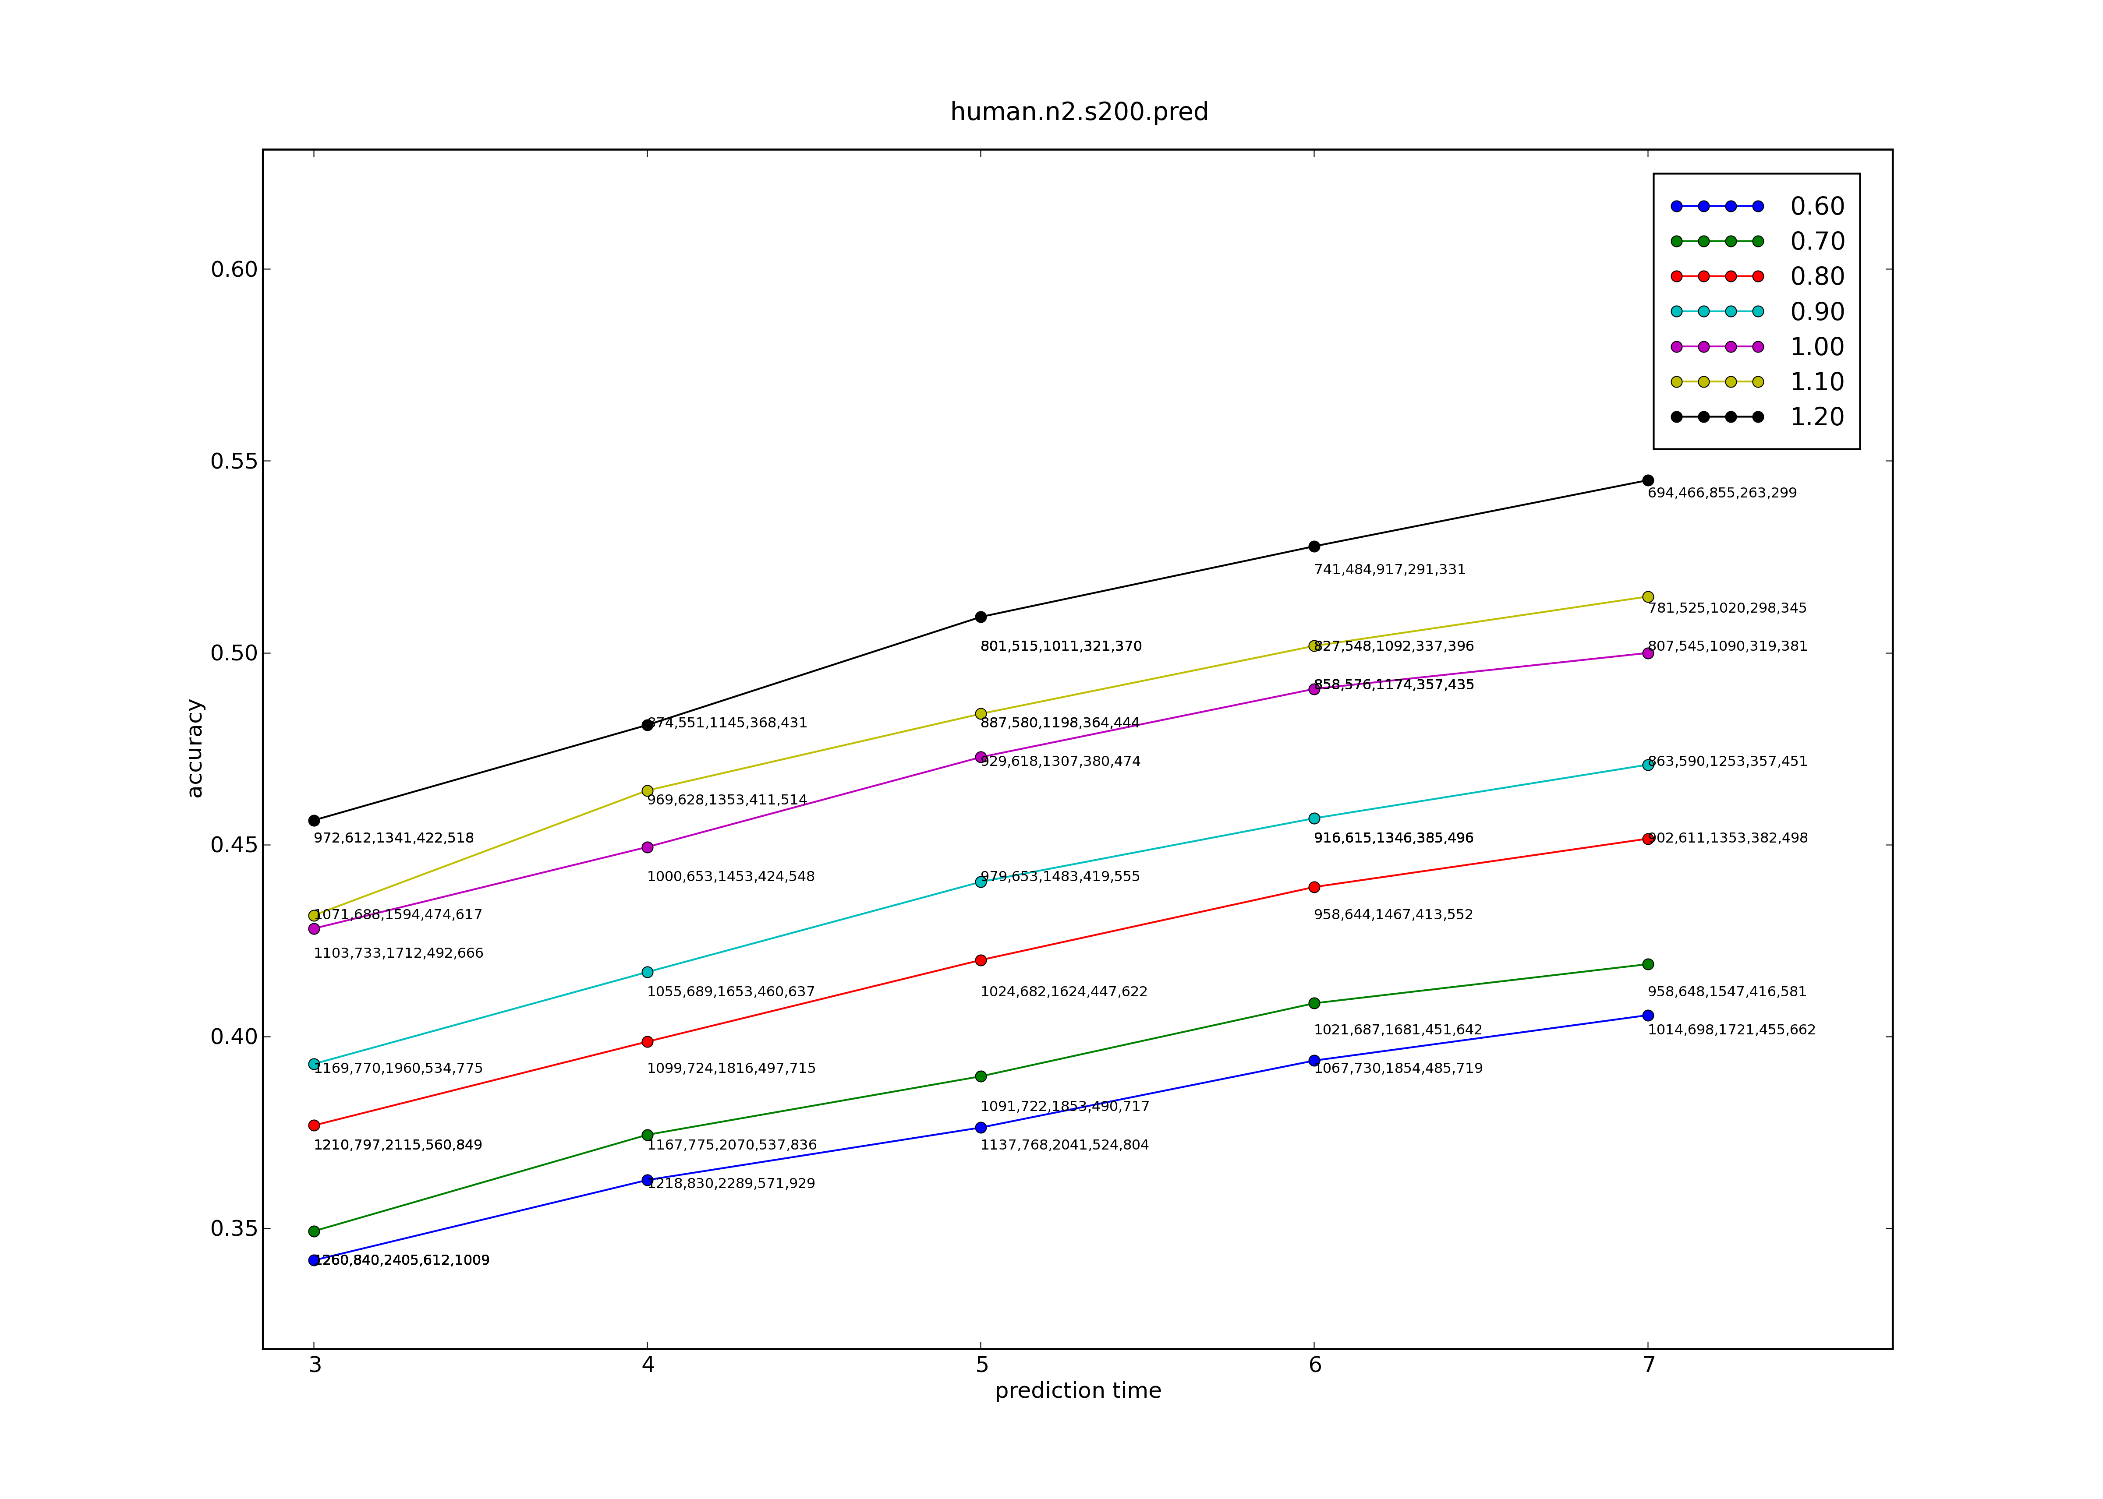
Prediction Curves

Slide 9
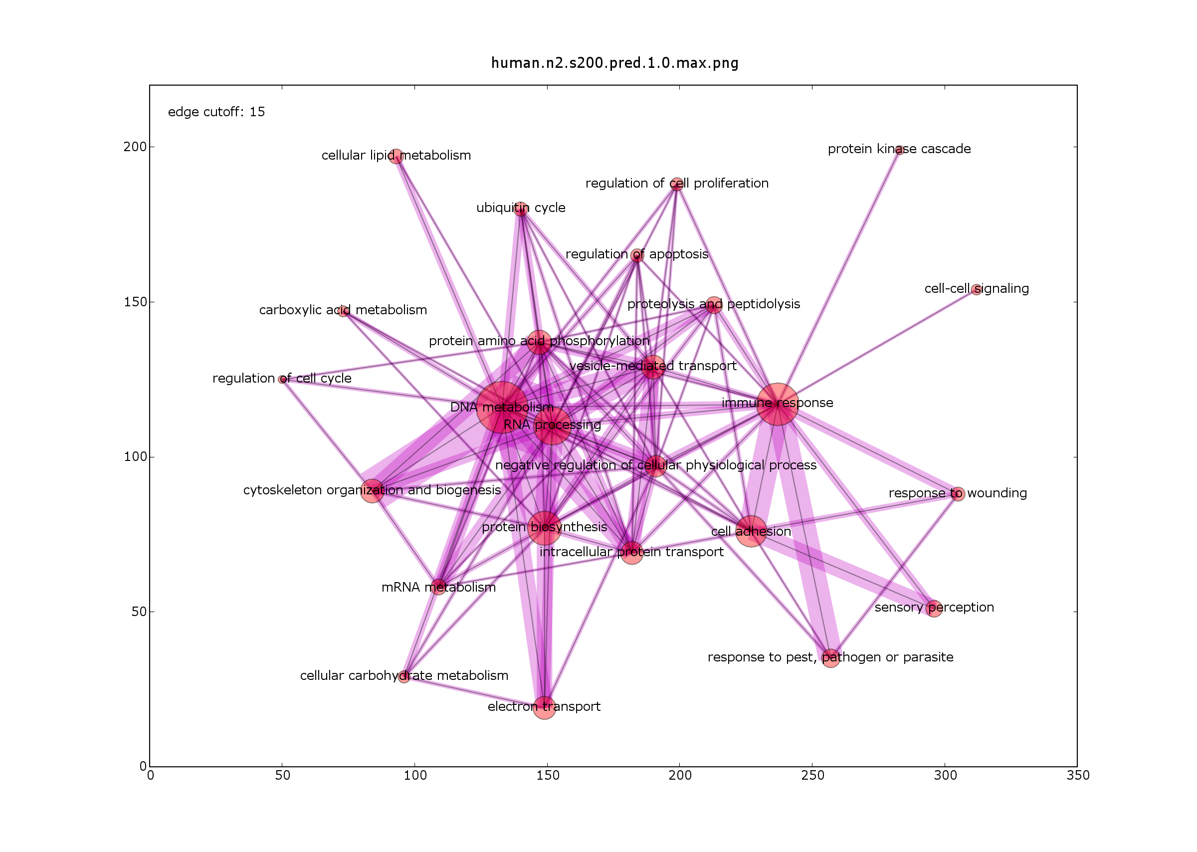
Distribution of Predicted Functions

Slide 10
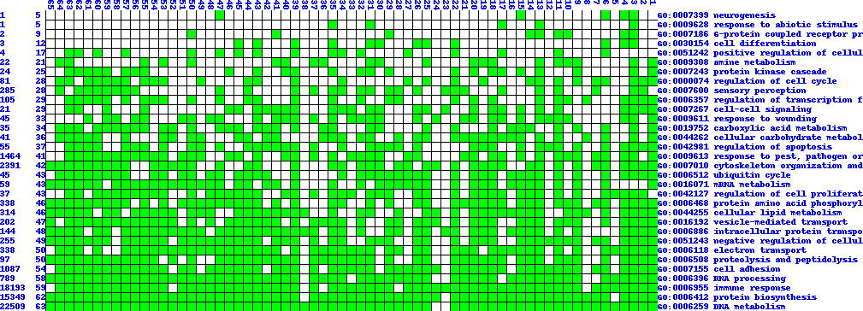
Function Map(gene-function map)

Slide 11
TF <-> target genes
download genome sequences and gene location information from NCBI Genome and Gene Database(ftp site)
get 10kb upstream based on CDS starting site or TSS(transcription starting site)
Use RepeatMasker to mask the upstream sequences
Run TRANSFAC's match over masked sequence

Slide 12
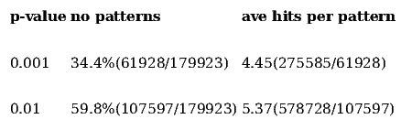
Hyper-Geometric Test

Slide 13
Top TF based on #patterns

Slide 14
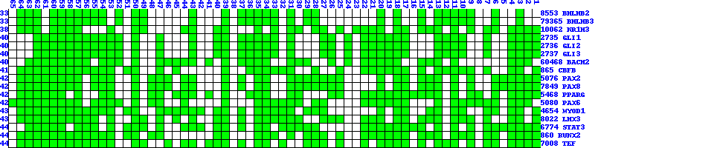
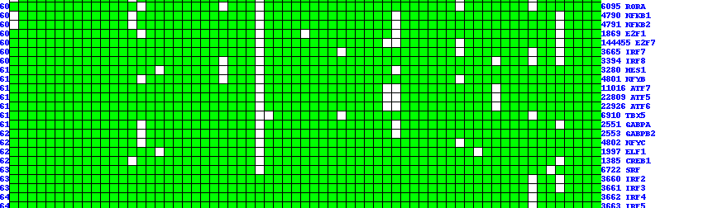
Top TF based on #datasets

Slide 15
overlapping with experimental hits

Slide 16
Co-expression uncovers hidden hits

Slide 17
Co-factor supported by experiment

Slide 18
TF module crosstalk

