Slide 1
Function Annotation By Context
-- human
2006-11-21
Yu Huang

Slide 2
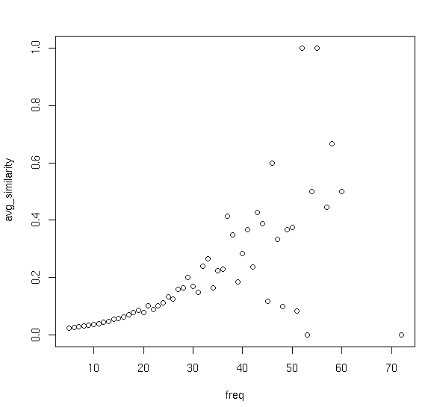
Motivation
Funcion Homogeneity vs. Recurrence

Slide 3
Overview
Datasets
Coexpression
Networks
Recurrent
Patterns
Annotation
Transcription Factors
Genes
f
j
f
j
e
----
----
----
----
----
a
c
h
a
c
h
e
e
g
b
k
b
k
h
d
g
i
d
g
i
i
e
h
a
f
j
a
f
j
Transcriptional Annotation
----
----
----
----
----
c
e
h
c
e
h
g
i
b
k
b
k
d
g
i
d
g
i
Gene Ontology
f
j
f
j
a
c
h
a
c
h
f
----
----
----
----
----
e
e
a
b
k
b
k
b
d
g
i
d
g
i
d
f
j
f
j
a
c
h
a
c
h
Functional Annotation
----
----
----
----
----
e
e
b
k
b
k
d
g
i
d
g
i

Slide 4
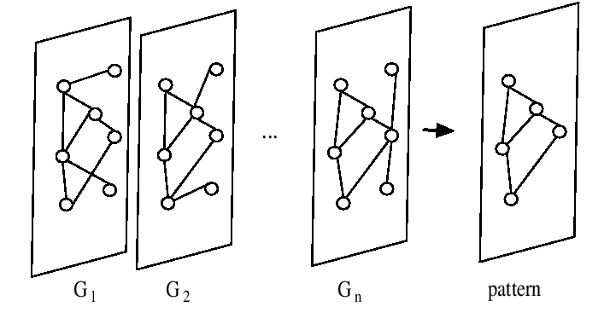
FIM (Frequent Itemset Mining)
Grahne,Gosta; Zhu,Jianfei(2003) Efficiently Using Prefix-trees in Mining Frequent Itemsets

Slide 5
Pattern Post-processing (Haifeng Li)
Remove Redundant Patterns
Merge Similar Patterns
Biclustering (simulated annealing)
Get Connected Components

Slide 6


Function Prediction Based on Distance (Haifeng Li)
i goes from 1 to 3.
leave one out, set diagonal of P = 0.
O is the GeneOntology binary matrix.
M is the final score matrix for each gene to each GO.

Slide 7
GeneOntology Categories

Slide 8
Prediction Curves

Slide 9
Distribution of Predicted Functions

Slide 10
Function Map(gene-function map)

Slide 11
TF <-> target genes
download genome sequences and gene location information from NCBI Genome and Gene Database(ftp site)
get 10kb upstream based on CDS starting site or TSS(transcription starting site)
Use RepeatMasker to mask the upstream sequences
Run TRANSFAC's match over masked sequence

Slide 12
Hyper-Geometric Test

Slide 13
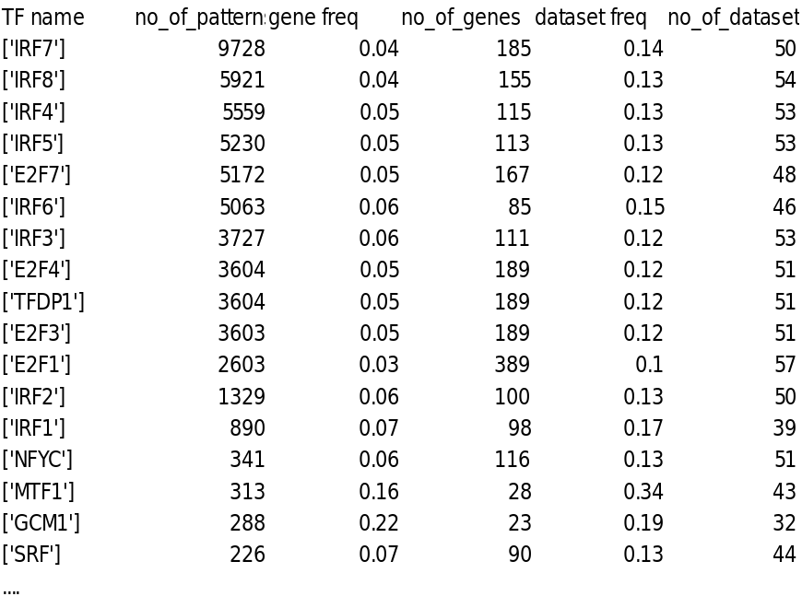
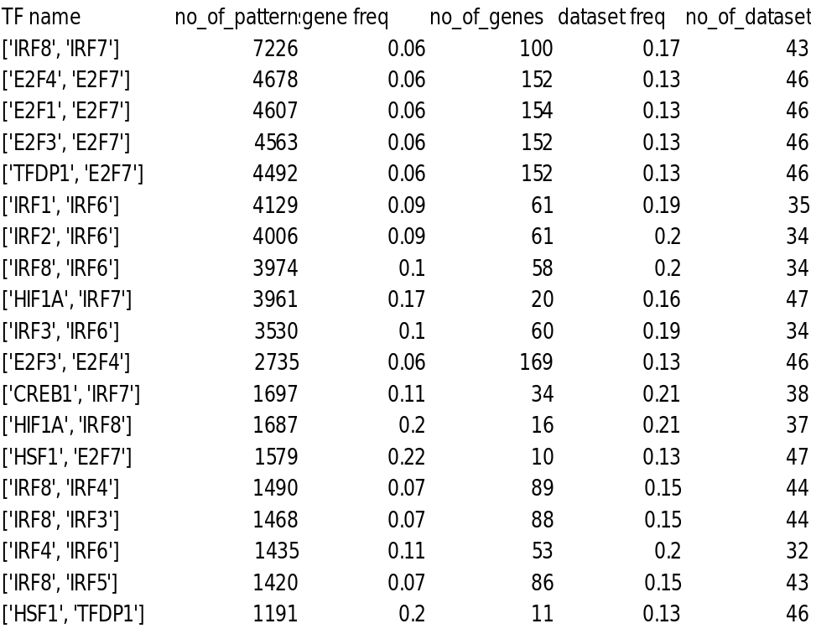
Top TF based on #patterns

Slide 14
Top TF based on #datasets

Slide 15
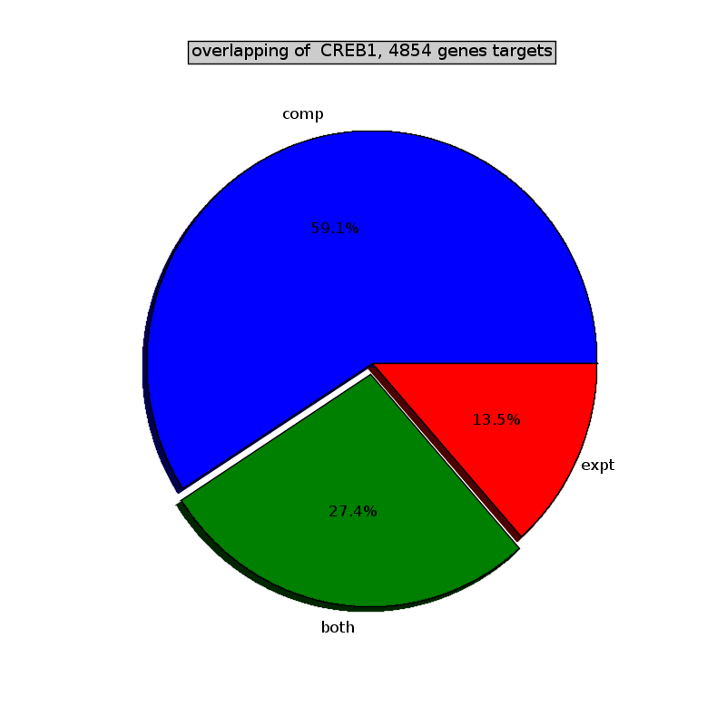
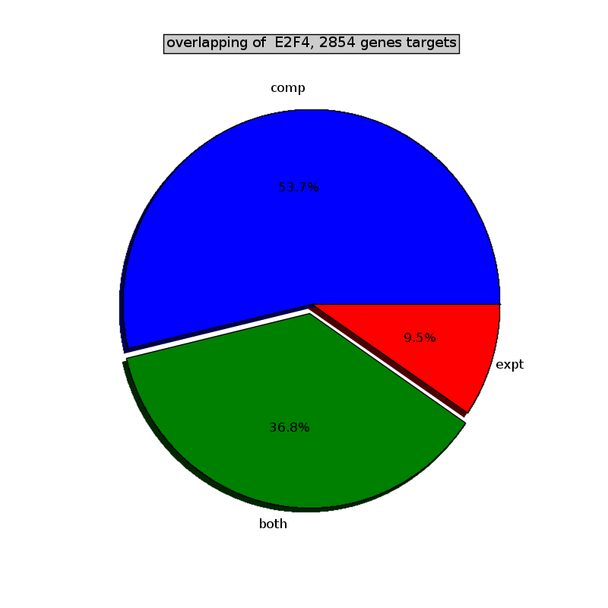
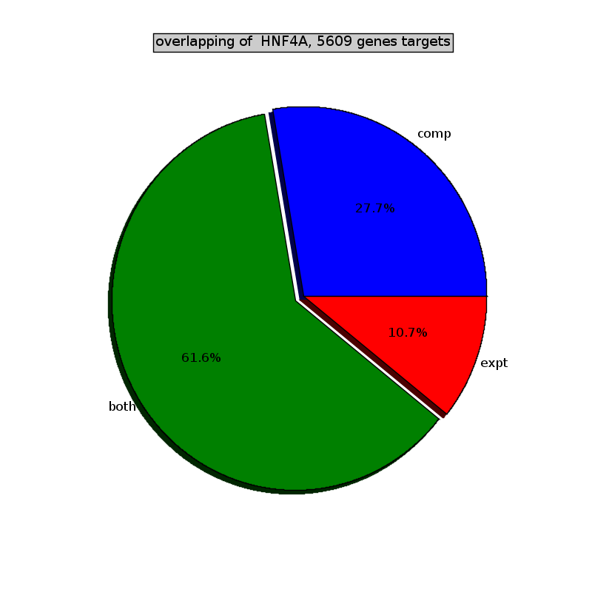
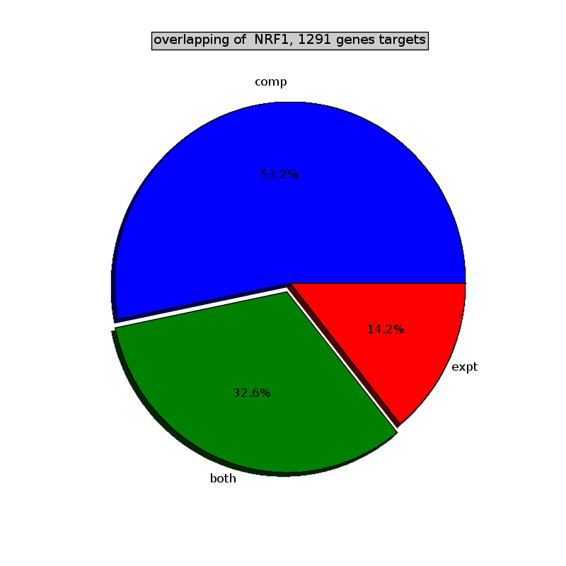
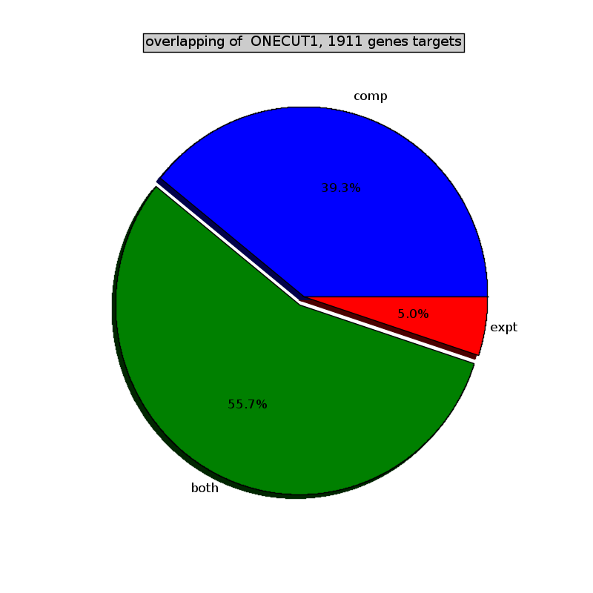

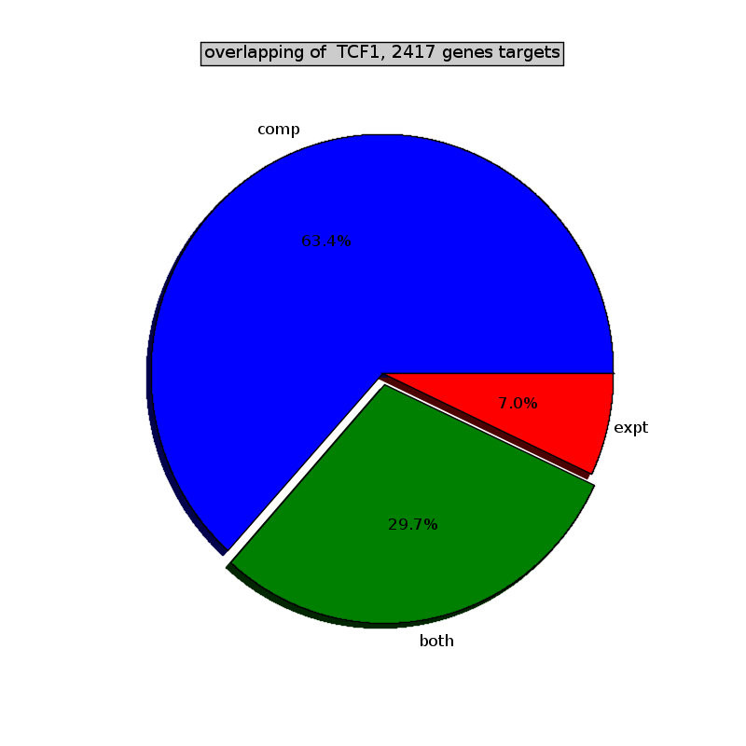
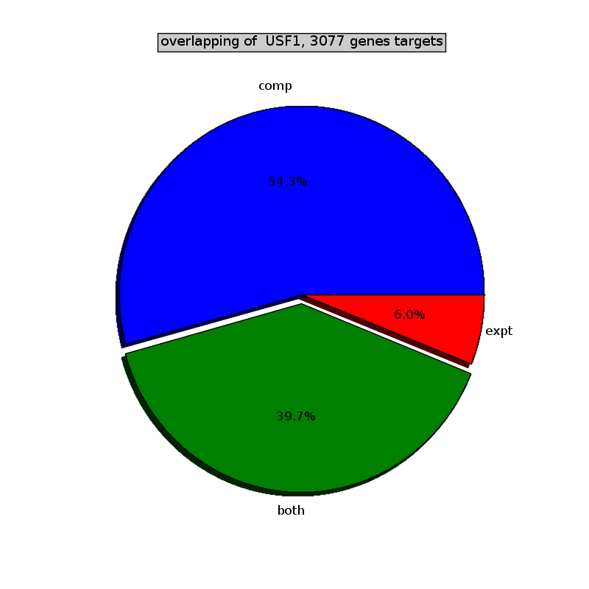
overlapping with experimental hits

Slide 16
Co-expression uncovers hidden hits

Slide 17
Co-factor supported by experiment

Slide 18
TF module crosstalk

