Slide 1
Function Annotation By Context
2006-04-11
Yu Huang

Slide 2
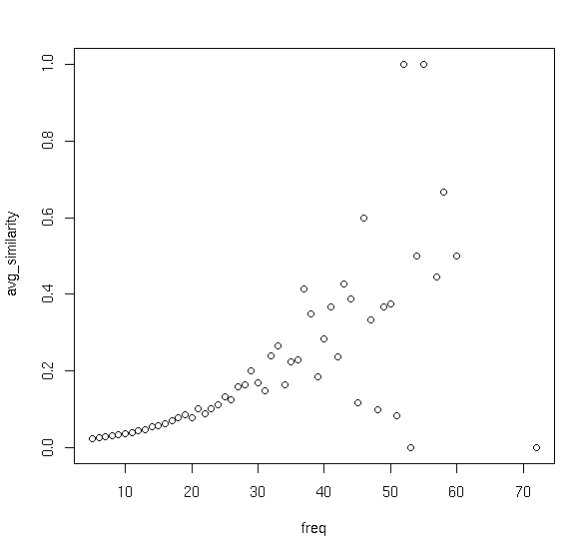
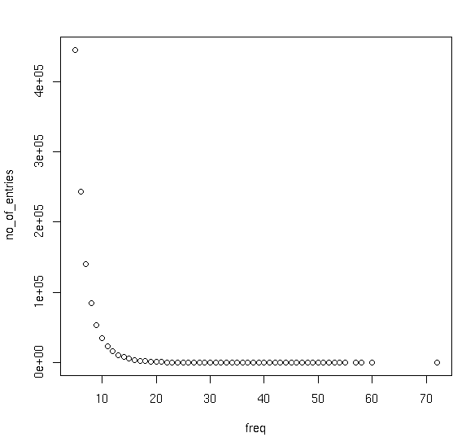
Funcion Homogeneity vs. Recurrence

Slide 3
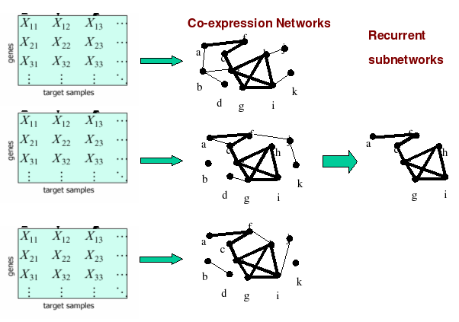
Microarray Dataset => Graph
120 datasets 120 graphs 5 million patterns

Slide 4
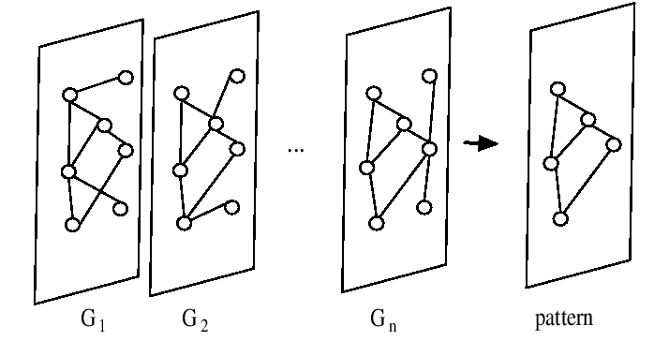
FIM (Frequent Itemset Mining)

Slide 5

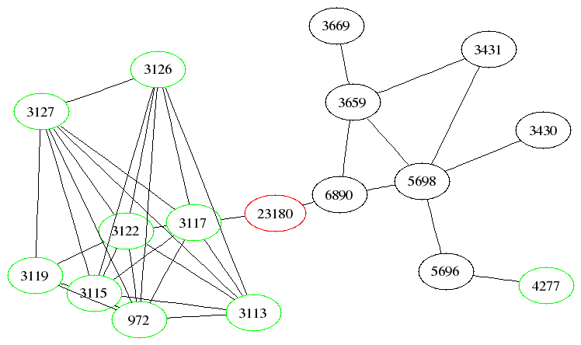
Prediction by “gradient”
v: vertex
L: layer
S(v): function-consensus score for vertex v
nL: number of vertices on layer L
antigen presentation

Slide 6
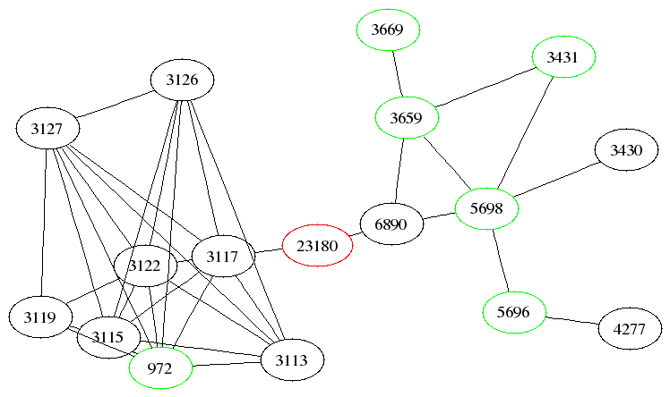
cellular metabolism

Slide 7
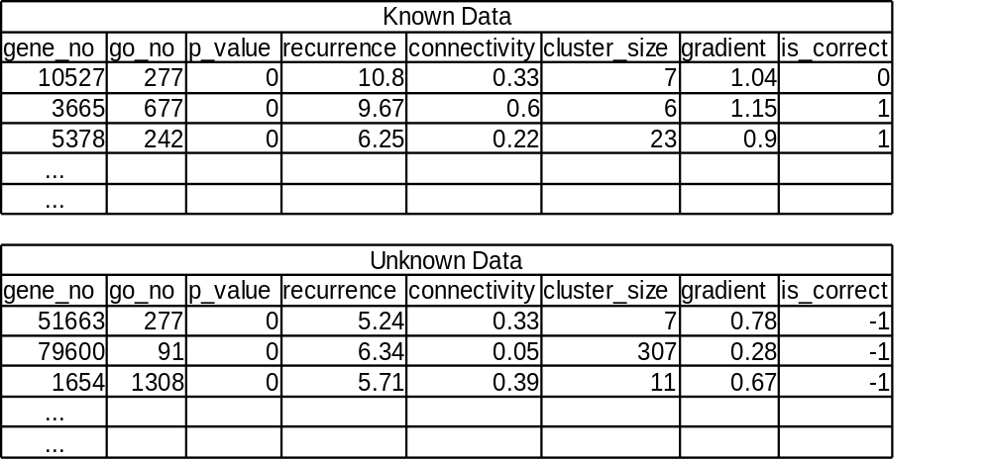
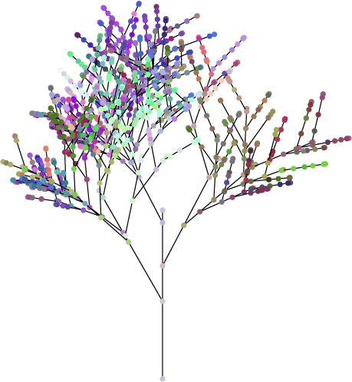
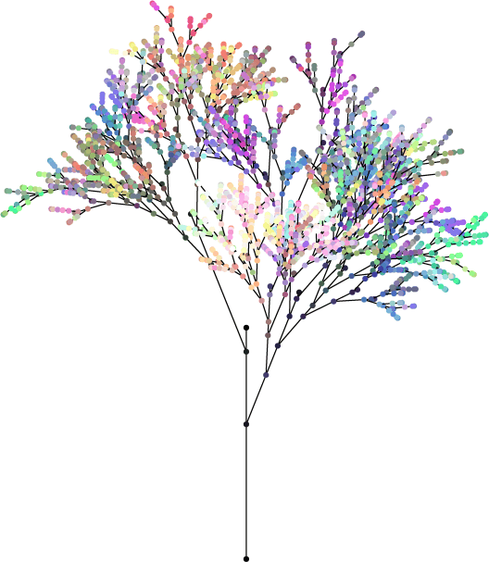
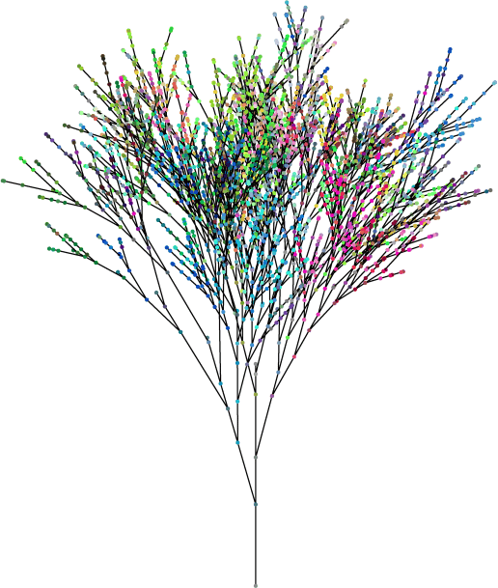
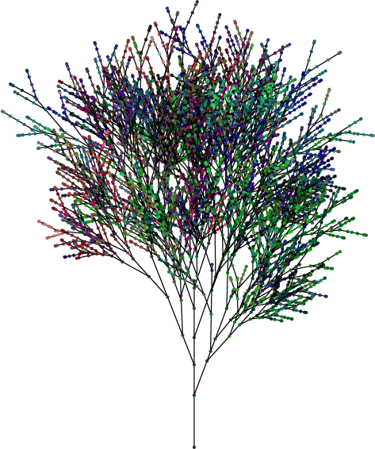
Classification By RandomForest
.....

Slide 8
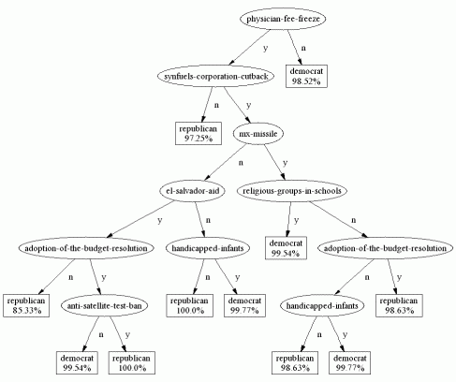
Classification Tree

Slide 9
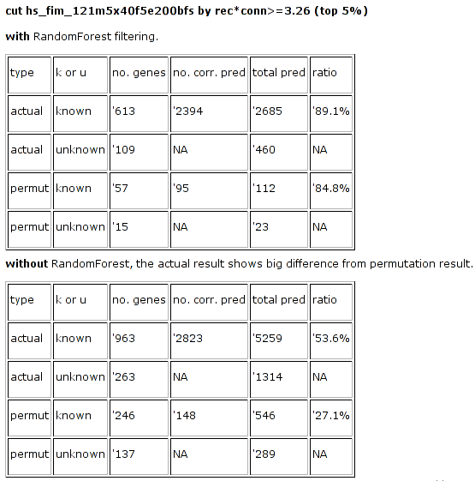

Slide 10
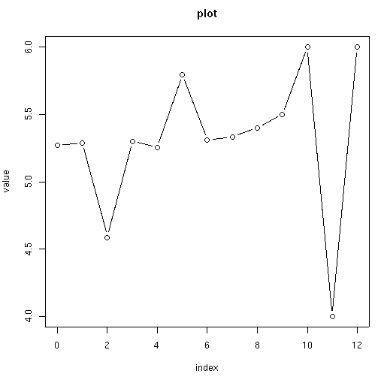
#functions vs alternative splicing, #promoters, #tissues, age...

Slide 11
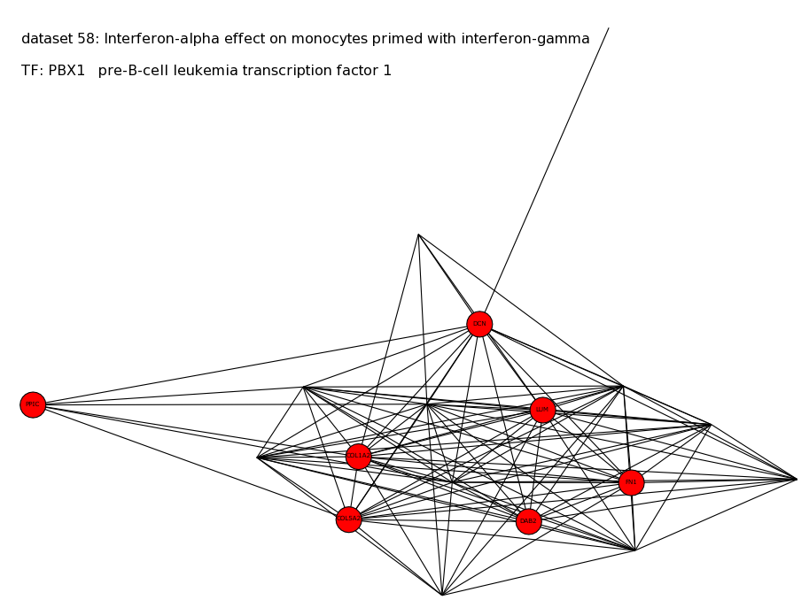
Which Transcription Factor(s) Cause Coexpression?

