Slide 1
Mass Spectra Signal Interpretation and Genotype Calling in TyperCALLER v3.3
Author: Dr. Guy Del Mistro

Slide 2
Introduction: Topics covered
Predicted linewidth
Concepts: signal; baseline; noise
Peak fitting details
Measurements from peak fitting
Assigning peak probability
Genotype calling
Appendix I: Probability functions
Appendix II: INI/Config parameters

Slide 3
1. Predicted linewidth
In the absence of more specific information, the expected width of a mass signal (at a given mass) is fundamental to peak identification and quantification.
Predicted linewidth (~= HWHH) is specified for mass M by two INI parameters by the equation:
λ_{e} = L_{A} + L_{B}.M
Initially (v3.1) λ_{e} was expected to be given by 0.1% of the signal mass (i.e. L_{A} = 0, L_{B} = 0.001). Later observations at lower and higher masses than usually considered in lower multiplexed spectra indicated that peak width did not vary so dramatically. For v3.3 (and SP3) more appropriate values for L_{A} and L_{B} were employed:
L_{A} = 2.5, L_{B} = 0.0005

Slide 4
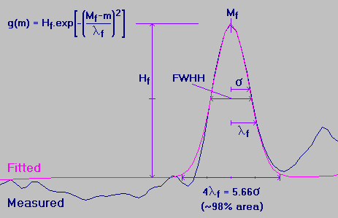
Linewidth defined
The (fitted) linewidth of a mass signal λ_{f} is defined by fitting a gaussian-shaped peak, g(m), to that signal:
Comparison of Gaussian to the Normal Curve gives:
λ² = 2σ²
FWHH = 2.3548σ
= 1.6651λ
Reported signal resolution is defined from fitted linewidth:
Res(M), M/ΔM = M / FWHH = M / (1.6651.λ_{f}(M))

Slide 5
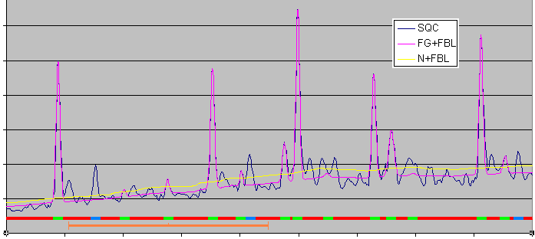
2. Concepts: signal; baseline; noise
Regions where signals are expected are masked out using 4λ_{e} ( )
Baseline fitted using window of 80λ_{m} ( ), where λ_{m} is the smallest λ_{e} (constant in point space, 400-540Da): window width is important
Noise calculated as running RMS of (signal - baseline)
Peaks discovered by masking points where height/noise (SNR) > 3 and noise > 1. Repeated twice to avoid strongest contaminant peaks. ( )

Slide 6
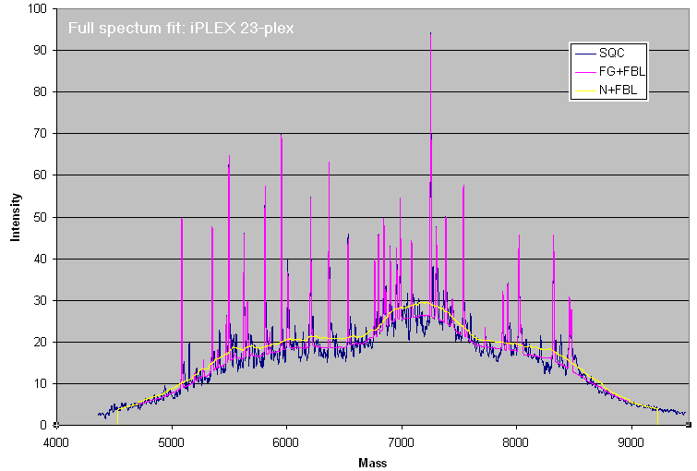
Baseline fitting example
Note 1st baseline point is N points in from ends; 1st noise point 2N in from ends

Slide 7
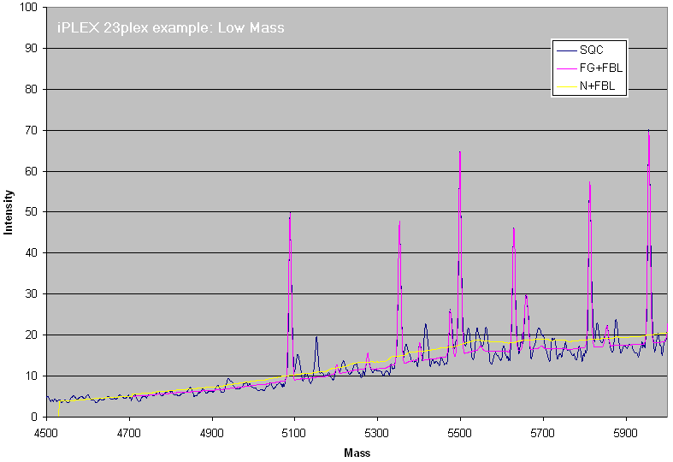
Baseline fitting example: low mass

Slide 8
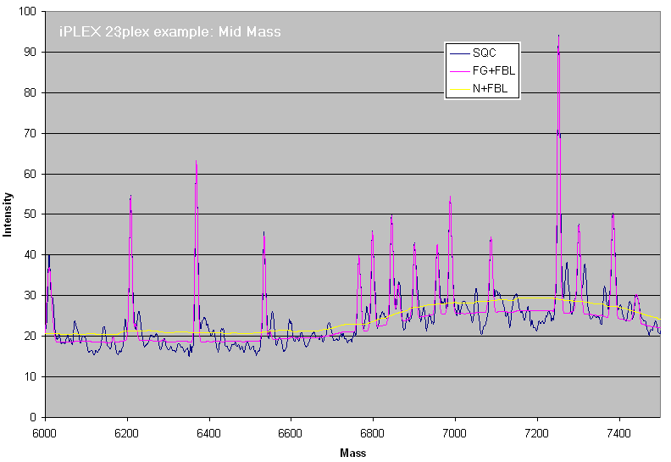
Baseline fitting example: mid mass

Slide 9
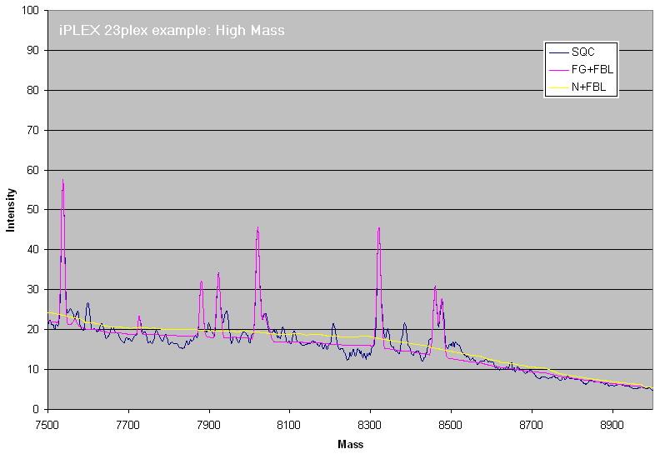
Baseline fitting example: high mass

Slide 10
3. Peak fitting details
One or more signals are fit to gaussian curves on the fitted baseline using the Levenberg-Marquardt minimization method.
Multiple signals are fit as a group with a single phase if their expected masses (m_{e}’s) are within 4λ_{e} of each other.
Each expected peak is fit over 4λ_{e} about the center but with 5x or 2.5x significance (depending on peak type) for the top λ_{e} (in data points).
Fitting fails for a peak, or group of peaks, if:
  λ_{f} > 4λ_{e}
  λ_{f} < sampling resolution (to catch data spikes)
  phase (shift or offset of the peak center), δ_{f} > 3λ_{e}
  H_{f} <= 0 (peak top is below the fitted baseline)

Slide 11
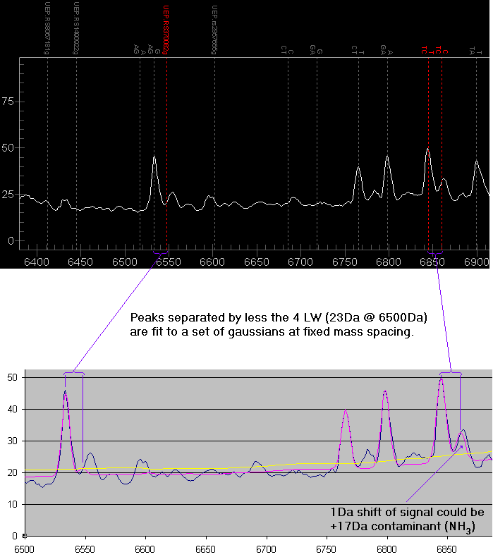
Example of multiple peak fit

Slide 12
Peak fitting exceptions
Fitted linewidth is larger than a tolerance governed by an INI parameter, λ_{f} > (1+ L_{C}).λ_{e}, OR if the fitting fails:
  H(m_{e}) is used with the linewidth at λ_{e}.
  or all measurements set to 0 if H(m_{e}) <= 0.
Offset is greater than a tolerance governed by an INI parameter, δ_{f} > L_{C}.λ_{e}:
  Shape is further analyzed. A fitted contamination peak is subtracted to give height at m_{e}. (identifies shoulder peaks)
Expected signals that are < λ_{e} apart may be fit to a single peak as any linear combination of curves.
  Heights and probabilities are adjusted with respect to their H(m_{e}) values and peak type. For example, 2 primers at same mass fit to one peak would get ½ of the height and ~0.5 prob.

Slide 13
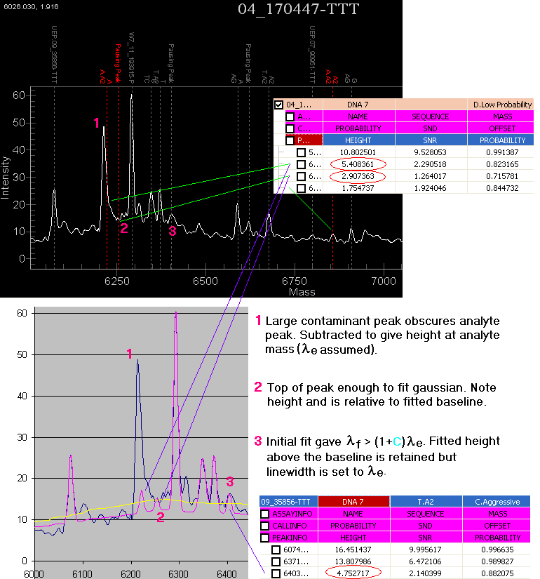
Examples of obscured peak fitting

Slide 14
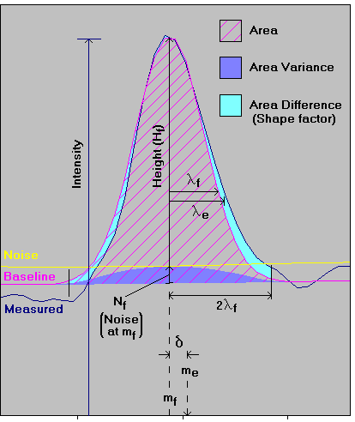
4. Measurements from peak fitting
Height above baseline, H = H_{f}
Fitted linewidth, λ_{f}
Offset: difference between fitted peak center and expected mass, δ = m_{f} – m_{e}
Area (A): integrated height above baseline under fitted peak over 4λ_{f}
Area Variance: uncertainty of peak area due to baseline fitting, V = A . H / N(m_{f})
Fit area difference (Δ): integrated height difference between fit peak and measured signal over 4λ_{f}
SNR: peak height / baseline noise, S = H / N(m_{f})

Slide 15
5. Assigning peak probability
Overall peak probability is product of five components, P = P_{S} . P_{Δ} . P_{δ} . P_{λ} . P_{R}
P_{S}: (probability based on SNR)
  Indicates how distinct the peak is from local baseline variation (chemical noise)
  Main contributor for well fitted peaks
P_{Δ}: (probability based on peak shape)
  Indicates how well a gaussian fits the measured peak shape
  May be significant contributor for poorly fitted peaks
P_{δ}: (probability based on peak offset)
  Indicates how close the peek was fitted to an expected mass signal
  Minor contributor: 1Da offset could be significant or just due to inaccuracy in the fitting or recalibration procedure
P_{λ}: (probability based on peak width)
  Meant to trap broad peaks that have gaussian shape (mostly redundant)
  Minor contributor: predicted linewidth (λ_{e}) is expected to be approximate

Slide 16
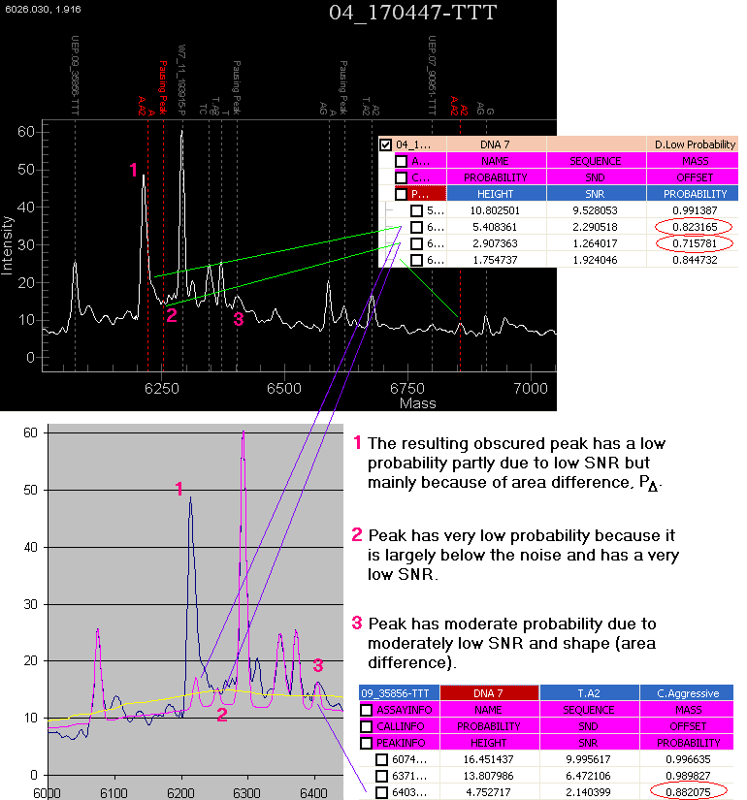
Obscured peaks and probability

Slide 17
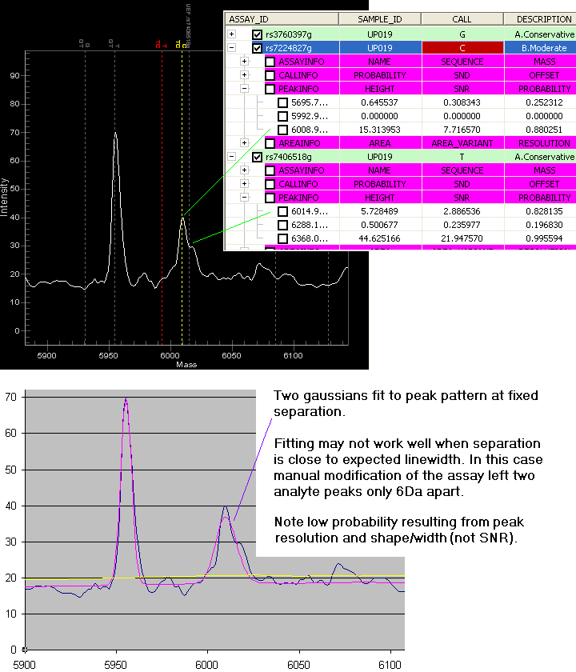
Reference Peak Resolution
P_{R}: (probability based on reference peak resolution)
Only significant for masses defined to be close (< 2λ_{e}) to other assay masses.
Takes into account peak types:
  Strong: analyte, primer, specified contaminant
  Weak: pausing, adduct, by-product
An analyte mass defined too close to another assay mass (typically 4-7Da depending on the difference between peak types and masses) will result in a Bad Assay call.

Slide 18
6. Genotype calling
Genotype call primarily depends on the number of analyte peaks identified by their probabilities (P):
  If all peaks have P’s < C_{NOP} (no-peak cutoff), a No Alleles call is made.
  If only one peak has P > C_{AGG} (aggressive cutoff), a homozygous call may be made.
    P_{S} is adjusted in expectation of a single analyte signal
  Otherwise a call will depend on the relative skew of analyte signals
    Skew is defined as the ratio of signal intensities for the smallest analyte to the largest analyte
    Skew probability function adjusts probability of the minor allele using an INI parameter for the cutoff such that: P_{SKW}(F_{SKW}) = C_{AGG} => homozygous call made

Slide 19
Genotype call score
Genotype Call Score is a product of three probability functions: GCS = P_{MA} . P_{SKW} . P_{YLD}
  P_{MA} is the probability of the minor allele peak
  P_{SKW} is the skew probability: there are actually 4 such measures depending on whether forward or reverse skew is identified and whether the minor allele is ignored:
    P_{SKW} = 1 if no second allele peak is identified
    if P_{SKW} < C_{AGG}, P_{HSKW} is employed (new for Typer3.3)
  P_{YLD} is a probability factor based on the allele peak yield. An INI parameter specifies a minimum, such that: P_{YLD}(F_{YLD}) = C_{AGG} => Low Probability call made
GCS governs the confidence assigned a the genotype call:
GCS > C_{CON} => Conservative, GCS > C_{MOD} => Moderate
GCS > C_{AGG} => Aggressive, GCS < C_{AGG} => Low Probability

Slide 20
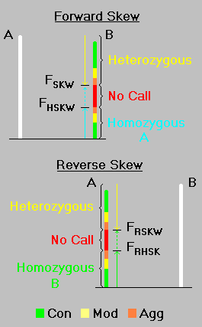
Signal Intensity, Skew and Yield
Single Intensity for a given peak is represented as the product of the fitted height x fitted mass for that peak.
  hME allele peaks have a large mass separation
    mass factor adjusts for width/height variation (minor)
    SNR had issues due to different noise environments
Skew = ratio of signal intensities = I_{B} / I_{A} , I_{A} >= I_{B} (forward skew) = I_{A} / I_{B} , I_{B} > I_{A} (reverse skew)
Heterozygous call IF P_{B} . P_{SKW}(I_{B}/I_{A}) > C_{AGG} (forward)
ELSE Homozygous call if P_{B} . P_{HSKW}(I_{B}/I_{A}) > C_{AGG} (forward)
Yield includes probe primer signal intensity: YLD = (I_{A}+I_{B}) / (I_{A}+I_{B}+I_{P})

Slide 21
Appendix I: Probability functions
SNR: P_{S} = 1 – exp( α_{S}.SNR ), α_{S} = ln(1- C_{AGG}) / F_{SNR}
Shape: P_{Δ} = exp( -F_{SHP}.Δ / λ_{f}.H_{f} )
Shift: P_{δ} = exp( α_{δ}.(δ/λ_{e})⁴ ), α_{δ} = ln(C_{AGG}) / (L_{C})⁴
Width: P_{λ} = 1 – exp( α_{λ}.(λ_{e}-λ_{f})² ), α_{λ} = -0.01F_{WTH}
RPR: P_{R}(j) = Π_{i≠j}{1 – exp( α_{R}(m_{i}-m_{j})² ).τ_{i} / (τ_{i} + τ_{j})},
- m_{i} and τ_{i} are the mass and peak type weighting for the i^{th} expected assay peak (strong: 1, weak: 0.05),
α_{R} = ln(0.02) / (2.5L_{C}.λ_{e}(j))²
Skew: P_{SKW} = (1 - exp( α_{SKW} .S )) / W_{S}, α_{SKW} = ln(1-C_{AGG}) / F_{SKW}
W_{S} = 1 – exp(α_{SKW})(S - F_{SKW})/(1- F_{SKW}) => P_{SKW}(S=1) = 1
P_{HSKW} = exp( α_{HSKW} .S ), α_{HSKW} = ln(C_{AGG}) / (F_{HSKW} . F_{SKW} )
S = I_{B}/I_{A}: for reverse skew S = I_{A}/I_{B}; substitute F_{RSKW} and F_{RHSK}
Yield: P_{YLD} = 1 if YLD > Y_{G} , Y_{G} = 0.7 (70%), otherwise:
P_{YLD} = exp( α_{YLD} .YLD/(Y_{G} - YLD) ), α_{YLD} = ln(1- C_{AGG}).(1 - F_{YLD}) / F_{YLD}

Slide 22
Appendix II: INI/Config parameters
L_{A} PEAKFIT_LINEWIDTH_A 2.5 Minimum expected linewidth
L_{B} PEAKFIT_LINEWIDTH_B 0.0005 Expected linewidth broadening with increasing mass
L_{C} PEAKFIT_AGG_SHIFT_F 0.7 Offset tolerance relative to expected peak linewidth
F_{SNR} PEAKFIT_AGG_SNR_T 1.5 SNR threshold for peak identification
F_{SHP} PEAKFIT_GAU_SHAPE_F 0.2 (0.1)* Penalty factor for peak shape vs. fitted gaussian
F_{WTH} PEAKFIT_GAU_WIDTH_F 0.1 (0.05) Penalty factor for fitted peak width vs. expected
C_{NOP} GENOTYPE_NOP_CUTOFF 0.7 Initial probability cutoff for peak identification
C_{AGG} GENOTYPE_AGG_CUTOFF 0.8 Call score cutoff for aggressive call status
C_{MOD} GENOTYPE_MOD_CUTOFF 0.85 Call score cutoff for moderate call status
C_{CON} GENOTYPE_CON_CUTOFF 0.93 Call score cutoff for conservative call status
F_{YLD} GENOTYPE_AGG_YSKW_T 0.1 (0.25) Extension yield threshold (for aggressive call)
F_{SKW} GENOTYPE_AGG_SKEW_T 0.2 (0.5) Forward skew threshold for (agg) HET / No Call
F_{RSKW} GENOTYPE_AGG_RSKW_T 0.3 (0.5) Reverse skew threshold for (agg) HET / No Call
F_{HSKW} GENOTYPE_AGG_HSKW_T 0.75 (0.6) Forward skew threshold for No Call / HOM (agg)
F_{RHSK} GENOTYPE_AGG_RHSK_T 0.75 (0.6) Reverse skew threshold for No Call / HOM (agg)
PEAKFIT_RECALMAXSHIFT 10.0 Maximum allowed spectrum recalibration shift (Da)
PEAKFIT_BASE_NOISE 0.15 Added to noise to prevent large SNR in smooth regions
* Values in parentheses are for iPLEX where they differ from those for hME

