Slide 1
Estimate Outcrossing
Lab Meeting
Yu Huang
2007-04-30

Slide 2
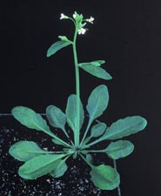
http://www.nsf.gov/
In A. thaliana, about 99% of the plants result from self-fertilization ... only about
1% from outcrossing.
Page 87, Hartl & Clark, 2007

Slide 3
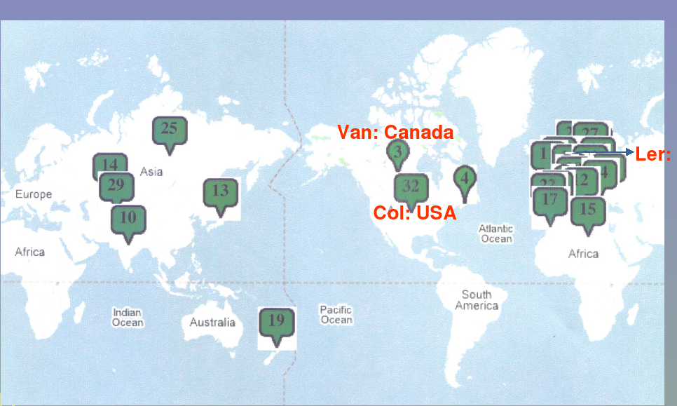
Data (dbSNP)‏
4664 strains from around the world
149 SNPs
Yan Li lab meeting ppt

Slide 4
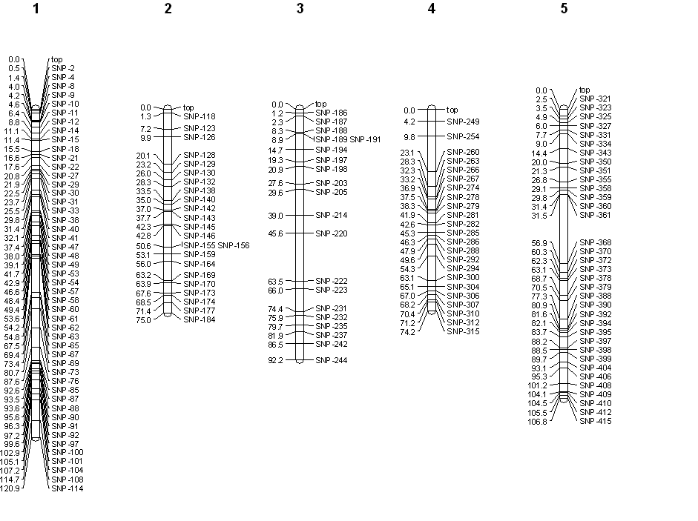
SNP locations on chr.
Yan Li lab meeting ppt

Slide 5
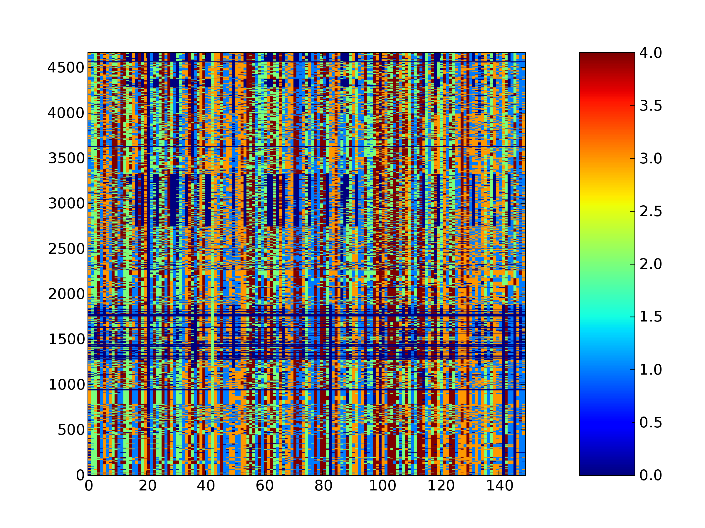
Data Overview
0=NA, 1=A, 2=C, 3=G, 4=T

Slide 6
Questions
What's the genotyping error rate compared to 2010's data?
Are there some bogus heterozygous calls?
Are there identity strains?
Which strains are recent products of outcrossing?
How many selfing generations are they away from the last out-crossing?

Slide 7
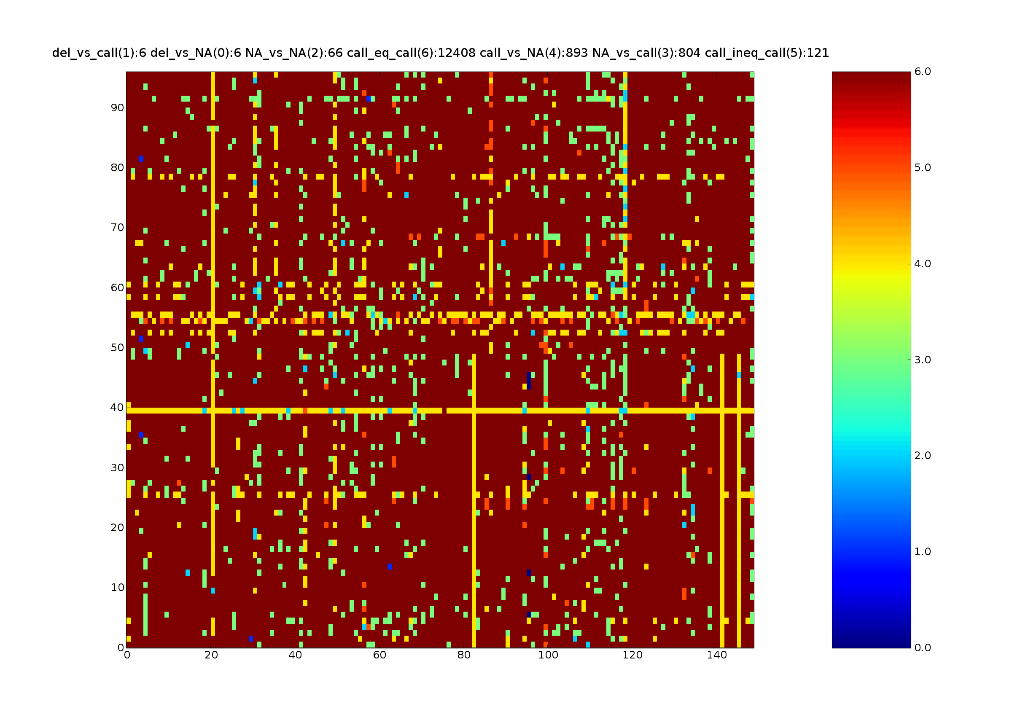
I. Genotyping Error Rate
program output result
two error rates
heatmap

Slide 8
I. (cont.)‏
optimistic error rate is 121/ (12408+121) ~0.96%
(121+893+804)/( 12408.0+121+893+804) ~ 12.78%

Slide 9
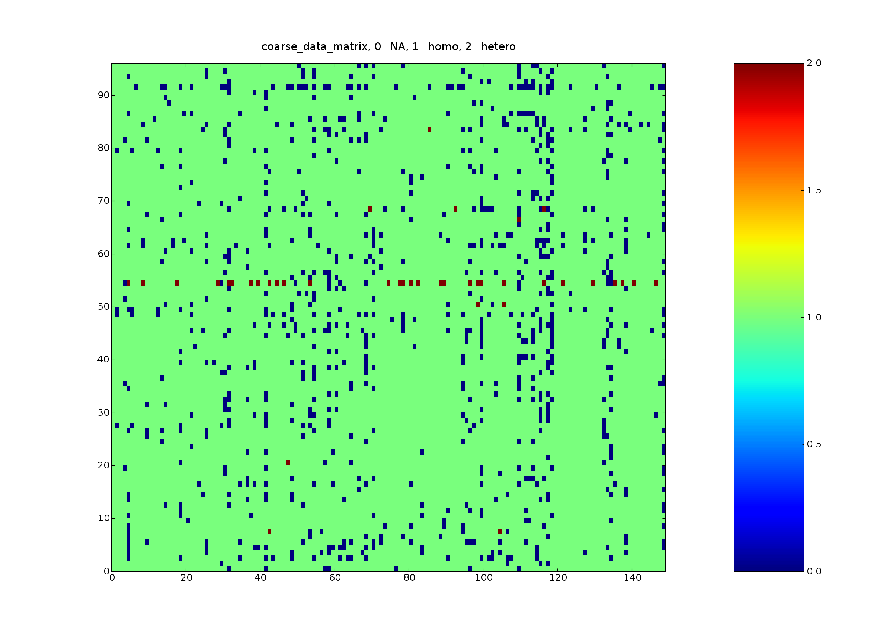
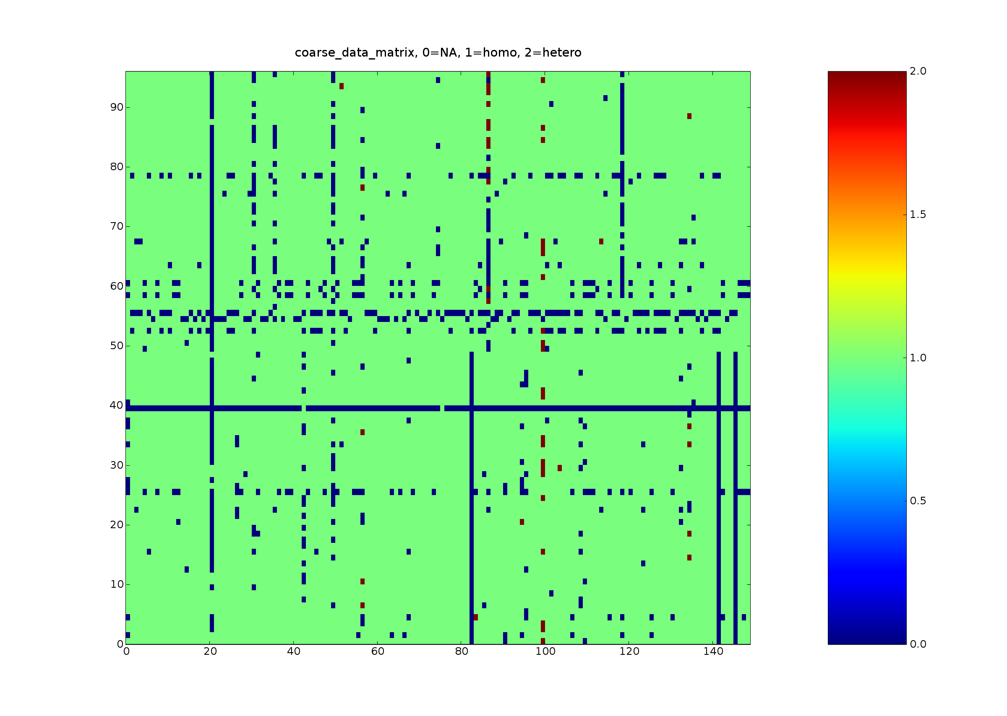
I. (cont.)‏

Slide 10
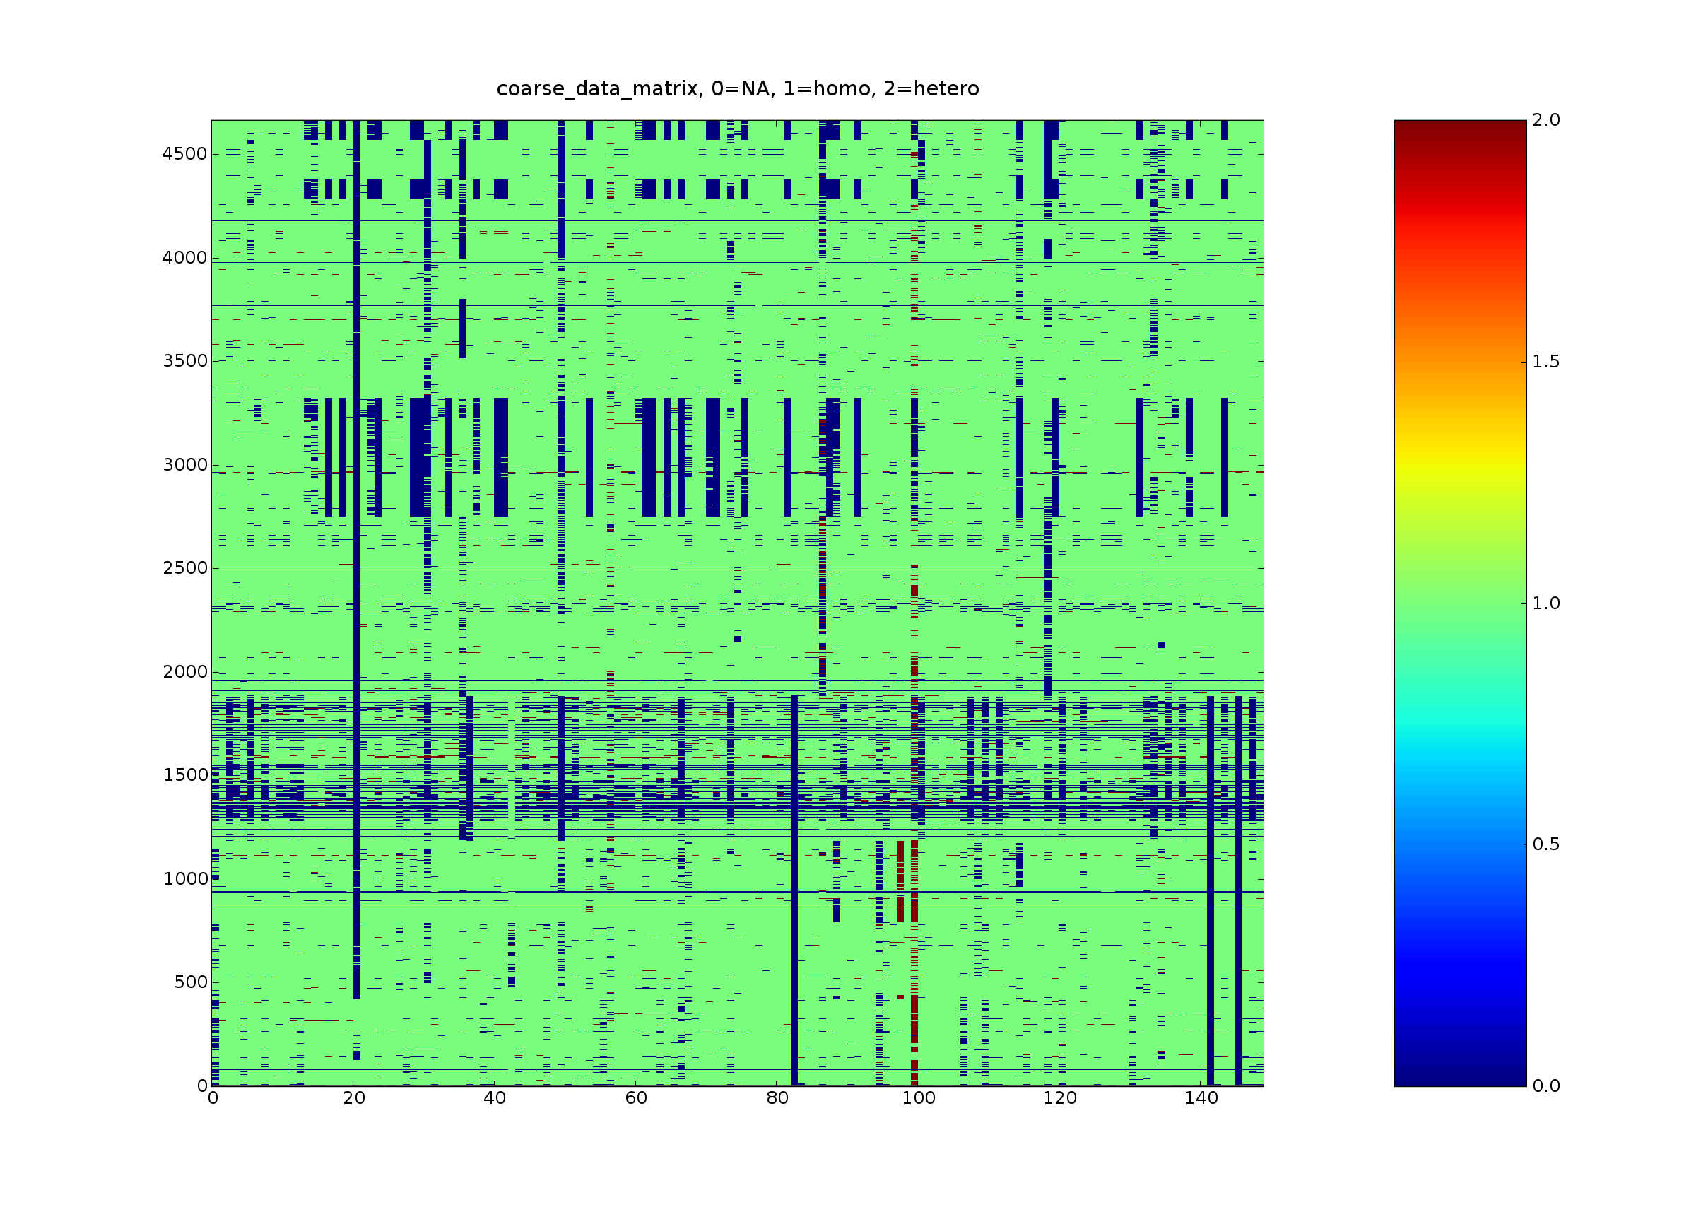
II. Bogus Hetero-calls
two heatmaps
probability model
histogram of log prob
why, show blast example

Slide 11
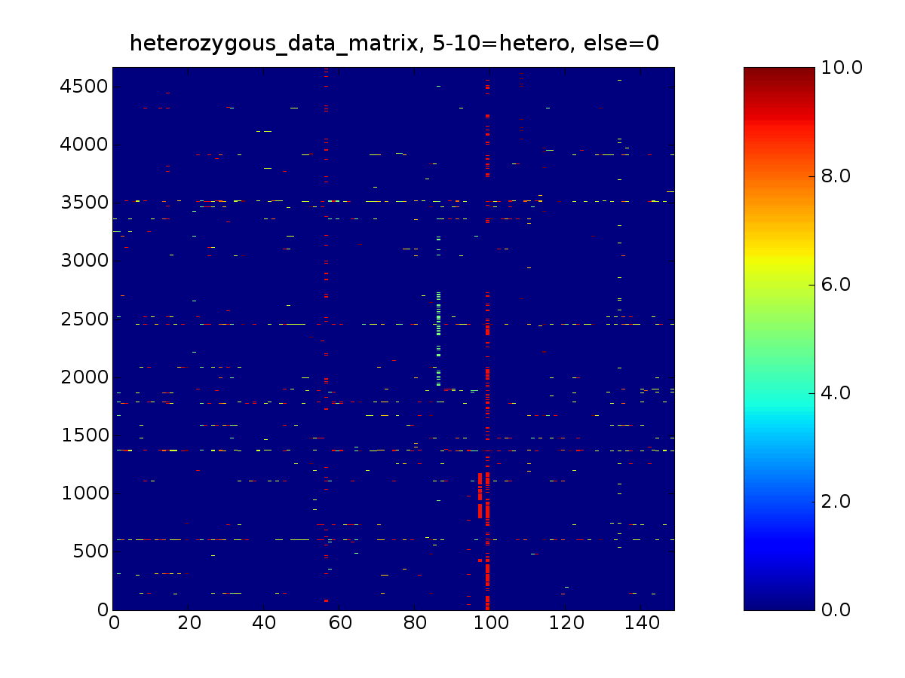
II. (cont.)‏

Slide 12
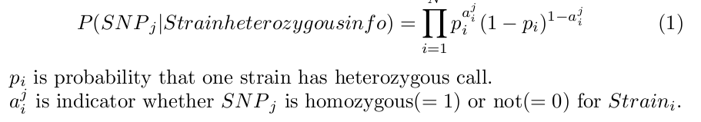
II. (cont.) probability model

Slide 13
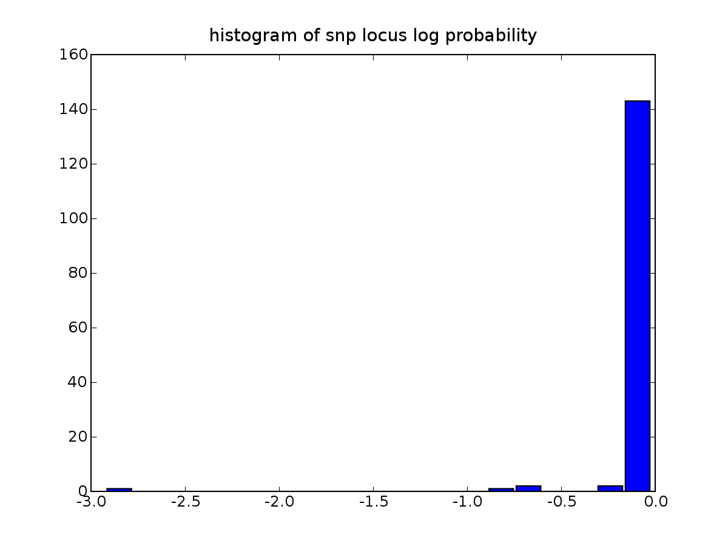
II. (cont.) probability hist

Slide 14
II. (cont.) cause of hetero
technical error
segmental duplication in all strains
segmental duplication in some strains
real heterozygous

Slide 15
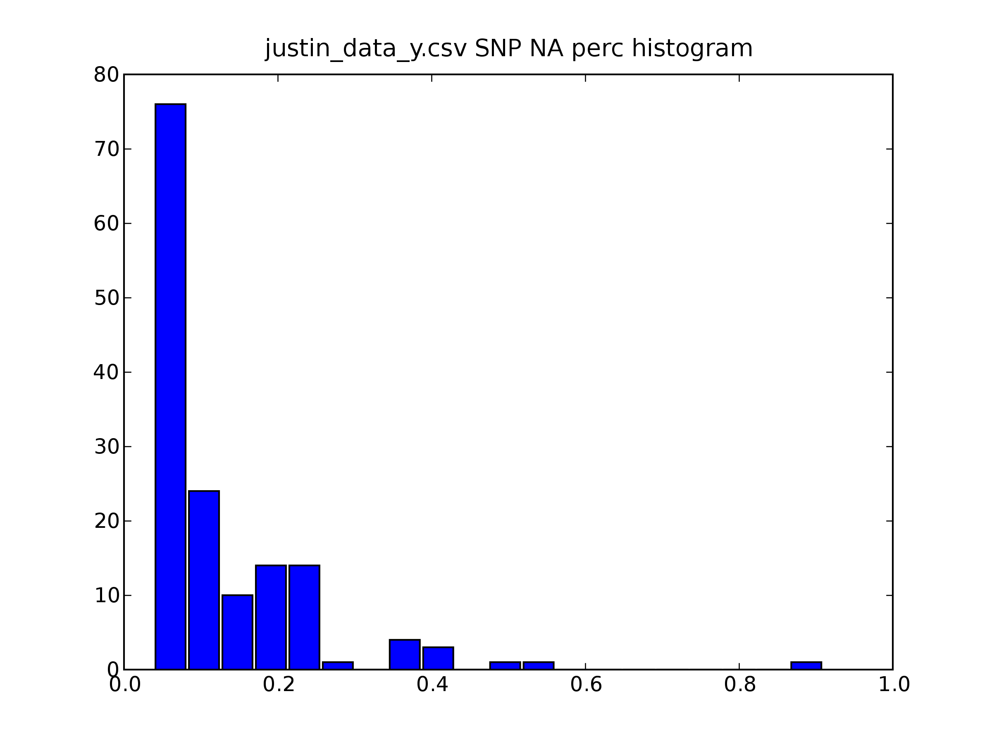
III. NA
too much NA in some strains and snps
cause of NA

Slide 16
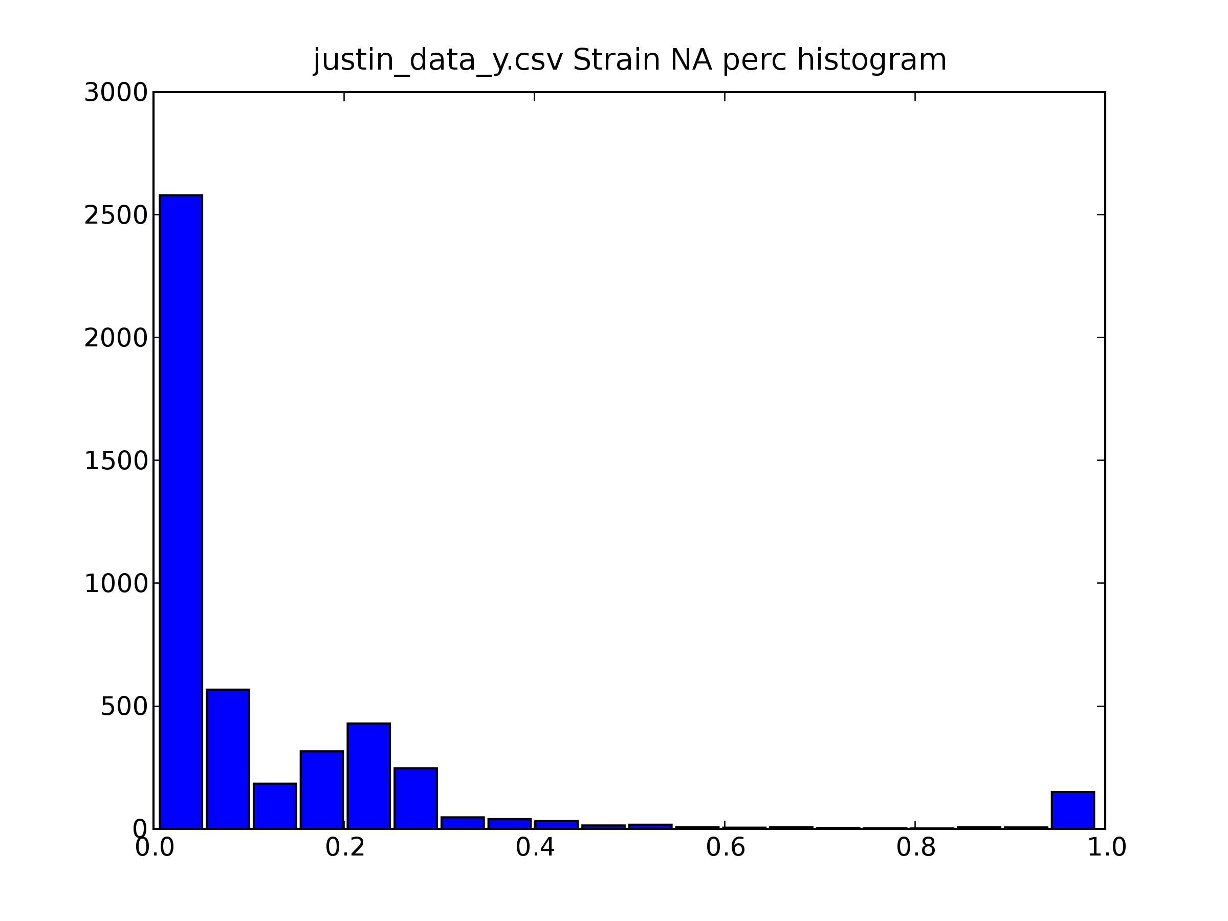
III. (cont.)‏

Slide 17
III. (cont.) NA removal result
254 strains with >=40 % NA, removed
3 SNPs with >=40% NA, removed

Slide 18
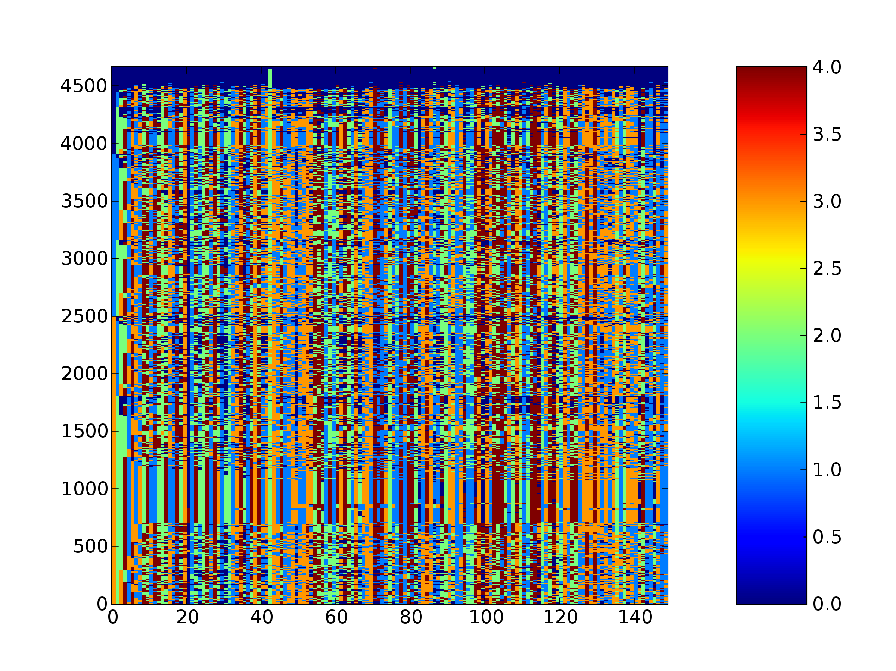
IV. Identity Strains

Slide 19
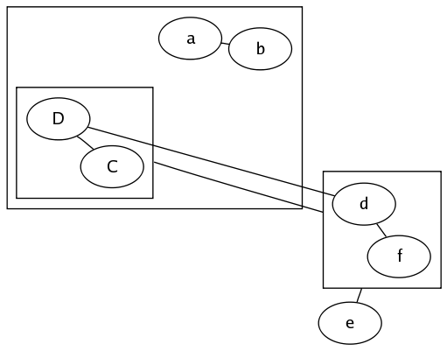
IV. (cont.) identity-relation graph

Slide 20
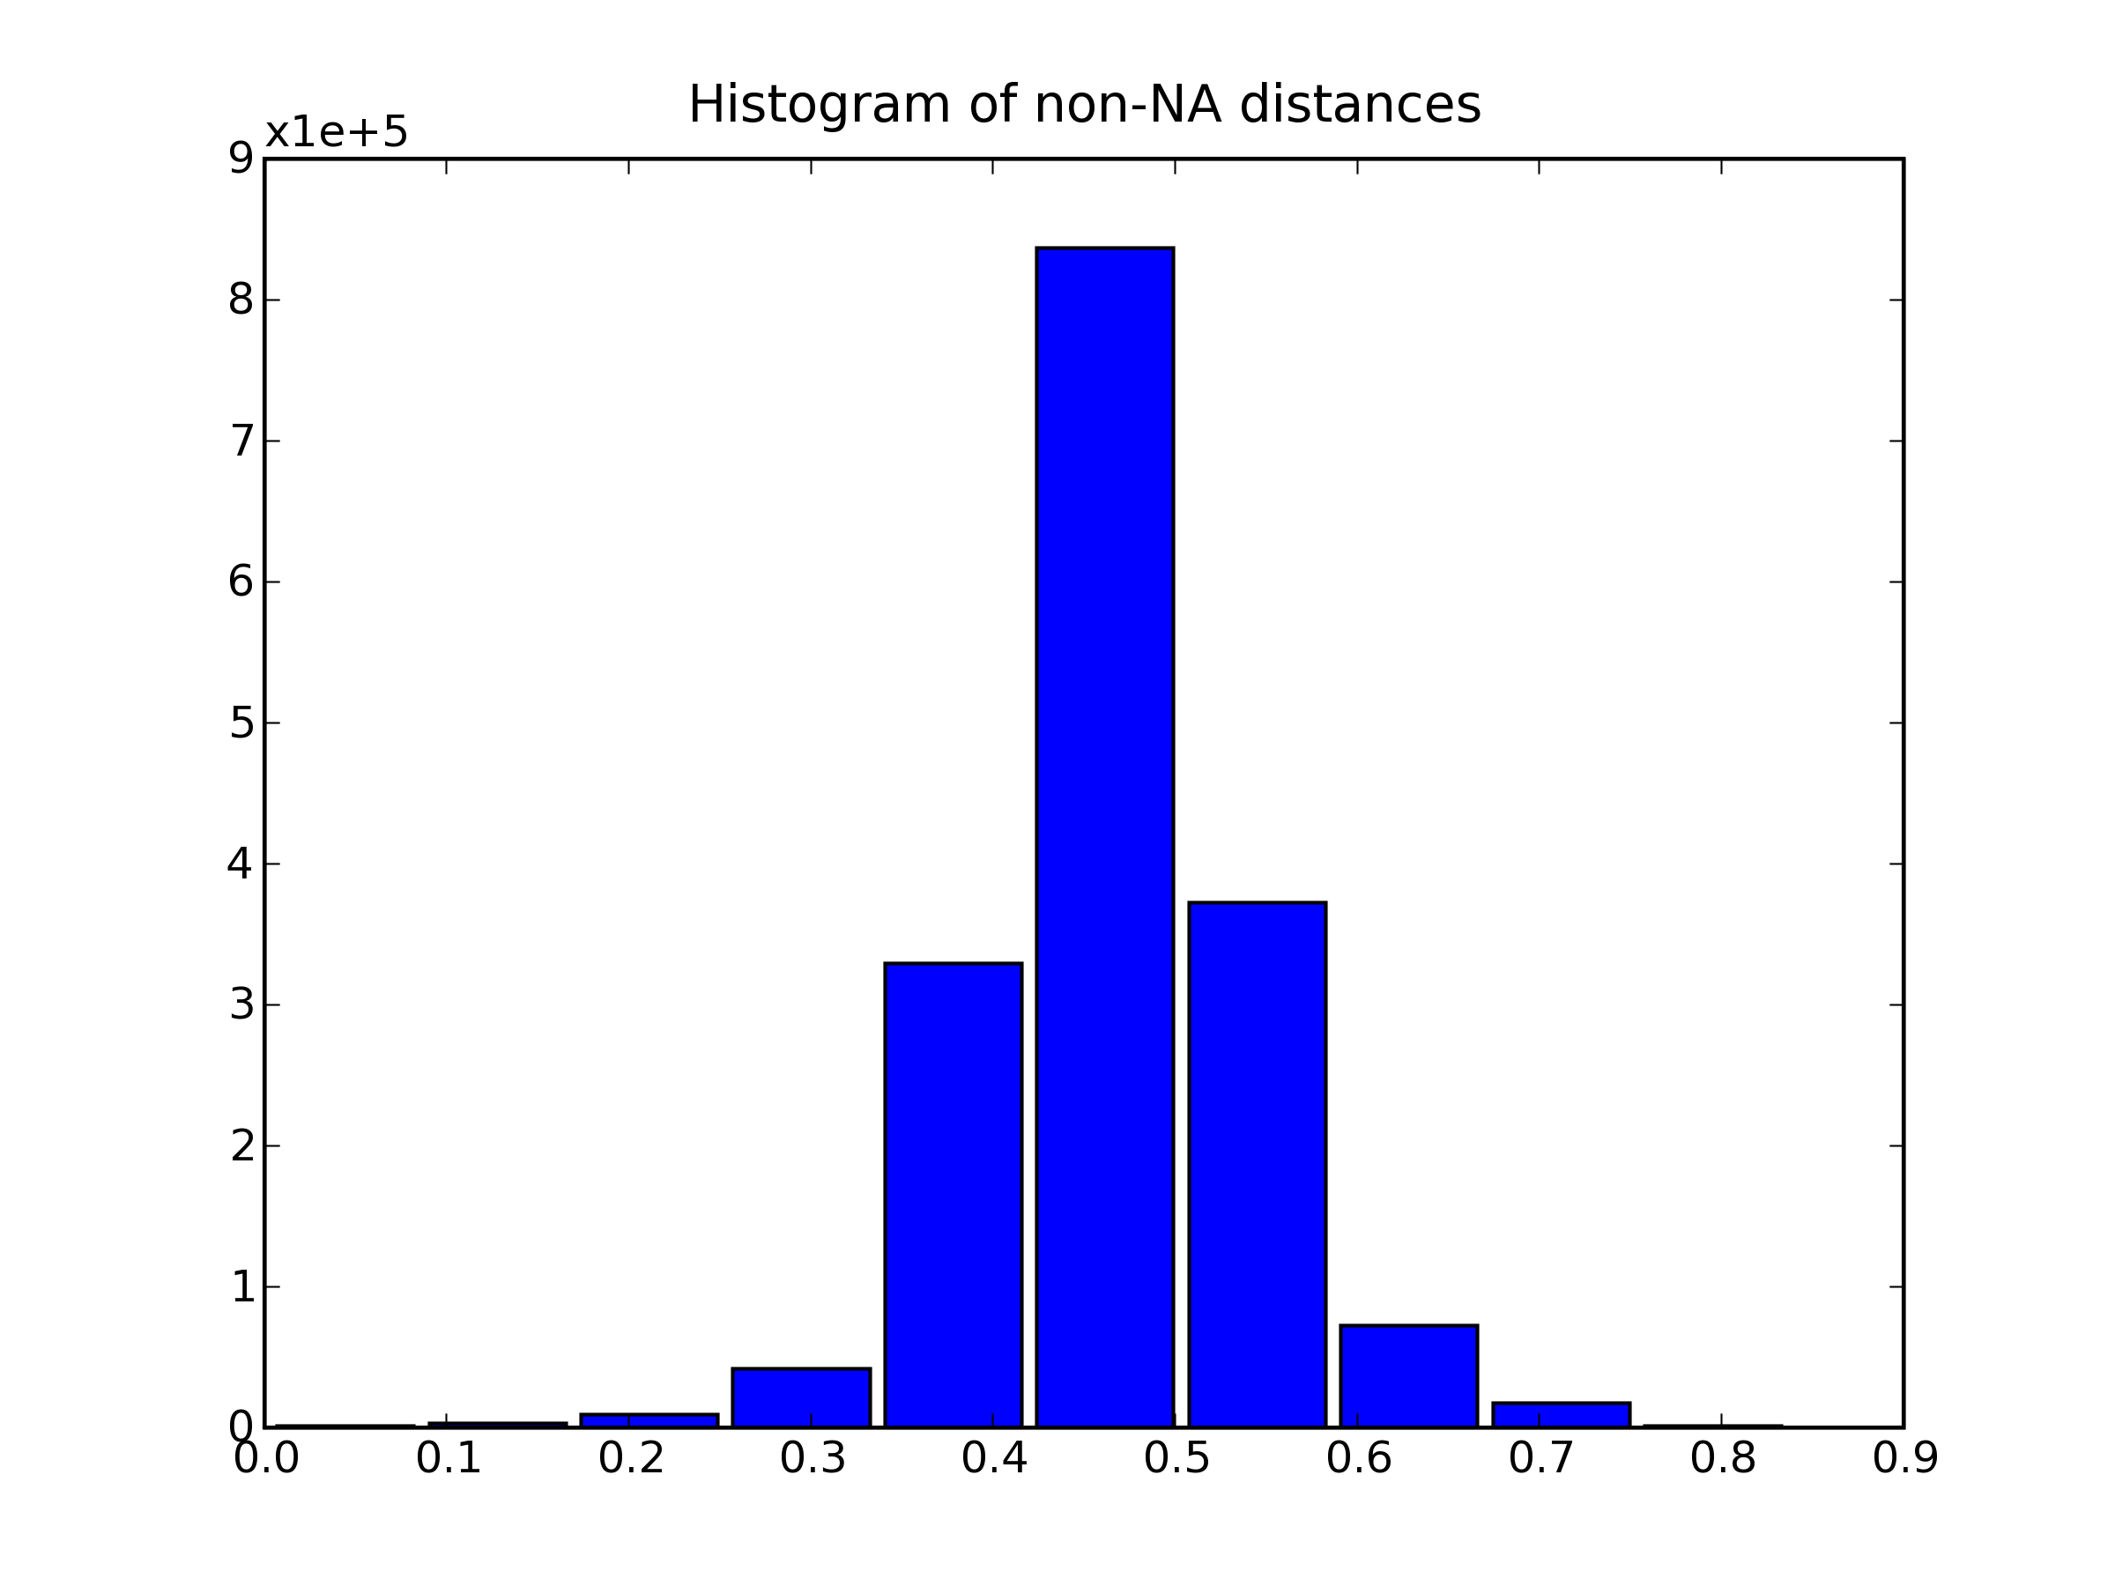
IV. (cont.)‏
2575 identity strains removed
1835 strains X 142 SNPs

Slide 21
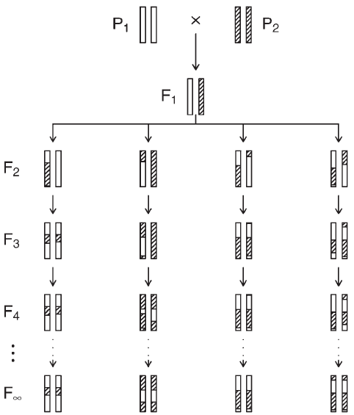
V. Outcrossing strains?
a₁₁
a₁₂
a_{1,j-1}
a_{1j}
a_{1n}
e₁
x₁
chasis
t₂₁
t_{2,j-1}
car
……….
……….
e₂
t₁₁
t_{1,j-1}
x₂
a₂₁
a₂₂
a_{2,j-1}
a_{2j}
a_{2n}

Slide 22
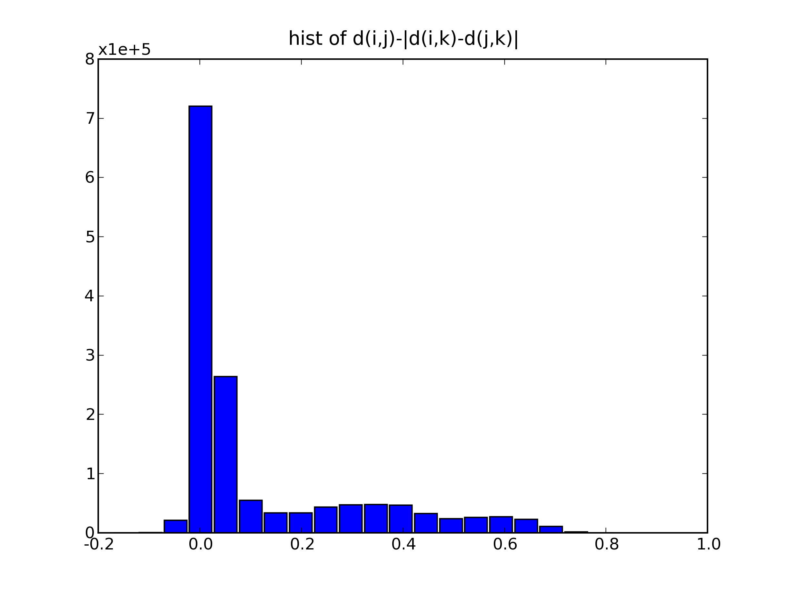
V. (cont.)‏

Slide 23
VI. No of selfing generation

Slide 24
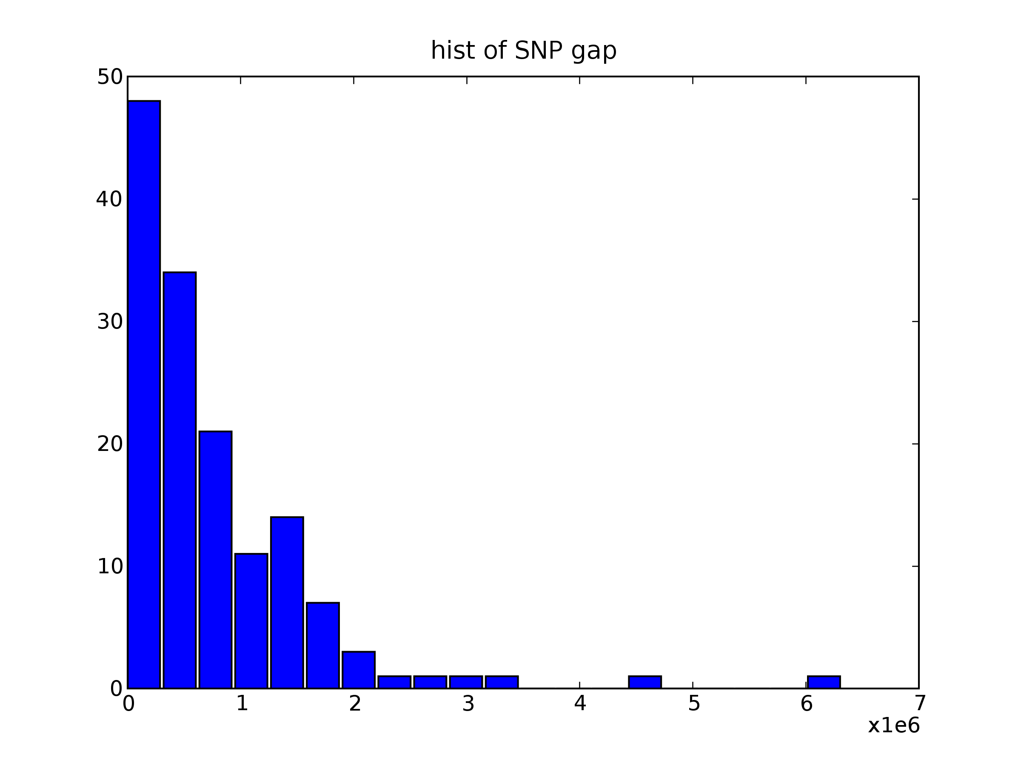
VI. (cont.)‏

Slide 25
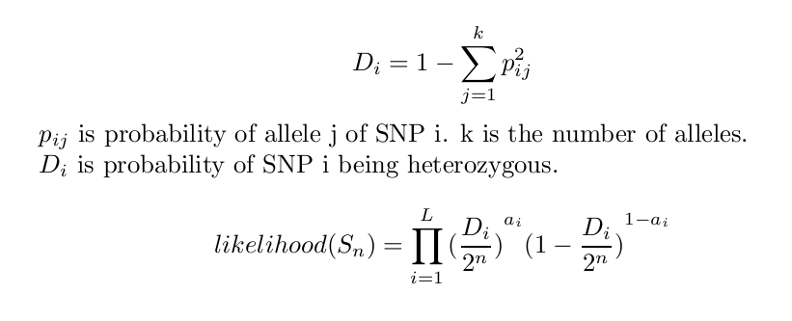
VI. (cont.) model => MLE

Slide 26
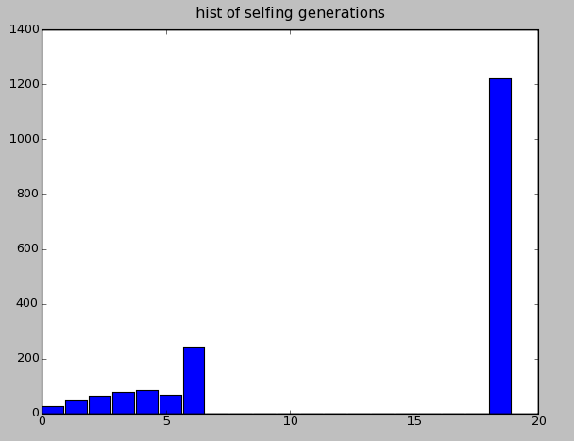
VI. (cont.)‏

Slide 27
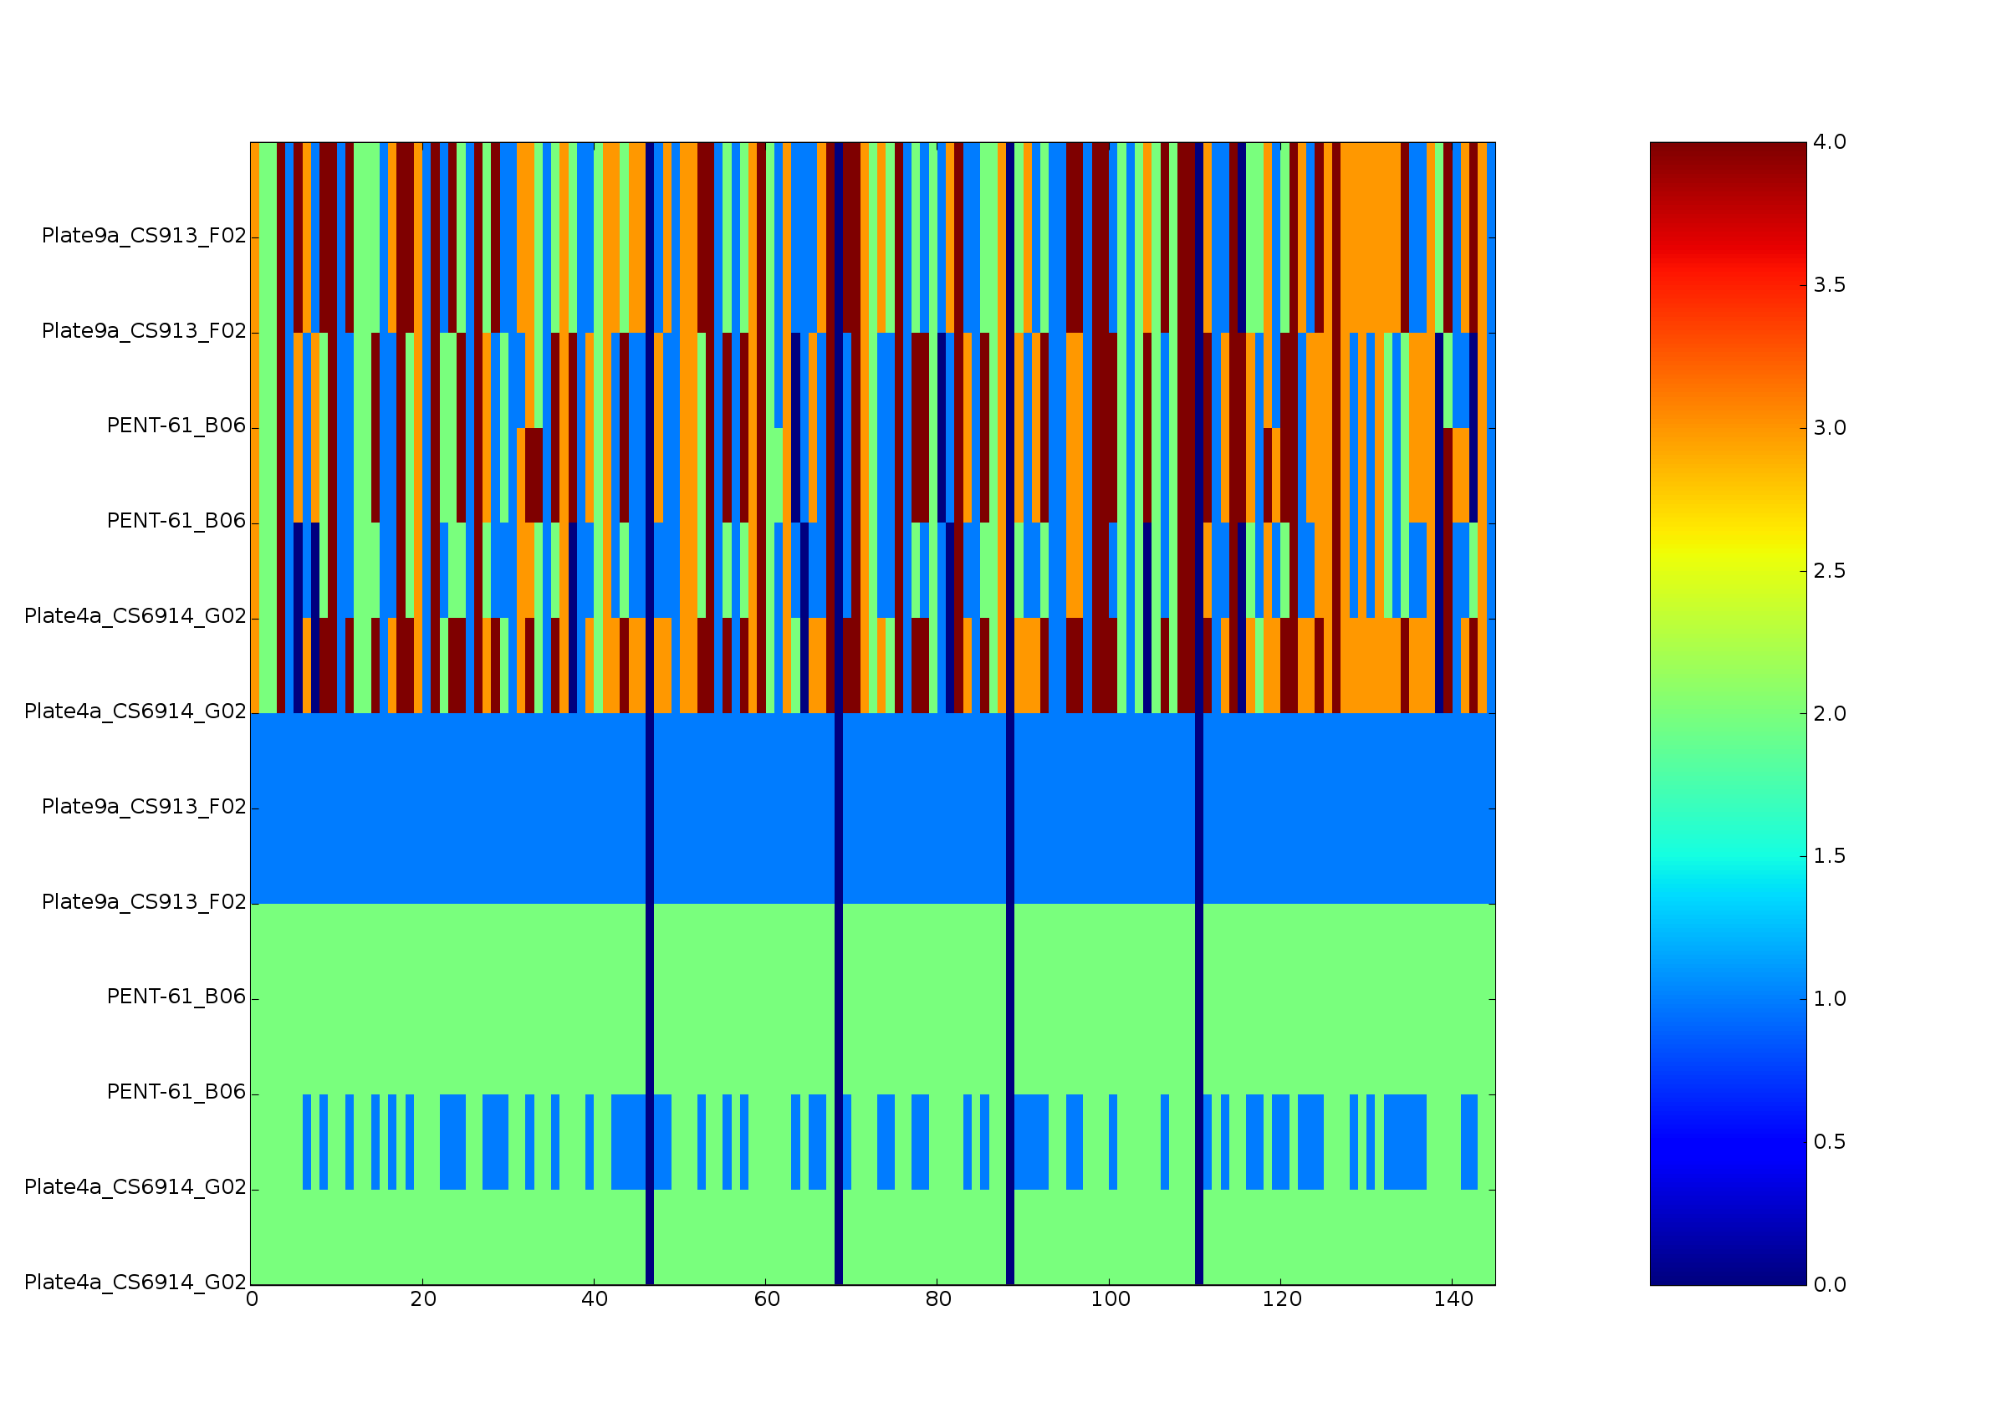
one

