Slide 1
Processing next-gen sequencing data through a Pegasus workflow
2011-9-19
Yu Huang

Slide 2
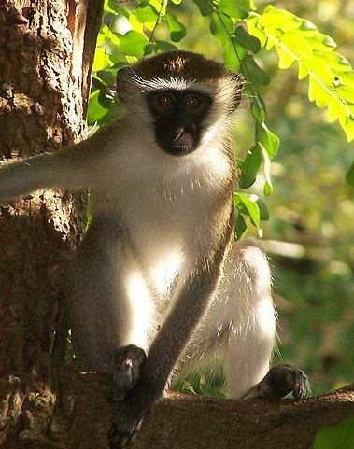
Brief Introduction to Vervet Project

Slide 3
Who are vervets (African green monkeys)?
Old world monkey from sub-Saharan Africa
~16-18 MYA (Millions of Years Ago): MRCA of vervet and macaque. (v.s. MRCA of macaque and human ~26MYA.)
~1.4-5 MYA (fossil + a few genes): Several vervet subspecies started to emerge. (v.s. MRCA of human and chimp ~6MYA)
1600s-1700s: A “small” number of vervets were brought to a few Carribean islands presumably through slave trade.

Slide 4
How is UCLA related to vervets?
1970s: Colony (VRC) with ~50 St. Kitts monkeys started at UCLA → Neurobehavioral research.
2000-2009: brain expression QTLs, microsatellite maps, etc.
2011: Reference is being assembled. ~110 Monkeys from VRC and 10 from St. Kitts have been sequenced.
Late 2011: ~500 VRC monkeys.
2012: ~100s from Africa.

Slide 5
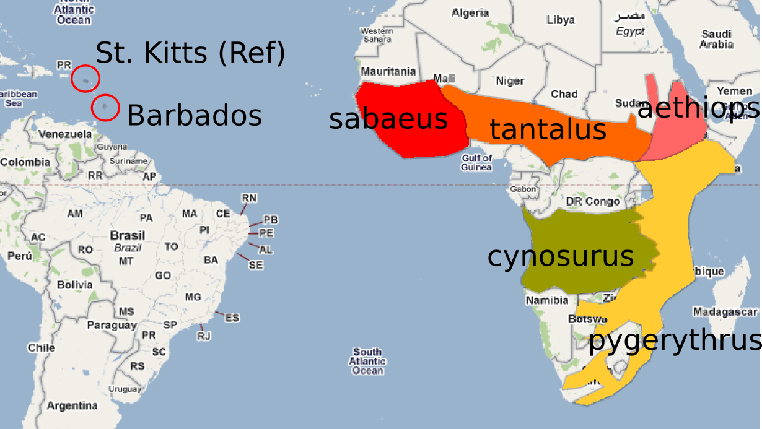
Geographic distribution

Slide 6
Main Questions
Relationship between Barbados and the reference (St. Kitts)?
Which African subspecies is the most likely source of Carribean monkeys?
What's the relationship among African subspecies?
Polymorphism level within VRC

Slide 7
Why do we care about questions aforementioned?
Genetic & phenotypic diversity level is key to trait mapping.
History is free genetic experiments.
Geographic distribution mimics different stages of history happening simultaneously.

Slide 8
But why do we choose vervets to spend $$$?
Widely available for research (v.s. Rhesus).
Model to study high-level phenotypes: novelty-seeking, bipolar disorder.
Model to study primate-specific diseases: SIV-infection, etc.
Human curiosity.

Slide 9
The part relevant to ICNN
Pipeline: from short reads to genetic variants

Slide 10
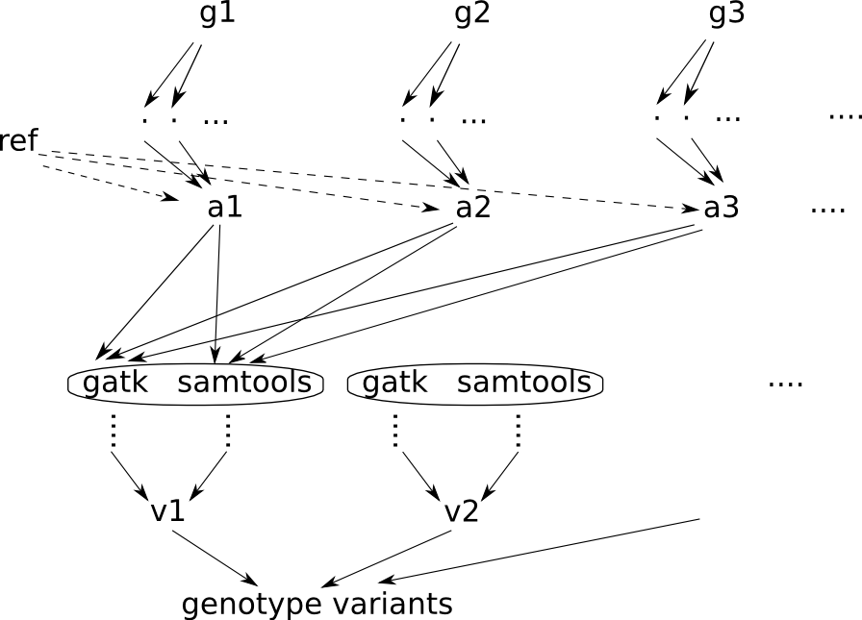

Slide 11
Usual Approach
Divide the whole pipeline into several steps.
Write scripts that submit qsub jobs for each step.
Run these submission scripts sequentially.
Sometimes, crank several steps into one shell script by using UNIX pipes. (Be careful about broken pipes.)

Slide 12
1. How do you know each job finishes properly.
Assuming the pipeline has been tested successfully,
Program segmentation fault
Computing machine failure
Memory blowout, job killed
Errors in intermediate UNIX pipes go undetected
...

Slide 13
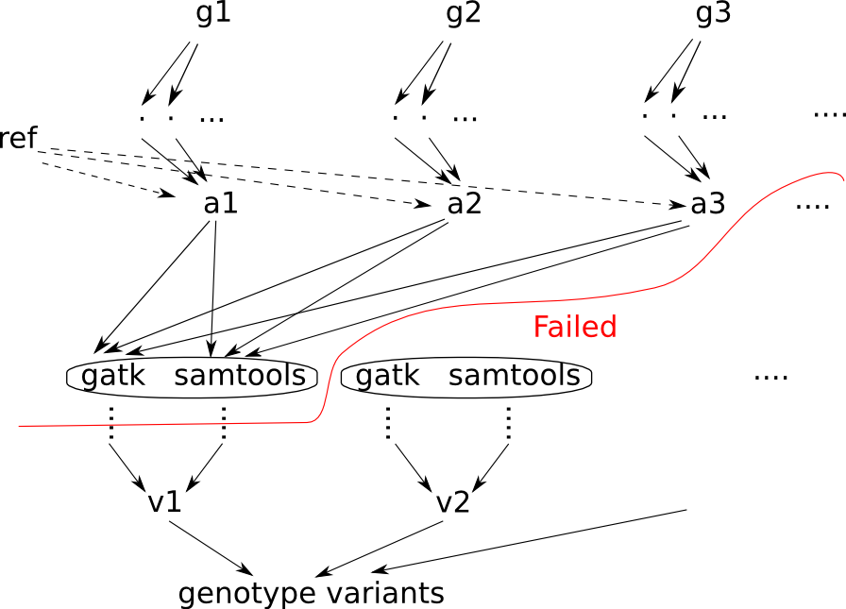
2. How to resume a half-finished pipeline?

Slide 14
3. How to handle non-linear dependency?
Add a checking script to make sure dependent jobs have proper output.
Or run all these sequentially in one shell script (no parallel).

Slide 15
How does Pegasus find out failed jobs?
crocea@dl324b-1:/Network/Data/vervet/vervetPipeline$ pegasus-status -l ./work/AlignmentToCallPipeline_552_554_557_605_615_vs_524_top_156Contigs_uschpc_bugfix/
AlignmentToCallPipeline-0.dag is running.
09/17/11 12:48:25 Done Pre Queued Post Ready Un-Ready Failed
09/17/11 12:48:25 === === === === === === ===
09/17/11 12:48:25 6427 0 3 0 0 1392 4
WORKFLOW STATUS : Running | 6427/7826 ( 82% ) | (condor processing workflow)
crocea@dl324b-1:/Network/Data/vervet/vervetPipeline$ pegasus-analyzer -d ./work/AlignmentToCallPipeline_552_554_557_605_615_vs_524_top_156Contigs_uschpc_bugfix/
...

Slide 16
How to resume a half-finished pipeline?
crocea@crocea:/Network/Data/vervet/vervetPipeline$ ./reSubmit.sh work/AlignmentToCallPipeline_552_554_557_605_615_vs_524_top_156Contigs_uschpc_bugfix/
AlignmentToCallPipeline-0.dag is running.
09/17/11 12:48:25 Done Pre Queued Post Ready Un-Ready Failed
09/17/11 12:48:25 === === === === === === ===
09/17/11 12:48:25 6427 0 7 0 0 1392 0
WORKFLOW STATUS : Running | 6427/7826 ( 82% ) | (condor processing workflow)

Slide 17
Non-linear dependency? => DAG (Directed Acyclic Graph)

Slide 18
What is Pegasus? pegasus.isi.edu
Pegasus is a configurable system for mapping and executing abstract application workflows over a wide range of execution environment including a laptop, a campus cluster, a Grid, or a commercial or academic cloud.
Today, Pegasus runs workflows on Amazon EC2, Nimbus, Open Science Grid, the TeraGrid, and many campus clusters.
One workflow can run on a single system or across a heterogeneous set of resources.
Pegasus can run workflows ranging from just a few computational tasks up to 1 million.

Slide 19
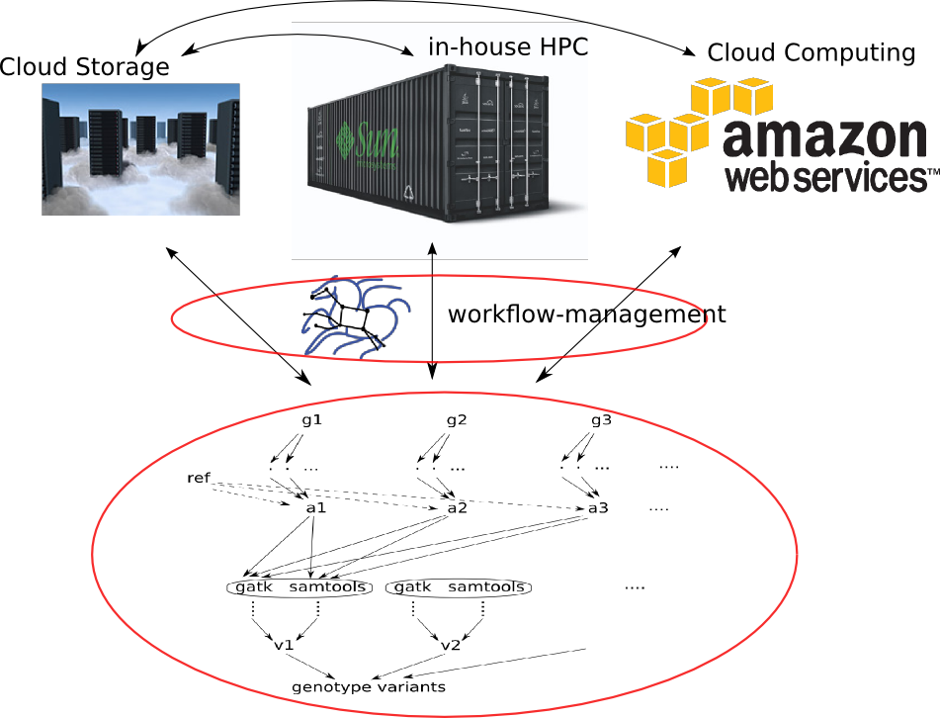

Slide 20
Summary of advantages over usual approach
Check failed jobs
Restart half-finished pipelines
Complicated dependency
Conditional dependency (if something is not there, add a job to generate it)

Slide 21
Other advantages
Multi-cluster capability (don't need to deal with cluster diversity).
Automatic re-trial on failed jobs for 3 times (error due to creation of the same directory, node failure/reboot, disk quota, memory blowout).
Utilize the cluster resource more efficiently. Start whenever the parent job is finished.
Saves lots of time as you skip qsub scripts, cleanup scripts, data integrity checking scripts.
Combine multiple workflows.

Slide 22
Analyze your workflow
Which step is failing most?
Which step uses most time?

Slide 23
Transformation Count Mean Variance Min Max Total
pegasus::dirmanager 1 0.1860 0.0000 0.1860 0.1860 0.1860
workflow::vcf_convert:1.0 1194 14.2852 685.3181 0.1120 404.4430 17056.5190
workflow::vcf_isec:1.0 597 1.1518 0.2919 0.1010 5.0990 687.6070
workflow::mkdirWrap:1.0 5 0.0394 0.0002 0.0240 0.0610 0.1970
pegasus::cleanup 3561 0.2605 0.0717 0.1030 6.1300 927.7870
pegasus::pegasus-transfer 13 75.3040 9843.8631 0.3880 341.0510 978.9520
workflow::vcf_concat:1.0 156 1.1243 0.2526 0.4320 4.2660 175.3840
workflow::bgzip_tabix:1.0 1194 0.5487 0.0554 0.0760 3.5100 655.1820
workflow::genotyperJava:1.0 599 293.9758 20062.3637 0.0810 869.7040 176091.4820
workflow::CallVariantBySamtools:1.0 597 157.3317 6341.1175 3.7520 811.4270 93927.0150
#Transformation - name of the transformation
#Count - the number of times the transformation was executed
#Mean(sec.) - the mean of the transformation runtime
#Variance(sec.) - the variance of the transformation runtime
#Min(sec.) - the minimum transformation runtime value
#Max(sec.) - the maximum transformation runtime value
#Total(sec.) - the cumulative of transformation runtime

Slide 24
Advantage over embarrassingly simple parallel MPI/Hadoop
Easy to debug. Debug/Test program individually. No crazy “printf” debugging for mpi programs.
Resistant to partial node/job failure, retry the job elsewhere

Slide 25
Advantage over LONI&Kepler
Scale
  Can you generate a workflow of 10s of thousands of jobs through mouse clicking?
  LONI&Kepler seem to be designed for non-programmers.

Slide 26
Downside of Pegasus
  Architecture is a bit complicated pegasus -> condor_g -> globus -> SGE
    Although a simpler setup, pegasus -> condor, is available if you have administration rights over the cluster.
    globus is the weak link in the complicated setup.
  It spends about ~60s in managing each job. Bad if you have lots of short jobs. (job clustering could mitigate this).
  Data passing between jobs is through files, rather than direct memory/network transfer in MPI/Hadoop. Unix pipe could mitigate this.

Slide 27
Demo Run

