Slide 1
Homolog of vervet contigs on the human & macaque genomes.
Software used: mummer.

Slide 2
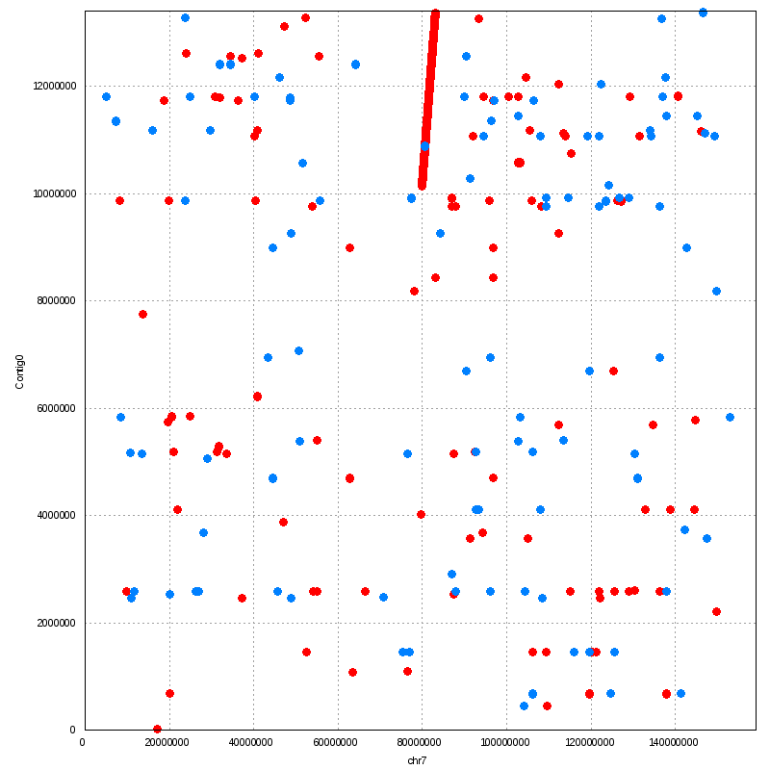
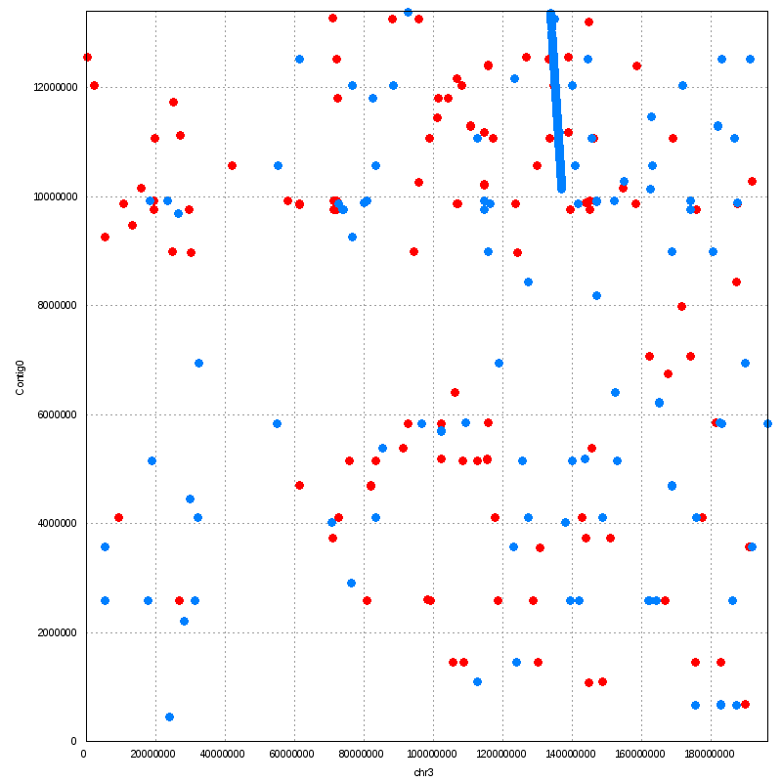
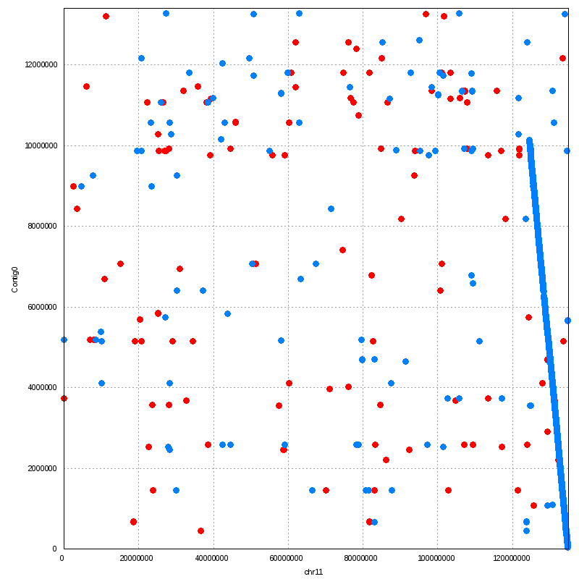
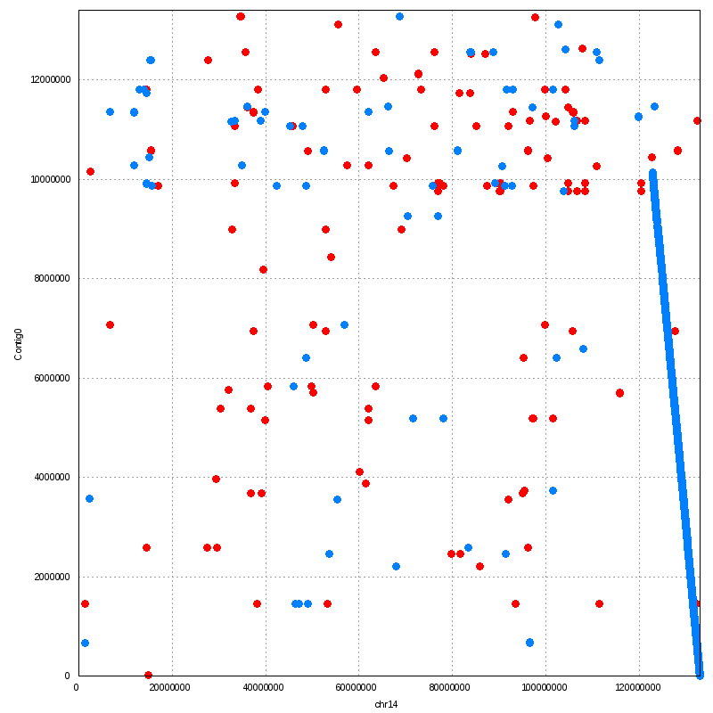
Contig0
human chr7/chr11 macaque chr3/chr14

Slide 3
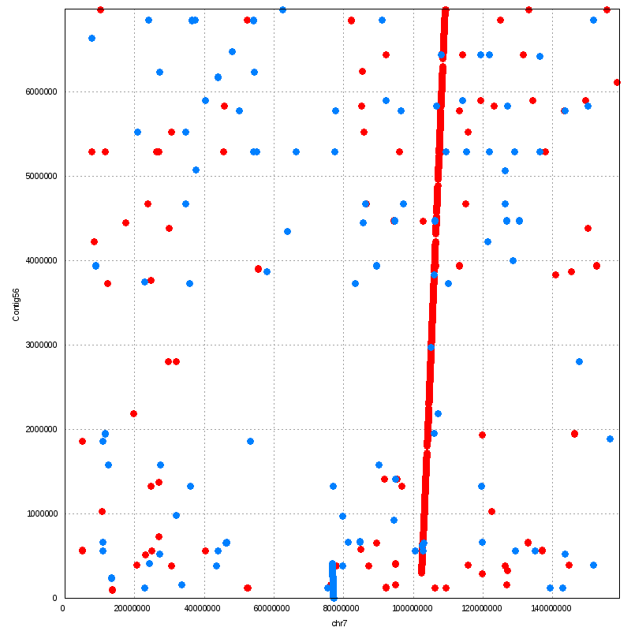
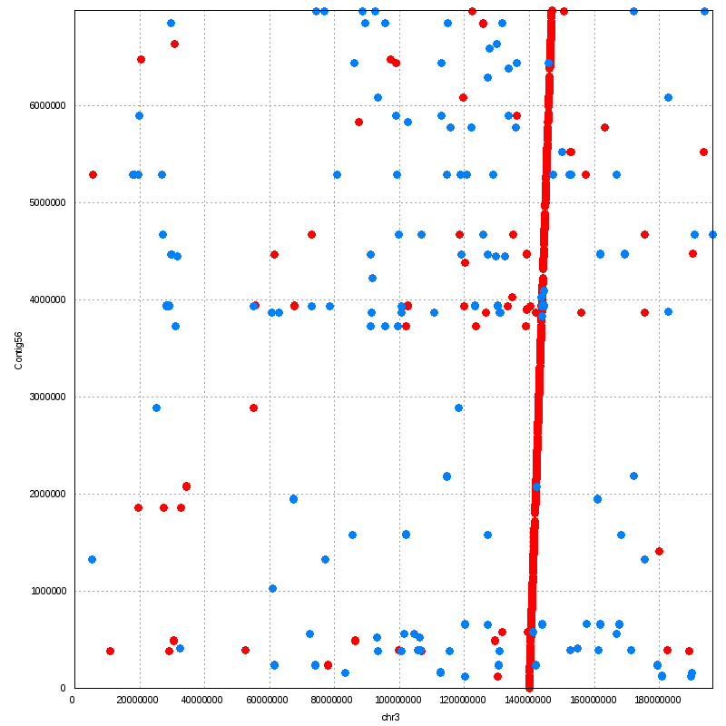
human chr7 macaque chr3
Contig56
translocation aided by a duplication?

Slide 4
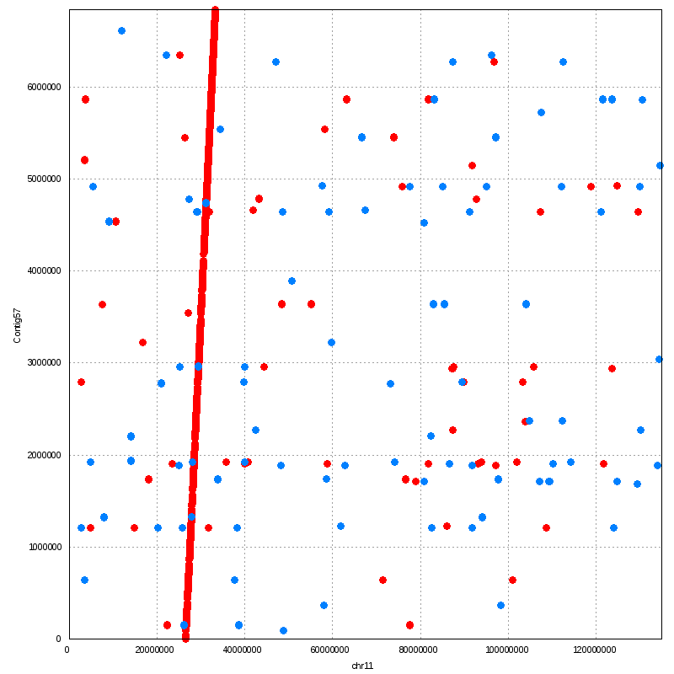
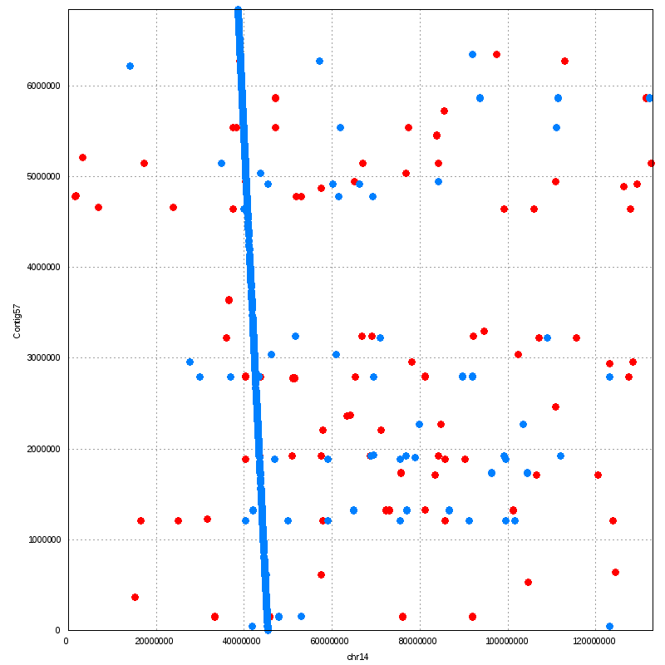
human chr11 macaque chr14
Contig57

Slide 5
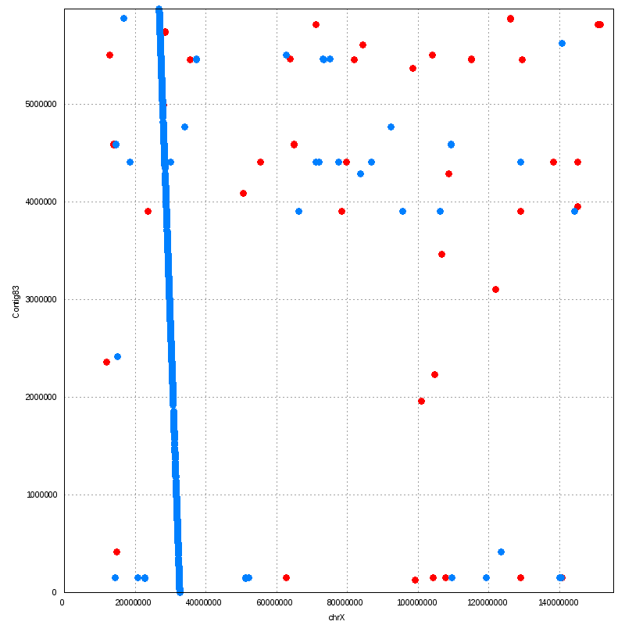
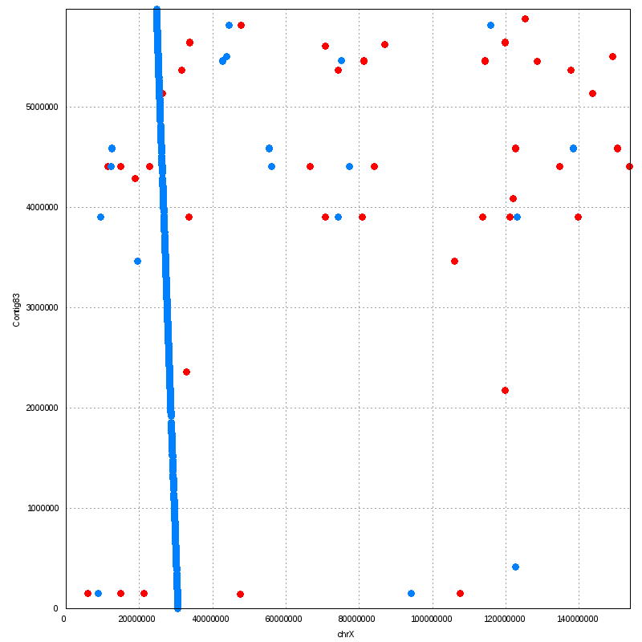
human chrX macaque chrX
Contig83

Slide 6
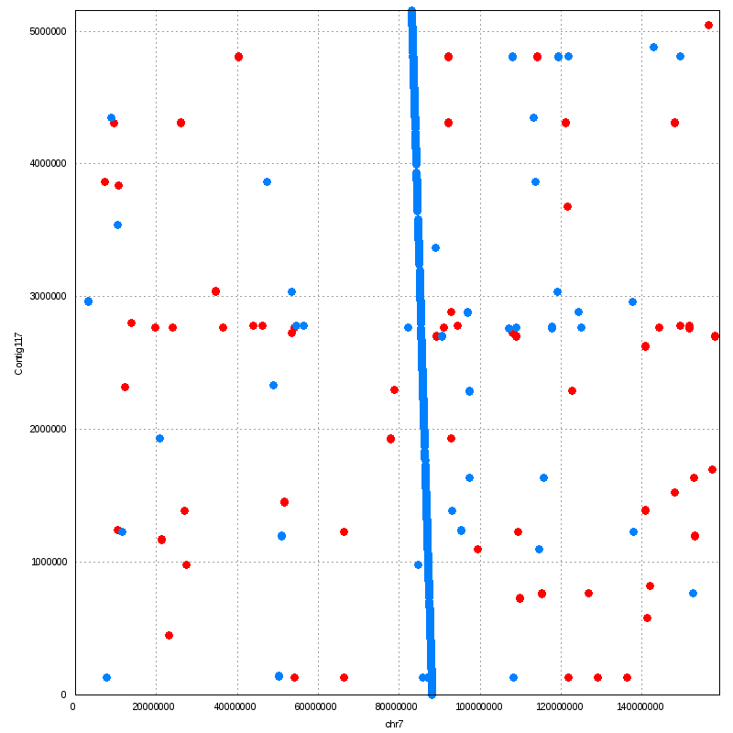
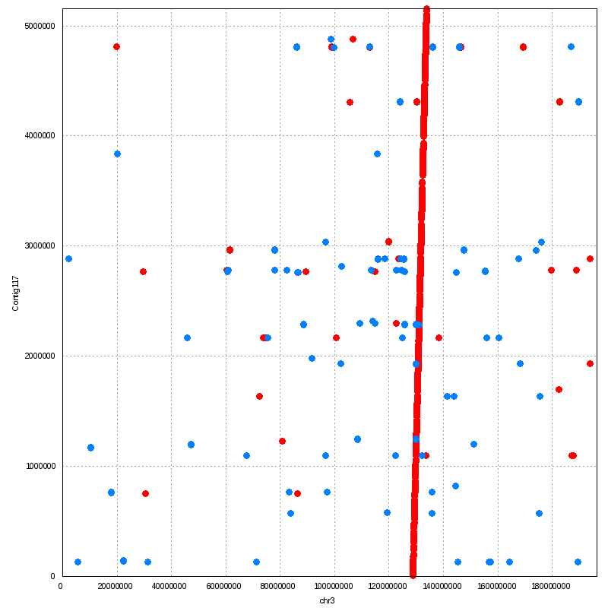
human chr7 macaque chr3
Contig117

Slide 7
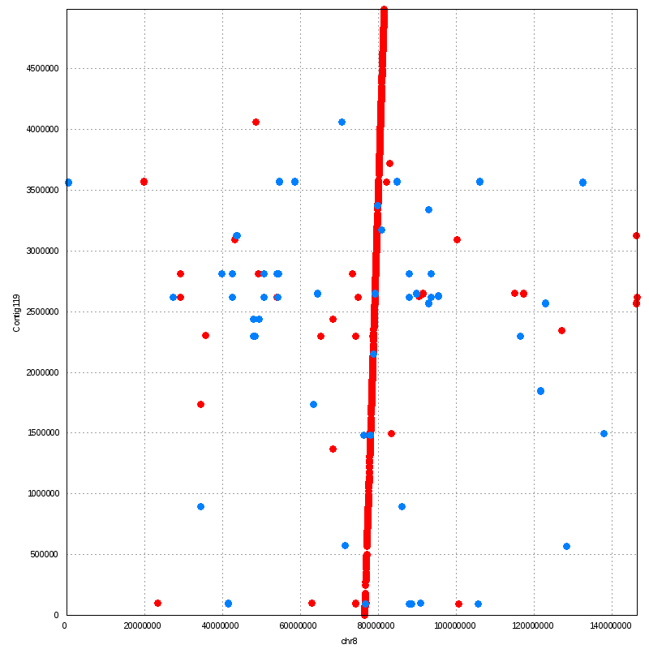
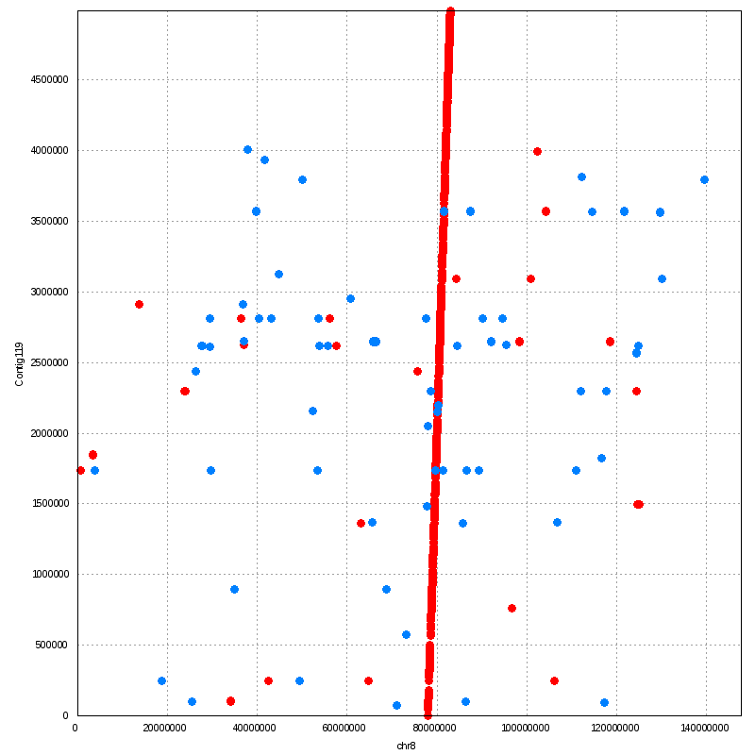
human chr8 macaque chr8
Contig119

Slide 8
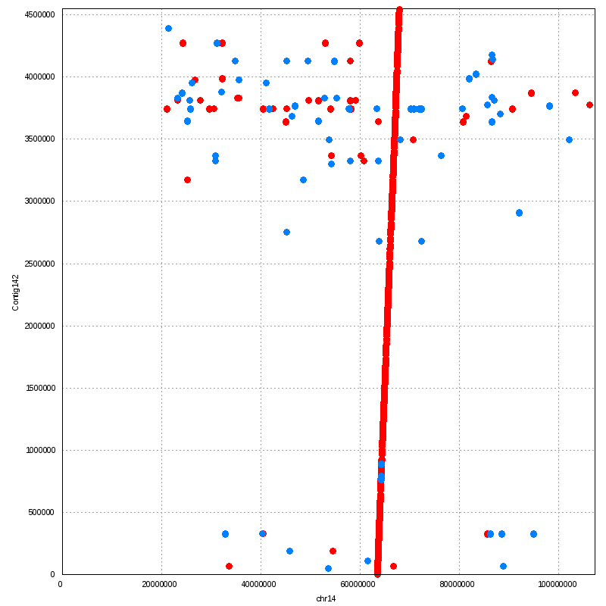
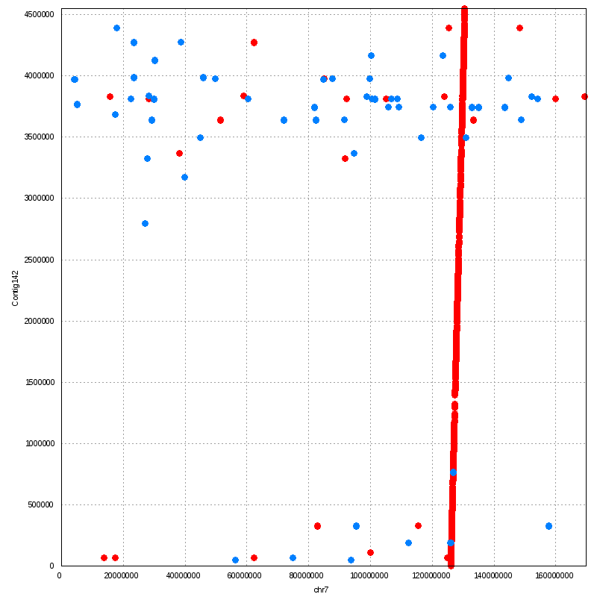
human chr14 macaque chr7
Contig142
middle emptiness -> unique genic region??

Slide 9
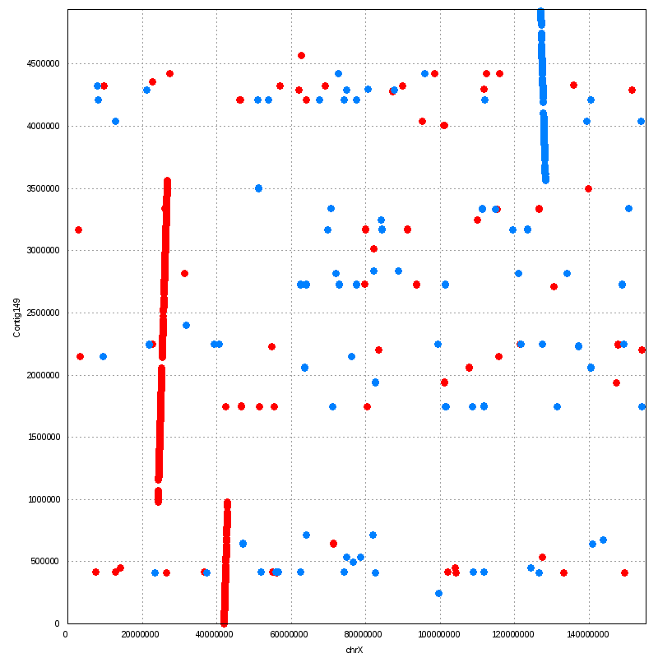
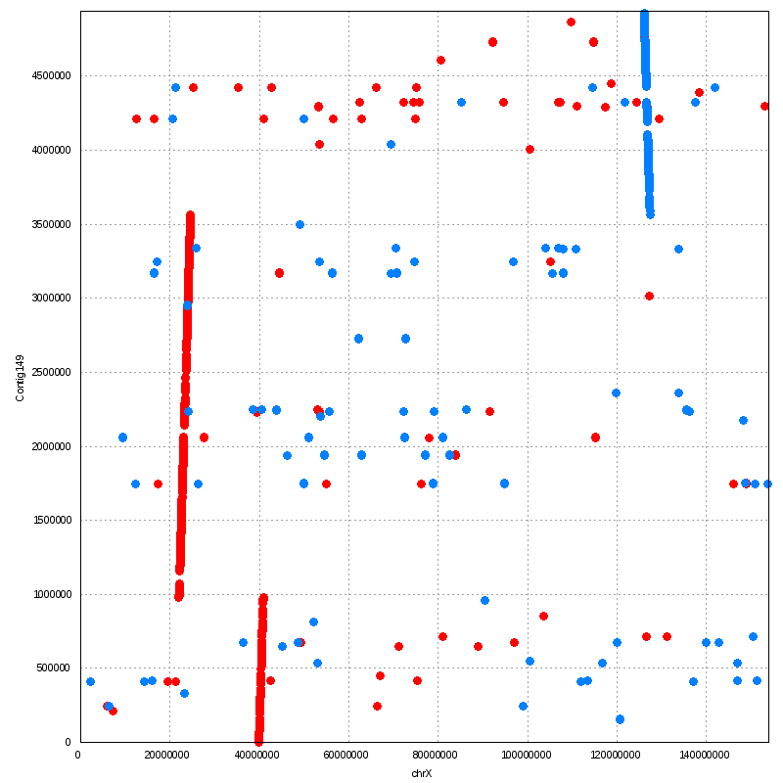
human chrX macaque chrX
Contig149
This contig (supercontig) might have got its sub-contigs placed wrongly unless this is duplication (check Contig193) + translocation event unique in vervet.

Slide 10
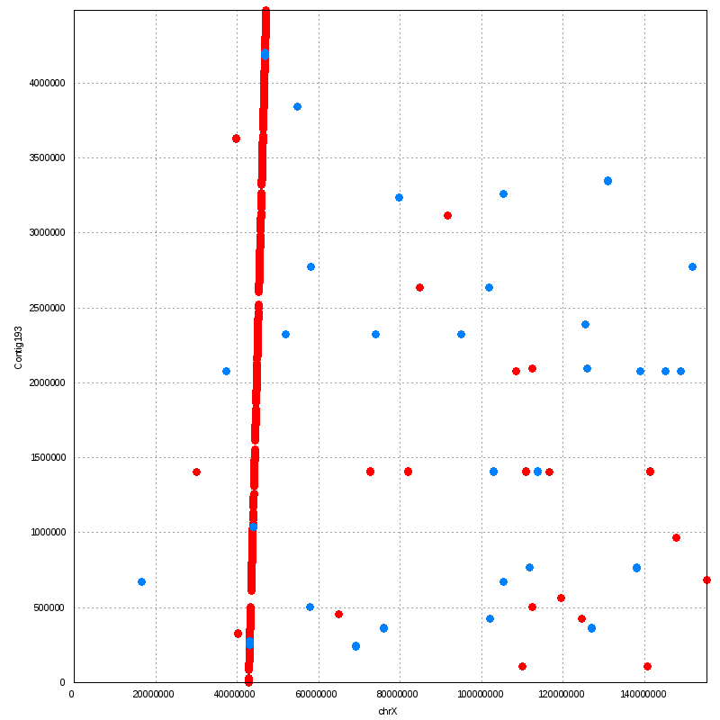
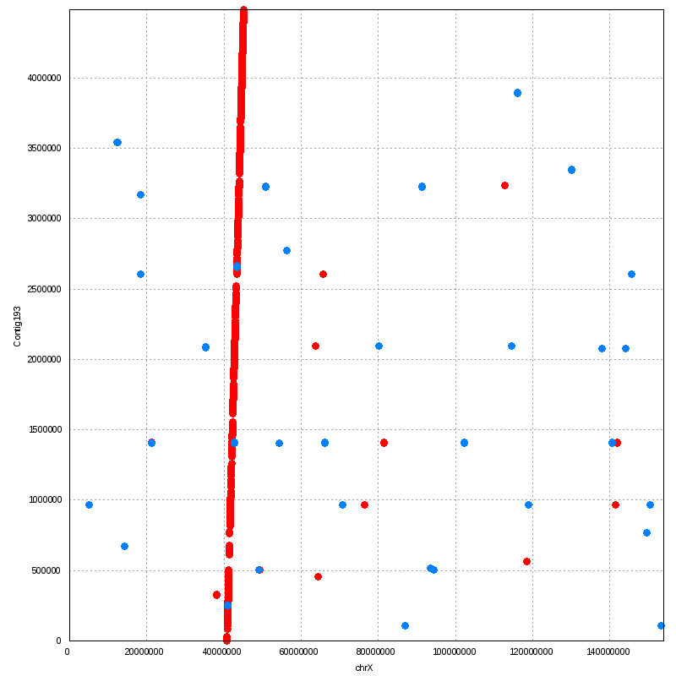
human chrX macaque chrX
Contig193

