Slide 1


Assistance and Control: Motorized RC Glider
Gaurav Kulkarni
Vladimir Poliakov
Sudheera Reddy Bandi
Hector Munoz

Slide 2

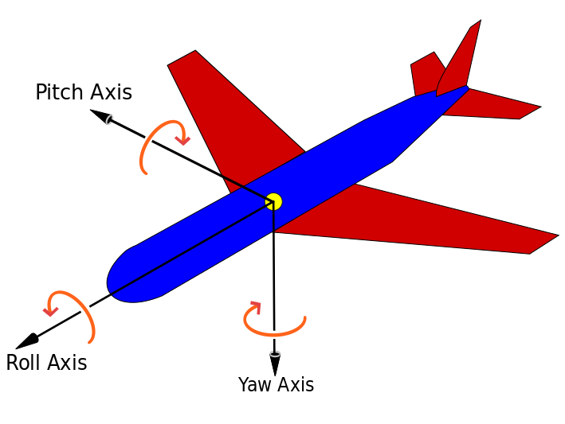
Aircraft principal axes
Image: https://en.wikipedia.org

Slide 3
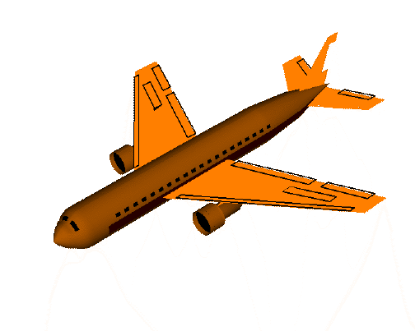
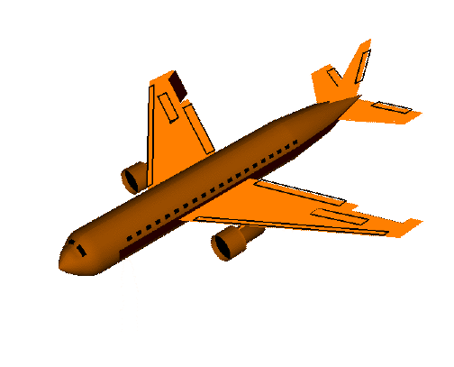
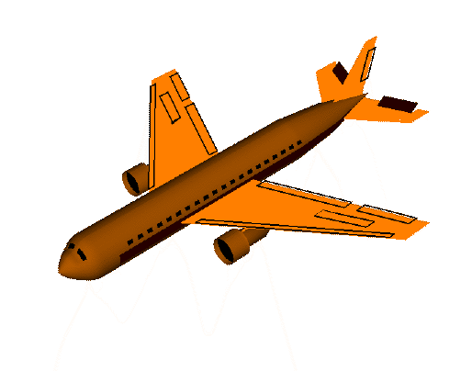
Control Components
Rudder
Aileron
Elevator
Image source: https://www.grc.nasa.gov/www/k-12/airplane/roll.html

Slide 4
Overview
RC Remote
Receiver
CH1
CH2
CH3
CH4
CH5
CH6
Motor Driver
Servo + Encoder
Motor

Slide 5
Overview II
RC Remote
Receiver
CH1
CH2
CH3
CH4
CH5
Gyroscope
CH6
MCU
Altitude Sensor
Accelerometer
CH2
CH3
CH1
CH4
Motor Driver
Servo + Encoder
Motor

Slide 6
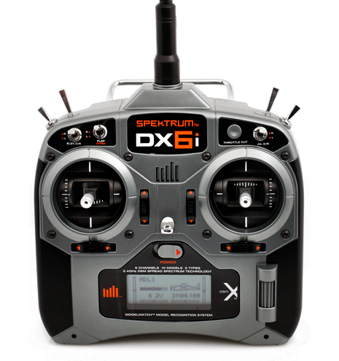
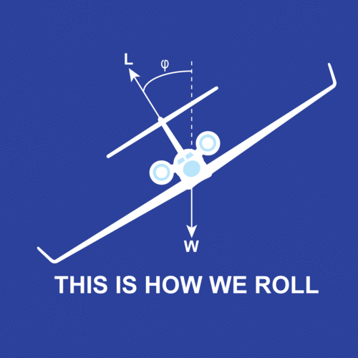
Roll Control & Stabilization
Roll
Image source: http://www.spektrumrc.com/Products/Default.aspx?ProdId=SPM1000

Slide 7
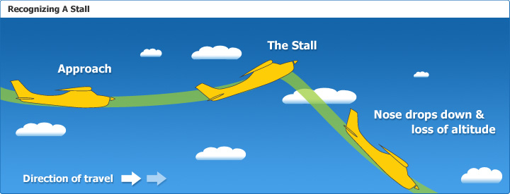
Stall recovery
Image source: http://www.controlchat.com/physics-of-flight-the-stall/

Slide 8
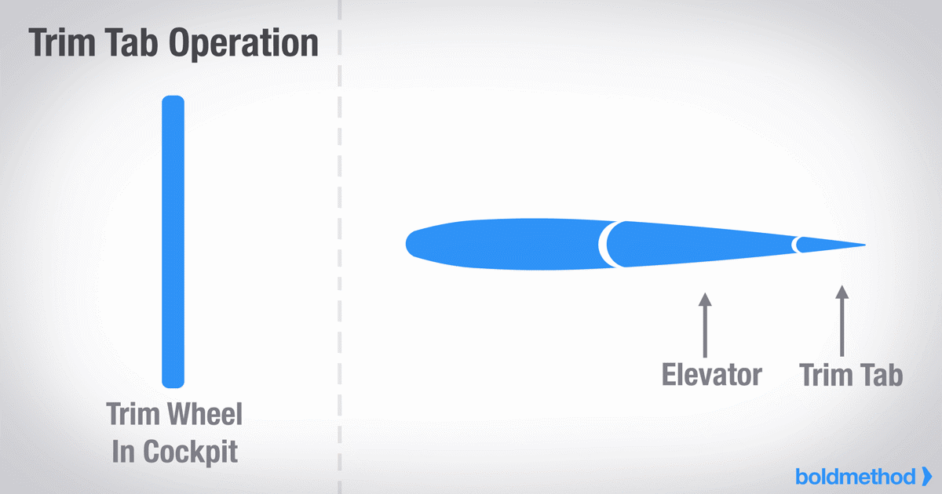
Trim adjustment
Trims
Image source: http://www.boldmethod.com/images/learn-to-fly/systems/4-types-of-trim-tabs/trim-operation-animated.gif

Slide 9
CONSENS

Slide 10
SysML

Slide 11
UPPAAL

Slide 12
Implementation &
Demo

Slide 13
Thank you!

