Slide 1
Topic Modeling Approach to Evaluating Interdisciplinarity in Theses of Faculty of Humanities, HSE University
Thesis by Anna Polyanskaya
Research Advisor: Daniil Skorinkin
NRU HSE, Moscow, 2021
Notes:
Тематическое моделирование междисциплинарности в выпускных квалификационных работах студентов ФГН НИУ ВШЭ

Slide 2
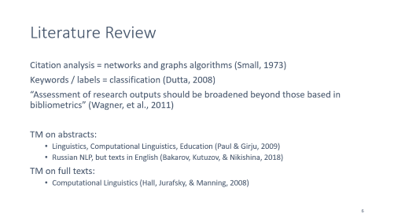
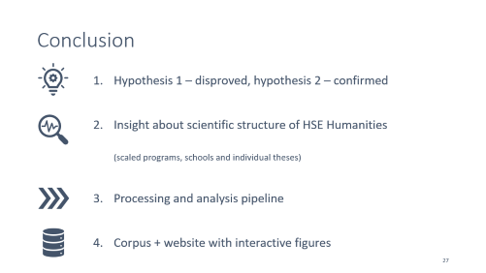
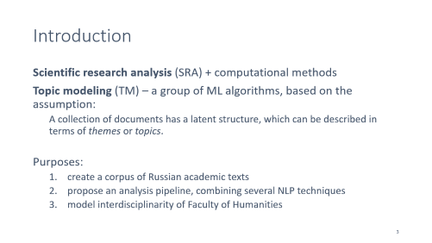
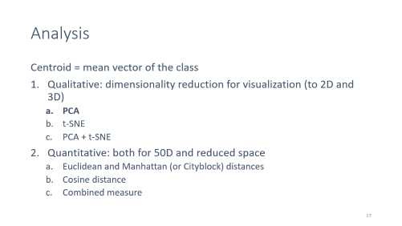
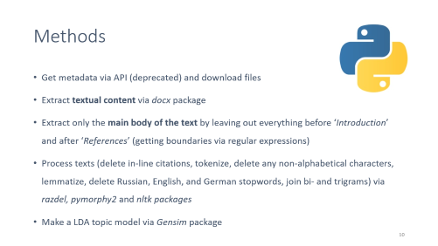
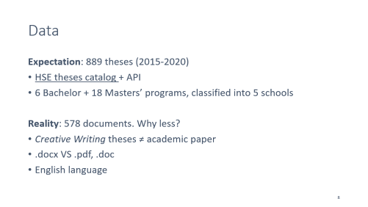
Contents
Code: https://github.com/polyankaglade/Theses_LDA
Interactive figures: https://polyankaglade.github.io/Theses_LDA/

Slide 3
Introduction
Scientific research analysis (SRA) + computational methods
Topic modeling (TM) – a group of ML algorithms, based on the assumption:
A collection of documents has a latent structure, which can be described in terms of themes or topics.
Purposes:
create a corpus of Russian academic texts
propose an analysis pipeline, combining several NLP techniques
model interdisciplinarity of Faculty of Humanities
Notes:
SRA: describe and provide a better understanding of history, structure, and current state of scientific knowledge useful for conferences, journals, funding and award campaigns
explore the development of different topics and predict some tendencies of the future
find out smth new about scientific trends here

Slide 4
Hypotheses
Masters’ theses are distinct from bachelors’ ones in a way that they come either from a narrower field of research or, on the contrary, combine more than one broad research fields.
Masters' programs such as Cultural and Intellectual History: Between East and West and History of Artistic Culture and the Art Market indeed show a more interdisciplinary approach, as it is advertised in the program description, while Philosophy and Religious Studies and Russian as a Foreign Language in Cross-Linguistic and Cross-Cultural Perspective represent highly specific topics, not presented anywhere else.

Slide 5
Main idea
Distribution of topics => vector
“Theme” space (like semantic space)
Theses from same schools would cluster together
Interdisciplinary work = a case of some document to be far from the center of its school cluster (showing that it combines topics from different scientific domains)
Methods similar to ones for the semantic spaces (distances, including cosine)

Slide 6
Literature Review
Citation analysis = networks and graphs algorithms (Small, 1973)
Keywords / labels = classification (Dutta, 2008)
“Assessment of research outputs should be broadened beyond those based in bibliometrics” (Wagner, et al., 2011)
TM on abstracts:
Linguistics, Computational Linguistics, Education (Paul & Girju, 2009)
Russian NLP, but texts in English (Bakarov, Kutuzov, & Nikishina, 2018)
TM on full texts:
Computational Linguistics (Hall, Jurafsky, & Manning, 2008)
Notes:
scientific research analysis is relatively new in a way that its development was hugely impacted be the development of the web and creation of academic DataBases like Google scholar
but also very common as it is a part of every conducted research, everybody here who has ever written an academic paper is familiar with the process of studying the field they are working in, learning about the tendencies, key names and most significant works motivation: meta-research, texts written by students, Russian

Slide 7
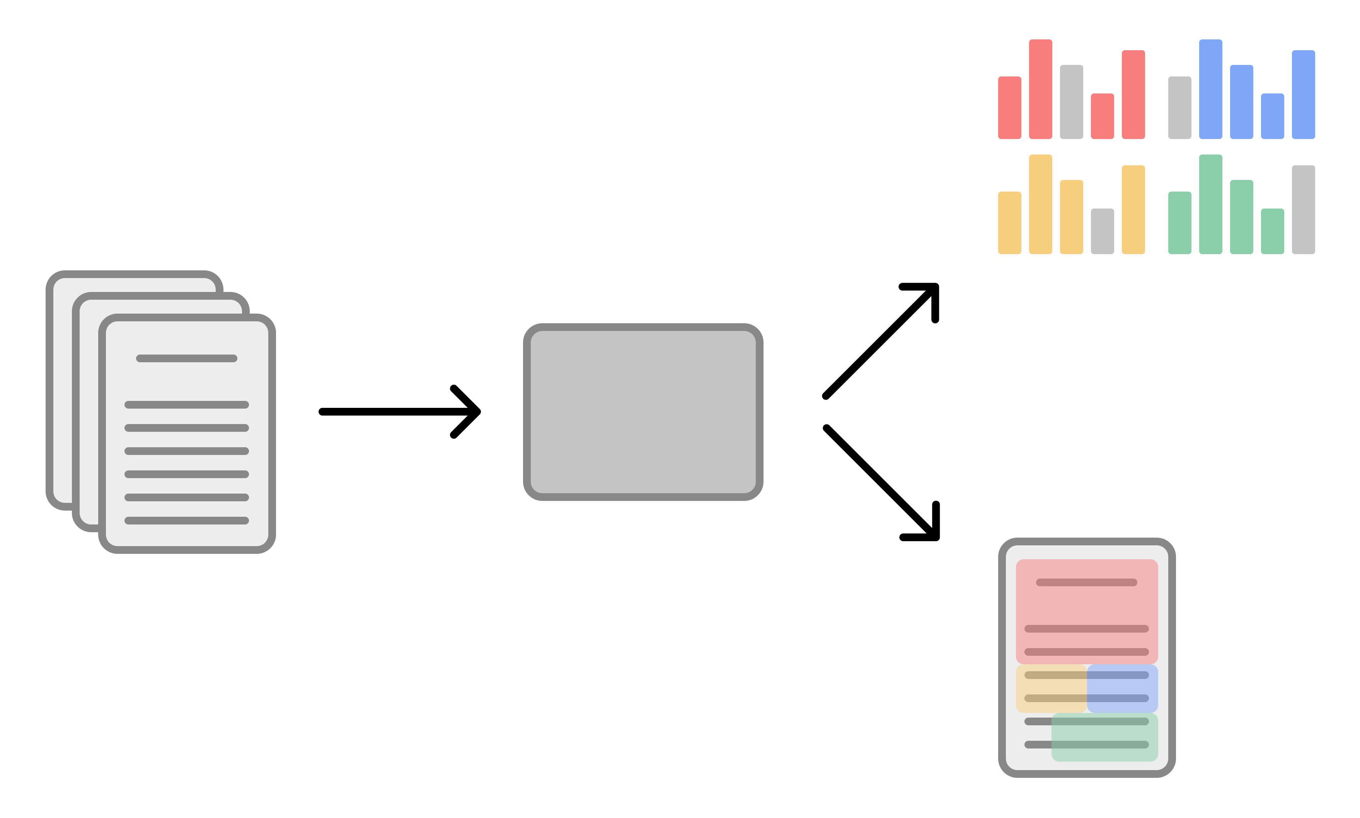
Topic modeling
Latent Dirichlet Allocation (Blei, Ng, & Jordan, 2003)
Topic = distribution of words
LDA
Document = distribution of topics
Notes:
algorithms tries to find similar patterns in the data collection.
person: pile of magazines, “sports, catr, coking, fashion” -> game, football, physical activity | clothes, hair, makeup, style
Why LDA over Latent Semantic Analysis (LSA) or Probabilistic Latent Semantic Analysis (PLSA)? Can work with new documents, because can model document’s probability from a Dirichlet distribution

Slide 8
Data
Expectation: 889 theses (2015-2020)
HSE theses catalog + API
6 Bachelor + 18 Masters’ programs, classified into 5 schools
Reality: 578 documents. Why less?
Creative Writing theses ≠ academic paper
.docx VS .pdf, .doc
English language
Notes:
Total 23 programs

Slide 9
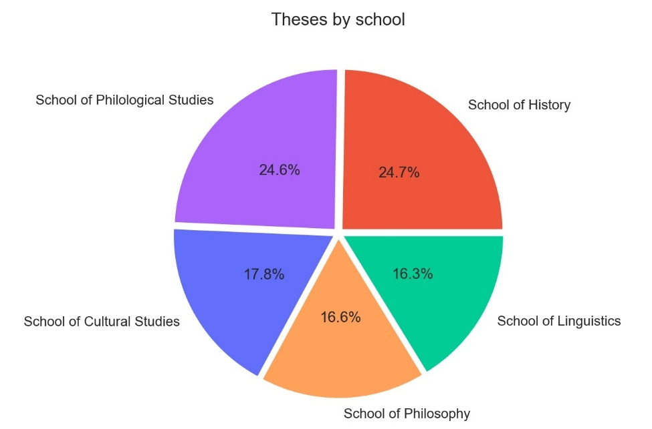
Data
578 documents + metadata
Processed main texts of theses in .txt
Volume in tokens:
9,688,788 raw
4,607,842 after processing

Slide 10

Methods
Get metadata via API (deprecated) and download files
Extract textual content via docx package
Extract only the main body of the text by leaving out everything before ‘Introduction’ and after ‘References’ (getting boundaries via regular expressions)
Process texts (delete in-line citations, tokenize, delete any non-alphabetical characters, lemmatize, delete Russian, English, and German stopwords, join bi- and trigrams) via razdel, pymorphy2 and nltk packages
Make a LDA topic model via Gensim package

Slide 11
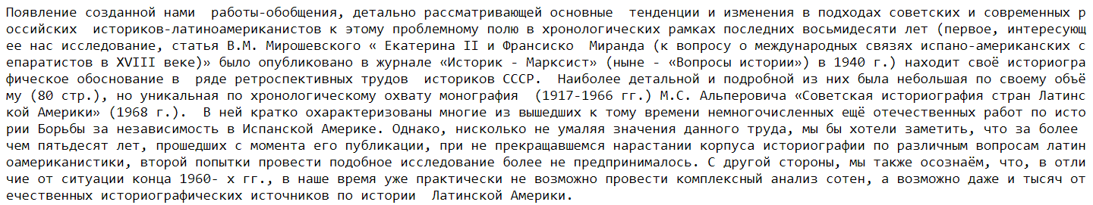
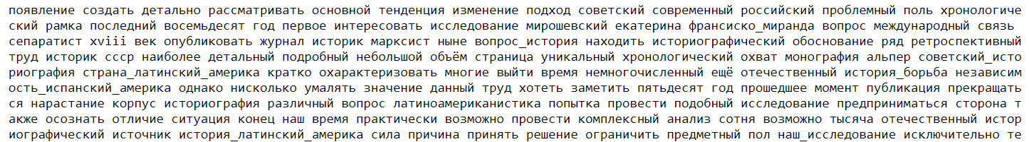
Example
before:
after:

Slide 12
LDA
Filter out tokens, that appear in less than 5 documents or in more than 50% of documents
Bag of Words document representation (better than TF-IDF)
50 topics (chosen based on the coherence measures + interpretability)
alpha = asymmetric, eta = auto
passes = 4
workers = 3 (on a machine with 4 cores)
chunksize = 1000 (whole corpus is less than 80 Mb in .txt format)
eval_every = False (to speed up training)
random_state = 42 (for somewhat replicable results)
Notes:
I strongly believe that, while increasing the number of topics to 100-150 would presumably contribute to higher coherence, model’s quality would increase insignificantly and such large number of topics would be much more difficult to analyze and interpret manually.

Slide 13
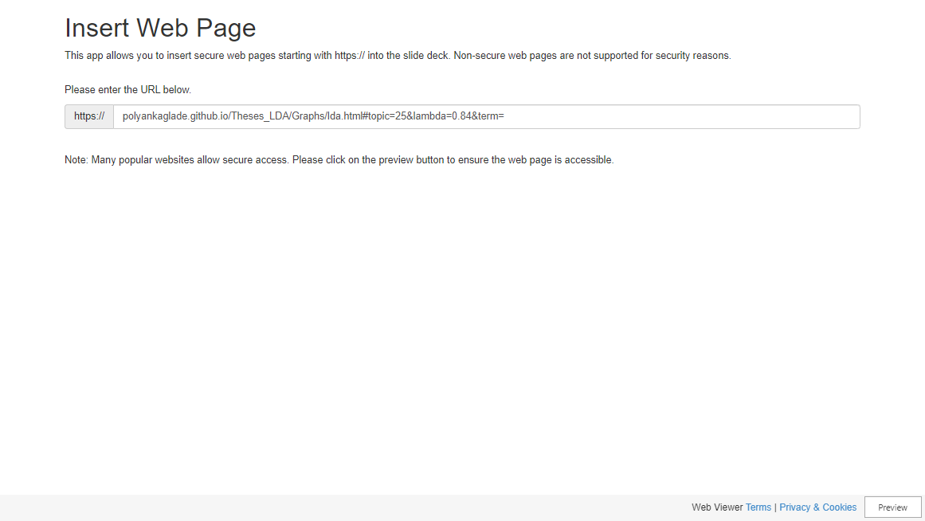

Slide 14
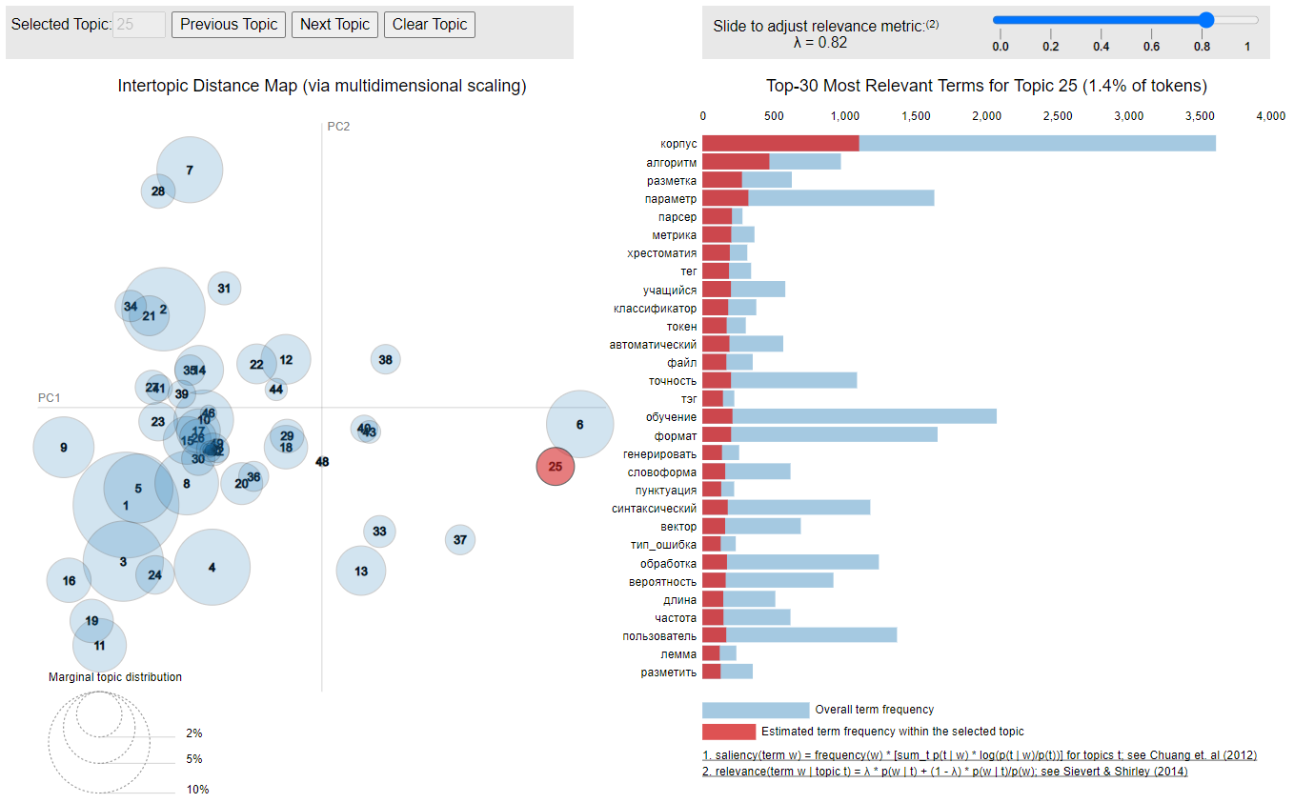
Computational linguistics

Slide 15
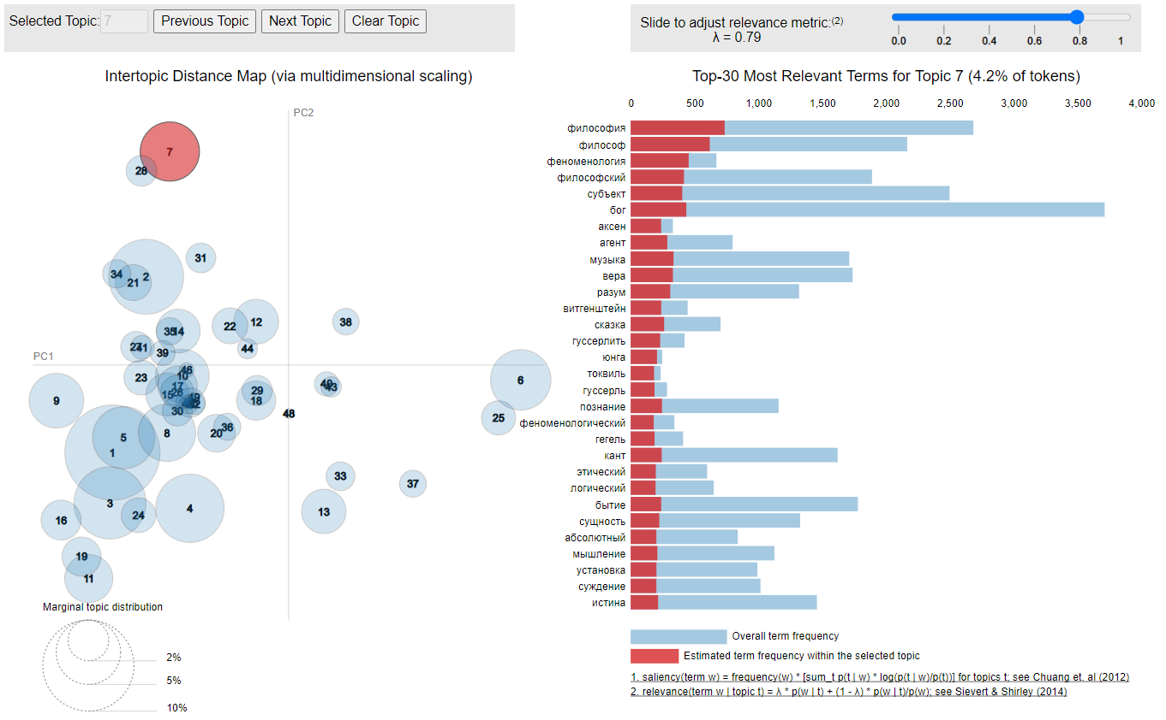
Philosophy

Slide 16
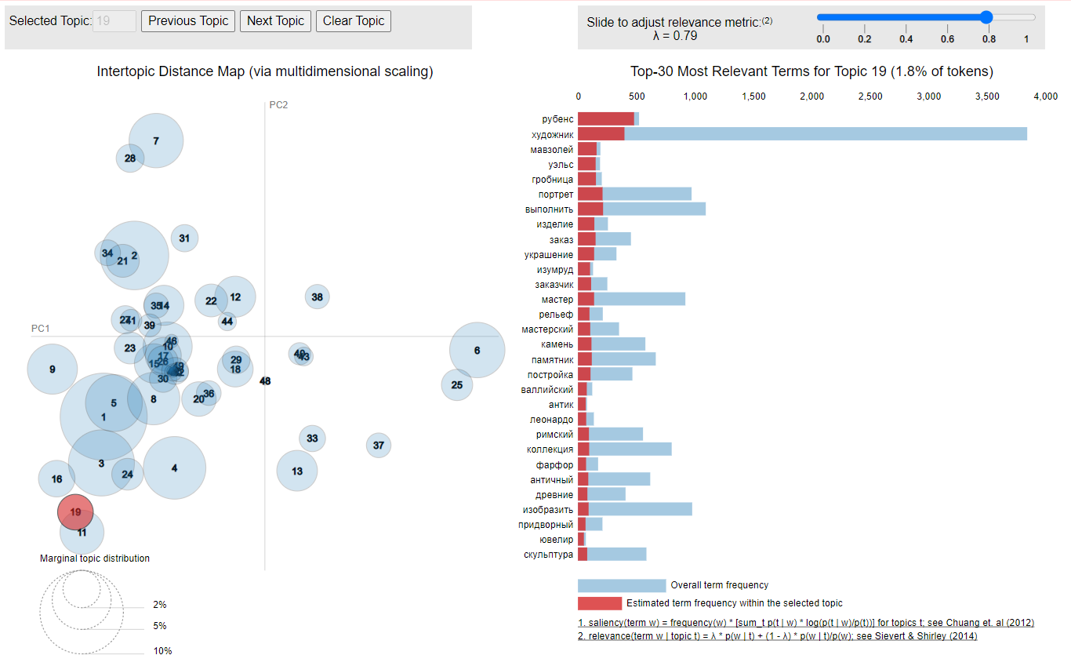
Art

Slide 17
Analysis
Centroid = mean vector of the class
Qualitative: dimensionality reduction for visualization (to 2D and 3D)
PCA
t-SNE
PCA + t-SNE
Quantitative: both for 50D and reduced space
Euclidean and Manhattan (or Cityblock) distances
Cosine distance
Combined measure
Notes:
Principal Component Analysis
t-distributed Stochastic Neighbor Embedding

Slide 18
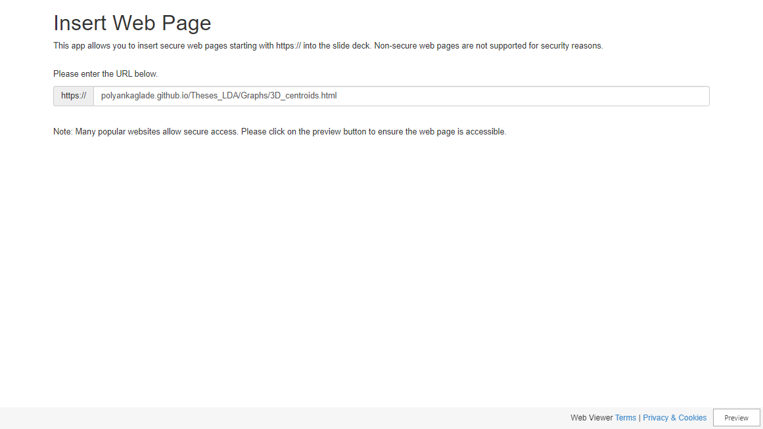

Slide 19


Slide 20
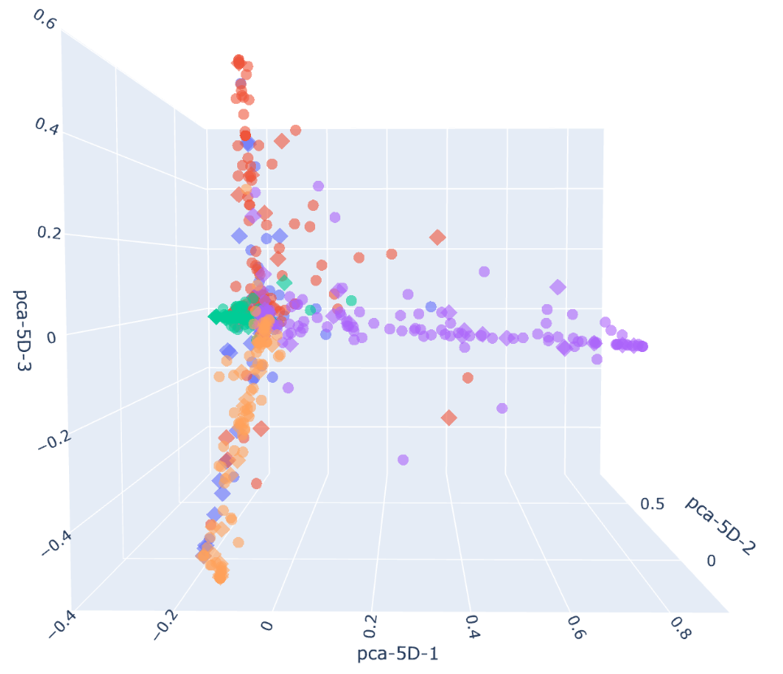
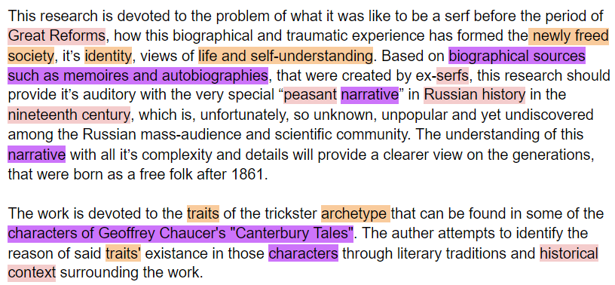
Example: two History works, located between Philosophy and Philology
“Generational Synthesis Principle and the Problem of Reflections on Serfdom among Russian Peasantry after 1861”
(History)
“Students, Scientists and Tricksters in the Works of Geoffrey Chaucer: Literary Traditions and Historical Context”
(Medieval Studies)

Slide 21
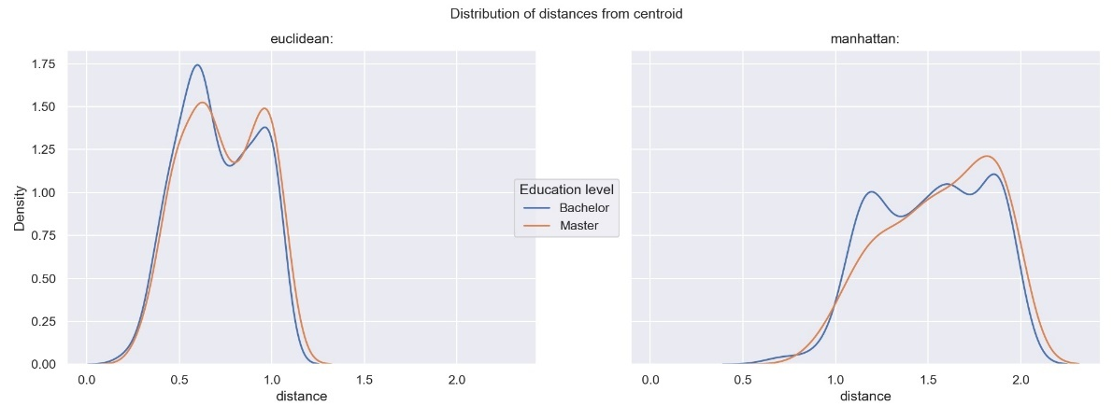
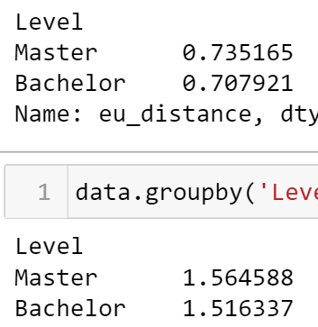
Mean distances: bachelor’s VS master’s
mean
No significant difference

Slide 22
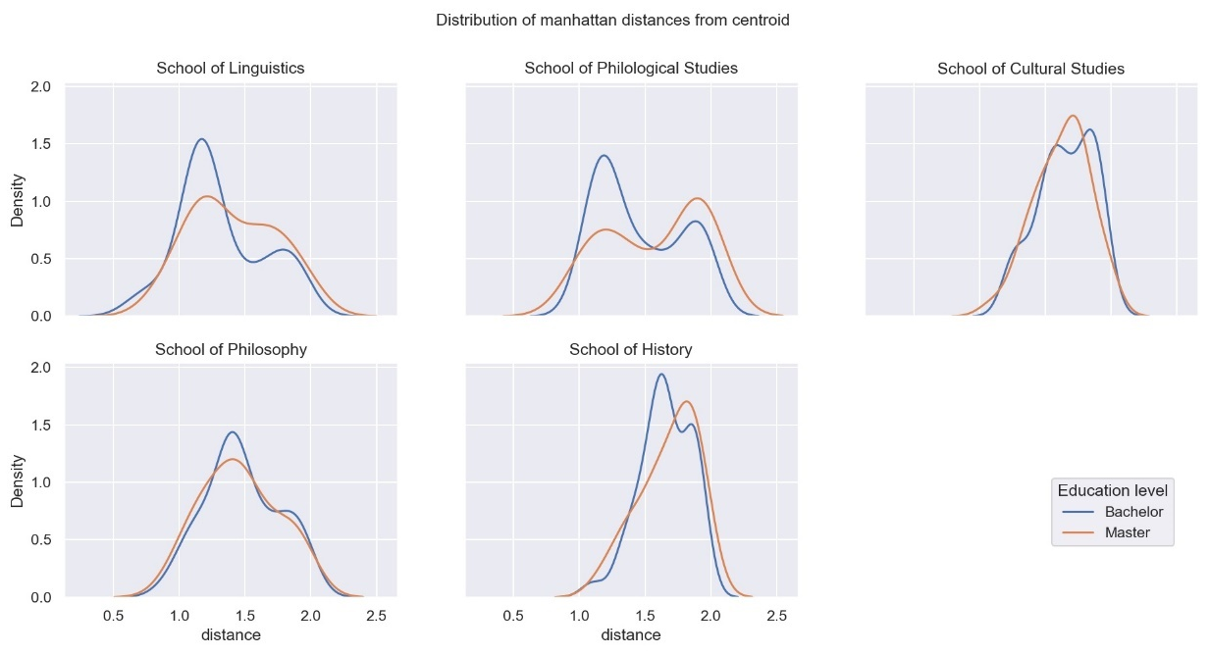
Mean distances: bachelor’s VS master’s

Slide 23
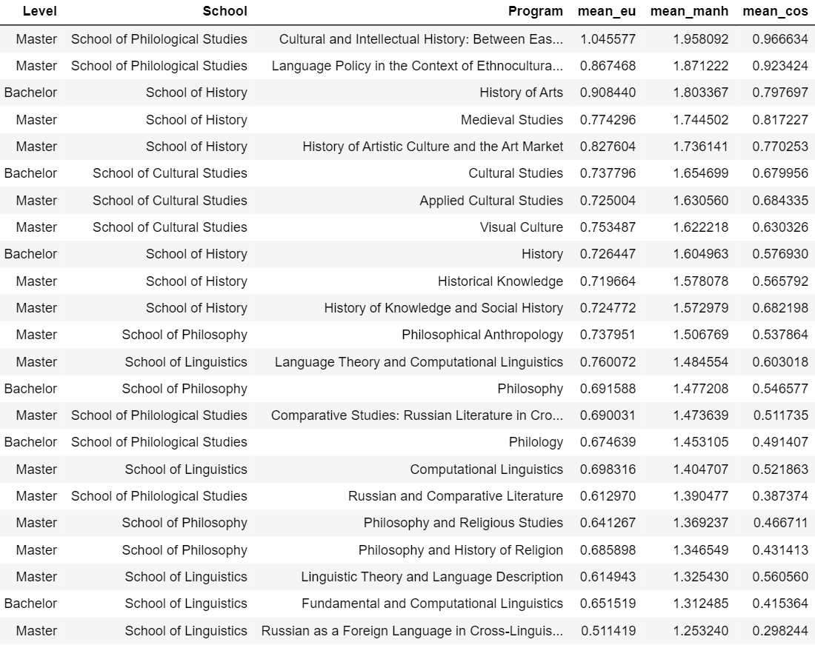
Mean distances: programs
Top three Programs with the highest mean distances are:
Cultural and Intellectual History: Between East and West
Language Policy in the Context of Ethnocultural Diversity
History of Arts
Top three Programs with the lowest mean distances are:
Fundamental and Computational Linguistics
Russian as a Foreign Language in Cross-Linguistic and Cross-Cultural Perspective
Philosophy and Religious Studies
Notes:
some correlation between the School and the position on this scale

Slide 24
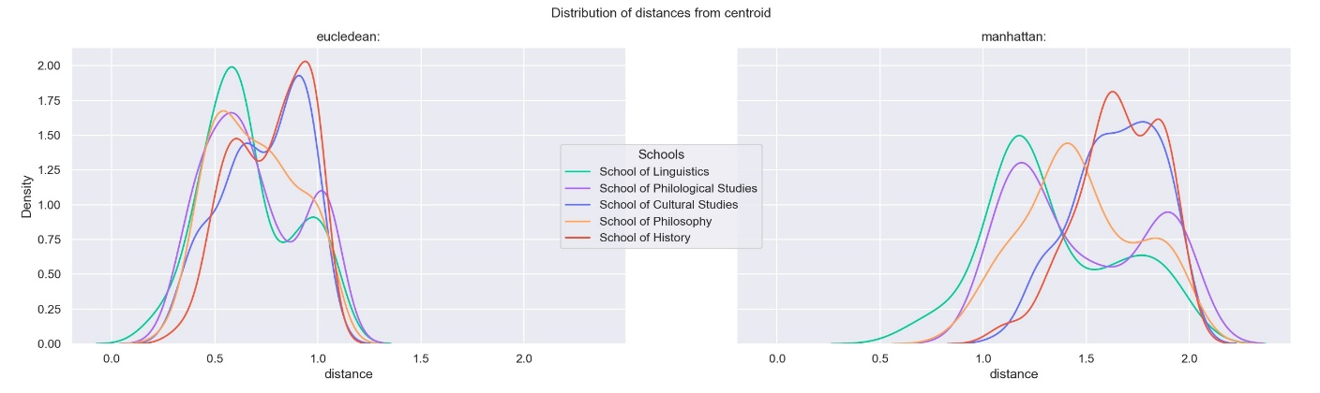
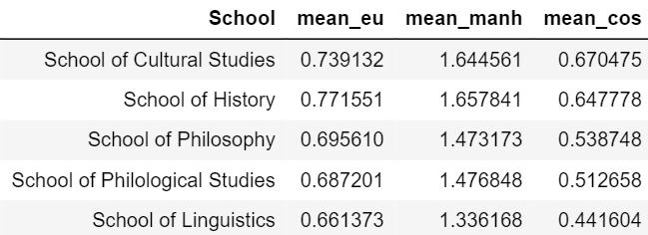
Mean distances: schools
Interdisciplinarity scale for schools:

Slide 25
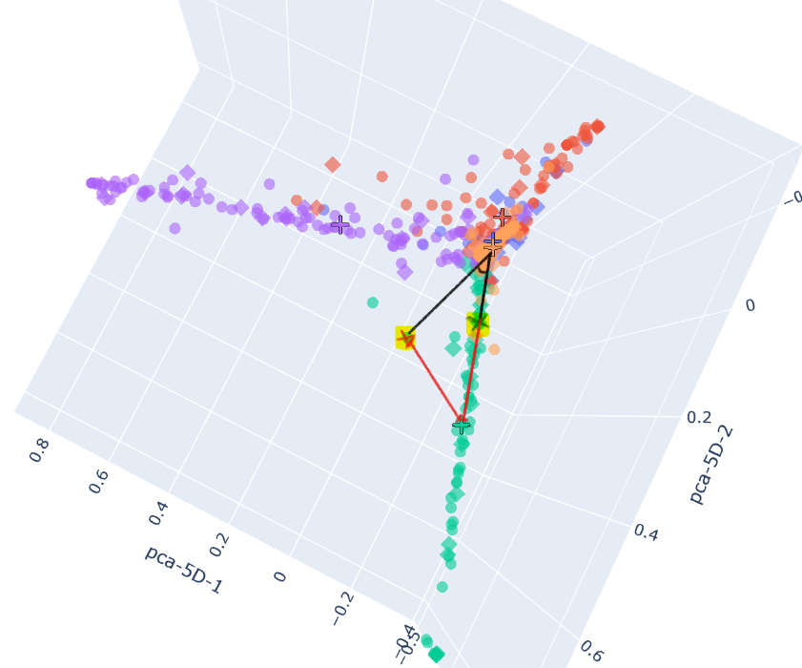
Individual thesis measure?
Intuition for a single work’s interdisciplinarity:
distance and cosine represent different types of relations to the centroid.
Marked dots:
same distance to the centroid
cosine left mark > cosine right mark
left thesis shows more interdisciplinarity
Lowest green dot:
same cosine as right mark
distance > both marks
thesis shows the least amount of interdisciplinarity
Notes:
Solution: use both. How? Sum, weighted sum?

Slide 26
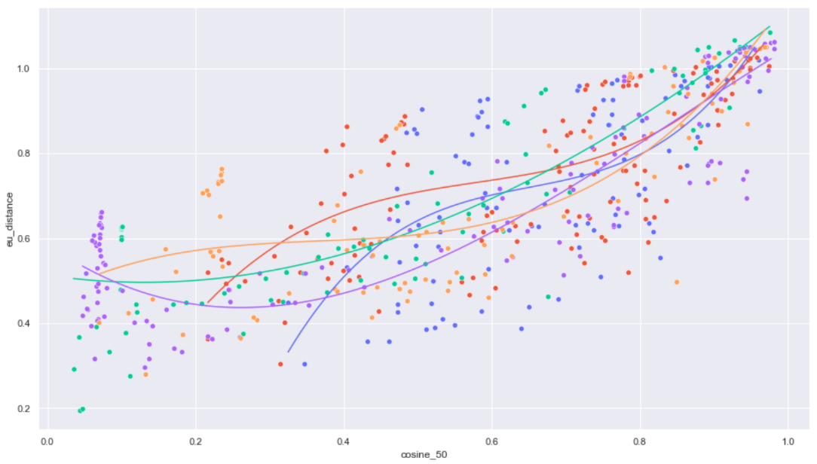
Curves, fitted on each School’s distance and cosine measures with objective of cubic equation.
Using the resulting function as a combined measure allows to distinguish the most interdisciplinary theses in a school with results, very similar to the qualitative analysis.

Slide 27




Conclusion
Hypothesis 1 – disproved, hypothesis 2 – confirmed
Insight about scientific structure of HSE Humanities (scaled programs, schools and individual theses)
Processing and analysis pipeline
Corpus + website with interactive figures

Slide 28
References
Bakarov, A., Kutuzov, A., & Nikishina, I. (2018). Russian Computational Linguistics: Topical Structure in 2007-2017 Conference Papers. https://doi.org/10.13140/RG.2.2.28391.75687
Blei, D. M., Ng, A. Y., & Jordan, M. I. (2003). Latent dirichlet allocation. The Journal of Machine Learning Research, 3, 993–1022.
Dutta, B. (2008). Classification of Keywords Selected from Research Articles on Physics and Development of a Quantitative Subject Access Tool. IFLA World Library & Information Congress (WLIC) 2013 Singapore.
Hall, D., Jurafsky, D., & Manning, C. D. (2008). Studying the history of ideas using topic models. Proceedings of the Conference on Empirical Methods in Natural Language Processing - EMNLP 08. https://doi.org/10.3115/1613715.1613763
Paul, M., & Girju, R. (2009). Topic Modeling of Research Fields: An Interdisciplinary Perspective. Proceedings of the International Conference RANLP-2009, 337–342. https://www.aclweb.org/anthology/R09-1061
Small, H. (1973). Co-citation in the scientific literature: A new measure of the relationship between two documents. Journal of the American Society for Information Science, 24(4), 265–269. https://doi.org/10.1002/asi.4630240406
Wagner, C. S., Roessner, J. D., Bobb, K., Klein, J. T., Boyack, K. W., Keyton, J., Rafols, I., & Börner, K. (2011). Approaches to understanding and measuring interdisciplinary scientific research (IDR): A review of the literature. Journal of Informetrics, 5(1), 14–26. https://doi.org/10.1016/j.joi.2010.06.004

Slide 29
Q&A
Thank you!

