Slide 1


Filipe Sbragio – filipe.sbragio@zbra.com.br
Márcio Hariki – marcio.hariki@zbra.com.br

Slide 2

Outline
STOMP
Why use STOMP?
Communication
Headers
Connection
Heartbeat
Frames
2

Slide 3

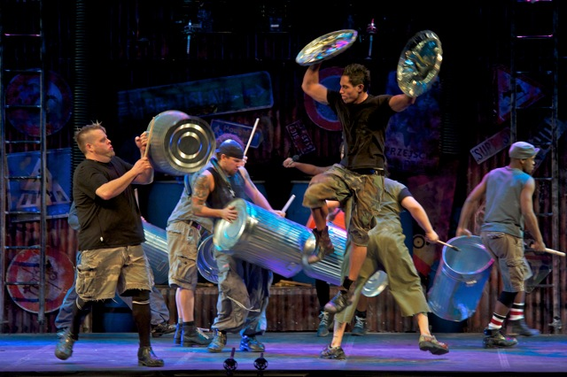
STOMP
3

Slide 4

STOMP
*Mandatory impact image
4

Slide 5

Why use STOMP?
5

Slide 6

Communication
6

Slide 7
Communication
COMMAND
header1:value1
header2:value2
Body
^@
6

Slide 8

Headers
COMMAND
content-length:50
content-type:text/html;charset=utf-16
receipt:arbitraryString
receipt:y-u-repeat-header?
Body
^@
7

Slide 9

Connection
8

Slide 10
Connection
CONNECT(or STOMP)
accept-version:1.0,1.1,2.0
host:hostname.com
login:mylogin
passcode:mypasscode
heart-beat:0,0
Body
^@
CONNECTED
version:1.1
session:s120
server:Apache/1.3.9*(apache server)
heart-beat:0,0
Body
^@
8

Slide 11

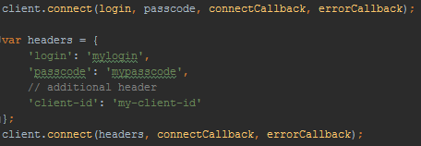
Connection (StompJS)
Stomp Client
Connection
9

Slide 12

Heartbeat
CONNECT
heart-beat:<clientMax>,<clientIdeal>
CONNECTED
heart-beat:<serverMax>,<serverIdeal>
10

Slide 13
Heartbeat
CONNECT
heart-beat:50,80
CONNECTED
heart-beat:100,150
10

Slide 14
Client Frames
SEND
destination:/zbra-chat/messages/1
content-length:50
content-type:application/json
irrelevant-header:isIrrelevant
{ user: { username: ‘zbra054', email: ‘zbra054@haha.com' }, text: ‘Hello! ' }
^@
11

Slide 15
Client Frames
SEND
destination:/zbra-chat/messages/1
content-length:50
content-type:application/json
irrelevant-header:isIrrelevant
{ user: { username: ‘zbra054', email: ‘zbra054@haha.com' }, text: ‘Hello! ' }
^@
SUBSCRIBE
Id:0
destination:/queue/messages/1
ack:client
^@
11

Slide 16
Client Frames
SEND
destination:/zbra-chat/messages/1
content-length:50
content-type:application/json
irrelevant-header:isIrrelevant
{ user: { username: ‘zbra054', email: ‘zbra054@haha.com' }, text: ‘Hello! ' }
^@
SUBSCRIBE
Id:0
destination:/queue/messages/1
ack:client
^@
UNSUBSCRIBE
id:0
^@
11

Slide 17
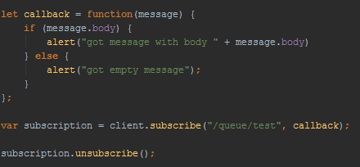
Client Frames
SEND
SUBSCRIBE & UNSUBSCRIBE
12

Slide 18
Client Frames
ACK
id:12345
transaction:tx1
^@
13

Slide 19
Client Frames
ACK
id:12345
transaction:tx1
^@
NACK
id:12345
transaction:tx1
^@
13

Slide 20
Client Frames
ACK
id:12345
transaction:tx1
^@
NACK
id:12345
transaction:tx1
^@
DISCONNECT
receipt:xd
^@
13

Slide 21
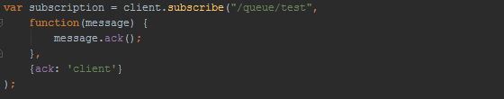
Client Frames
ACK
id:12345
transaction:tx1
^@
NACK
id:12345
transaction:tx1
^@
DISCONNECT
receipt:xd
^@
13

Slide 22
Transaction Frames
BEGIN
transaction:tx1
^@
14

Slide 23
Transaction Frames
BEGIN
transaction:tx1
^@
COMMIT
transaction:tx1
^@
14

Slide 24
Transaction Frames
BEGIN
transaction:tx1
^@
COMMIT
transaction:tx1
^@
ABORT
transaction:tx1
^@
14

Slide 25
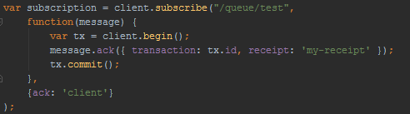
Transaction Frames
BEGIN
transaction:tx1
^@
COMMIT
transaction:tx1
^@
ABORT
transaction:tx1
^@
14

Slide 26
Server Frames
MESSAGE
subscription:0
message-id:007
destination:/queue/messages/1
content-type:application/json
{ user: { username: ‘zbra054', email: ‘zbra054@haha.com' }, text: ‘Hello! ' }
^@
15

Slide 27
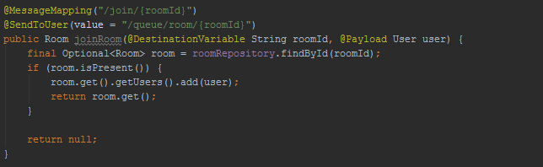
Server Frames
MESSAGE
subscription:0
message-id:007
destination:/queue/messages/1
content-type:application/json
{ user: { username: ‘zbra054', email: ‘zbra054@haha.com' }, text: ‘Hello! ' }
^@
15

Slide 28
Server Frames
RECEIPT
receipt-id:xd
^@
16

Slide 29
Server Frames
RECEIPT
receipt-id:xd
^@
ERROR
receipt-id:xd
content-type:application/json
content-length:171
message:message could not be processed
{ faultReason: ‘User zbra054 has been removed, try using zbra54’ }
^@
16

Slide 30

Questions
18

Slide 31
Filipe Sbragio - filipe.sbragio@zbra.com.br
Márcio Hariki - marcio.hariki@zbra.com.br

