Slide 1
INFDEV026A - Algoritmiek Week 7
G. Costantini, F. Di Giacomo, G. Maggiore
costg@hr.nl, giacf@hr.nl, maggg@hr.nl – Office H4.204

Slide 2

Today
Why is my code slow?
Empirical and complexity analysis
How do I order my data?
Sorting algorithms
How do I structure my data?
Linear, tabular, recursive data structures
How do I represent relationship networks?
Graphs
Proeftentamen

Slide 3
Proeftentamen – Question 1
What is the (tightest) complexity class of the code below with the big-Oh notation?
public int factorial(int n)
{
if (n == 0)
return 1;
else
return n * factorial(n - 1);
}

Slide 4

Proeftentamen – Question 1
Answer:
$O(n)$
Why?
The factorial method is called $n$ times
The base case ($n == 0$) has constant complexity

Slide 5
Proeftentamen – Question 2
Complete the code below (in correspondence of …………) so that it produces the desired result: insertion of a given new node (newNode) in a doubly linked list (list), after a specified node (node).
public void insertAfter(DLinkedList list, Node node, Node newNode)
{
newNode.prev = ………………………… ;
newNode.next = ………………………… ;
if (node.next == null)
list.lastNode = ………………………… ;
else
node.next.prev = newNode;
node.next = ………………………… ;
}

Slide 6
Proeftentamen – Question 2
Complete the code below (in correspondence of …………) so that it produces the desired result: insertion of a given new node (newNode) in a doubly linked list (list), after a specified node (node).
public void insertAfter(DLinkedList list, Node node, Node newNode)
{
newNode.prev = node;
newNode.next = node.next;
if (node.next == null)
list.lastNode = newNode;
else
node.next.prev = newNode;
node.next = newNode;
}

Slide 7
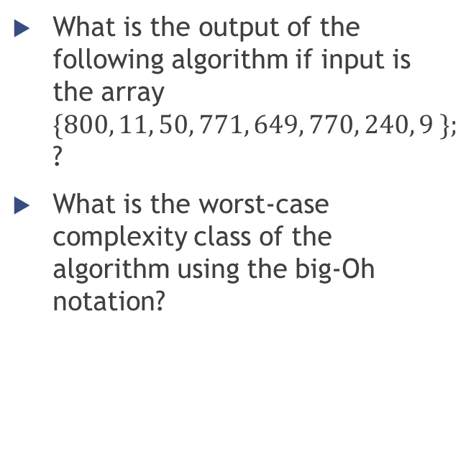
Proeftentamen – Question 3
public void MysteryMethod(int[] numarray)
{
for (int i = 1; i < numarray.Length; i++)
{
int j = i;
while (j > 0)
{
if (numarray[j - 1] < numarray[j])
{
int temp = numarray[j - 1];
numarray[j - 1] = numarray[j];
numarray[j] = temp;
j--;
}
else
break;
}
}
}
What is the output of the following algorithm if input is the array $\{800, 11, 50, 771, 649, 770, 240, 9 \};$ ?
What is the worst-case complexity class of the algorithm using the big-Oh notation?

Slide 8
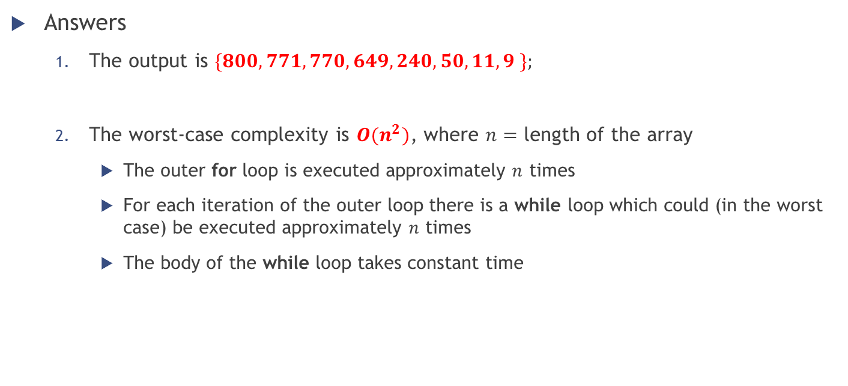
Proeftentamen – Question 3
Answers
The output is $\{800, 771, 770, 649, 240, 50, 11, 9 \};$
The worst-case complexity is $O(n^{2})$, where $n=$ length of the array
The outer for loop is executed approximately $n$ times
For each iteration of the outer loop there is a while loop which could (in the worst case) be executed approximately $n$ times
The body of the while loop takes constant time

Slide 9
Proeftentamen – Question 4
public void insert(int key)
{
root = insertRec(root, key);
}
public Node insertRec(Node root, int key)
{
if (root == null)
{
root = new Node(key);
return root;
}
if (key < root.key)
root.left = insertRec(………………………… , …………………………);
else if (key ………………………… )
root.right = ………………………… ;
return root;
}
Complete the code below (in correspondence of …………………) so that it correctly performs the insertion of a new node in a binary search tree. The Node class contains three fields: key (integer value), left (left child node), right (right child node).

Slide 10
Proeftentamen – Question 4
public void insert(int key)
{
root = insertRec(root, key);
}
public Node insertRec(Node root, int key)
{
if (root == null)
{
root = new Node(key);
return root;
}
if (key < root.key)
root.left = insertRec( root.left , key );
else if (key > root.key )
root.right = insertRec( root.right, key );
return root;
}
Complete the code below (in correspondence of …………………) so that it correctly performs the insertion of a new node in a binary search tree. The Node class contains three fields: key (integer value), left (left child node), right (right child node).

Slide 11
Proeftentamen – Question 5
MysteryMethod(Graph, root)
for each node n in Graph:
n.visited = FALSE
create empty stack S
root.visited = TRUE
print(root)
S.push(root)
while S is not empty:
currentTop = S.peek()
while (exist v adjacent to currentTop that is not visited yet) {
v.visited = TRUE
print(v)
S.push(v)
currentTop = S.peek()
}
S.pop()
Suppose that a graph is stored as a list of nodes (and each node contains information on its neighbours). What does the following algorithm (written in pseudocode) do and with which complexity?

Slide 12

Proeftentamen – Question 5
Answers
The code performs a depth first traversal of the graph
The complexity is $O\left(\left|V\right|+\left|E\right|\right)$
Where $V$ is the vertices set (and thus $\left|V\right|$ is the number of vertices)…
…and $E$ is the edges set (and thus $|E|$ is the number of edges)

Slide 13
Proeftentamen feedback
How did you find it?
Where do you have more difficulties?
Do you have specific doubts/questions?

