Slide 1
HTML && CSS GIST
<Tag attribute=“value”></Tag>
Selector(h1/.class/#id) {property(color):value(blue);}

Slide 2
Various selectors
Element Selector
Id Selector
Class selector

Slide 3
Different ways of Adding CSS
External
In head tag add <link rel="stylesheet" type="text/css" href="mystyle.css">
Internal
Code between <style> </style> tags
In line
Style=“color:blue;”

Slide 4
Bootstrap
Responsive

Slide 5
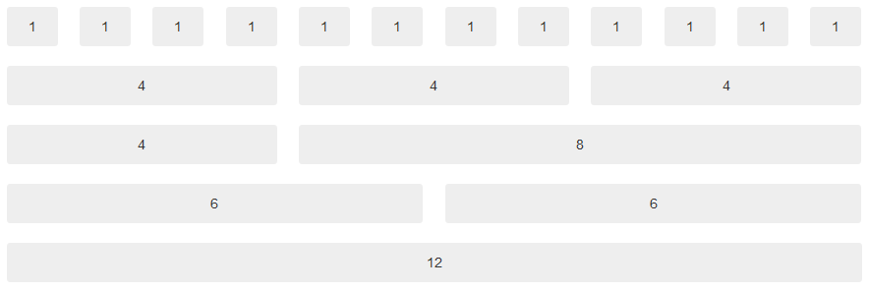
Bootstrap Grid system

Slide 6
Grid Rules
Container/container-fluid class
Row -> columns
All the numbers add up to ten

Slide 7
Sizes
Xs (<768px)
Sm (768-992)
Md (992-1200)
Lg (>1200)

Slide 8
Basic Grid Structure
<div class="row"> <div class="col-*-*"></div> </div> <div class="row"> <div class="col-*-* *"></div> <div class="col-*-* *"></div> <div class="col-*-* *"></div> </div> </div>

Slide 9
Nested Grid
<div class="row"> <div class="col-sm-8"> .col-sm-8 <div class="row"> <div class="col-sm-6">.col-sm-6</div> <div class="col-sm-6">.col-sm-6</div> </div> </div> <div class="col-sm-4">.col-sm-4</div> </div>

Slide 10
A Part from Grid
Typorgraphy
<small> in headings
<mark>
<abr title=“”>
<blockquote> <p>My life is my message.</p> <footer> Gandhi</footer> </blockquote>
<code>, <kbd>

Slide 11
Tables
table
table-striped
table-condensed
table-hover
Etc..

Slide 12
Image
img-rounded
img-circle
img-thumbnail
img-responsive

Slide 13
Well (inner shadow)
Adds a padding and look like depth
Well well-sm, well-lg.

Slide 14
Alert
Success
Info
Danger
Warning

Slide 15
Labels

Slide 16
Btn / label
.btn-default
.btn-primary
.btn-success
.btn-info
.btn-warning
.btn-danger
.btn-link (not for label)

Slide 17
Badges
Used for notifications usually

Slide 18
Progress Bar
<div class="progress-bar" style="width:90%">
Also have context

Slide 19
Pagination
UL class pagination
Active
Disabled
sizes

Slide 20
List Group
Similar to pagination
Active
Disabled
L -> .list

Slide 21
Panel
.<div class="panel panel-default"> <div class="panel-heading">Panel Heading</div> <div class="panel-body">Panel Content</div> </div>
Has context.

Slide 22
Java script
Why JS?
Syntax and programming little bit.

