Slide 1


Predicting the Premier League
A.Maksymczuk, C.Knight, B.Folland, E.Mark Fisher. Project sponsored by Atass Sports

Slide 2
Project briefing
Our project had the following tasks we had to complete.
Read through and fully understand the Spiegelhalter model.
Recreate the Spiegelhalter excel model in R with the 2009/10 data model
Rerun, test and analyse the results for the 2011/12 league
With all the other football leagues analyse the results: find strengths and weaknesses.
Repeat for the current season.

Slide 3
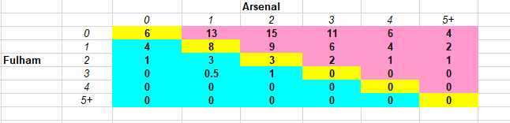
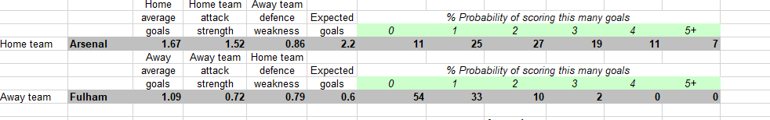
Spiegelhalter's Model
Spiegelhalters' Model used many different factors and weightings to conclude the final scores.
All of this was completed in an excel spreadsheet.
Notes:
1. For each team he took home and away scores, averaged them over all the games for each team and made a new variable the home attack advantage which is the ratio of the home/attack average scores.
He also made a variables – home/away attack strength which are dependant on each teams average scores compared to the whole entire leauges average. From this, and some weightings each time he managed
To come up with a weighted home/away attack strength. This weighting is very important. It allowed the probablity of teams scoring change depend on whether they are play better at home or away. This is useful because teams often perform worse when playing away. For example a weighting of 0 would cause your weighted home-attack strength to be based only goals scored at home and a weighting of 0.5 would set your attack strength for home and away to be equal. Speiglalpter set his to be 0.33 meaning the home attack strength on average is a little higher compared to the away attack strength.
2. He did this for defence weakness aswell
In the bottom diagram, he takes the three variables home.avg.goals, home attack-strength, and away team weakness and mutiply them to calulcate the expected goals, then a poisson distrubution is used to map the possible number of goals to a probability for each team
In the top diagram he calculates the probability of each of the score combinations happening, and the score pairing with the maxiumum probablity
Is the score used in the prediction
This model has a downside because it only works with the data set given, our job was to recreate this model such that it worked with any given dataset

Slide 4
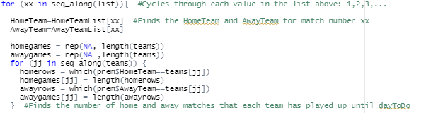
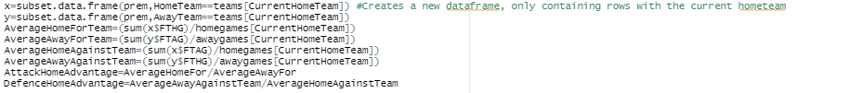
Our Code – Calculating data
Here, are a few bits of code showing how we imported the data and formatted it to create our variables used in mapping the probabilities
Notes:
1. Our code can be split into two parts, the first part was us calculating all the values we need. And the second part is mapping theses data values to probabilitys to find the projected score

Slide 5
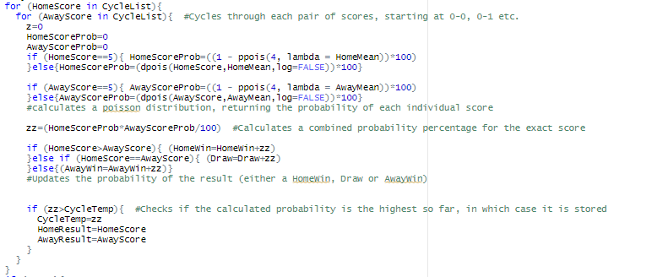
Our Code – Mapping probabilities
Notes:
Cycle list is = (1,2,3,4,5)

Slide 6
Our pre-results (the week before)
We ran our code on the weeks leading up to the final weekend, here are some interesting findings. Let w be the weighting value.
Week 30 2021 Prem:
For 0≤w≤0.1 - 2 exact correct scores.
For w>0.5 - no correct scores. Is this logical?
Let's investigate more.
Notes:
For a weighting of 0.5 or over weight is given the the away attack strength instead of the home attack strength

Slide 7
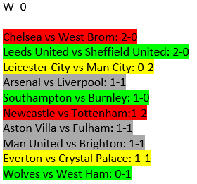
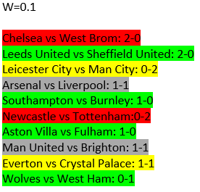
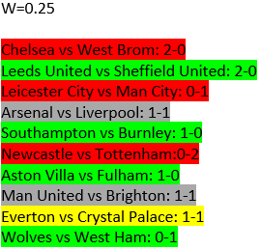
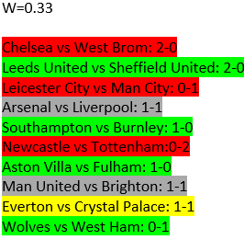
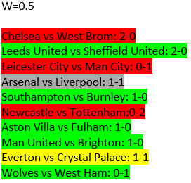
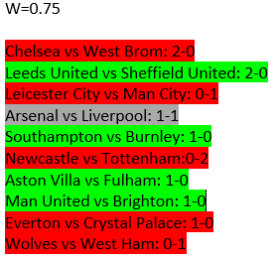
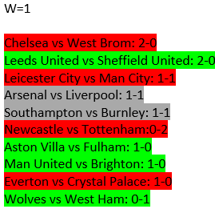
Week 30 Predictions with different weightings
Notes:
Will go over and explain things.
Gray = draw when predicted a win/loss
Yellow = exact score
Red = Loss.
When w =0, the attack home strength would be based on statistics only from playing on home. So would on average more teams win at home with w=0 prediction? 3 teams won at home so
But when w=1, 5 teams won at home? Is this right?
From this week alone it looks like the perfect weighting would be around 0.5, meaning the home and away attack strength and would be equal. But you really cannot come to any conclusions from one week.

Slide 8
How good is Spiegelhalter's model?
Out of 110 matches only 9 where exactly right
Out of 110 matches 57 where the right way
Out of 110 matches only 1 was predicted to have 5 or more goals

Slide 9
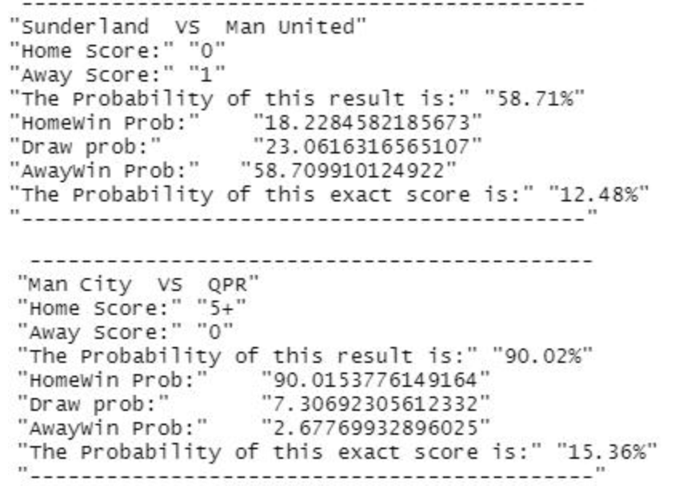
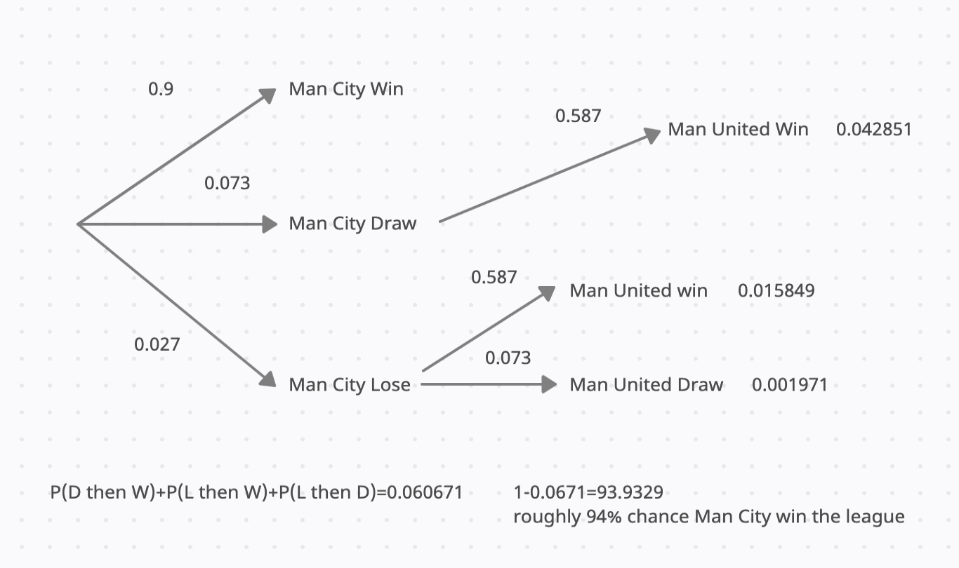
Probability of Man City Winning the league in 2011-12
Man City would win the league if on the last day they get more or the same points as Man United

Slide 10
Our Predictions
These are our predictions for the games the week after
Southampton vs Leicester 1-2 Newcastle vs Arsenal 0-1
Crystal Palace vs Man City 0-2. Man United vs Liverpool 1-1
Brighton vs Leeds 1-1 Tottenham vs Sheffiield United 2-0
Chelsea vs Fulham 1-0 West Brom vs Wolves 0-1
Everton vs Aston Villa 1-1. Burnley vs West Ham 0-1

Slide 11
Thanks for listening
Any questions?

