Slide 1
Only to save pictures
Dimensione Cognitiva 1

Slide 2
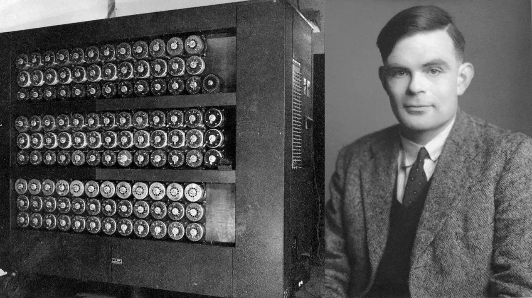

Slide 3
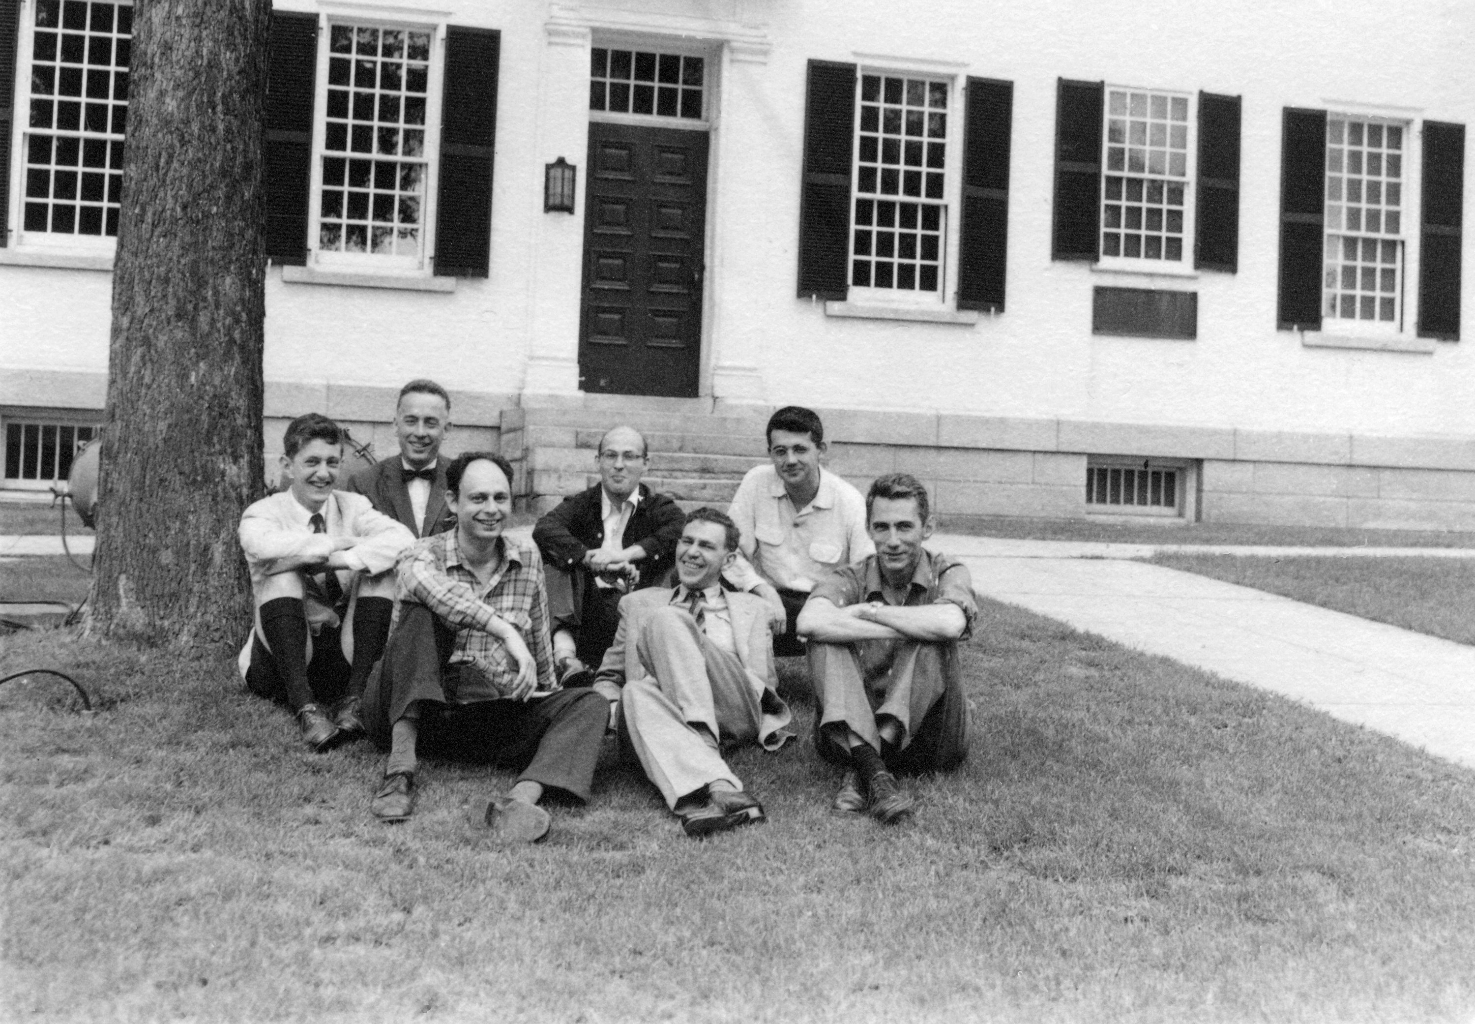

Slide 4
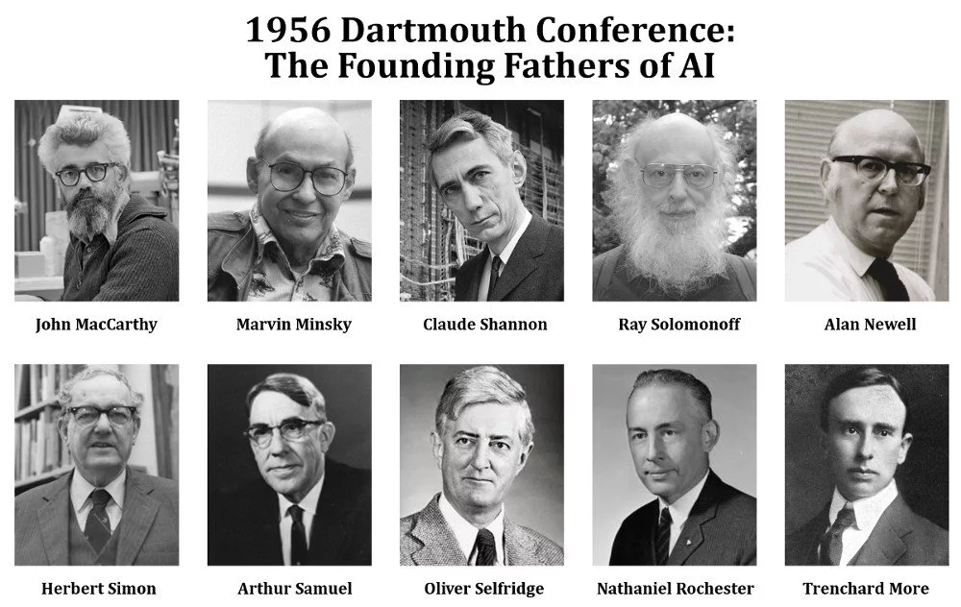

Slide 5
