Slide 1
Only to save pictures
Appendix-A

Slide 2
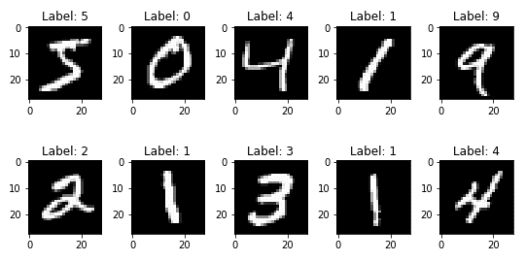

Slide 3
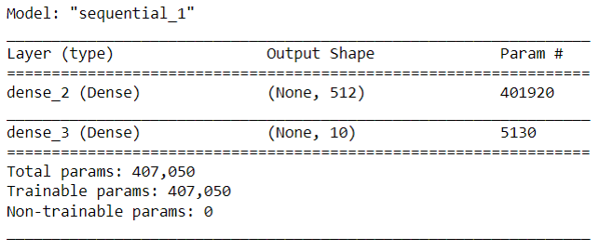

Slide 4


Slide 5
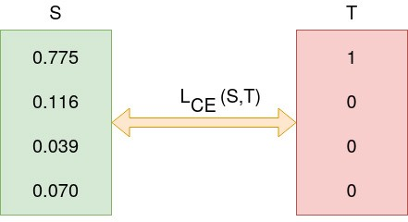

Slide 6


