Slide 1
Only to save pictures
Chapter-03

Slide 2


Slide 3
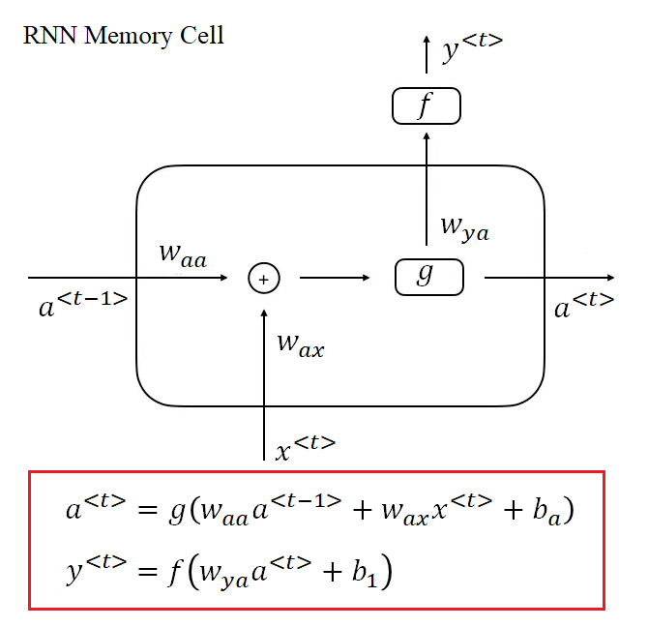

Slide 4
