Slide 1
Financial Data Gathering using Pandas

Slide 2
Pandas Datareader

Slide 3
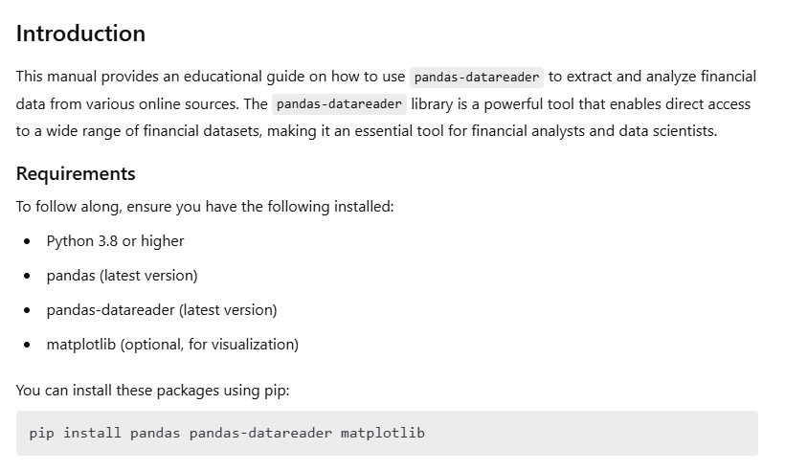
Data Gathering with Pandas

Slide 4
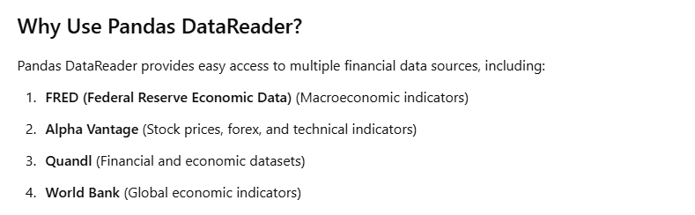
Data Gathering with Pandas

Slide 5
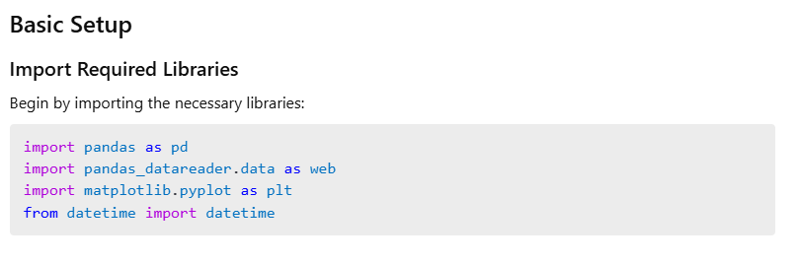
Data Gathering with Pandas

Slide 6
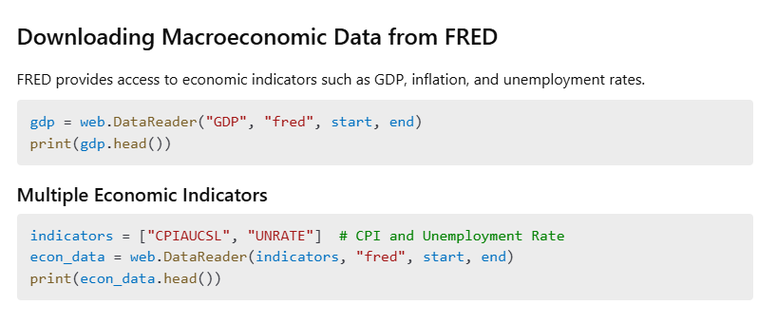
Data Gathering with Pandas

Slide 7
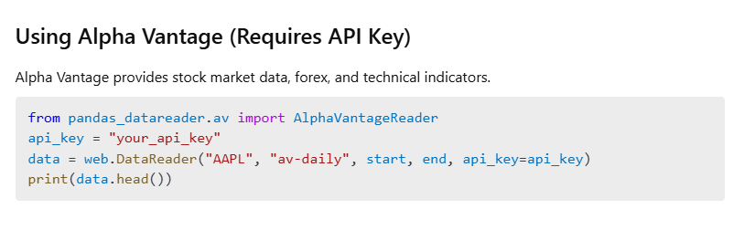
Data Gathering with Pandas

Slide 8
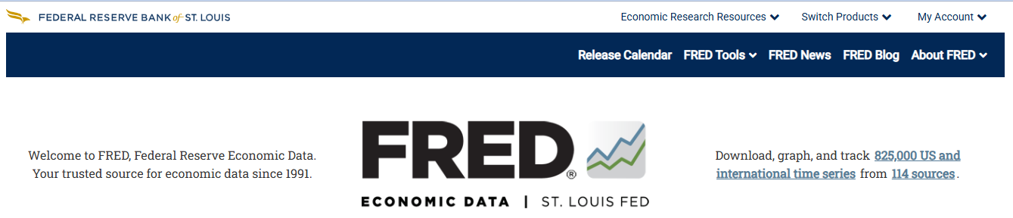

Slide 9
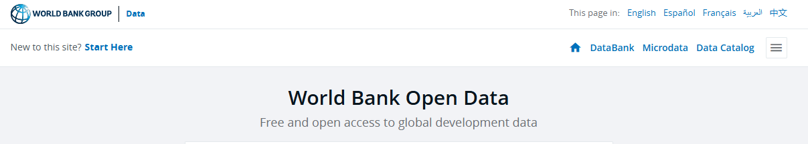

Slide 10
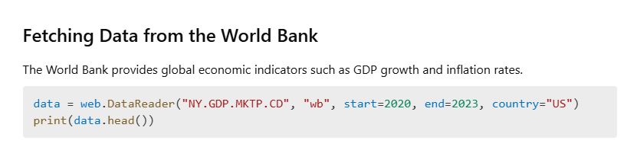
Data Gathering with Pandas

Slide 11
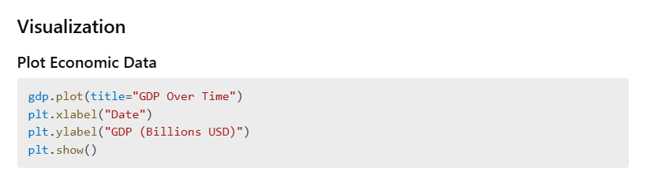
Data Gathering with Pandas

Slide 12
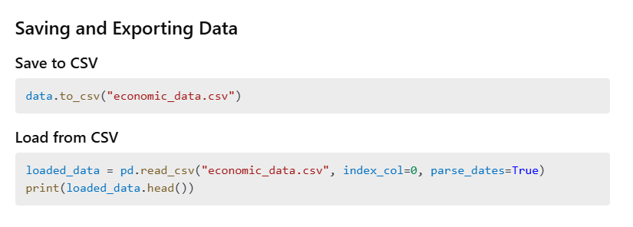
Data Gathering with Pandas

Slide 13
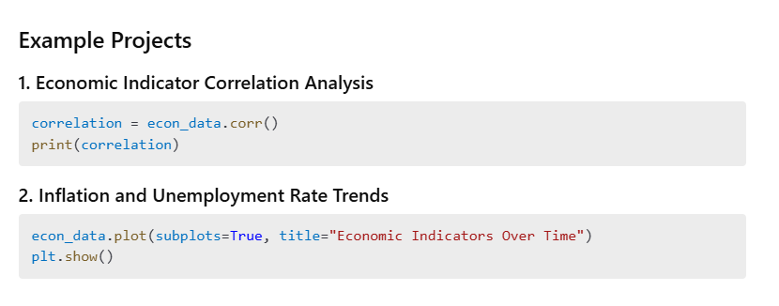
Data Gathering with Pandas

Slide 14
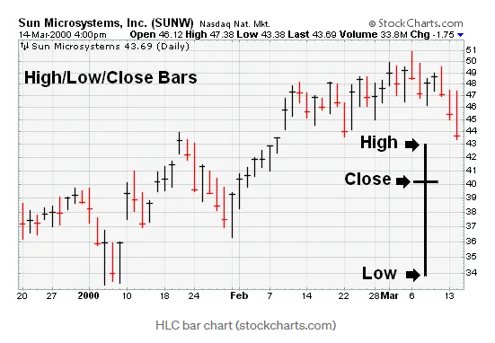

Slide 15
Yahoo Finance
Using the yfinance python library

Slide 16
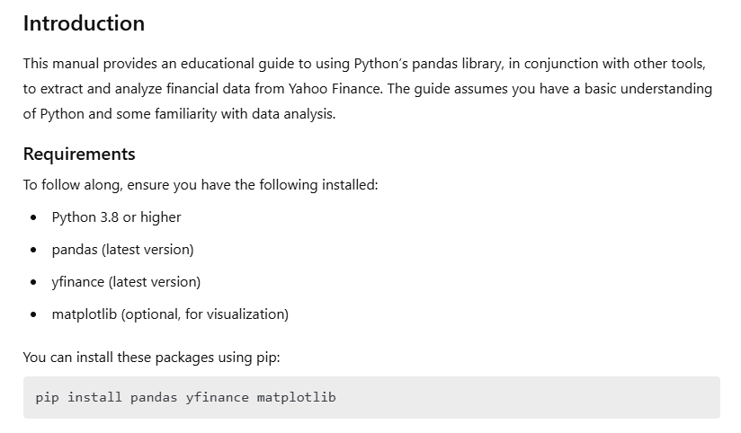
Data Gathering with Pandas

Slide 17
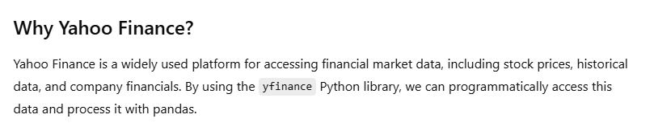
Data Gathering with Pandas

Slide 18
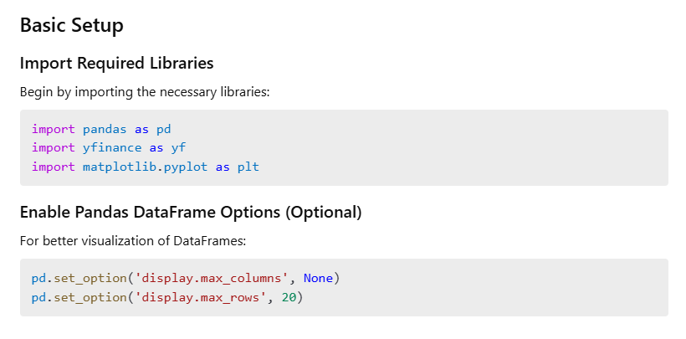
Data Gathering with Pandas

Slide 19
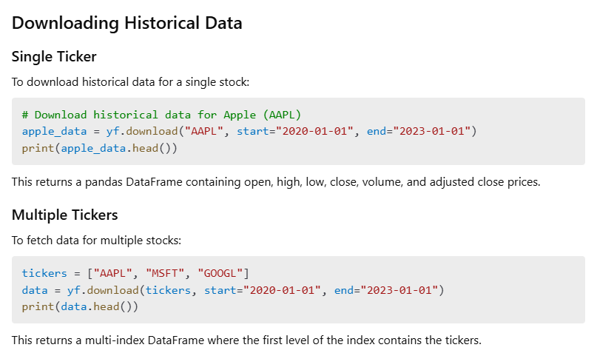
Data Gathering with Pandas

Slide 20
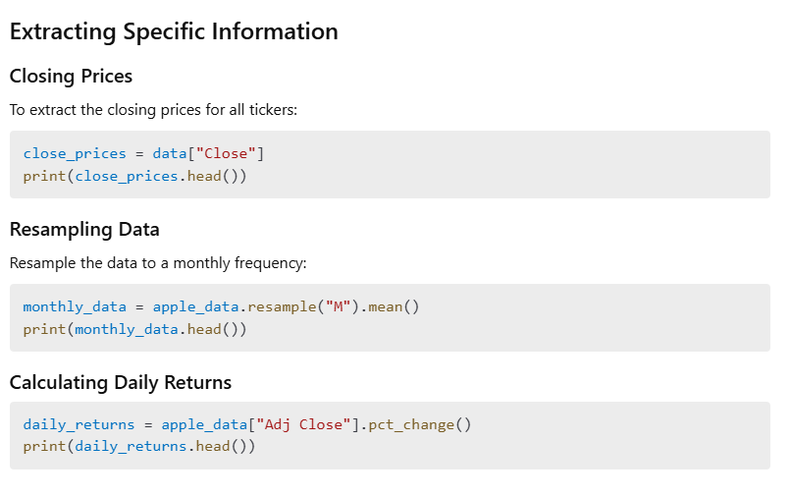
Data Gathering with Pandas

Slide 21
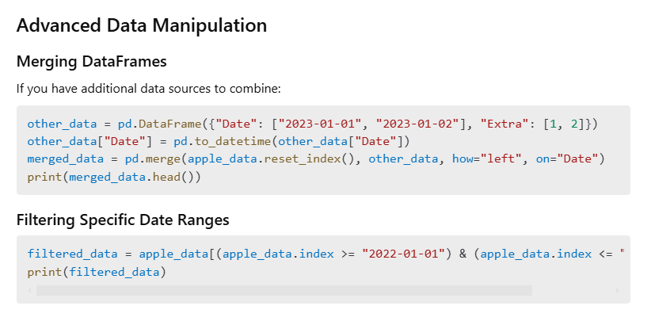
Data Gathering with Pandas

Slide 22
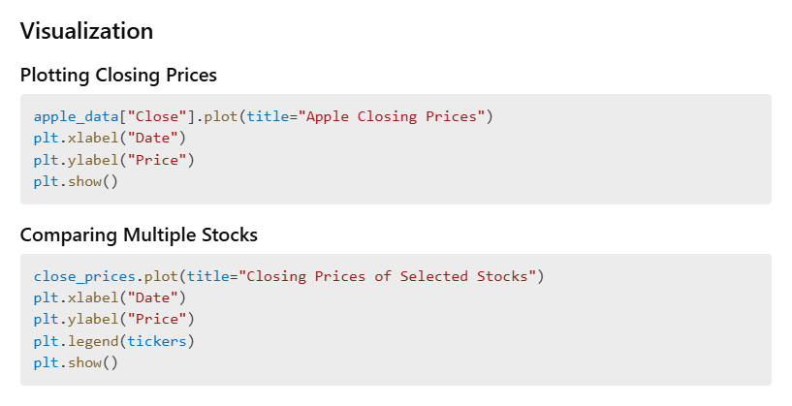
Data Gathering with Pandas

Slide 23
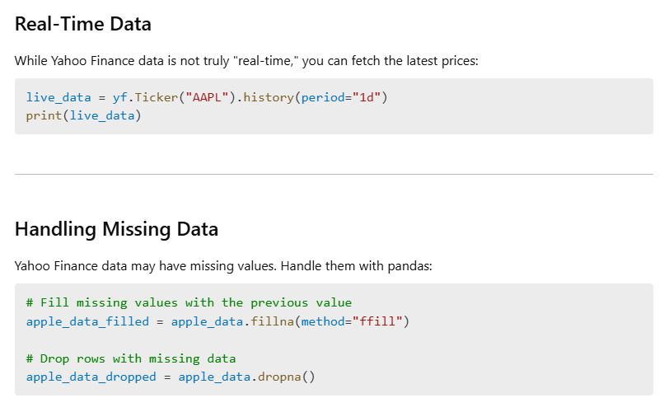
Data Gathering with Pandas

Slide 24
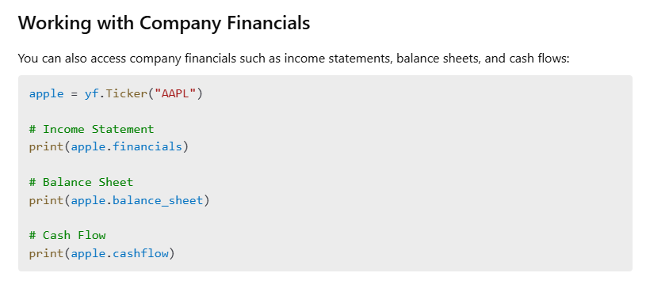
Data Gathering with Pandas

Slide 25
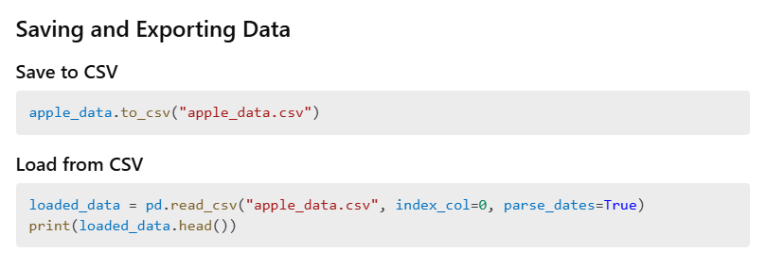
Data Gathering with Pandas

Slide 26
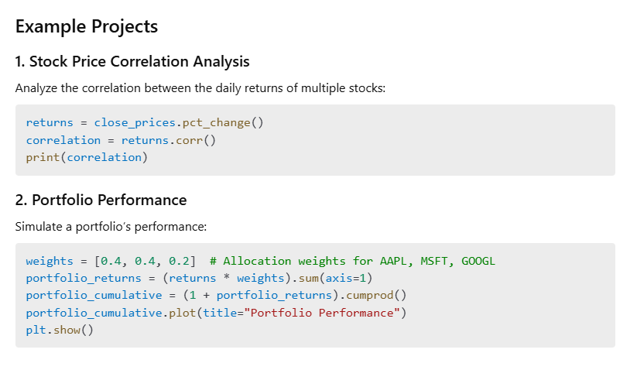
Data Gathering with Pandas

Slide 27


