Slide 1


Face Recognition Attendance System
Automating Attendance with AI
Team: Aditya Pandey, Yash Vardhan Singh, Mehul Kujur
College Name & Date
by Aditya Pandey

Slide 2
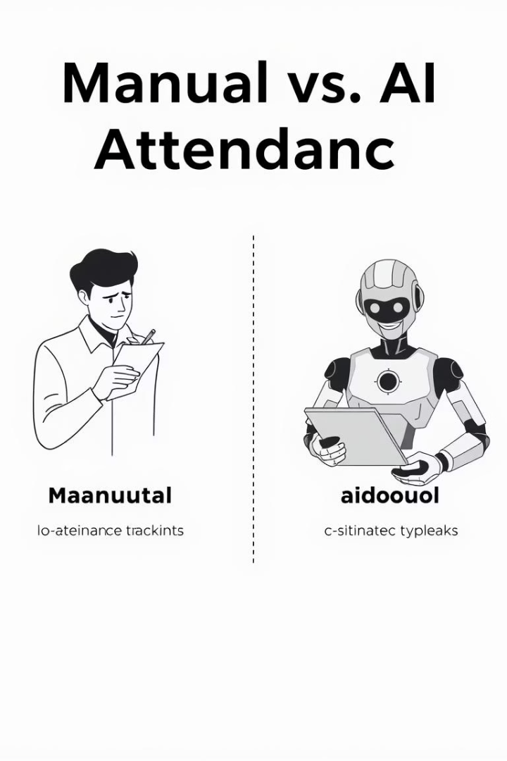
Introduction
Problem
Solution
Manual attendance is slow, error-prone, and vulnerable to proxy risks.
AI-powered, contactless attendance tracking system.
Key Features
Real-time face detection
MySQL database integration
CSV export/import
Admin-friendly GUI

Slide 3
Objectives
Replace manual attendance with automated face recognition.
Achieve >85% accuracy using LBPH algorithm.
Prevent proxy attendance via biometric verification.
User-friendly GUI for admins using Tkinter.
Scalable for large classrooms.

Slide 4





System Architecture
Student Registration
GUI to MySQL database
Face Data Collection
100 samples per student
Model Training
LBPH classifier
Real-Time Detection
Using OpenCV
Attendance Logging
CSV and database

Slide 5

Technologies Used
Face Detection
Haar Cascade (OpenCV)
Face Recognition
LBPH Algorithm
Database
MySQL
GUI Framework
Tkinter (Python)
Backend
Python, OpenCV

Slide 6
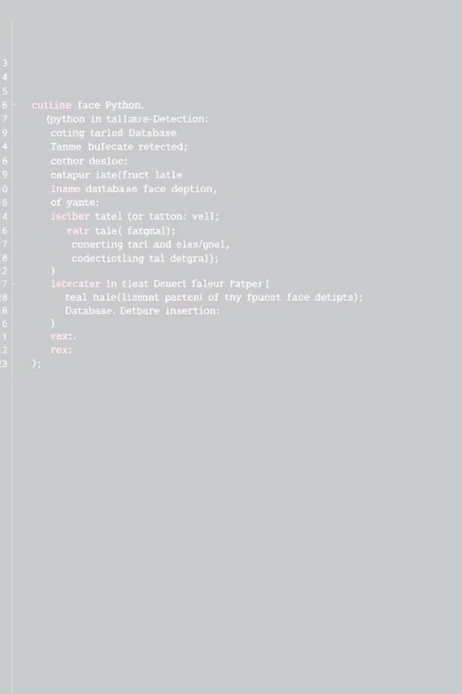
Code Snippets
1
Face Detection
2
Database Insertion
face_cascade = cv2.CascadeClassifier("haarcascade.xml")
cursor.execute("INSERT INTO student VALUES (%s,%s,%s,%s,%s,%s,%s)", (rollno, dept, ...))
3
Attendance Logging
f.write(f"{roll},{dept},{datetime.now()},Present")

Slide 7

Dataset & Training
1
Dataset
2
Training Steps
100 images per student named data/user.{rollno}.{id}.jpg
Convert images to grayscale
Extract LBPH features
Train model → classifier.xml

Slide 8
Results & Performance
Accuracy & Speed
Storage & Comparison
85-90% accuracy in good lighting
Data stored in MySQL and CSV
10-15 FPS with standard webcam
Metric
Manual System
Our System
Speed
Slow
Real-time
Proxy Risk
High
Low

Slide 9

Challenges & Solutions
Challenge
Solution
Low-light faces
Adaptive thresholding
False recognitions
Multi-sample training

Slide 10
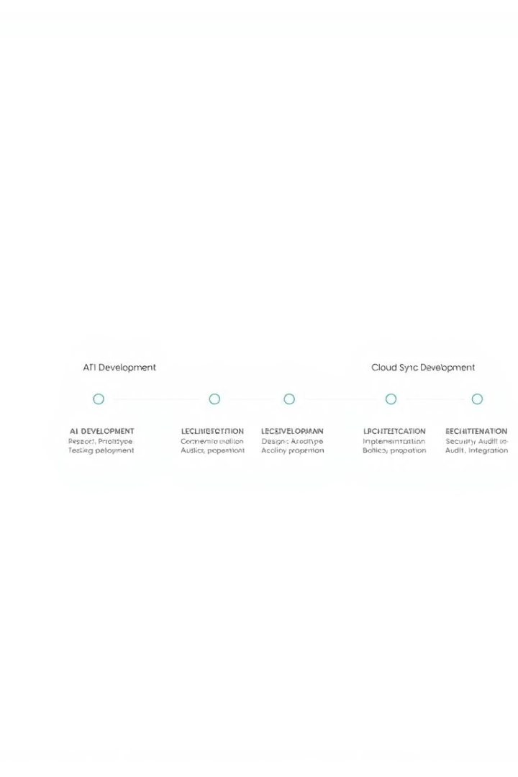
Future Work
Deep Learning
Mobile App
CNN for better accuracy
Android and iOS platforms
Cloud Sync
Integration with AWS and Azure

