Slide 1


Data analysis and visualization
(DAV)
Gantt plot
Łukasz P. Kozłowski
Warsaw, 2026
l.kozlowski@mimuw.edu.pl

Slide 2
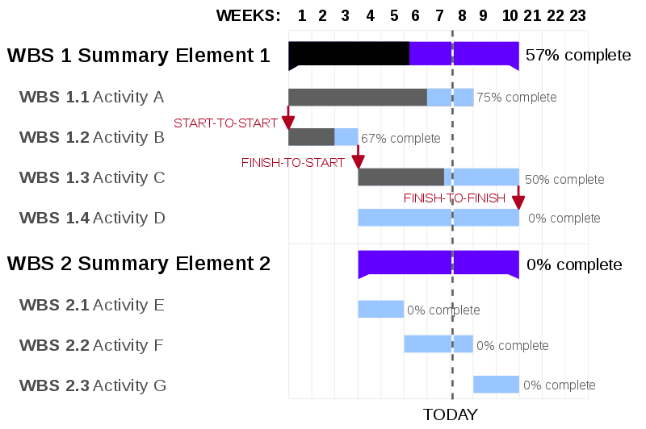
People
Gantt chart
Data analysis and visualization
Gantt charts were adapted by Karol Adamiecki in 1896. But the name comes from Henry Gantt who independently adapted this bar chart type much later, in the 1910s

Slide 3
People
Gantt chart
Data analysis and visualization
Gantt charts were adapted by Karol Adamiecki in 1896. But the name comes from Henry Gantt who independently adapted this bar chart type much later, in the 1910s
bar chart that illustrates a project schedule

Slide 4
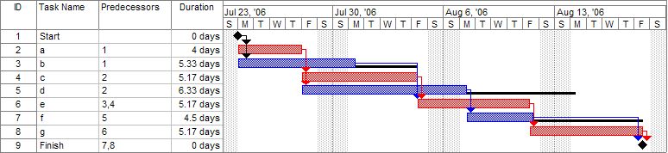
People
Gantt chart
Data analysis and visualization
Also can show the dependency relationships between activities and current schedule status

Slide 5
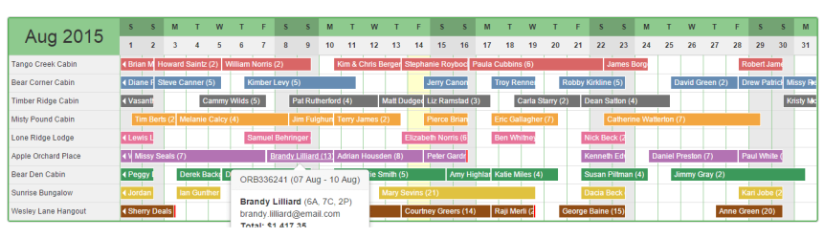
People
Gantt chart
Data analysis and visualization
Can also be used for instance for in rental businesses, displaying a list of items for rent (cars, rooms, apartments) and their rental periods
Minimum requirement: a start date and an end date of each event

Slide 6
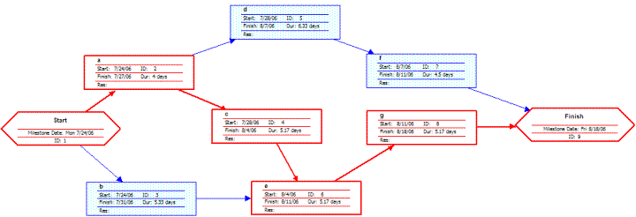
People
Gantt chart
Data analysis and visualization
Frequently, Gantt chart are used in parallel to network diagrams (that add another dimension i.e. the relationship between tasks

Slide 7
People
Gantt chart
Data analysis and visualization
- improve the project structure design
- should be updated if needed

Slide 8
People
Gantt chart
Data analysis and visualization
- improve the project structure design
- should be updated if needed
Unfortunetelly, many funding bodies / companies use it as definitive plan of the project and do not allow to any extensions or re-scheduling
but
if stage „N” relay on stage „N-1” and stage „N-1” is delayed because some unexpected, extra tasks, it is not possible to move to stage „N”, no matter how pretty your Gantt plot is*
* this means that you need to think about some extra time between critical milestones of the project (the more risky the project, the more extra task will appear e.g. science projects in novel areas are extreme examples of that

Slide 9
People
Gantt chart
Data analysis and visualization
In python:
matplotlib
https://www.geeksforgeeks.org/python-basic-gantt-chart-using-matplotlib/
Plotly
https://www.geeksforgeeks.org/python-basic-gantt-chart-using-matplotlib/
Additional packages (python-gantt)
http://www.clowersresearch.com/main/gantt-charts-in-matplotlib/

