Slide 1


STELLAR BUILDSTATION
B2B · PaaS
Web2 products. Web3 rails.
Built for businesses that will onboard millions of users.
ZEXVRO is a unified Web3 PaaS — private, verifiable, agent-ready infrastructure on Stellar,
so product teams ship capability without chain-first UX for their customers.
BUYER
Platforms · SaaS · Studios
OUTCOME
Scale users · monetize agents
RAILS
Stellar · APIs · Agents · Dashboard
ZEXVRO · Enterprise Web3 PaaS
01 / 14

Slide 2
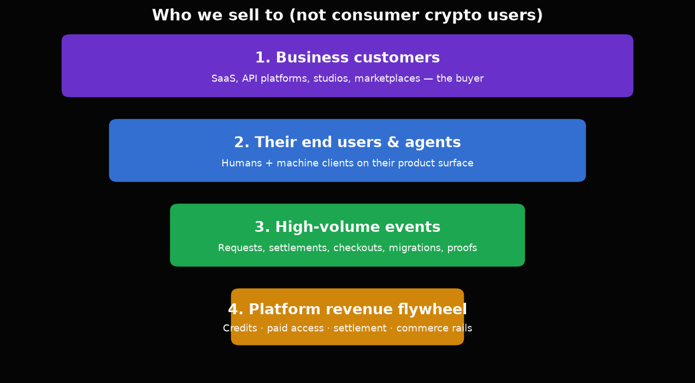
STELLAR BUILDSTATION
zexvro.in
Not consumer crypto users
We sell infrastructure to businesses. Their customers — humans and agents — create volume.
ENTERPRISE LENS
Why this matters
• One business customer can mean 10k–10M end users
• Agent traffic multiplies request volume overnight
• Paid access + settlement = real platform economics
• Privacy & proofs unlock B2B payment use cases
We optimize for seats that move money — not vanity wallets.
ZEXVRO · Enterprise Web3 PaaS
02 / 14

Slide 3
STELLAR BUILDSTATION
zexvro.in
The problem
Web2 teams want Web3 capability — without chain-first UX for their customers.
01
APIs can’t monetize machines
Agents hit free endpoints. No clean pay-per-request layer.
02
Migration is painful
Teams fear turning the product into a wallet tutorial.
03
Trust is broken
Platforms claim “ready” without status, proof, or honest limits.
04
Six products ≠ one story
Selling everything at once kills credibility with buyers.
ZEXVRO · Enterprise Web3 PaaS
03 / 14

Slide 4
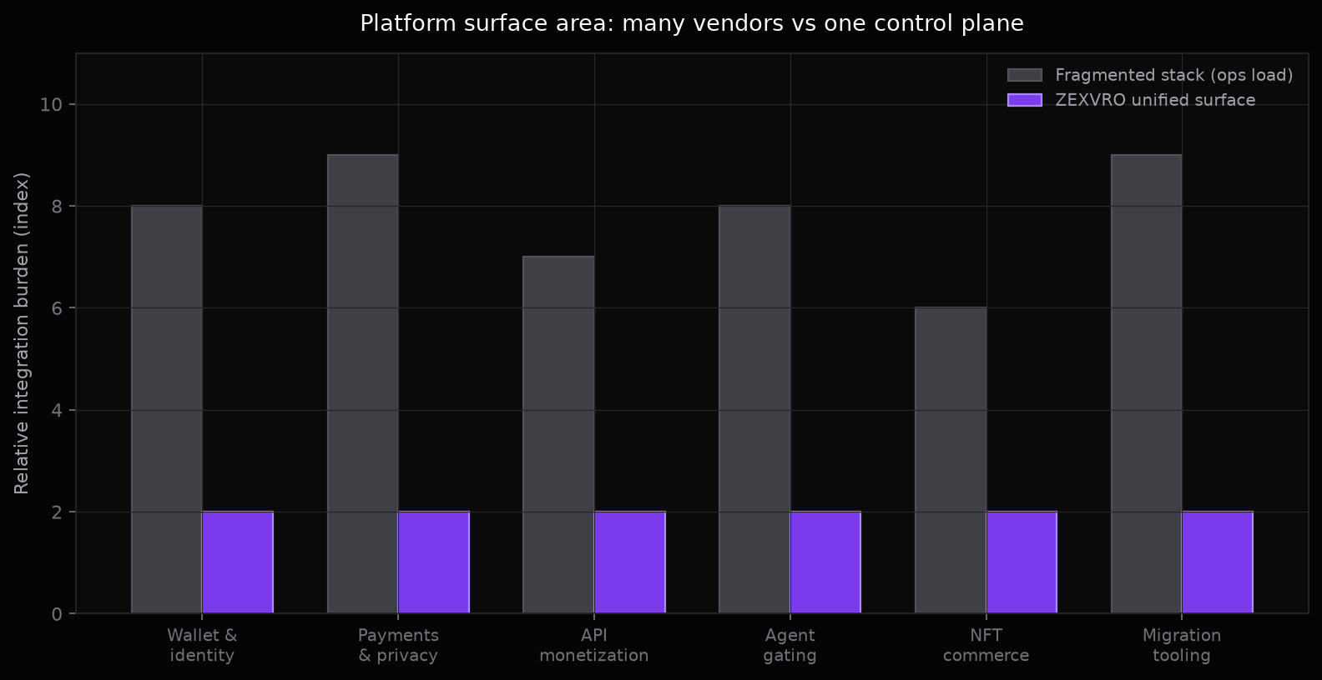
STELLAR BUILDSTATION
zexvro.in
Fragmented stack vs one control plane
Businesses don’t want six vendors for migration, identity, paywalls, privacy, and commerce.
ZEXVRO · Enterprise Web3 PaaS
04 / 14

Slide 5
STELLAR BUILDSTATION
zexvro.in
The solution
One developer-first platform for private, verifiable, agent-ready capability on Stellar.
01
Private
Settlement & proofs without exposing the full payment graph
02
Verifiable
Honest status, receipts, and limits — not vapor claims
03
Agent-ready
Classify, price, and unlock machine traffic cleanly
04
Product-first
Chain stays in infra — UX stays familiar for end users
ZEXVRO · Enterprise Web3 PaaS
05 / 14

Slide 6
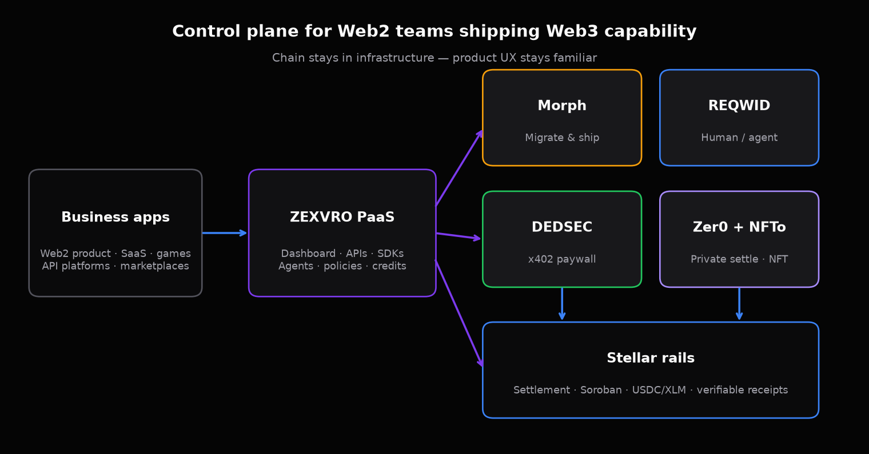
STELLAR BUILDSTATION
zexvro.in
Platform architecture
ZEXVRO · Enterprise Web3 PaaS
06 / 14

Slide 7





STELLAR BUILDSTATION
zexvro.in
Five MVP services. One platform story.
Each product is a revenue surface for the business — not a toy feature for hobby wallets.
Morph
Web2 → Web3 transformation agent
Migrate product capabilities without a chain tutorial for customers
Zer0
Private settlement with verifiable proof
B2B payments that settle privately — prove compliance without a public graph
NFTo
Embedded NFT infrastructure
Issue, manage, checkout inside product UX — scale creators & commerce
REQWID
Human vs agent identity layer
Gate access, price agent traffic, protect free tiers at platform scale
DEDSEC
x402 paid access for APIs & compute
HTTP 402 → pay → unlock. Monetize machine traffic before it becomes free-tier abuse
ZEXVRO · Enterprise Web3 PaaS
07 / 14

Slide 8
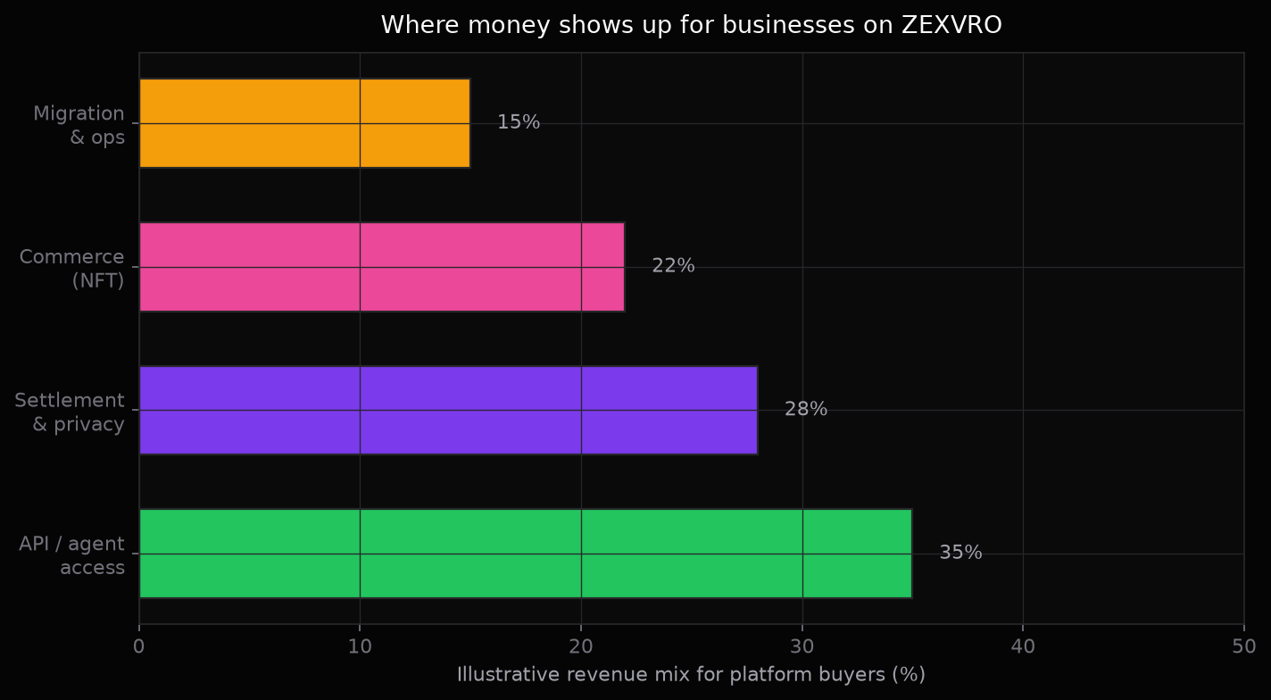
STELLAR BUILDSTATION
zexvro.in
How businesses make money on the rails
Illustrative mix — real pricing follows usage, not token hype.
UNIT ECONOMICS LENS
Volume compounds at the edge
1 business seat
→ N end users + agents
→ M billable events / day
→ credits, 402 unlocks, settlement, commerce
We design for platforms where one design partner can unlock more traffic than a thousand retail wallets.
ZEXVRO · Enterprise Web3 PaaS
08 / 14

Slide 9
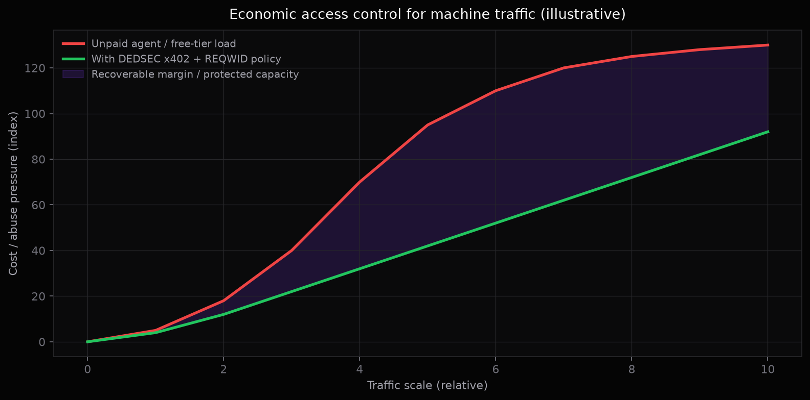
STELLAR BUILDSTATION
zexvro.in
Agent traffic is a business problem
DEDSEC (x402) + REQWID turn free-tier abuse into priced, policy-aware access.
ZEXVRO · Enterprise Web3 PaaS
09 / 14

Slide 10
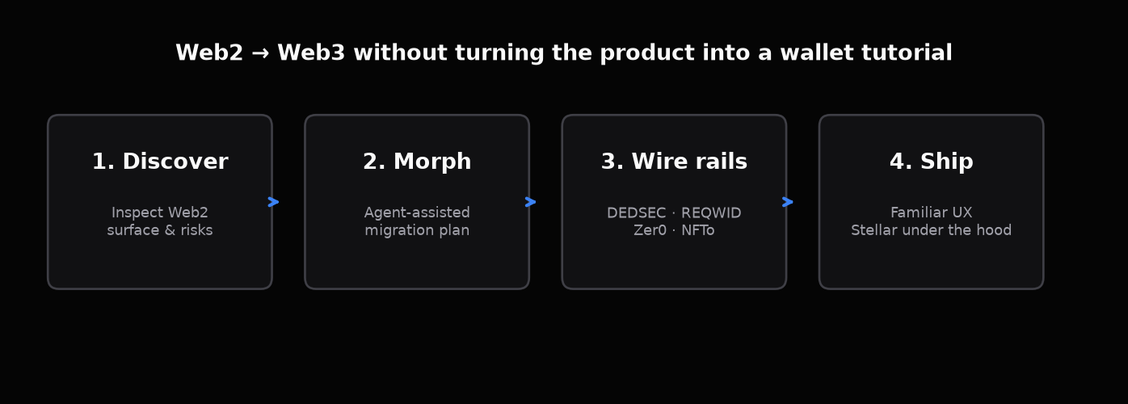
STELLAR BUILDSTATION
zexvro.in
Morph: Web2 → Web3 without the tutorial tax
Migration is a product workflow — not a multi-month chain consulting project.
Keep product UX
Customers stay in familiar flows — wallets optional, not the product.
Ship faster
Agent + MCP tooling shortens migration paths for real codebases.
Land revenue rails
Wire DEDSEC / REQWID / NFTo / Zer0 where the business model needs them.
ZEXVRO · Enterprise Web3 PaaS
10 / 14

Slide 11
STELLAR BUILDSTATION
zexvro.in
Business outcomes by service
Morph
Lower migration cost & time-to-Web3
Product teams ship capability without hiring a chain squad
Buyer impact → retention, margin, scale
Zer0
B2B private settlement
Prove payment without broadcasting the full commercial graph
Buyer impact → retention, margin, scale
NFTo
Embedded commerce
Collections & checkout inside the product — scale creators/users
Buyer impact → retention, margin, scale
REQWID
Trust at the edge
Price and route human vs agent traffic with honest confidence
Buyer impact → retention, margin, scale
DEDSEC
Monetize machine demand
HTTP 402 → pay → unlock. Capacity stops being free by default
Buyer impact → retention, margin, scale
ZEXVRO · Enterprise Web3 PaaS
11 / 14

Slide 12
STELLAR BUILDSTATION
zexvro.in
Why Stellar for business rails
Settlement-grade network for payments, agents, and product commerce — not a casino UI.
Fast settlement
Business workflows need confirmation that feels like software, not a waiting room.
Asset rails
USDC / XLM-style settlement where product money already lives.
Soroban programs
Programmable receipts, NFT collections, and paywall verification.
Agent-compatible
Machine clients can pay and prove without a browser-only wallet dance.
Enterprise posture
Clear ops surfaces: environments, proofs, status — claim-safe.
One story
Infrastructure under the product — buyers sell features, not chains.
ZEXVRO · Enterprise Web3 PaaS
12 / 14

Slide 13
STELLAR BUILDSTATION
zexvro.in
Proof points (claim-safe)
We show working surfaces — not vapor. Status matches product reality.
Product UI
Zer0 & NFTo product surfaces live in the console
DEDSEC path
Unpaid → HTTP 402 → payment verification path in progress
Morph
CLI + agentic migration track; demos (e.g. arcade / PromptWars)
REQWID / Gate
Human vs agent gate — classification & captcha surfaces shipping
Demos
Live product demos for migration & commerce narratives
Honesty rule
No “fully shipped” claims beyond documented status
ZEXVRO · Enterprise Web3 PaaS
13 / 14

Slide 14
Build with businesses that scale.
Thank you — let’s ship private, verifiable, agent-ready infrastructure.
Console
zexvro.in
Positioning
Web2 → Web3 PaaS
Network
Stellar
Contact
@zexvro.in
We don’t chase individual wallets. We equip platforms that will onboard the users — and the volume.
ZEXVRO · Stellar BuildStation · Confidential if needed
14 / 14

