Slide 1


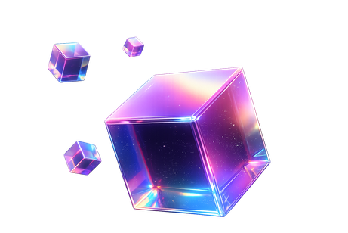
THE PROBLEM !?
STELLAR BUILDSTATION
@ZEXVRO.IN
HELLO :)
WEB2 TEAMS WANT WEB3 CAPABILITIES — WITHOUT CHAIN-FIRST UX.
1. APIs can’t monetize machine traffic — agents call endpoints; there’s no clean pay-per-request layer
2. Migration is painful — teams fear turning the product into a wallet/blockchain tutorial
3. Trust is broken — platforms claim “ready” without status,
proof, or honest limits
4. Six products ≠ one story — selling everything at once kills credibility
Core tension: Capability is needed. Chain should stay in infrastructure — not the interface.

Slide 2


THE PROBLEM !?
HELLO :)
WEB2 TEAMS WANT WEB3 CAPABILITIES — WITHOUT CHAIN-FIRST UX.
1. APIs can’t monetize machine traffic — agents call endpoints; there’s no clean pay-per-request layer
2. Migration is painful — teams fear turning the product into a wallet/blockchain tutorial
3. Trust is broken — platforms claim “ready” without status,
proof, or honest limits
4. Six products ≠ one story — selling everything at once kills credibility
Core tension: Capability is needed. Chain should stay in infrastructure — not the interface.

Slide 3


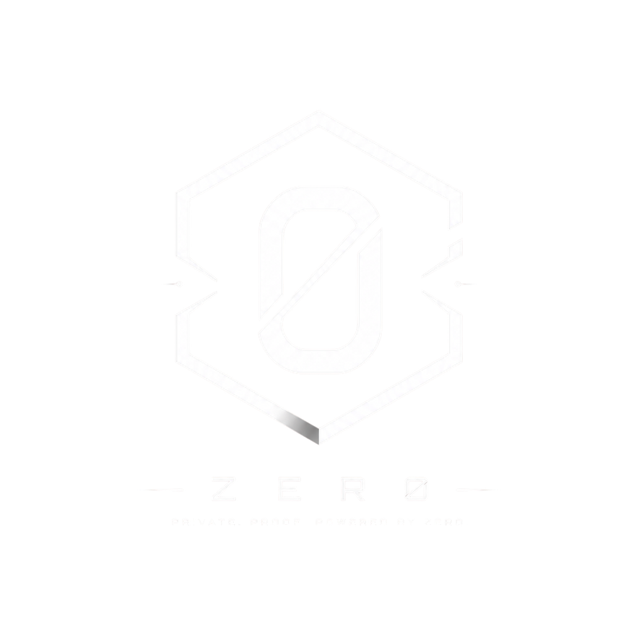



THE PROBLEM !?
WEB2 TEAMS WANT WEB3 CAPABILITIES — WITHOUT CHAIN-FIRST UX.
1. APIs can’t monetize machine traffic — agents call endpoints; there’s no clean pay-per-request layer
2. Migration is painful — teams fear turning the product into a wallet/blockchain tutorial
3. Trust is broken — platforms claim “ready” without status,
proof, or honest limits
4. Six products ≠ one story — selling everything at once kills credibility
Core tension: Capability is needed. Chain should stay in infrastructure — not the interface.
Zexvro
is a developer-first infrastructure platform
that helps Web2 product teams add private, verifiable, and agent-ready capabilities on Stellar — while keeping the product experience familiar.

Slide 4
Zexvro
MORPH
Web2-to-Stellar migration tooling.
Helps teams move product capabilities onto,
Stellar rails without turning the app into a chain tutorial.
is a developer-first infrastructure platform
that helps Web2 product teams add private, verifiable, and agent-ready capabilities on Stellar — while keeping the product experience familiar.

Slide 5
Zexvro
MORPH
Zer0
is a developer-first infrastructure platform
that helps Web2 product teams add private, verifiable, and agent-ready capabilities on Stellar — while keeping the product experience familiar.
Web2-to-Stellar migration tooling.
Helps teams move product capabilities onto,
Stellar rails without turning the app into a chain tutorial.
Private settlement with verifiable proof.
Businesses can settle and prove payments
without exposing the full payment graph.

Slide 6
MORPH
Zer0
NFTo
Web2-to-Stellar migration tooling.
Helps teams move product capabilities onto,
Stellar rails without turning the app into a chain tutorial.
Private settlement with verifiable proof.
Businesses can settle and prove payments
without exposing the full payment graph.
Embedded NFT infrastructure for products and creators
issue, manage, and checkout NFTs inside normal product UX instead of a wallet-first flow

Slide 7
Zer0
NFTo
REqWId
Private settlement with verifiable proof.
Businesses can settle and prove payments
without exposing the full payment graph.
Embedded NFT infrastructure for products and creators
issue, manage, and checkout NFTs inside normal product UX instead of a wallet-first flow
Identity layer for human vs agent access
so products can know who (or what) is calling them and apply the right rules

Slide 8
NFTo
REqWId
Dedsec
Embedded NFT infrastructure for products and creators
issue, manage, and checkout NFTs inside normal product UX instead of a wallet-first flow
Payment-aware access for APIs. An unpaid GET/HEAD request gets an HTTP 402 challenge; after supported Stellar-testnet payment verification, one request is unlocked
Identity layer for human vs agent access
so products can know who (or what) is calling them and apply the right rules

Slide 9
REqWId
Dedsec
Payment-aware access for APIs. An unpaid GET/HEAD request gets an HTTP 402 challenge; after supported Stellar-testnet payment verification, one request is unlocked
Identity layer for human vs agent access
so products can know who (or what) is calling them and apply the right rules

Slide 10
THANKYOU

