Slide 1
Pixie
A System for Recommending 3+ Billion Items to 200+ Million Users in Real-Time used in Pinterest

Slide 2
What is Pinterest?
Pinterest is a visual catalog with several billion pins, which are visual bookmarks containing:
a description
a link
an image or a video

Slide 3
What is Pinterest?
Users at Pinterest view pins and curate them into collections called boards.
A single pin can be saved by thousands of users into tens of thousands of different boards.
This curation captures the multi-faceted relationships between objects.
Think of Pinterest as a giant human curated bipartite graph of 7 billion pins and boards, and over 100 billion edges.

Slide 4
The main problems
Provide personalized, engaging, and timely recommendations from a pool of 3+ billion items to 200+ million monthly active users.
Recommendations have to be calculated on demand and in real-time.

Slide 5
Why on demand?
Users prefer recommendations responsive to their behavior.
The system can instantaneously react to changes in user behavior and intent.
Recommendations for all users would have to be precomputed and materialized on a daily schedule.
Total number of registered users is usually much larger than the number of daily active users
Time and resources would be wasted updating recommendations for inactive users.

Slide 6
Present work: Pixie

Slide 7
What is Pixie?
Pixie, a scalable real-time graph-based recommendation system deployed at Pinterest.
Pins recommended by Pixie represent more than 80% of all user engagement at Pinterest.

Slide 8
What is Pixie?
Pixie uses the bipartite graph of pins and boards to generate recommendations.
As a user interacts with pins Pixie creates a query (Q) set of pins each with its own weight.
The query set is user-specific and changes dynamically.
It can contain most recently interacted pins as well as pins from longtime ago.
Pixie Random Walk algorithm is used given a query (Q).
Because the walk visits both boards as well as pins both types of objects can be recommended to the User.

Slide 9
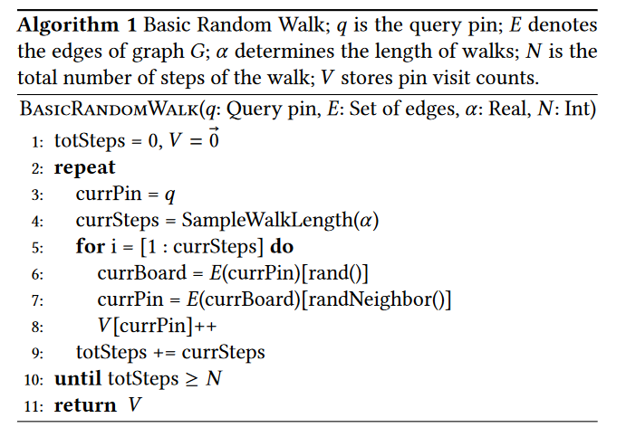
Pixie Random Walk Algorithm
It start with a simplified random walk algorithm.
Then transforms, step by step, into Pixie.

Slide 10
Pixie Random Walk Algorithm
Biased in a user-specific way.
for example, based on the topic and language of the user.
Allows for multiple query pins with different importance weights.
Helps capture entire context of the user’s previous behavior.
Combines results from multiple independent random walks
it rewards recommendations that are related to multiple query pins.
In combinations with (2) this leads to more relevant recommendations.
Uses special convergence criteria which allows for early stopping.
This is crucial for achieving real-time performance and throughput.

Slide 11
Biasing the Pixie Random Walk
Changes the random edge selection to be biased based on user features.
The set of user features U are passed as an input to the process along with the query pins.
Selects edges with PersonalizedNeighbor(E,U) to prefer edges important for user (U).
This allows to bias the walk in a user specific way but with minimal storage as well as computational overhead.

Slide 12


Multiple Query Pins with Weights
Pixie makes recommendations based on multiple input query pins, not just a single pin.
The number of steps required to obtain meaningful visit counts depends on the query pin’s degree.
A high-degree query pin that occurs in many boards requires many more steps than from a pin with a small degree.
A function is used that increases sub-linearly with the query pin degree and scale the per pin weights (Wq) by a scaling factor (Sq) .
Q is the scaling factor for a query pin q∈Q
|E(q)|is the degree of q
C=max p∈P|E(p)|is the maximum pin degree.
Using the scaling factor, the number of steps Nq allocated to a query starting from pin q with weight Wq is given by:

Slide 13
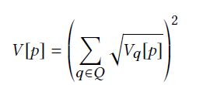
Multi-hit Booster
Candidates with high visit counts from multiple query pins are considered more relevant to the query than candidates that may have an equally high visit count but where all of those visits come from a single query pin.
V[p] is the combined visit count for pin p.
A query with four initial query pins. If the visit counts are [16,0,0,0] then the combined visit score will be 16.
If the visit counts are [4,4,4,4] then the combined visit score will be (2+2+2+2)^2 = 64.

Slide 14
Early Stopping
The user is waiting, so faster response times are much better.
Once a set of top candidate pins has become stable, Pixie terminates the random walking early.
When at least Np candidate pins have been visited at least Nv times.
Early stopping produces almost the same results, but in about half the number of steps.
Thus it speeds up the algorithm by a factor of 2.

Slide 15
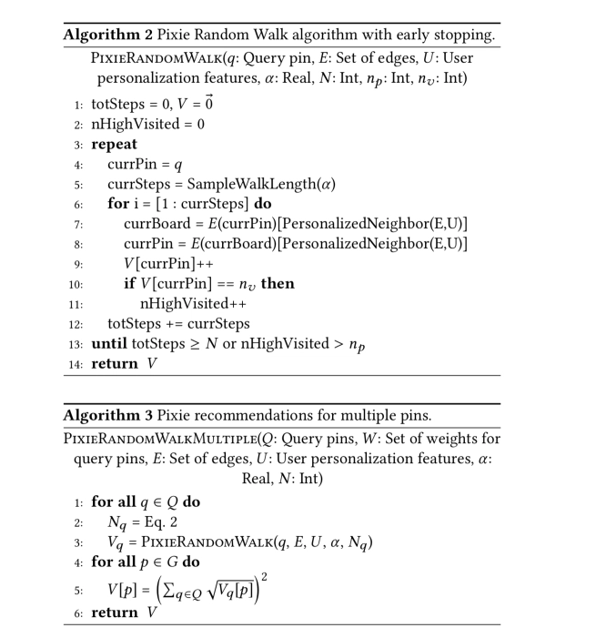
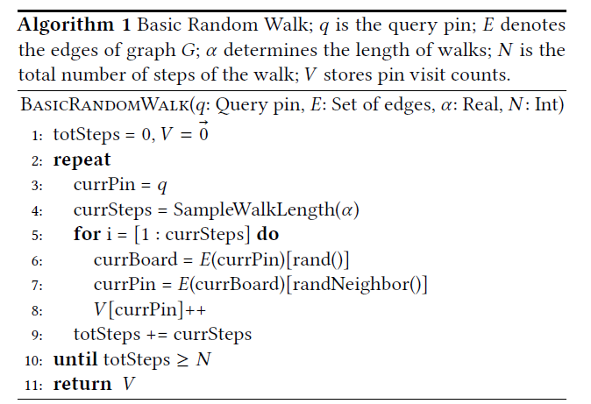

Slide 16
Graph Pruning
The original Pinterest graph has 7 billion nodes and over 100 billion edges.
Not all boards on Pinterest are topically focused.
Large diverse boards diffuse the walk in too many directions which leads to low recommendation performance.
Many pins are mis-categorized into wrong boards.
The graph pruning procedure cleans the graph and makes it more topically focused.

Slide 17
Graph Pruning
LDA topic models are run on each pin description in a board to obtain topic vectors.
Boards with high entropy in topic vectors are removed from the graph, along with all their edges.
Pin with very high degree are also pruned via selective edge removal.
This discards edges connecting to boards where there is low cosine similarity between the topic vector of the pin and the board.
The pruned graph has approximately 1 billion boards, 2 billion pins, and 17 billion edges and is decreased by a factor of 6.
It is shown to be 58% more relevant to the user.

Slide 18
LDA Topic Modeling
Assume there are k topics across all of the documents
Distribute these k topics across document m (this distribution is known as α and can be symmetric or asymmetric, more on this later) by assigning each word a topic.
For each word w in document m, assume its topic is wrong but every other word is assigned the correct topic.
Probabilistically assign word w a topic based on two things: - what topics are in document m - how many times word w has been assigned a particular topic across all of the documents (this distribution is called β, more on this later)
Repeat this process a number of times for each document and you’re done!

Slide 19
Implementation
For each node edges are stored in an adjacency list, and the adjacency lists are concatenated into one contiguous edgeVec array.
Visit counts are maintained in open addressing hash table with linear probing.
The number of steps N provides an upper bound on the number of keys the hash table needs to support
To avoid resizing an array of size N is conservatively allocated at the outset.

Slide 20
Implementation
The pruned graph is generated by a Hadoop pipeline followed by a graph compiler.
The graph compiler runs on a single terabyte-scale RAM machine and outputs a pruned graph in binary format.
Graph generation is run once per day. Loading the graph binaries takes ≈10 minutes.
Linux HugePages is used to increase each vm page from 4 KB to 2 MB decreasing the number of page table entries needed by a factor 512.
This enabled Pixie on virtual machines to serve twice as many requests at half the runtime.

Slide 21
Implementation
Pixie is deployed on Amazon AWS r3.8xlarge machines with 244GB of RAM.
The pruned Pinterest graph fits into about 120GB of main memory. This means that:
The random walk does not have to cross machines, bringing huge performance benefits
Queries can be answered in real-time and multiple walks can be executed on the graph in parallel
Pixie can be scaled and parallelized by simply adding more machines to the cluster.

Slide 22
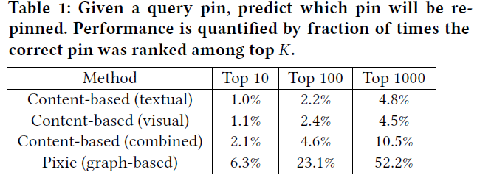
Results
Ranking the most related pin
Pixie gives much better performance of recommendations and is able to predict which of the pins is most related to the query pin for all values of K.

Slide 23
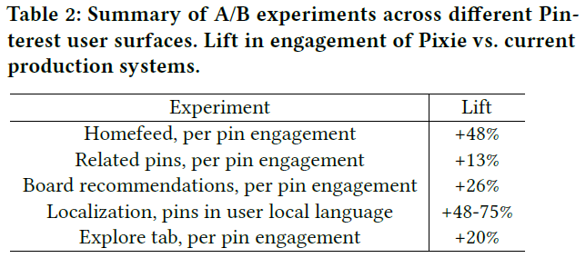
Results
Results of A/B experiments
A random set of users experiences Pixie recommendations, while other users experience recommendations given by the old Hadoo-based production system that precomputes recommendations and is not real-time.

Slide 24
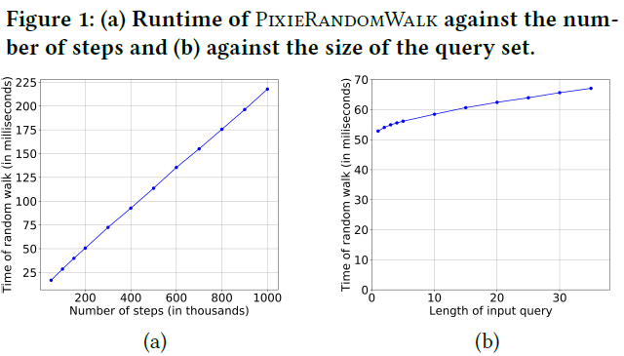
Results
Pixie Runtime
During random walks from a query pin, the cache gets warmed with the neighborhood around the pin.
When the walks are started from a different query pin, the cache becomes cold and needs to be warmed again.

Slide 25
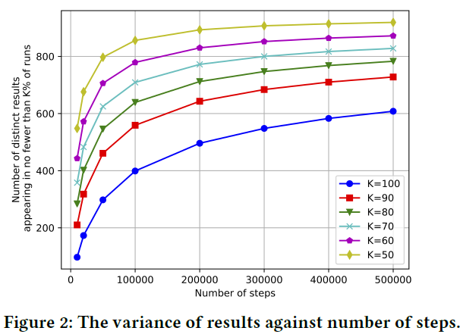
Results
Variance of Top Results
Several hundred thousand steps are enough to obtain a stable recommendation set and increasing the number of steps beyond it does not help much.

Slide 26
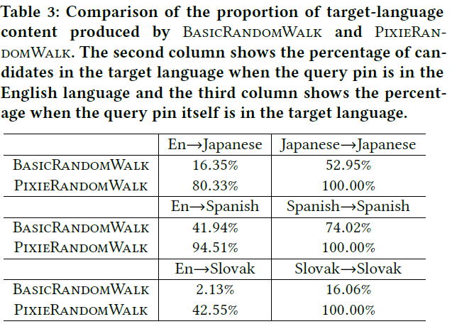
Results
Evaluation of the Biased Walk
Pixie Random Walk significantly boosts the target-language content in the query responses.

Slide 27
Results
Early Stopping
Pixie algorithm terminates random walks after np pins reach a visit count of nv .
Thus nv acts as a minimum threshold of visit counts that the pins in the recommendation set have to meet
np denotes the minimum number of pins that reach this threshold before we stop the walks.
Lower values of np and nv lead to lower running time but potentially also unstable recommendation results.
Choosing parameters np = 2, 000 and nv = 4, achieves a good similarity with the gold-standard set of results(84%) improving the runtime for a factor of three.

Slide 28
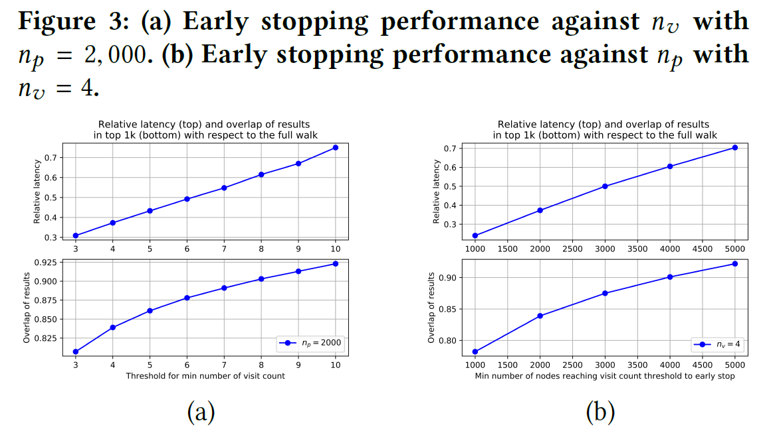

Slide 29
Results
Evaluating Graph Pruning
Figure 4 shows that when = 0.91, the F1 score peaks at 58% above the unpruned graph F1 and the graph contains only 20%the original number of edges.
This means that the graph pruning actually improves the quality of recommendations by 58%, while also pruning the graph to only a sixth of its size.
Figure 5 shows that as the size of the graph decreases, both the memory as well as the Pixie RandomWalk runtime decrease significantly.

Slide 30
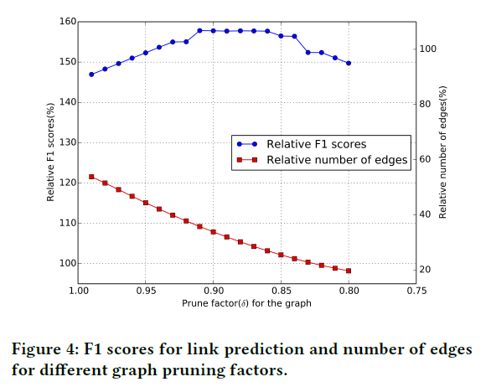
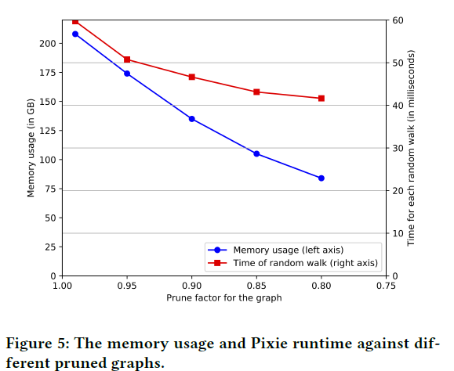

Slide 31
Conclusion
At 99%-ile latency Pixie takes 60ms to produce recommendations,
a single Pixie server can serve about 1,200 recommendation requests per second.
The overall cluster servers around 100,000 requests per second

Slide 32
Conclusion
Thanks to the high performance, scalability, and generic nature of the Pixie architecture and algorithms, a bright future with new algorithms and graphs is anticipated
Featuring novel node types and edge definitions for even more applications at Pinterest.

Slide 33
The end

