Slide 1
OpenCCFinder: A code clone search tool for open source repositories
Pei Xia
Sep 8,2011

Slide 2
Outline
Background
Overview of OpenCCFinder
Sample Query and Results
Discussion

Slide 3
Background
Open source repositories are growing fast
Google code, Koders, sourceforge …
Many developers reuse codes from existing open source projects
But many problems happen
License issues : Illegally reuse?
Reused old code: Old codes may cause bugs.

Slide 4
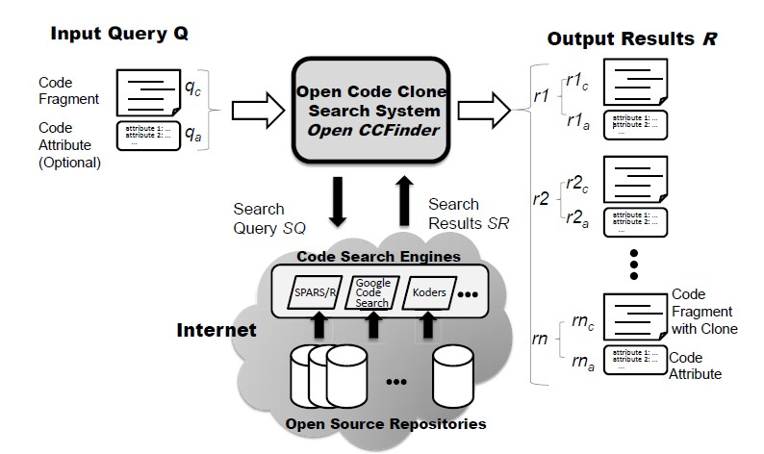
Overview of OpenCCFinder(1/2)

Slide 5
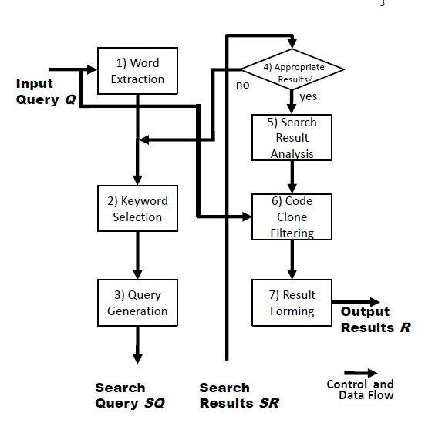
Overview of OpenCCFinder(2/2)

Slide 6
Get Appropriate cadidates (keywordsList)
Cadidates = ɸ;
CurrentKeywords = ɸ;
While IsAppropriateCadidates==false //Judged by human
cadidatesOfLoop = ɸ;
While Size(cadidatesOfLoop)>MaxResultsNumber || Size(cadidatesOfLoop)==0
CurrentKeywords = CurrentKeywords U keywordsList.nextKeyword
cadidatesOfLoop = results that searched with CurrentKeywords ;
End while
Cadidates = Cadidates U cadidatesOfLoop
CurrentKeywords = ɸ;
End while

Slide 7
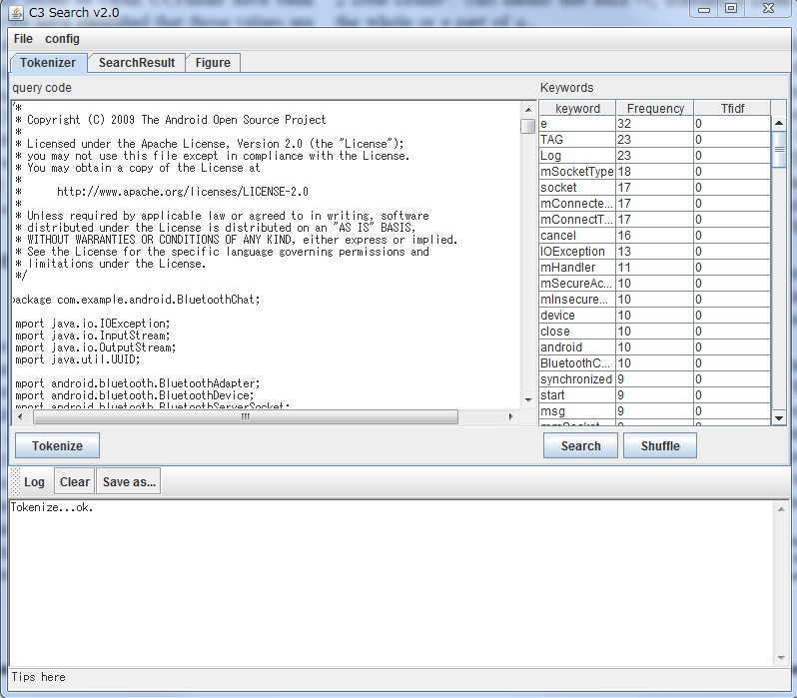
Sample Query and Results(1/4)
Input query
BluetoothChatService .java, Sample codes of Android
Language: java

Slide 8
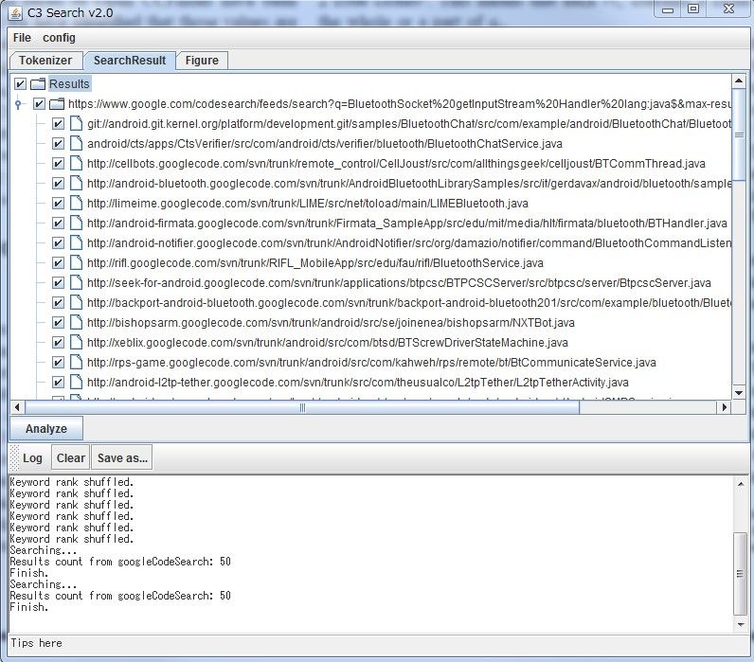
Sample Query and Results(2/4)
Input query
BluetoothChatService .java, Sample codes of Android
Language: java
Search for candidates

Slide 9
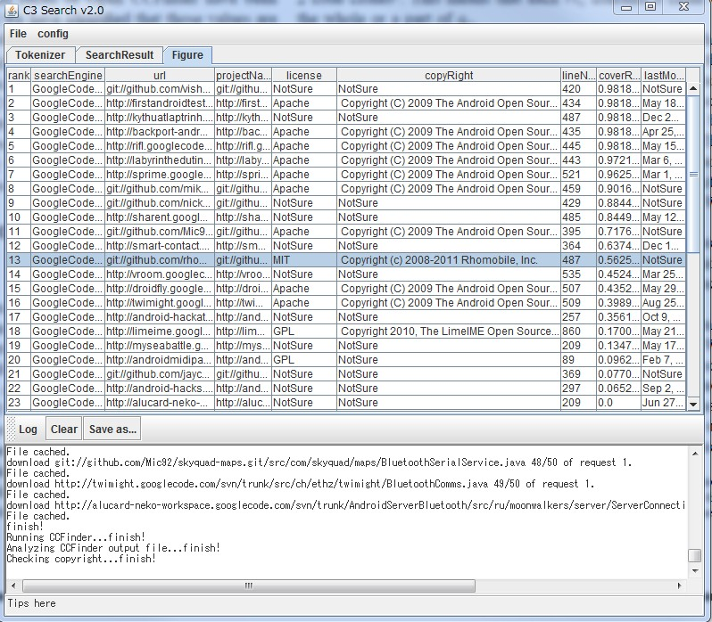
Sample Query and Results(3/4)
Input query
BluetoothChatService .java, Sample codes of Android
Language: java
Search for candidates
Analysis results
Url
License
Copyright
Loc
coverRatio
Last modified time

Slide 10
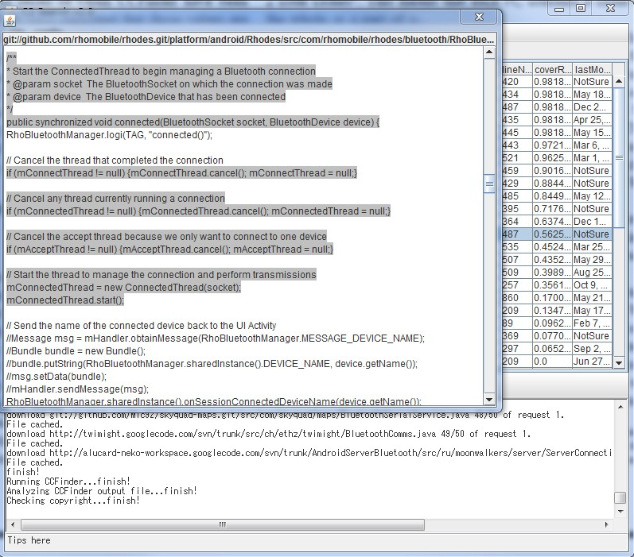
Sample Query and Results(4/4)
Input query
BluetoothChatService .java, Sample codes of Android
Language: java
Search for candidates
Analysis results
Url
License
Copyright
Loc
coverRatio
Last modified time
View cloned codes

Slide 11
Discussion
Recall and Precision
Performance
“Tools can find only evidence, no proof”

