Slide 1
License Plate Recognition
By: Tyler Boraski
CSCI Major/Math Minor
Clark University
12/14/12

Slide 2
Goal
To be able to read characters off a license plate from a webcam feed.
This is a difficult problem for computers, because they can’t read words like we do.
I simply wanted to challenge myself to see if I could actually do it.

Slide 3
Overview
Two step system
License plate locator
Uses color edge detection to find a Massachusetts license plate.
Character reader
License plate is cropped and sent through Tesseract.

Slide 4
Methods
License Plate Locator
Get image from web feed
Image is converted to HSV
Image is then run through a Sobel filter
If there are teal edges in the resulting image, then we have a license plate candidate.

Slide 5
Methods
Character recognizer
Once our license plate candidate is found, we try to crop it out of the image.
This is then sent through Tesseract-OCR
Hopefully, the string of the license plate is then returned.

Slide 6
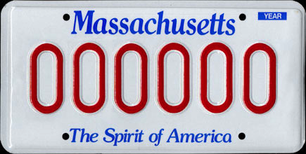
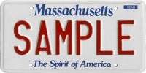
Experiments
I found two sample license plates online to test my program.
I simply moved them both around my webcam feed to see how well it worked.

Slide 7
Results
It works!!!!.....sorta
Tesseract is VERY sensitive to it’s input image.
It produces incorrect results the majority of the time.
But, it CAN produce correct results, which is a step in the right direction.

Slide 8
Resulting Limitations
Edge detection only works if license plate is still or almost still.
Tesseract only produces the correct output when the license plate is held a certain distance from the webcam.

Slide 9
Conclusion
This is a much more difficult task that I had imagined.
The locator module is what is causing Tesseract to output weird strings.
If rewritten using contours and connected-component analysis, the result can be greatly improved.
Time for a demo!

