Slide 1
Lee Nackman - Biography
IBM
  VP, Application Development Tools (’00-now)
    Compilers (C/C++, Fortran, PL/1, Cobol) and Java JITs
    Enterprise and Web application development tools
  Dir. Architecture, Application & Integration Middleware (’98-’00)
    Initiated IBM’s Eclipse effort
  Thomas J. Watson Research Center (’82-’98)
    Robotics; 3D Solid Modeling; Finite Element Mesh Generation
    Programming environments; compilers; application development tools
    Co-author of: Scientific and Engineering C++: An Introduction with Advanced Techniques and Examples, Addison-Wesley, 1994
Education
  B.Sc., Computer Science, Brown Univ., 1976
  Ph.D., Computer Science, Univ. N. Carolina at Chapel Hill, 1982

Slide 2
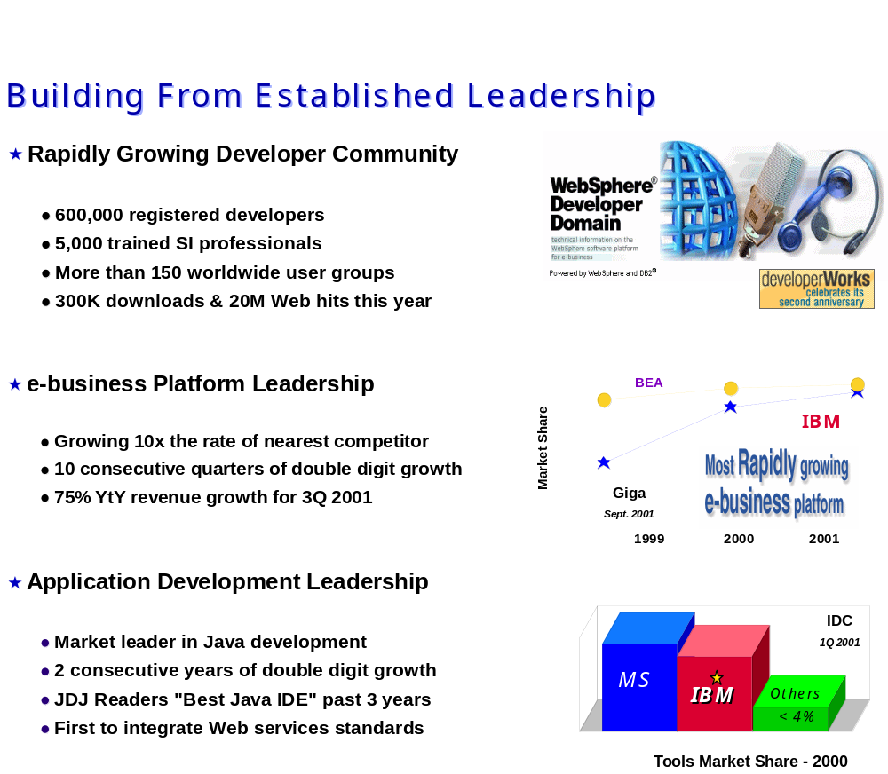
WebSphere e-Business Platform

Slide 3
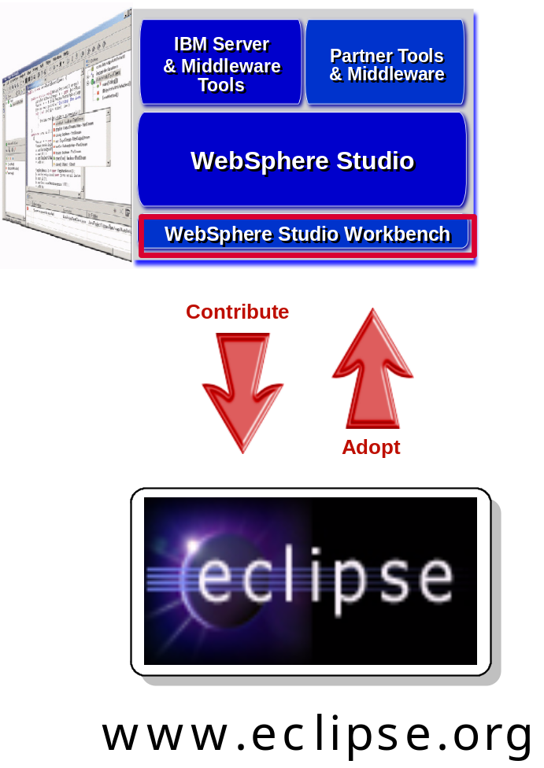
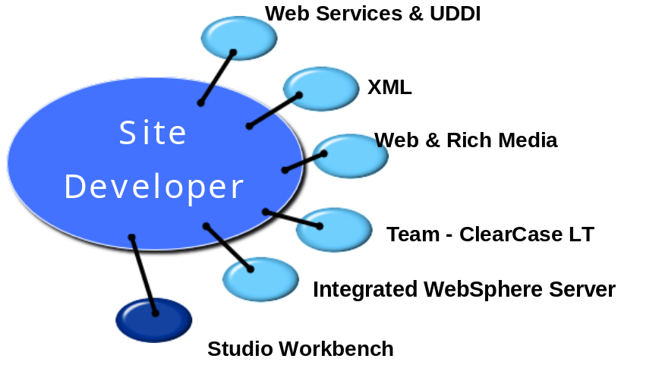
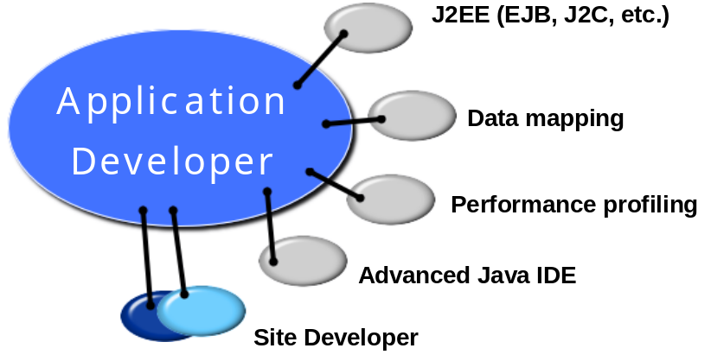
WebSphere Studio Products

