Slide 1

Dave Bernstein
BSEE MIT, 1973
Data General, 1972 – 1981
  CPU designer & programmer
  Led CPU, operating system, & compiler development teams
Rational Software, 1982 – present
  Led the Rational Environment development team
  Led the Rational Rose development team
  Lead Rational’s Product Group

Slide 2





The Rational Solution
Best Practices
Process Made Practical
Tools
Unified Tools for the Project Team
Customer Success
Develop Iteratively
Manage Requirements
Use Component Architectures
Model Visually (UML)
Continuously Verify Quality
Manage Change
Requirements Management
Visual Modeling
Automated Testing
Content Management
Change Management
Services
Accelerated Implementation
Technical Support and
Tools Application
Project Implementations
Education and Training
Rational Developer Network
Notes:
How do our customers overcome the software development paradox?
Several factors contribute to the success of a software project. First, at the heart of the solution, are the people you hire to build software. Now, Rational can't can't help you in that area. But the three other factors -- the process those those teams follow, the skills they use to do their jobs, and the tools they employ-- are all very critical areas in which Rational can provide assistance.
It’s the synergy of all three of these critical success factors that enable our customers to produce higher quality software in less time.

Slide 3
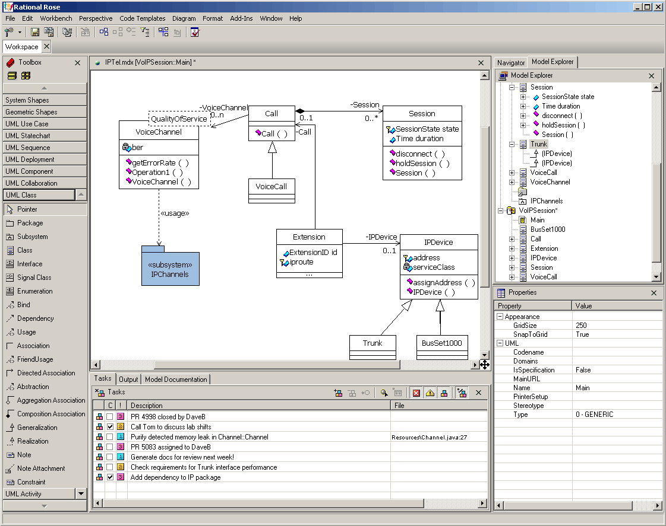
Rational’s Vision for Eclipse

