Slide 1

SuSE LINUX AG
and the Eclipse Platform
29 November 2001
Juergen Geck, VP Technology Partners, SuSE Linux AG

Slide 2
Introduction
Juergen Geck
Born in 1967
Studied mechanical engineering in Erlangen/Germany
worked on x-ray machine projects at the university, programming image processing and machine control components in C++
Founded a company doing project work on x-ray machines for e.g. multi-layer PCB testing, structural analysis of bones etc.
Migrated into SuSE …
Juergen Geck at SuSE
Joined SuSE in 1997
Started managing alliance accounts in 1998
Responsible for all Strategic Alliances in SuSE since 1999
Became appointed head of the Technology Partners Business Unit in 2001
contact
Juergen Geck, gecko@suse.de

Slide 3
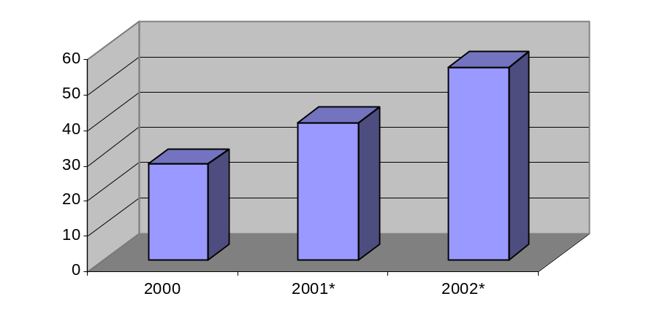
SuSE Linux AG- Key Facts
The Company
Founded in 1992
The European No. 1 in Linux
Headquartered in Nuremberg, subsidiaries in Czech Republic, Italy,
Mexico, South Africa, United Kingdom and USA
ca. 370 employees worldwide
The Business
Preferred Linux operating system among leading
IT companies like IBM, Intel, Compaq, AMD, FSC,
SAP, and Oracle
First enterprise Linux with maintained interfaces for at least two years – “SuSE Linux Enterprise Server”
First true x-platform Linux
Strong revenue growth
Revenue Development
(Forecast, in million Euro)
27,2
42
60

Slide 4
The Eclipse Platform and SuSE Linux
The Synergies
Eclipse will conquer hardware and OS platforms
Eclipse supports Windows, Unix and Linux
Eclipse is available for SuSE Linux – now!
The Eclipse Platform gets built automatically on all hardware architectures supported by SuSE Linux. The Intel Architecture version is already released, others will follow. The rpms will continue to show up for download on eclipse.org – up to date and well maintained
The Eclipse platform will
Allow programmers to run projects on their native setups
Allow programmers to migrate their projects smoothly to Linux
Substantially ease porting applications to hardware architectures running SuSE Linux
and through all this increase the amount of applications available on Linux dramatically ☺

Slide 5
The Eclipse Platform and SuSE Linux
The Synergies - why is it import
Linux provides a means of consolidating hardware platforms through one common OS
SuSE Linux provides a Linux version for all relevant hardware platforms,
e.g. all four IBM eServer platforms, Sparc
Eclipse based tools will be available on these platforms
The Benefits
Easy access for programmers
One working environment for all hardware architectures

