Slide 1

gitflow
A smart workflow with git
Igal Tabachnik
@hmemcpy

Slide 2







Thank you
our sponsors

Slide 3

special thanks to endjin!
Strategy
Strategic Development
Enterprise Backlog Shaping
Facilitation
endjin
work smarter
Creative
Branding
Communication
Digital
Development
Application Development
Application Lifecycle Management
Process & Engineering Practices
Cloud
Platform Migration
Scale & Performance
Grid Computing

Slide 4

contents
git
A BRIEF INTRODUCTION TO GIT
gitflow
WHAT IS IT?
WHAT PROBLEMS DOES IT SOLVE?
HOW DO I USE IT?
q&a
ANSWERING YOUR QUESTIONS

Slide 5
git
Designed to solve problems
“
I'm an egotistical bastard, and I name all my projects after myself.
First 'Linux', now 'git'.
Linus Torvalds
Creator of Linux & Git
Based on experience of maintaining a large, complex, distributed project
Does not require centralized server
Gives developer local copy of entire repo
Simplifies branching, merging & reviewing
Does not get slower as the project grows
”

Slide 6
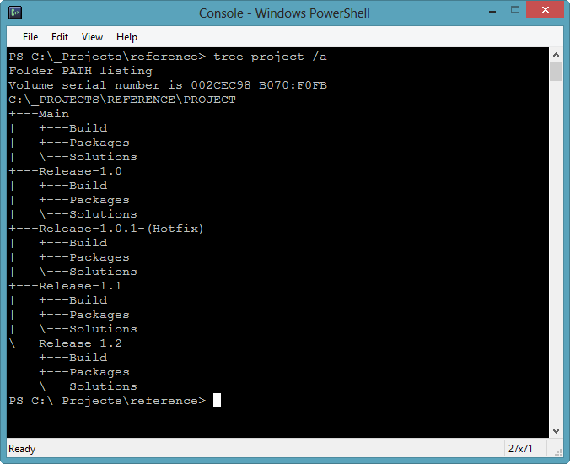
git
Traditional Branching
VSS, SVN, TFS: branches are parallel – they sit side by side on your file system
With each new branch you pay a branching tax
Result = avoid branching at all costs

Slide 7
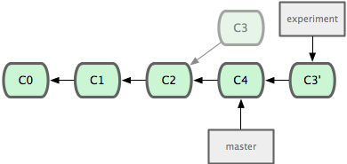
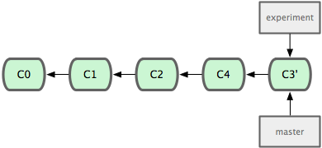
git
Git Branching
Git doesn’t use deltas or changesets – it uses snapshots
A branch in Git is simply a lightweight movable pointer to a commit
A branch is actually a SHA1 checksum of the commit
A new branch = writing 41 bytes to a file

Slide 8
gitflow
a branching model
for a release cycle

Slide 9
gitflow
Getting Started…
Or
Download getopt.exe & libintl3.dll from util-linux-ng for Windows and copy to C:\Program Files (x86)\Git\bin.
Install git-flow-dependencies from Chocolatey:
cinst git-flow-dependencies
$ git clone --recursive git://github.com/nvie/gitflow.git
$ cd gitflow
Run "contrib\msysgit-install.cmd" as Administrator

Slide 10
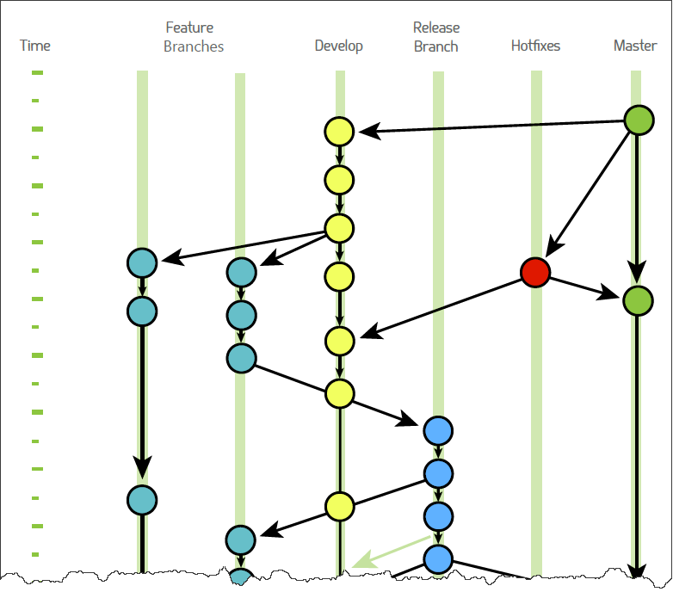
gitflow
>git flow init [-d]
master (production)
hotfixes
release branches
develop
feature branches

Slide 11
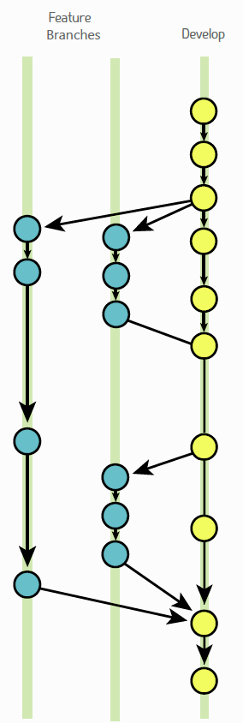
gitflow
>git flow feature start
Translates to:
> git branch feature/<name>
> git checkout feature/<name>

Slide 12
gitflow
>git flow feature finish
Translates to:
> git checkout develop
> git merge -–no-ff “<name>”
> git branch -d <name>

Slide 13
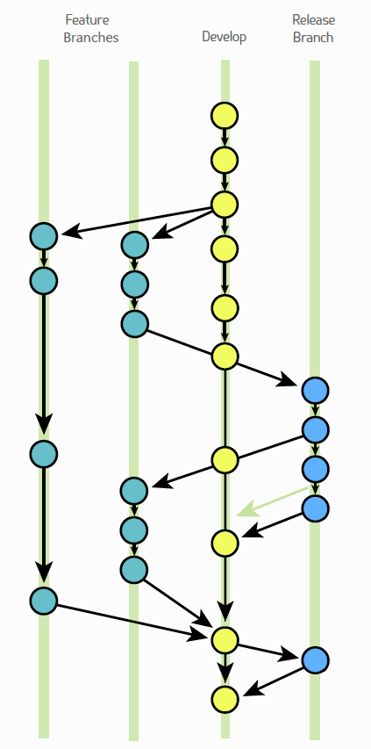
gitflow
>git flow release
git flow release start <version>
git flow release finish <version>
git flow release publish <name>
git flow release track <name>

Slide 14
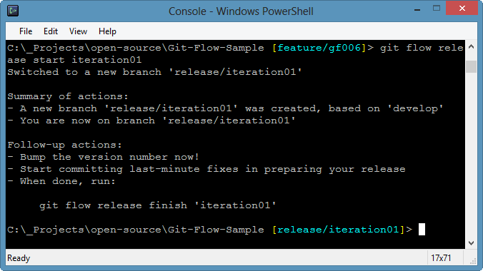
gitflow
>git flow release start
git flow release start <version>
git flow release finish <version>
git flow release publish <name>
git flow release track <name>

Slide 15
gitflow
>git flow release finish
git flow release finish -F -p Version_1.0
Translates to:
> git checkout master
> git fetch origin master
> git merge –no-ff Version_1.0
> git tag -a Version_1.0
> git push origin master
> git checkout develop
> git fetch origin develop
> git merge –no-ff Version_1.0
> git push origin develop
> git branch –d Version_1.0

Slide 16
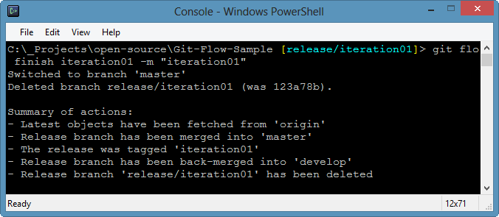
gitflow
>git flow release finish

Slide 17
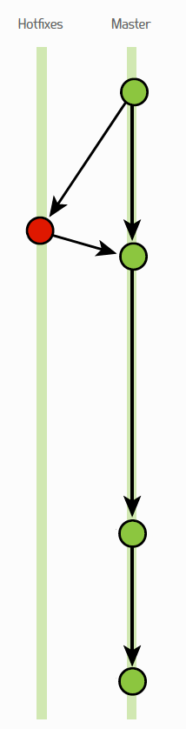
gitflow
>git flow hotfix
git flow hotfix start <version>
git flow hotfix finish <version>
git flow hotfix publish <version>
git flow hotfix track <version>

Slide 18
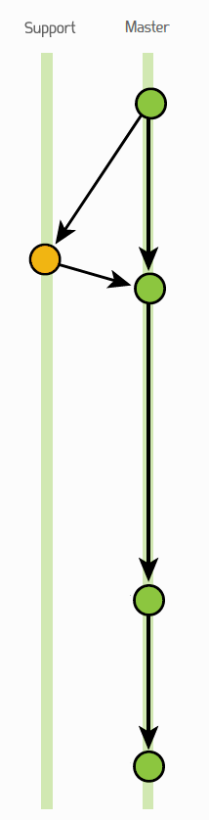
gitflow
>git flow support
Experimental feature for supporting customers who need fixes but don’t want to upgrade to new release.

Slide 19
useful links
Google
Successful git branching model
Chocolatey
Git Extensions
posh-git

Slide 20
@hmemcpy hmemcpy@gmail.com http://hmemcpy.com

