Slide 1







Thank you

Slide 2
River A data workflow management system
Harel Ben Attia
Senior Software Engineer

Slide 3



Tens of Billions of Recommendations per month
Most major publishers in the World
Hundreds GBs of new data every day

Slide 4
Context
Data Processing Workflows
Multiple Types of Processing
Rollups, Grouping, Filtering, Algorithm Calculations
Multiple Stages of Processing
Using the output of other processes as input

Slide 5
Problems
Dependency “Management”
Hardcoded into code/scripts
Time-based using cron or another scheduler
Logic is scattered around the system
Developers need to take care of monitoring, alerts, permissions etc.
Multiple Locations of Execution

Slide 6

River
Data Processing
Management Infrastructure

Slide 7
River
Execution Management
Full Execution History and Filtering
Monitoring and Actionable Alerting
Automatic Retries
Web UI
Ease of Development
Declarative Data Processing Definitions
Decentralized
Shared Data, separate development
JobLogs
Data Driven Dependencies
Why?
Ops / NOC
Developers

Slide 8
Other Approaches
A
B
C
Option 1
Option 2
A
B
C
A
J
B
C
t
J

Slide 9



Other Approaches
Option 2
A
J
B
C
t

Slide 10


Other Approaches
D Fails
D sends email
Developer of D
still works here
Where is the code?

Slide 11


Other Approaches
D =
2am is a
great hour for
troubleshooting!
Data from C is missing…
C =
The data of C
is all there!

Slide 12
J
Other Approaches
X:37 seems like a good time… C never finished after X:30 anyway
A
B
C
t
D
…
Job J has been working for more than a week before the incident

Slide 13

Other Approaches
Need to rerun processes B, C and D
Which hours failed?
How to run all of them for the specific hours?
Without running A again?
Without colliding with ongoing executions?

Slide 14

Other Approaches
“A will never take more
than 15 minutes, so X:20 is more than enough”
A
t
J
X:00
A WILL eventually take longer

Slide 15
River
Execution Management
Full Execution History + Filtering and Searching
Monitoring and Actionable Alerting
Automatic Retries
Web UI
JobLogs
Ease of Development
Declarative Data Processing Definitions
Decentralized
Shared Data, separate development
Data Driven Dependencies
Why?
Robustness
Reliability
Parallelism

Slide 16
River
What?
When?
Where?
How?

Slide 17

Execution Layer – the “What”
Every data processing task is called a Job
A Job can contain multiple Steps
Importing from MySQL to Hive
Hive Queries
JDBC Queries
Transfer data from Hive into MySQL and to Cassandra
Running External Commands: MapReduce, Java, bash, Legacy code, etc.
Jobs use Parameters

Slide 18
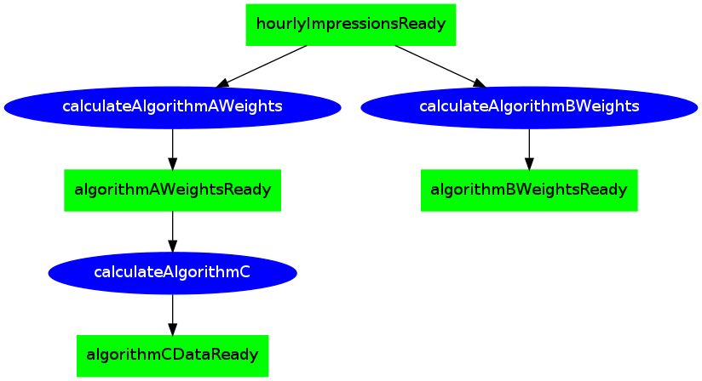
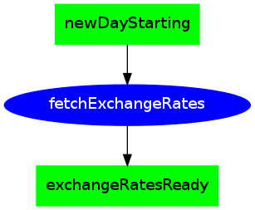
Scheduling Layer – the “When”
Each job registers to an event, which will trigger its execution
Each job emits an event at job completion
Events that describe Data Availability
Events that are time dependent

Slide 19
The “How” and the “Where”
Both handled by the infrastructure
Integration to other systems
Connecting to Hive/Hadoop/Cassandra
Connecting to JDBC Databases
Retries, throttling, timeouts
Logical names to all data sources
“readOnlyDataWarehouse”
”productionCassandra”
Centralized Management, email notifications and dashboards
Monitoring and Alerts
Location of Execution
Actual location is hidden from the developer/ops

Slide 20
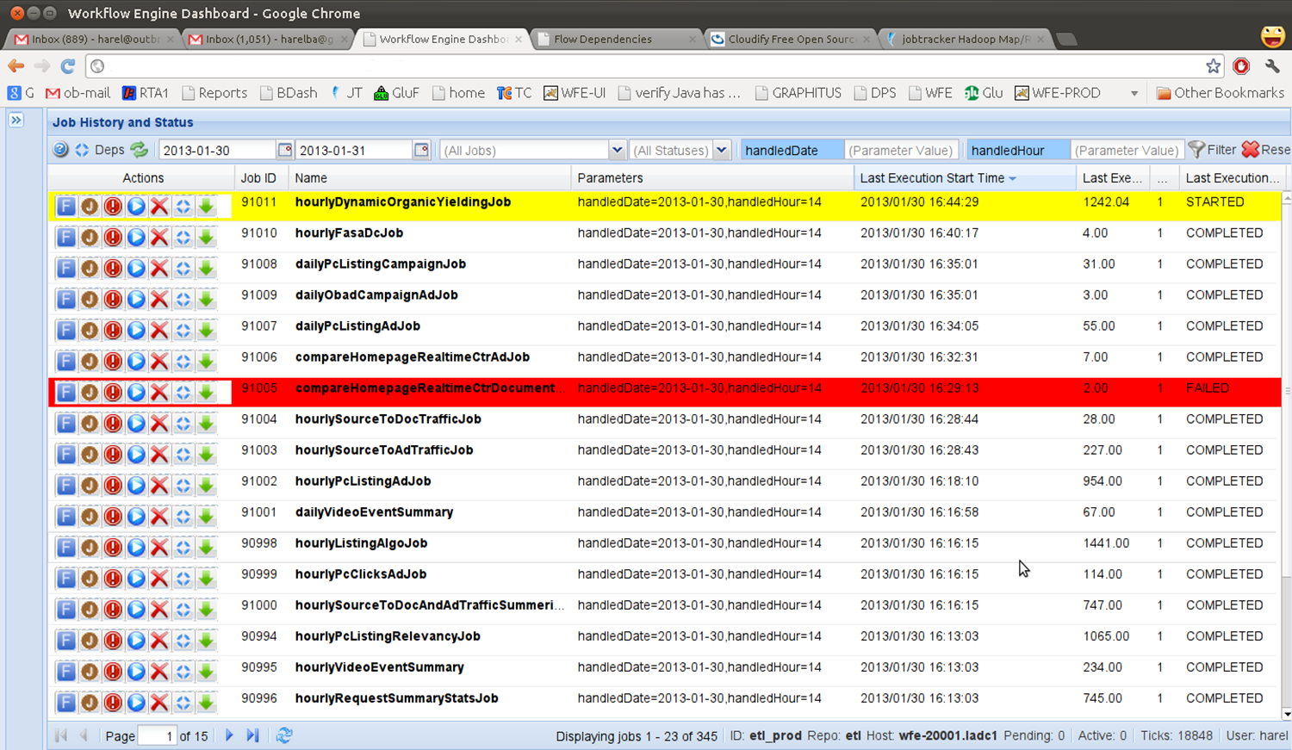



River UI
Restart Job
Fail Job and Dependents
Download JobLog

Slide 21
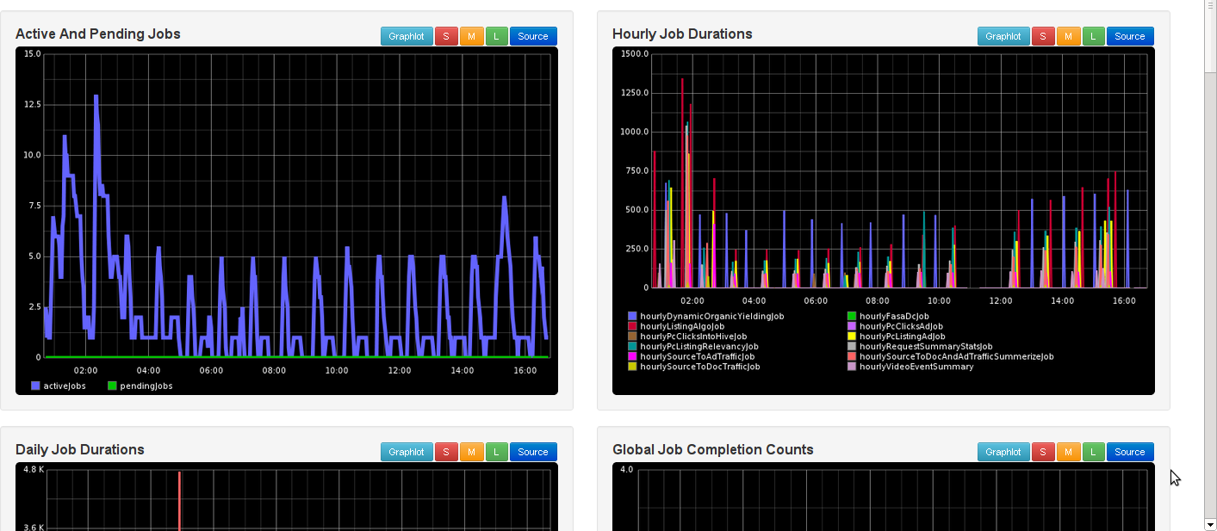
Monitoring Dashboard

Slide 22
Monitoring Dashboard

Slide 24
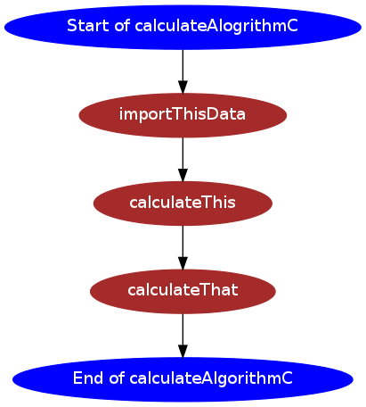
Steps
Copy Data From JDBC to Hive
sourceDB = “productionDatabase”
sourceTable = “myRawData”
targetCluster = “onlineHadoopCluster”
targetHiveTable = “rawDataTable”
Filter = “date=#handledDate#”
Steps only contain what needs to be done

Slide 25
A bit more about triggers
Triggers have parameters as well
Date=2012-10-10,hour=15
Date=2012-10-10,hour=19
Parameters Propagate through jobs and to other triggers

Slide 26
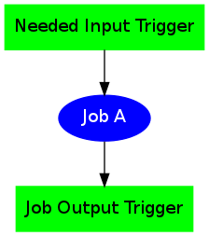
Developer’s Point-of-View
Automatic Retries
Parameters
Pass-through

Slide 27
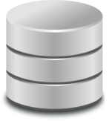
Trigger Queue
Execution Queue
River
Trigger
Manager
Execution
Manager
Spring Batch
Topology
Spring Batch DB
Hive/Hadoop Interface
OS
Interface
Cassandra
Inerface
JDBC
Interface
External Systems

Slide 28
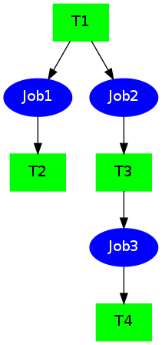
Dependencies for detailed example

Slide 29

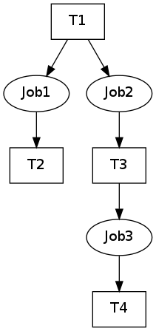
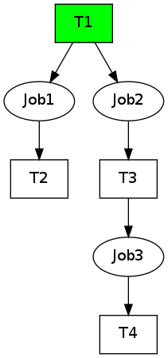
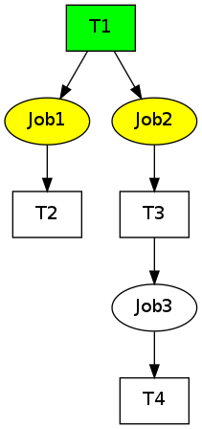
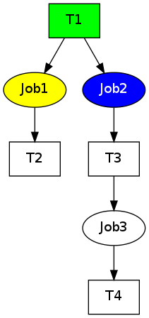
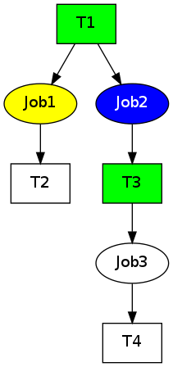
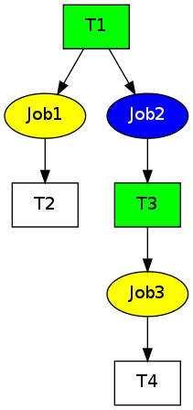
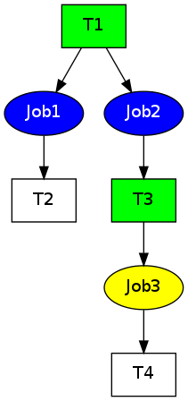
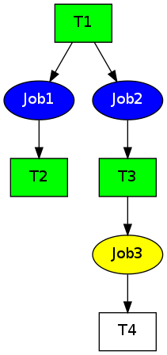
Trigger Queue
Execution Queue
Date=2012-01-02
hour=03
T1
Job1,Job2
T2
Job3
T3
Date=2012-01-02
hour=03
Date=2012-01-02
hour=03
Job2
Job1
River
T1
Job3
T2
T3
Job1,Job2
Trigger
Manager
Execution
Manager
Spring Batch
Job1,Job2
Job3
Topology
(from Job2)
Spring Batch DB
(from Job1)
Hive/Hadoop Interface
OS
Interface
Cassandra
Inerface
JDBC
Interface
External Systems
Success Example

Slide 30



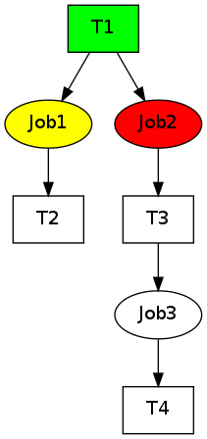
UI
Trigger Queue
Execution Queue
Job2
T3
Job3
Job2
Date=2012-01-02
hour=03
Date=2012-01-02
hour=03
Job2
Job2
River
T3
Job2
Job3
Trigger
Manager
Execution
Manager
Spring Batch
Job3
Topology
Spring Batch DB
Hive/Hadoop Interface
OS
Interface
Cassandra
Inerface
JDBC
Interface
External Systems
Failure Example

Slide 31
Notable Features
Parameter Enrichment
Example: #beginningOfMonth
Precondition Expressions
Example: isLastDayOfMonth(#handleDate)
Data Comparison Capabilities
Data Validations
Supports Tolerance
Absolute and Percentage margins
Command Line and Java Clients

Slide 32
River at
6 River Instances Running
5 Teams
~4100 Jobs running every day
~50 Different Job Types
Job Failures due to environment issues have almost no overhead
Automatic restarts of jobs when data arrives late

Slide 33

Future Plans
Illustration by Chris Whetzel
Multiple Dependencies
Offline Job Testing Capabilities
Improved DSL for Job Definitions
Support for Master/Worker River machines
Job Priorities
Analysis Tools
Outbrain is working on Open Sourcing River

Slide 34
Questions
Notes:
Thank you.

Slide 35
Thank You
Harel Ben Attia
@harelba on Twitter
harel@outbrain.com
http://www.linkedin.com/in/harelba

