Slide 1
Welcome!
Sign in to your computer and open IDLE.
Download the workshop materials:
https://tinyurl.com/2018-bcb-adv-python
Ask a volunteer for help if you need it.

Slide 2
BCBGSO ADVANCED PYTHON WORKSHOP 2018

Slide 3
Welcome to the Advanced Python Workshop
Organized by the Bioinformatics and Computational Biology Graduate Student Organization.
The BCB Symposium is next week. More info here: http://www.bcb.iastate.edu/bcb-symposium-march-30-2018
This year’s theme is “The Past, Present, and Future of Bioinformatics and Computational Biology.”
Please register if you’re interested!

Slide 4
Acknowledgements
Thanks to Urminder for organizing these workshops.
Trish Stauble for helping us with logistics.
Thanks to Levi Baber and Jennifer Johnson from IT for helping us set up the virtual machines.
BIG UPS to our volunteers: Sagnik, Akshay, Pranav, Sharmistha, and Avani.

Slide 5
Today’s Plan
Review Lists
Review Reading files
Review Functions
Designing Basic Programs

Slide 6
Lists

Slide 7
Lists (and dictionaries) are probably the most used data structure in Python.
They are mutable, easy to work with, and pretty efficient.
They can hold any combination of data types, unlike, say, Java.
We will be working a lot with lists today, so it’s important for you to be comfortable with them.

Slide 8
Some common list operations:
names = [‘Alice’, ‘Adrianna’, ‘Gia’]
names[-1] # ‘Gia’
names[:2] # [‘Alice’, ‘Adrianna’]
names2 = [‘Juliet’, ‘Rami’]
names.extend(names2)
len(names) # 5
names.remove(“Gia”)
len(names) # 4

Slide 9
A powerful aspect of lists is list comprehensions. There is a decent outline of them here.
List comprehensions are expressions that create lists. It is a lot more useful than it sounds.
For example, instead of doing:
num_list = [1, 2, 3, . . ., 100]
We can type:
num_list = [i + 1 for i in range(100)]
Open list_review.py and work through the examples.

Slide 10
Reading Files

Slide 11
It is very easy to read from and write to files in Python.
In most cases, code involving files will be built off of the following:
with open(file_name) as fin:
for line in fin:
< do stuff >
This opens up the file, reads it line by line, does whatever to each of the lines, and closes it when you’re finished.
Open up file_io.py and work through it.

Slide 12
Functions

Slide 13
Functions are modules of code that take in arguments and do something with them.
For instance, the len() function takes in an object and returns it’s length.
The str.replace(target, replace) is a function performed on a string that replaces all instances of target with replace.
The syntax to define a function is:
def function_name(input_arguments):
< do stuff >

Slide 14
Why use functions?
Portability – by writing your code as a function, you can export it to your other programs or share it with others
Readability – it’s easier to understand what a function is doing by it’s name than by looking at it’s code (assuming it’s named well)
Debugging code – if you don’t use functions and instead just copy-paste your code everywhere, you have to make corrections to each of those code chunks each time you want to change something. If you have a function, you only need to make one change.
Open up functions.py and work through the examples.

Slide 15
Designing Basic Programs

Slide 16
Exercise 1
We will now walk through the process of designing a simple program.
Go to the exercise_1 folder.
The folder contains several files containing song lyrics.
We want to find the song with the most lines, as well as the song title and artist.

Slide 17
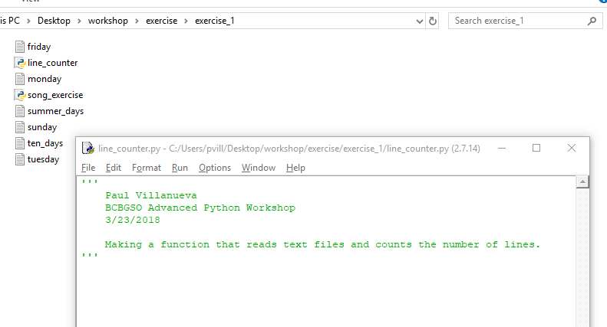
In IDLE, do File > New File.
Add a header containing your name and today’s date.
Save it in the exercise_1 folder as line_counter.

Slide 18
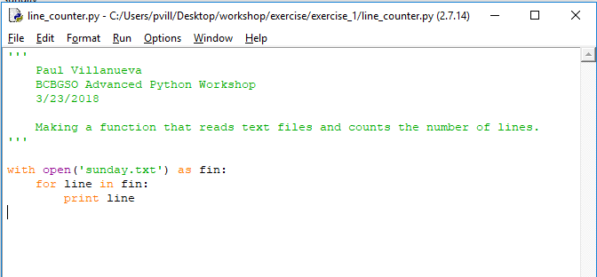
Begin by writing code to open sunday.txt and print out each line.
Run the code. What happened?

Slide 19
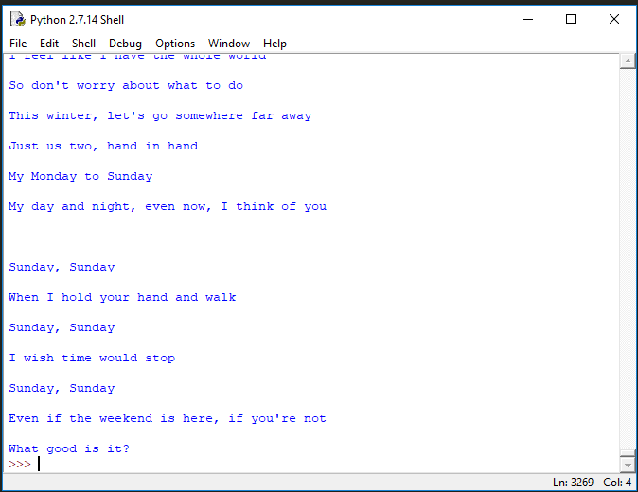
Why are extra lines being printed out?

Slide 20
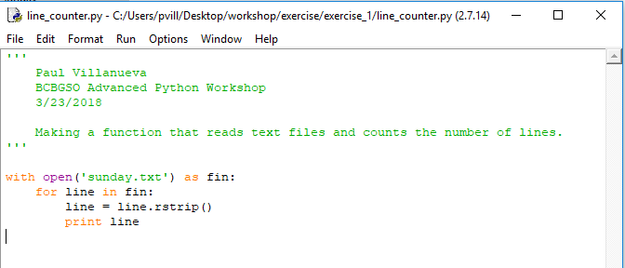
Modify your code to remove trailing newline characters from each line.
(Hint)

Slide 21
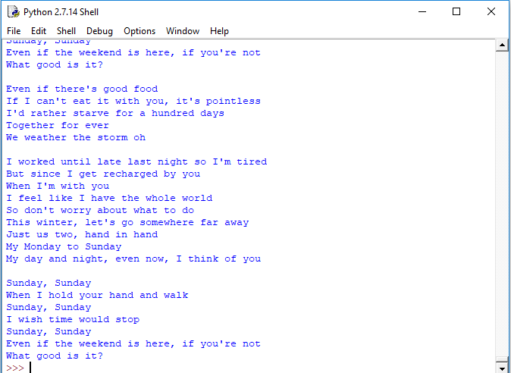
N I C E
Now, let’s add some code to start counting lines.

Slide 22
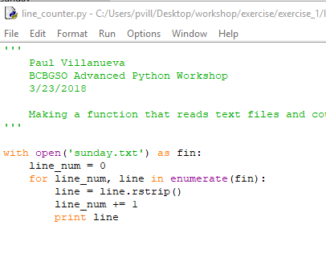
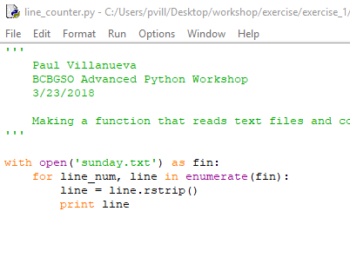
Hint: there are two ways to do this listed here.
Both work equally well. I will use the method on the right that uses enumerate().
See documentation here to learn more about enumerate().

Slide 23
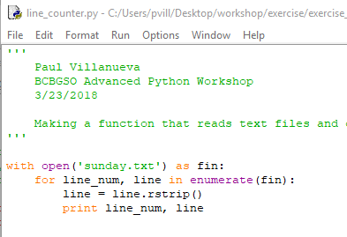
Let’s output the line number with the lines.

Slide 24
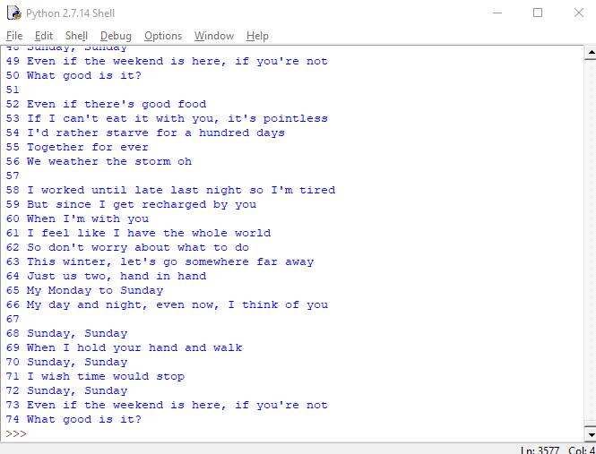

Slide 25
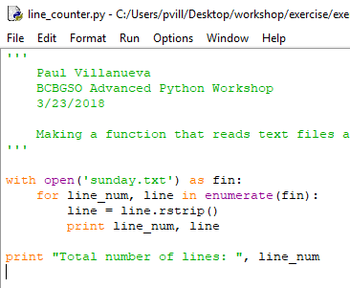
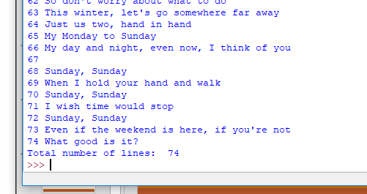
Output the total number of lines at the end.

Slide 26
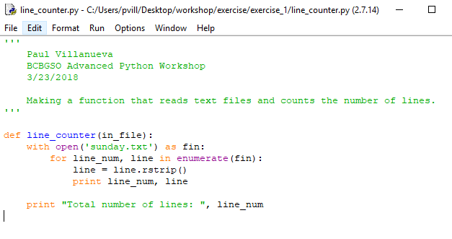
Let’s turn this into a function now.
Using the code you just wrote, define a new function line_counter() that takes as input the name of a file and outputs the total number of lines.
What happens when you run this code? Why?

Slide 27
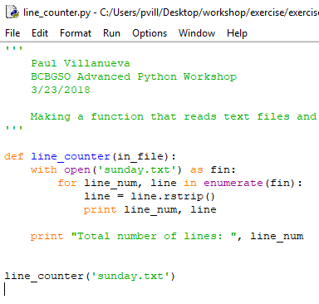
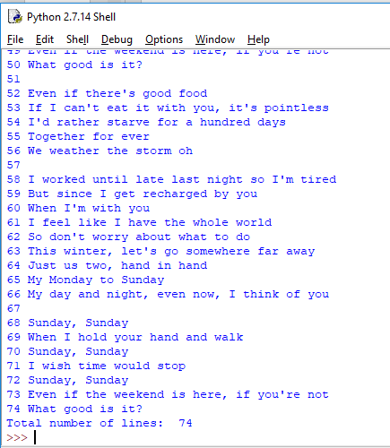
Nothing happens because this file no longer contains any commands. It only contains a function definition.
To use the function, we have to call it:
And we’re now getting the same output as before.

Slide 28
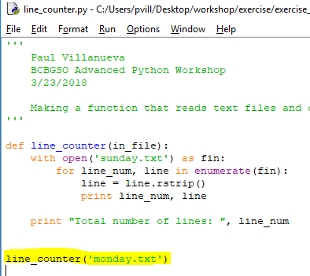
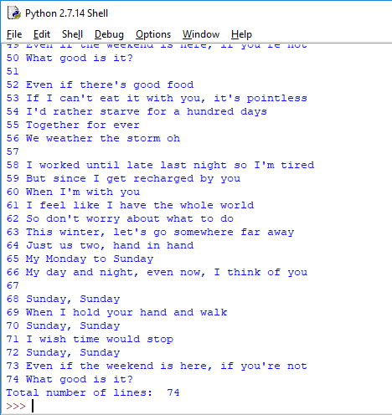
Try it on some of the other files by changing the file name in the line_counter() call.
What did you expect? What did you get? What’s wrong?

Slide 29
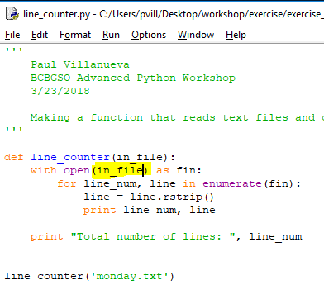
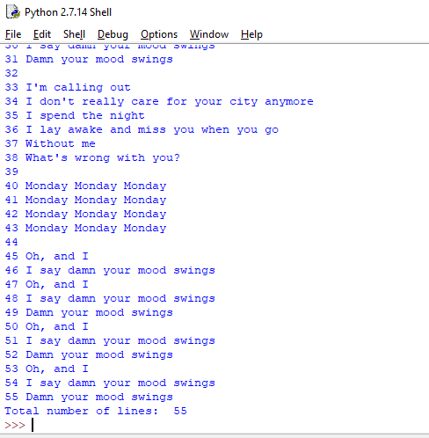
The problem is that we never changed the sunday.txt file name to the input variable.
Let’s change it now and run it again.
Great! Print out some other songs.

Slide 30
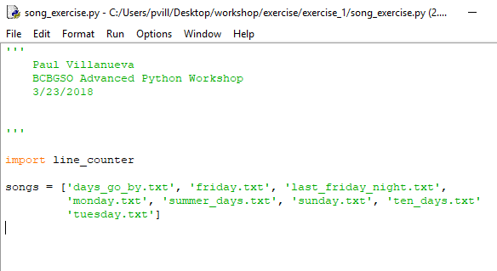
Open song_exercise.py in the exercise_1 folder.
We can use functions from outside our code by importing it.
Add the following line just beneath the header of song_exercise.py:
import line_counter
and run the code. What happens?

Slide 31
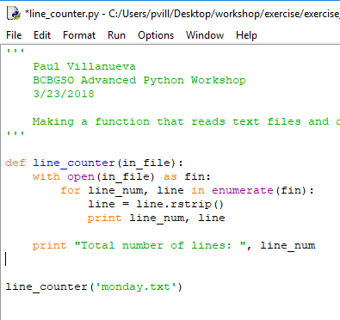
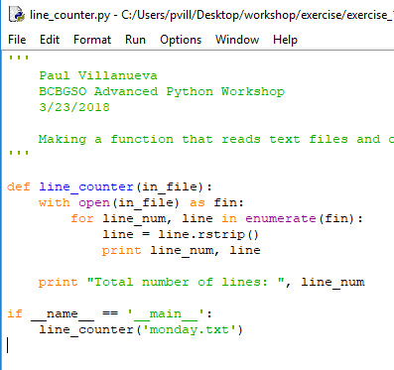
When we import the line_counter.py file, Python executes all of its code.
This will import the line_counter function so that we can use it in song_exercise.py. However, Python will also run the call to line_counter(file_name) that was added at the bottom of the file.
To fix this, make the following changes to line_counter.py:

Slide 32
Rerun line_counter.py. It will still run just like we had it before because it was being run as a main. This is equivalent to calling python line_counter.py from the command line.
Rerun song_exercise.py. Now the function call isn’t being performed because we’re only importing line_counter.py, not running it as a main.
You can read a more detailed explanation of what’s going on here.

Slide 33
So how do we call the line_counter function?
In IDLE, type import line_counter. This will import the function into the IDLE terminal.
Well, not exactly. It imports line_counter as a module into the environment.
In order to run the line_counter() function, we have to call it like this:
line_counter.line_counter(file_name)
This is like saying “Use the line_counter function from the line_counter module.”
Call it the line_counter function a few times.

Slide 34
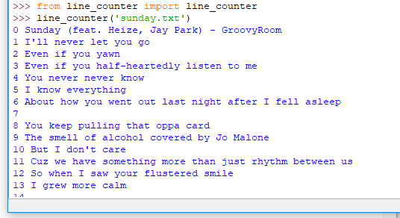
There are two annoying things that we are going to fix now.
First, it is annoying to type line_counter.line_counter() every time we want to use the line_counter function.
To fix this, we can modify our import statement to only import a specific function:
from line_counter import line_counter
This will only load the line_counter function into the environment. We will now be able to access the function by typing just line_counter(file_name).

Slide 35
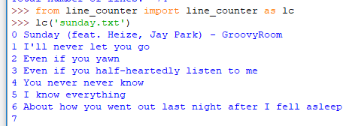
We can also create an alias for a function as we import it by doing
from line_counter import line_counter as lc
This will enable us to call the line_counter function by typing lc(file_name).
Doing this saves time/keystrokes, but often comes at the expense of readability.
What’s easier to understand?
line_counter(‘sunday.txt’) lc(‘sunday.txt’)

Slide 36
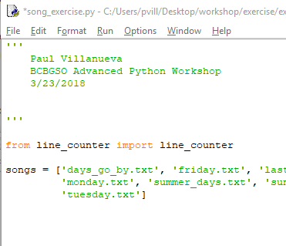
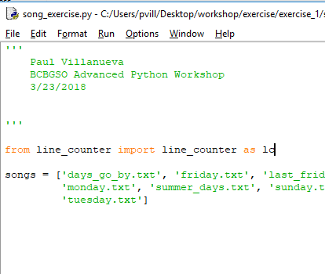
Let’s change the import line in song_exercise.py.
For this workshop, I won’t be creating an alias for line_counter.
Your song_exercise.py should look like one of the following:
We can now access the line_counter function in song_exercise.py in fewer keystrokes

Slide 37
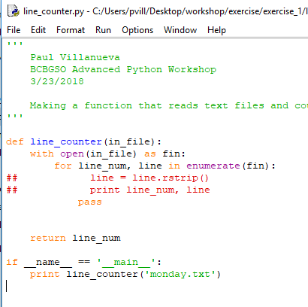
The second annoying thing is that our line_counter function is printing out the whole file when all we really want is the number of lines in the song.
Let’s change that by
commenting out the code inside the for loop,
adding a pass statement in its place, and
changing the final print statement to a return statement.
Your code should look like this.
We’re only commenting out the liens inside of the for loop instead of deleting them because we may want them later for debugging purposes.
Notice the new print under main. Why is that there?
What about the line = line.rstrip() line? It’s not printing anything, so why bother commenting it out?

Slide 38

Running the code with monday.txt provides the following output.
Much nicer to deal with than the giant block of text.
Now that we’ve dealt with those two issues, let’s return to song_exercise.py.
Write a for loop to print out the number of lines in each song.
Answer:
for song in songs:
print line_counter(song)

Slide 39
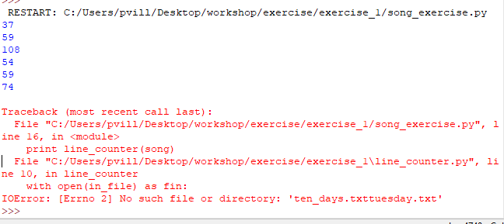
Run the code. What do you expect? What happened? Why?
The error we’re getting says that “there is no such file or directory ten_days.txttuesday.txt”.
Where is this error from? Find the error, fix it, then run the code again.

Slide 40
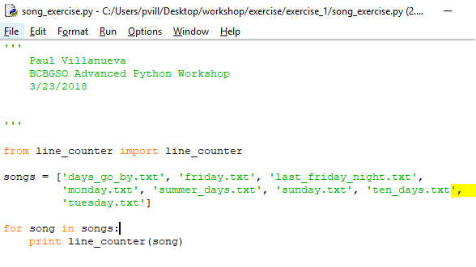
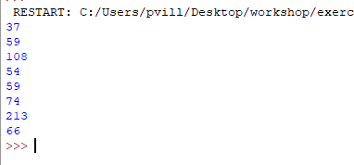
Your code should be similar to the code above, and your output should be the same.

Slide 41
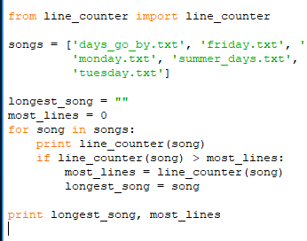
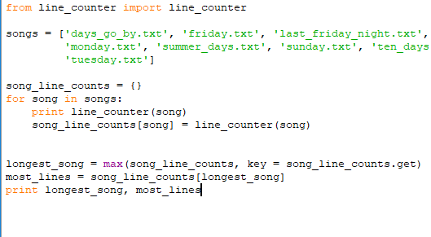
So far so good. But what was our original problem? We wanted to find the song that had the most lines in it.
How can we track of which song had the most lines in it?
Two possible solutions are:

Slide 42
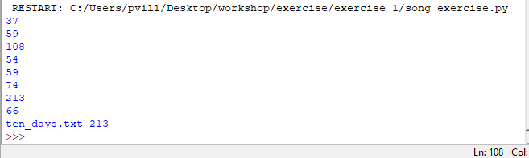
They both provide the same answer.
So when should you use one approach over the other?
What kind of tradeoffs are there?
For this workshop, we’ll use the approach that doesn’t use the dictionary.

Slide 43
We’re almost done! We found the song with the most lines. Now we just need to pull the song title and artist information and print it out a little nicer.
This information is on the first line of each of the song files in the format
Song name – Artist
The problem is that when Python reads a line in a file, it reads the entire line as one long string.
How can we separate this line into the format we want? Hint here.

Slide 44

We’re going to use the split function (documentation). Every string object comes with the split function which takes as input a delimiting character (ie, the character to split the string on). By default, split splits a string on whitespace.
The function returns the list of strings you get when you break the original string into chunks on the delimiting character.
For example:
This doesn’t transform the original object, so you have to save it to another variable if you want to keep this list.
So how can we use this to get the artist and song information from the files?

Slide 45
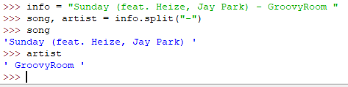
Since we know that the song and the artist are separated by a -, we can use split to separate the two into a list, then assign them both to new variables.
Implement this code in song_exercise.py. A hint for one possible solution is here.

Slide 46
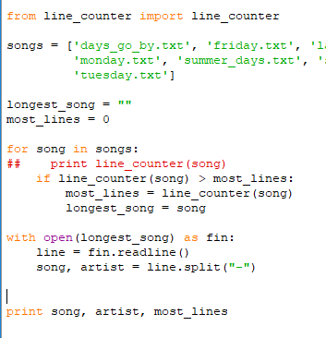

We forgot to strip the newline character from the line before we saved it.
We’ll do that now with strip.

Slide 47
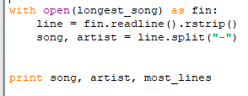
We almost have it the way we want, but there are some weird spaces between the artist and song.
We could modify the individual song and artist variables to get our desired result.
Instead of doing that, we’re going to take advantage of list comprehensions to take care of all the formatting at once.

Slide 48
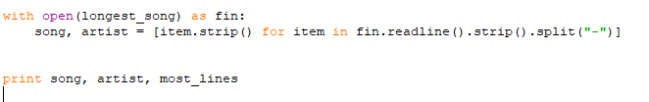
What is this line doing?
song, artist = [item.strip() for item in fin.readline().strip().split("-")]
fin.readline() reads the first line of fin
.strip() removes leading and trailing whitespace from that line
split(“-”) separates the line into two chunks delimited by ‘–’
Then, for each item in this list:
item.strip() removes leading and trailing whitespace
Puts these items into a new list
Finally, assigns the two values to song and artist.

Slide 49

The last thing we’re going to do is make the print out a little more informative.
This is what I had, but try out different formats for yourself.
The code in the previous slide was an example of string formatting via the string.format function.
It’s value wasn’t apparent in such a simple example, but it’s very powerful and allows you to programmatically format strings.
Some examples are on the next slide.

Slide 50
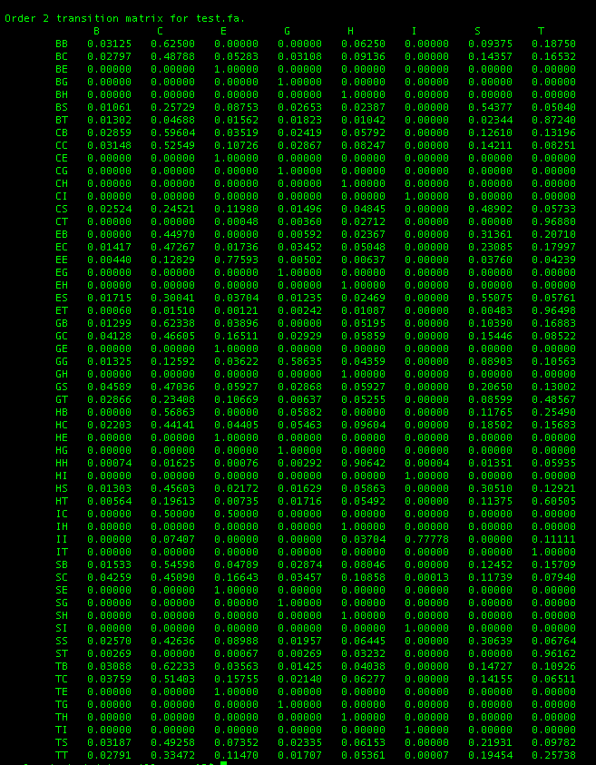
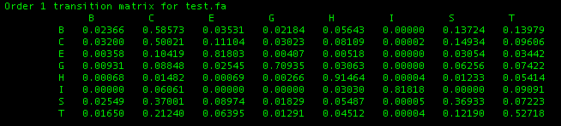

Slide 51
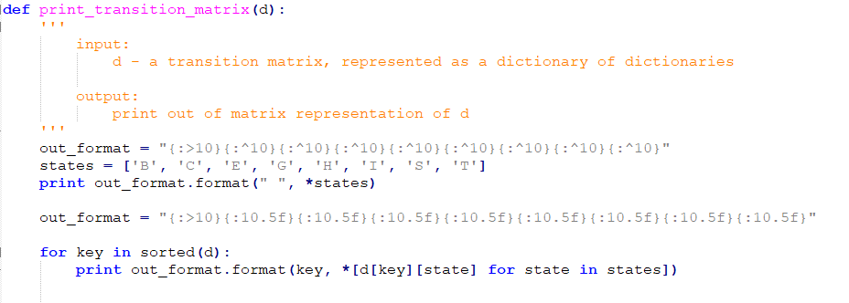
Both of the preceding matrices were printed out using the same code.
Here is a good source to learn more about string.format().
The basic idea is that the {} in the string are placeholders that you supply as arguments to string.format().

Slide 52
Back to song_exercise.py. Let’s take a look at our longest song. Open up ten_days.txt. What’s wrong?
It’s full of blank lines! Then why is line counter still counting them?
Because they’re not technically blank – they contain a newline character.
How can we test if a line is blank?
In our line_counter function, the lines that only contain a newline character should become empty strings when we do the line = line.rstrip() line.

Slide 53
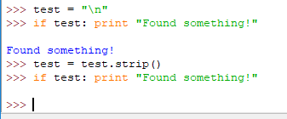
Empty strings (and most other empty objects) in Python evaluate to False when in a Boolean statement.
Let’s implement this in line_counter(). Open up line_counter.py and fix the function.
Hint: You’ll need to add a counter for the number of blank lines. See the alternate line counting solution on slide BLAH for how to do this.

Slide 54
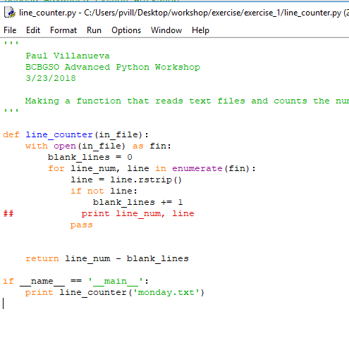
Your code should look something like this.

Slide 55

When we run song_exercise.py, we get:
There we go. Now our line_counter is correctly counting the number of lines in the song and correctly identifies the song with the longest number of lines.
How could we improve this program?

Slide 56
Exercise 2
Now it’s your turn to implement something similar.
Go to the exercise_2 folder.
There are several files containing ratings for stuff.
Your job is to find the highest rated item in each one.
I’ve supplied some commented starter code to guide you through this task.
You can implement much of the same code as we did in Exercise 1.
Work with your neighbor or search the internet if you get stuck.

Slide 57
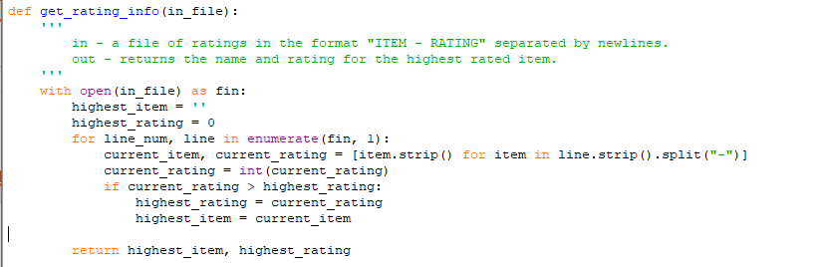
Here’s one solution for the get_rating_info function.

Slide 58
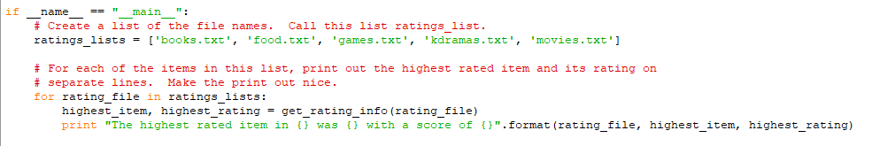
Here’s one solution for the main section.

Slide 59
Exercise 3
More likely than not, someone has worked on a problem similar to the one you are working on. In these cases, it can save a lot of time and heartache to take other people’s code and adapt it to your purposes.
In this exercise, we’re going to work with someone else’s code to solve some bioinformatics problems.
Go to the exercise_3 folder. It contains:
Two fasta files
bioinformatics_utilities.py
bioinformatics_exercises.py

Slide 60
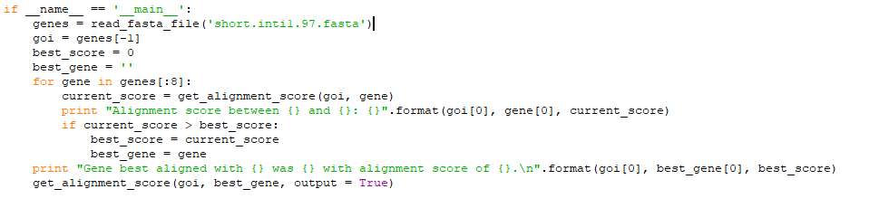
Fasta files are text files containing genes and their nucleotide sequences.
short.inti1.97.fasta contains the sequences in inti1.97.fasta of length less than 200 nucleotides.
bionformatics_utilities.py contains functions and classes that we will be working with. We will look at bioinformatics_exercises.py later.
For now, open up bioinformatics_utilities.py in IDLE.
Spend a few minutes reading through the main section. Run the code.

Slide 61
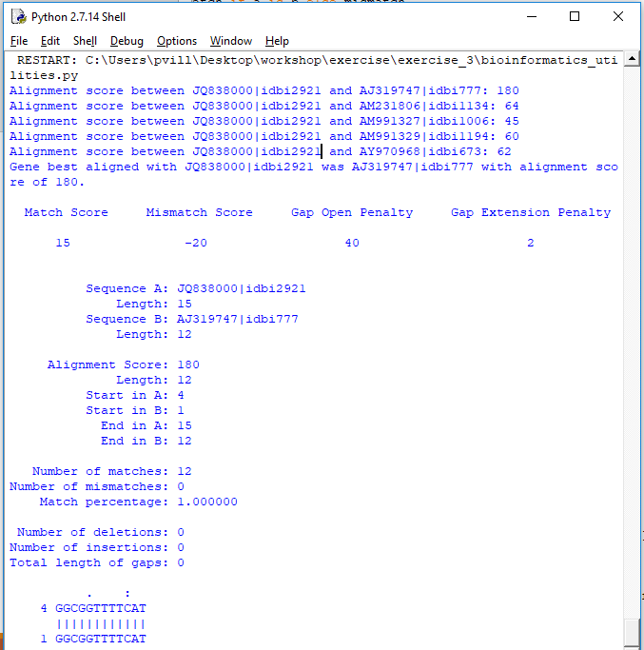
What’s being printed out? Can you trace what’s happening?

Slide 62
When run as main, bioinformatics_utilities.py does the following:
Reads in all the sequences from short.inti1.97.fasta into the list genes.
Chooses the last gene in genes as the gene of interest.
Initialize highest alignment score to 0 and best gene to an empty string.
Then, for the first 5 genes in genes:
Calculates the alignment score between the current gene and the gene of interest
If the alignment score is better than the highest alignment score:
Update highest score, best gene
After going through all five genes, prints out the full alignment information between the gene of interest and the gene with the best alignment.

Slide 63
It’s not necessary to know local sequence alignment is done for this exercise, but you can learn more about what it is and how it’s calculated from these sources:
MIT Algorithms for Computational Biology
Globin Gene Server
Wikipedia: Sequence Alignment
https://en.wikipedia.org/wiki/Smith%E2%80%93Waterman_algorithm

Slide 64
Open up bioinformatics_exercises.py and work through the code.
Work with your neighbors and Google stuff.

Slide 65
Exercise 4
We did a little bit of file output in the last exercise. We’re going to practice more of it in this exercise.
In this exercise, we will be working on data representing mathematical knots. If you’d like to learn more about knot theory, these are good places to start:
Wikipedia: Knot Theory
Knot Atlas
Cornell: Introduction to Knot Theory
Go to the exercise_4 folder. It contains:
gauss_codes.txt, a file contain Gauss codes for some knots,
calc_wirt.py, a module that calculates the Wirtinger number of a knot diagram, and
knot_calcs.py, the exercise file.

Slide 66
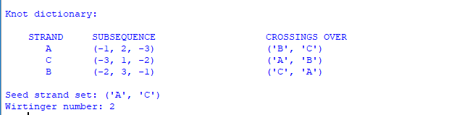
Open up calc_wirt.py and run it.
When run as main, calc_wirt.py prints out all of this information here.
Our goal will be to make a new file with the name of the knot, the Gauss code, the seed strand set, and the Wirtinger number.
You can read more about how the program works here.
Open up knot_calcs.py and work through the comments.

Slide 67
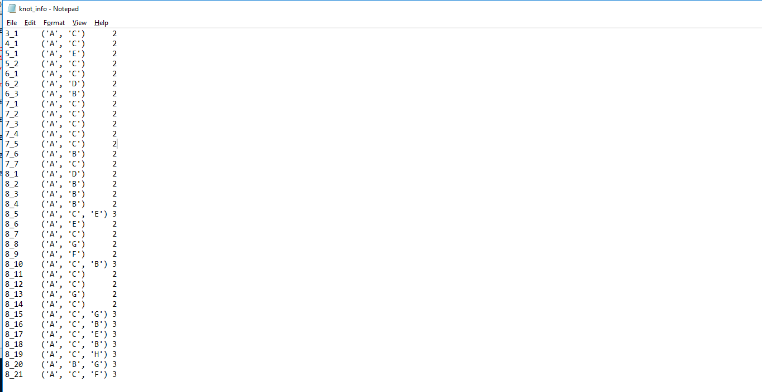
When finished, you should have a file that looks something like this:

Slide 68
Conclusion
Some learning resources:
Automate the Boring Stuff With Python
Google's Python Class
Stack Overflow
Online courses are great because they offer a structured learning plan.
However, the best way to learn Python (or any coding language) is to work on something you’re personally interested in, such as an element of your research that can be automated.

Slide 69
Bye! Have a nice day!

