Slide 1
Why User Growth Does Not Revenue Growth
Firuzjon Qurbonov
Product analyst

Slide 2

Case Problem
Increased user activity does not lead to increased revenue.
Despite the high growth in page views, users are not adding products to cart.

Slide 3

Purpose of the Case
Analyze user behavior by segments.
Identify the reasons for low conversion.
Identify revenue growth points.

Slide 4

Key insights
The Add-to-Cart conversion rate of new users is 1.8 times lower than that of the core users.
The main traffic is generated by core users (~ 80% of views).
New users actively browse categories, but add products to cart significantly less often than core users.
The problem is observed in all key categories.

Slide 5
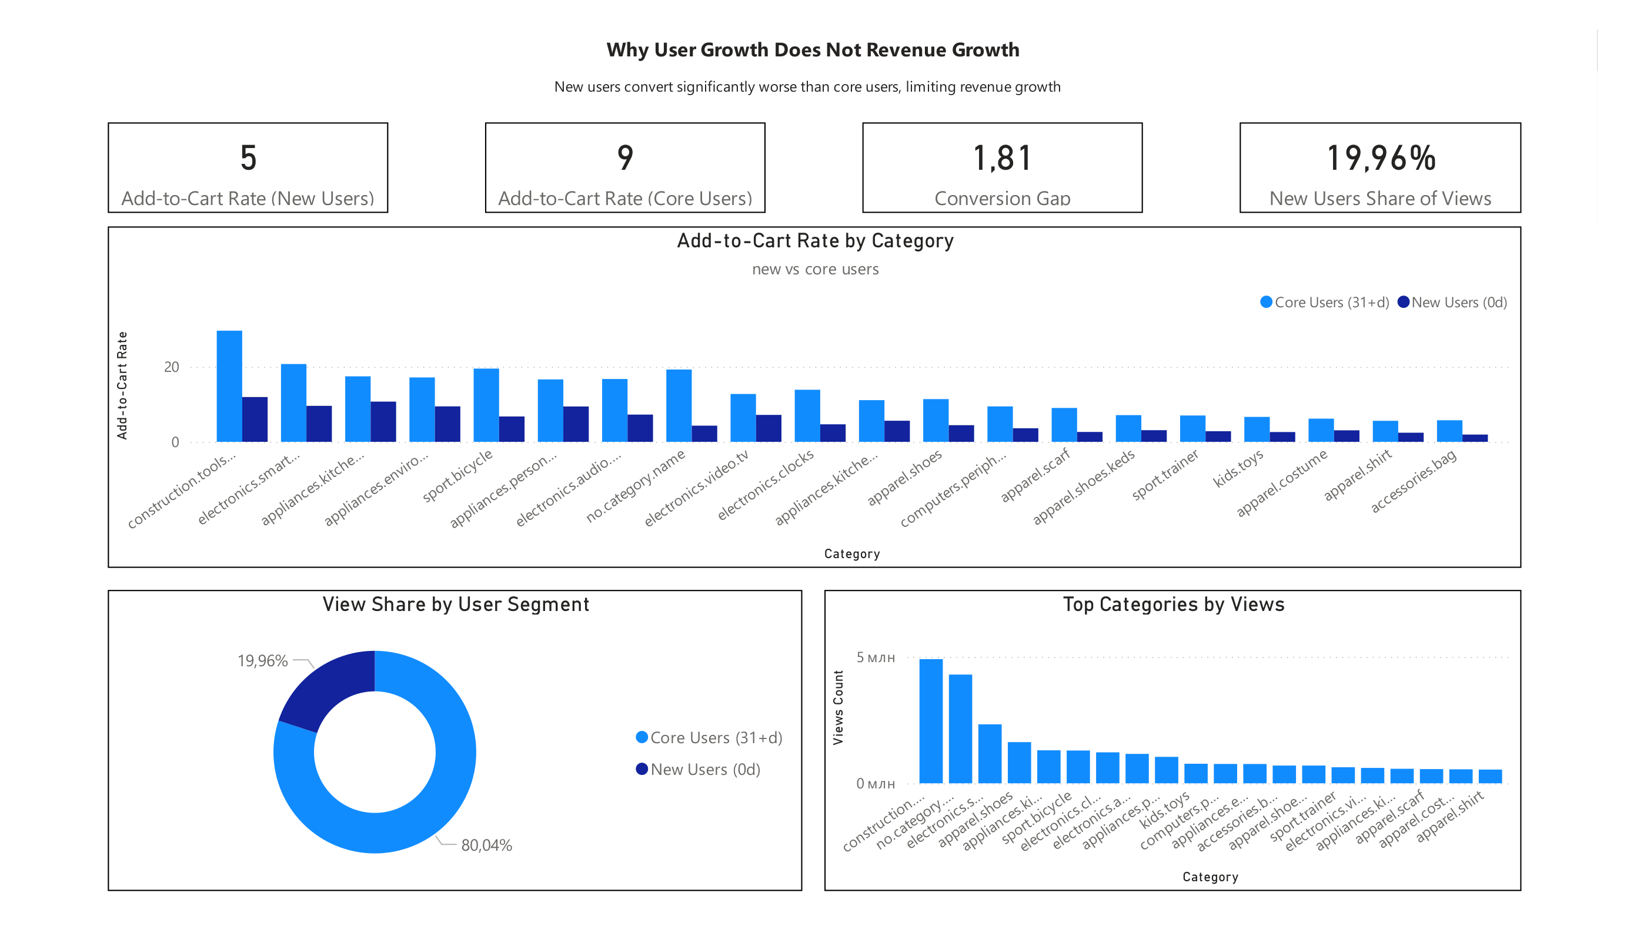

Visualizations
The analysis showed a systematic decline in conversion rates for new users across all categories.

Slide 6

Interpretation
New users do not go through the process of adding to cart.
Possible reasons:
Lack of confidence in the product
Interface inconvenience
lack of motivation to buy

Slide 7

Recommendations
Simplify the path to adding to cart for new users.
Add trust triggers:
Run A/B tests to improve new users conversion.
Focus on monetizing new users, and not just on attracting them.
reviews
guarantees
social proof.

Slide 8

Conclusions
The main growth point is improving conversion of new users.
Even a small increase in conversion can lead to a significant increase in revenue without increasing traffic.

