Slide 1
This slide intentionally left blank

Slide 2

Open Meeting
14th January 2010
www.pompeybug.org.uk

Slide 3
Agenda
Welcome
Minutes of meeting of 19 November 2009
Barry Rawlings on traffic signals
Chairman's report
Treasurer's report - Roger
Seafront Cycle Route Phase II - Roger
Infrastructure update and a proposal - Mike
New Web site - Jon
CTC / Cyclenation conference 17 April 2010
Diary Dates
Open Forum.
Video time
Close

Slide 4
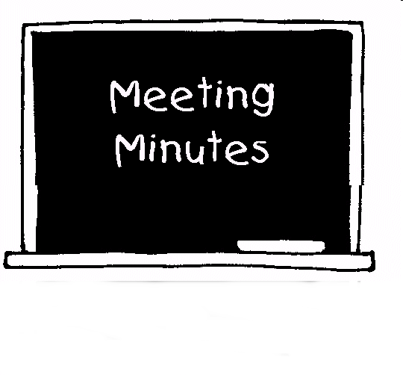
PCF meeting 19 November 2009
Minutes
Matters arising

Slide 5
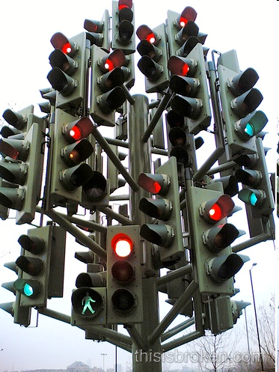
Traffic signals the inside story
Barry Rawlings
PCC

Slide 6
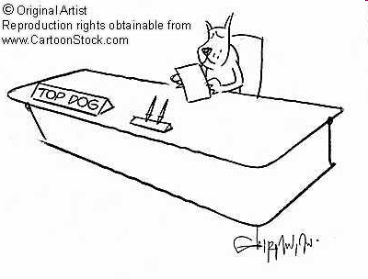
Chairman’s Report
John Holland

Slide 7
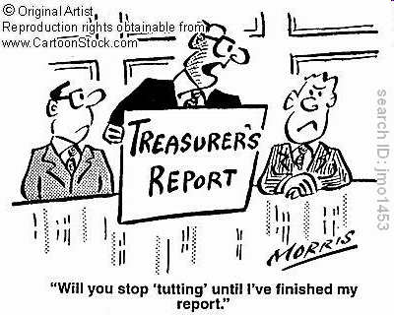
Treasurer’s Report
Roger Inkpen

Slide 8
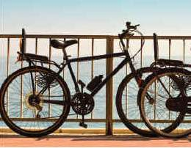
Southsea Seafront Cycle Route Phase II
Roger Inkpen

Slide 9

Infrastructure Update
Mike Dobson

Slide 10
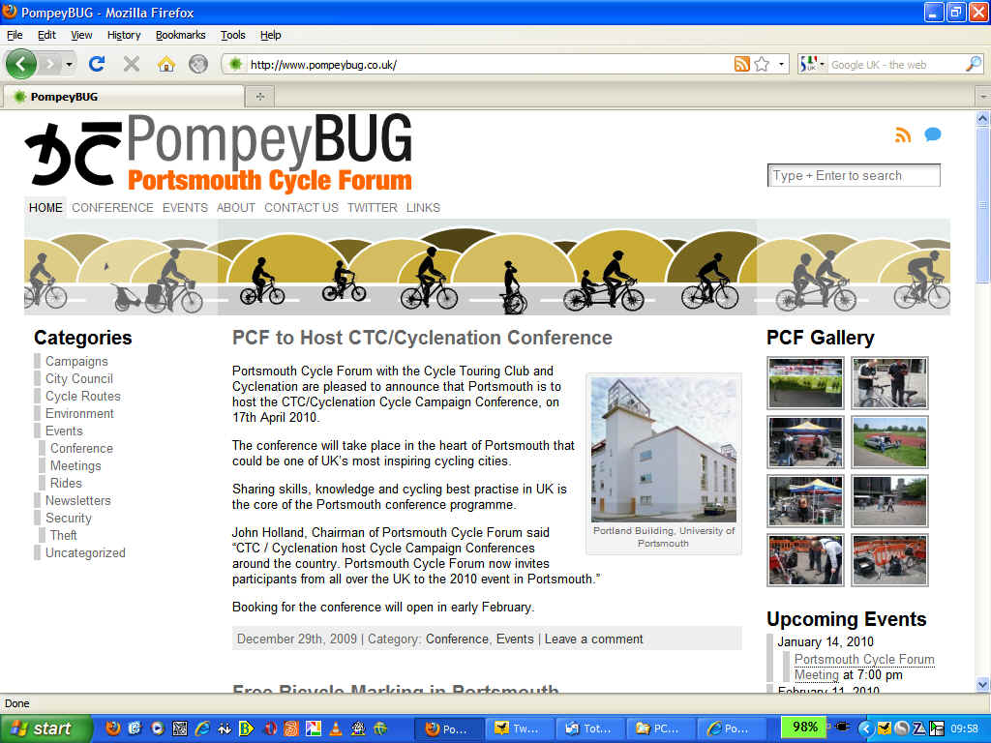
New Web Site & Logo
Jon Spencer

Slide 11

CTC / Cyclenation Conference
17 April 2010

Slide 12
Diary Dates
PCF AGM - Thursday 4 March
Other PCF meetings 13 May, 9 September, 11 November
Informal meetings at the King Street Tavern :
Thursday 11 February April 8th from 7.30pm
also 12 August, 14 October and 9 December
Speakers / topics for future meetings please!
Next PCF committee meeting: Friday 5 February

Slide 13

Open Forum
?
?
?
?

Slide 14

Video time …

Slide 15
This slide intentionally left blank

