Slide 1
The Emergency Active Travel Fund
21st Jan 2021

Slide 2
The Emergency Active Travel Fund (EATF) - Why was it needed
Under CV19, Bus and Train Companies needed to maintain 2m between their Passengers.
This meant that a Single Decker Bus, such as used on the Number 8 Service from Waterlooville to Portsmouth, via QA Hospital, had an approx 70% reduction in capacity
Many Key Workers such as Nurses, Porters, Doctors,, Teachers etc still needed to travel to work, and many would normally have used Public Transport (PT).
With this reduction in Capacity on PT, these users still needed to travel to work
Many people use Public Transport for any numerous Reasons, including Protected Characteristics such as Age - too young to drive, disabilities – Unable to drive, poverty – can’t afford to own and run a vehicle.
Government advice to Avoid Public Transport if possible
An “instant” alternative needed to be found that didn’t cause other problems such as increased costs(e.g. taxis), parking, “car led recovery”

Slide 3
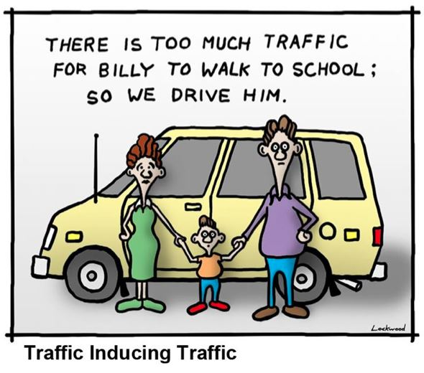
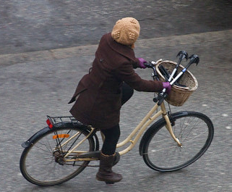
Enter: Cycling.
Many people already own a Cycle.
A Cycle journey is Door to Door,
Cycling is CV19 safe - no sharing with others needed
BUT most people won’t cycle because they feel it unsafe
To enable people to Cycle, it needed to be made to feel Safe
Provide Protected Cycling Facilities, Separated from Motor Traffic

Slide 4
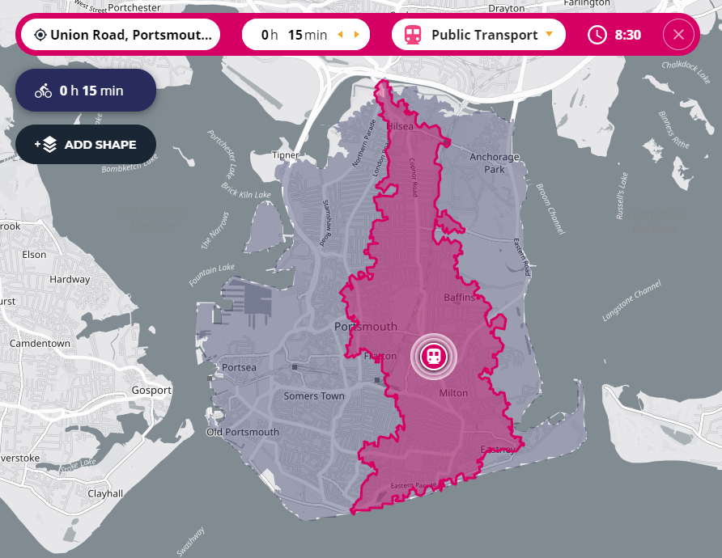
Nobody will travel on a Cycle far It’ll take too long
Arrive at St Marys Hospital at 08:30 AM within a 15 Minute journey time
Bus: Pink
Cycle (Leisurely): Blue
Travel Time Map | Drive Time Radius & Other Modes

Slide 5
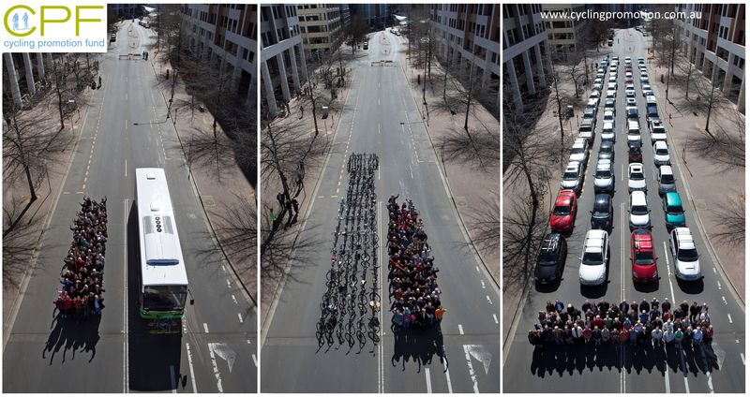
How to Make Space?
Significantly less Motor Traffic on the Roads : Approx 90% of typical Vehicular Traffic in April 2020 - But some vehicular traffic travelling Significantly Faster than “normal”
“ 65% of people across England support reallocating road space to cycling and walking in their local area. Nearly eight out of ten people (78%) support measures to reduce road traffic in their neighbourhood [1]
“Materially Re-allocate Space to Active Travel”

Slide 6
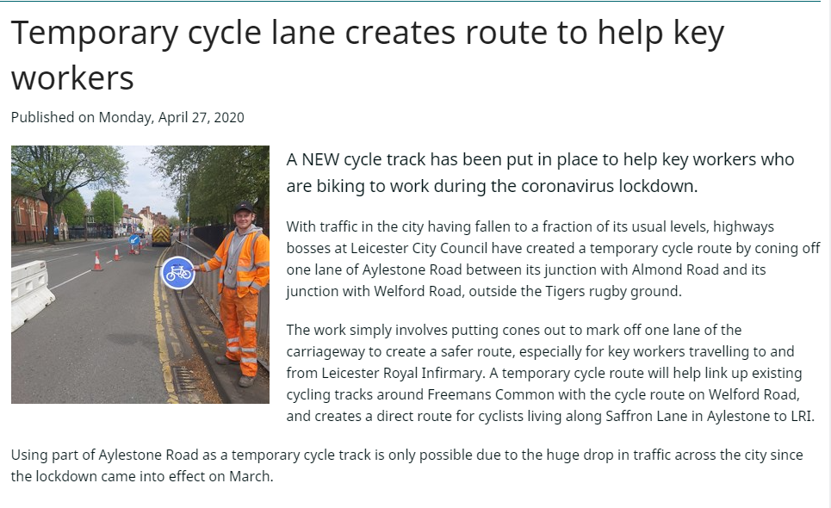
What?
Temporary cycle lane creates route to help key workers (leicester.gov.uk)

Slide 7
Funding Delivered in 2 Tranches, - £250M across England
Tranche 1 – Announced 9th MAY 2020
Portsmouth CC Indicatively Allocated £961,000 (May 29th) [1]
Rapid Deployment Needed
Deliver First, Reclaim Later Principle if possible.
Bid’s Needed to Justify Requests
Tranche 2 – Announced Nov 2020 (~2 months late)
Portsmouth CC’s Final Allocations:
Tranche 1: £214,515
Tranche 2: £461,400
Active travel fund: final allocations - GOV.UK (www.gov.uk)

Slide 8
What’s Next?
Utilise EATF Tranche 2 funding to deliver long term, Improved Active Travel Facilities to enable people to travel without being driven.
Portsmouth’s Already Congested – More people Travelling by Car and less by Public Transport = More Congestion.

