Slide 1

Seafront Cycle Route: Phase II
[<number>]

Slide 2
SCF: Phase I
Phase I due to complete this spring/summer
2 lane cycle path separated from main carriageway
Will create route from Hayling Ferry to South Parade Pier
Portsmouth Cycle Forum are in favour:
  Will make safe, attractive route
  Will encourage cyclists of all abilities
[<number>]

Slide 3
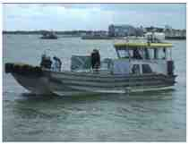
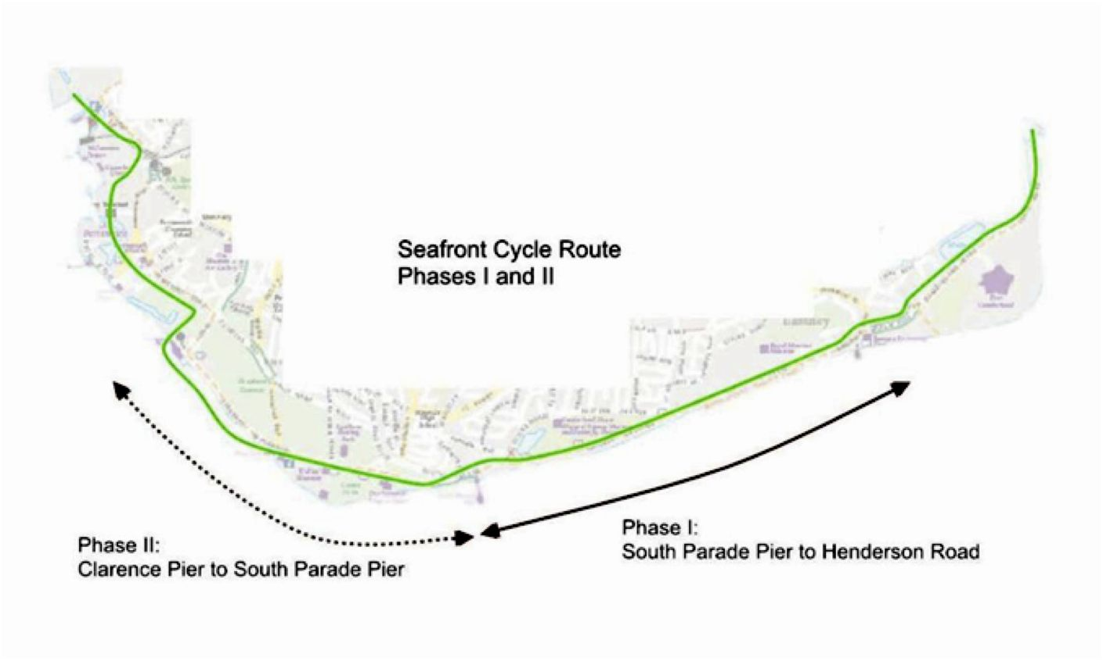
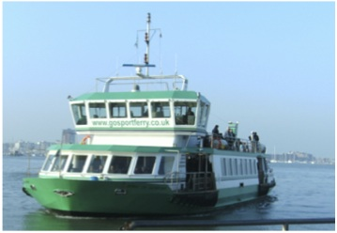
Cycle Ferry to Ferry
[<number>]

Slide 4
Aims of SCR
To encourage cycling along FULL length of seafront
To provide safe, attractive and convenient route
To encourage residents and visitors to cycle
To make more use of seafront out of season
[<number>]

Slide 5
Benefits of SCR
provides an environmentally-friendly, low carbon means of travel
encourages residents to lead a healthier, more active lifestyle
brings more attractions within reach without additional transport measures
[<number>]

Slide 6
Current Situation
Hayling Ferry to Henderson Road well established
Phase I will extend this to SPP
Small section of dual cycle lane west of SPP
Mostly echelon parking facing seafront
[<number>]

Slide 7
Options
Do nothing
Mark a cycle lane on the side of each carriageway
Provide dual lane cycle path north side (away from parking)
Provide dual lane cycle path south side (in front of parking)
[<number>]

Slide 8
Do Nothing
Pros
  No capital cost
Cons
  this will leave a major missing link in the Sustrans NCN2
  it will also leave a gap in PCC cycling strategy
  cyclists using Phase I will not know how/whether to continue
  Many cyclists will continue to use promenade
[<number>]

Slide 9
Marked Cycle Lanes
Pros
  low-cost option
  white line marking lane each side of road
Cons
  Novice/younger cyclists may not feel safe
  DfT recommended width 1.2m will reduce road space
  Vehicles tend to park on marked lanes
  Unsafe behind parked vehicles
[<number>]

Slide 10
Dual Cycle Lane
North Side
Pros
  Will avoid parked vehicles
  Will segregate cycles from vehicles
  Will be seen as safer than marked lanes
Cons
  Will require one-way for vehicles from Pyramids to Clarence Pier
  Will change side of road from phase I reducing convenience
  Takes cyclists away from sea view
[<number>]

Slide 11
Dual Cycle Lane
South Side
Pros
  Will avoid parked vehicles
  Will segregate cycles from vehicles
  Will be seen as safer than marked lanes
  Will provide continuous, safe, separated route along seafront
Cons
  Will require one-way for vehicles from Pyramids to Clarence Pier
  Will move parking further from sea view
[<number>]

Slide 12
Cycling on Promenade
Pros
  Seen as safer for novice/younger cyclists
  Little infrastructure cost
Cons
  Safety issues for unsegregated pedestrians and cyclists
  Too slow for experienced cyclists
[<number>]

Slide 13
Next Steps
Portsmouth City Council will be devising a plan over the coming months
The intention is to implement phase II as soon as phase I is complete
Now it the time for Forum members to have their voice heard
[<number>]

Slide 14
Conclusion
Portsmouth Cycle Forum welcomes your comments
Please visit out website and leave comments in the guest book
www.pompeybug.org.uk
[<number>]

