Slide 1
Cycling Infrastructure Guidance
Local Transport Note 01/20
Gear Change Policy

Slide 2
What’s it all About?
Previous DFT Cycling Infrastructure Guidance (LTN 01/08, LTN01/12) Out of Date and Poor.
It’s only Guidance.
Subguidance Cycling Infrastructure often delivered, and can be more dangerous than nothing.
Cycling Infrastructure often pushed to the “Back roads”, as an after thought, and not the direct, desirable route

Slide 3
Chris Heaton-Harris MP Minister of State with responsibility for cycling and walking :
Too much cycling infrastructure is substandard, providing little protection from motorised traffic and giving up at the very places it is most needed. Some is actually worse than nothing, because it entices novice cyclists with the promise of protection, then abandons them at the most important places. Poor cycling infrastructure discourages cycling and wastes public money. – LTN 01/20

Slide 4
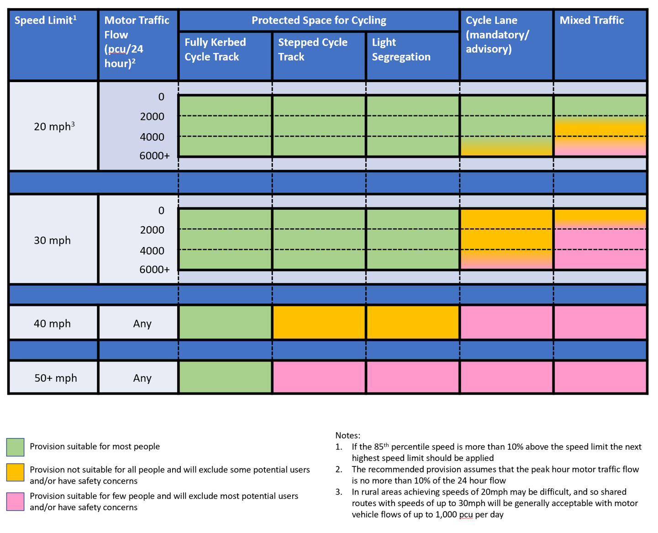
So what’s New?

Slide 5
So what’s New?

Slide 6
So what’s New?

Slide 7
Learn More:
Cycle infrastructure design (LTN 1/20) - GOV.UK (www.gov.uk)
Cycling and walking plan for England - GOV.UK (www.gov.uk)
Ideas wth Beers Ideas with beers 28.7.20 - YouTube
(Urban Movement) Cycle Infrastructure Guidance & Junction Assessment Tool 50:10

