Slide 1
Local Cycling and Walking Infrastructure Plan (LCWIP)

Slide 2
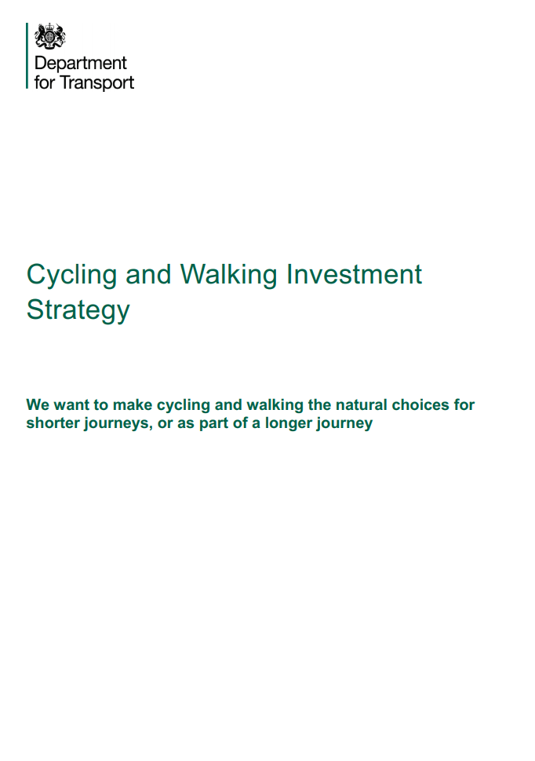
Where did they come from?
In 2017 the DfT says the CWIS:
outlines the government’s ambition to make cycling and walking a natural choice for shorter journeys, or as part of longer journeys by 2040
sets out the objectives and the aims and target that we will work towards in the shorter term
details the financial resources available
includes a number of indicators that will help us understand how we are performing
sets out the governance arrangements that will be put in place and outlines actions that have already been taken, as well as actions planned for the future

Slide 3

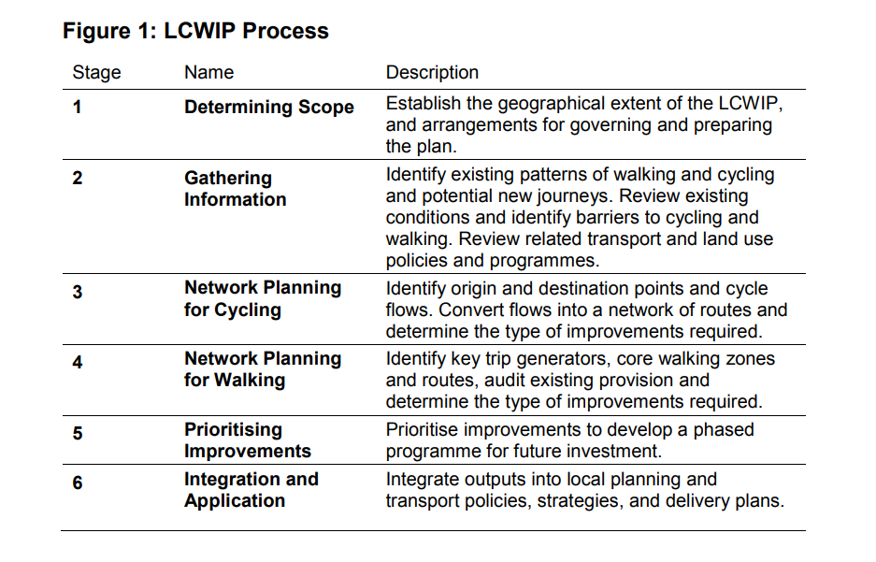
What are they?

Slide 4
Local
Led by the Highway Authority
Engaging local stakeholder groups

Slide 5
Cycling
Evidence based (PCT)
Cycle network

Slide 6
Walking
Zones or routes
Harder to do

Slide 7
Infrastructure
‘I’ is for infrastructure not investment (there’s no money)
Sets out high level suggested options

Slide 8
Plan
Short, medium, long term
Funding options

Slide 9

Portsmouth’s LCWIP
Drafted with input from local stakeholders
Consulted on late 2020
PCF promoted to members, and responded formally

Slide 10
What did we think of it?
VERY, VERY, VERY PLEASED THAT THEY DID IT
Thankful to have been involved in a small way but…
4 big issues:
Move faster, and be more ambitious
Consider alternative routes, not just the existing highway network
Add missing east-west routes
Provide for journeys outside the City Centre

Slide 11
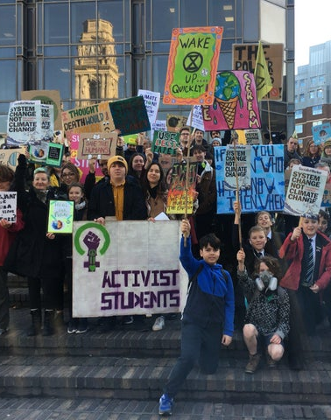
1. Move faster and be more ambitious
“By 2036 Portsmouth will have a people-centred travel network that prioritises walking, cycling and public transport to help deliver a safer, healthier and more prosperous city.” vs “balancing the needs of all road users”
Our house is on fire – Climate Emergency
PCC LTP4 (draft)

Slide 12
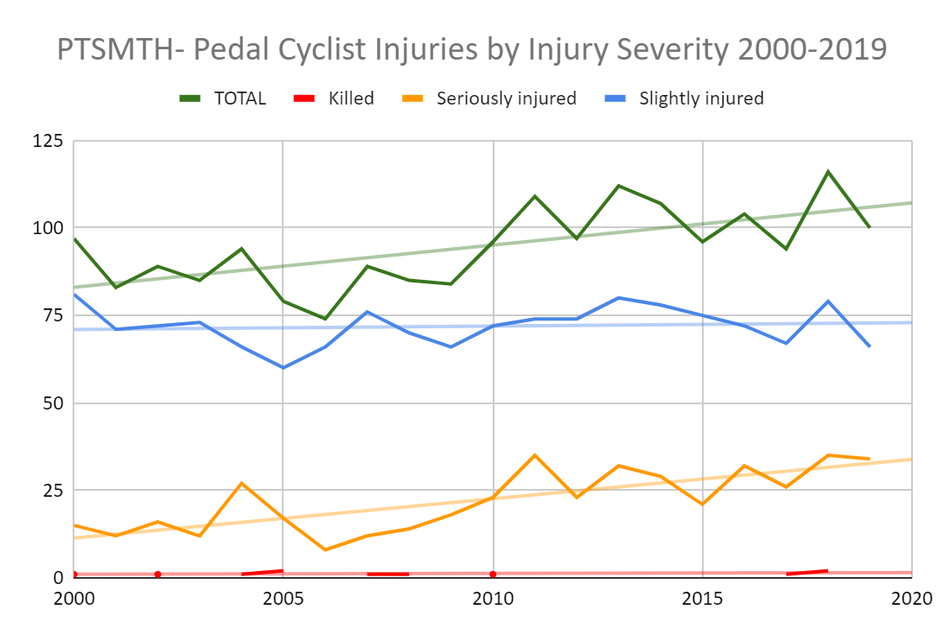
2. Consider alternative routes, not just the existing highway network
Biggest reason for not cycling is fear of traffic
Add in Tipner Path and dedicated routes through City Centre away from traffic

Slide 13
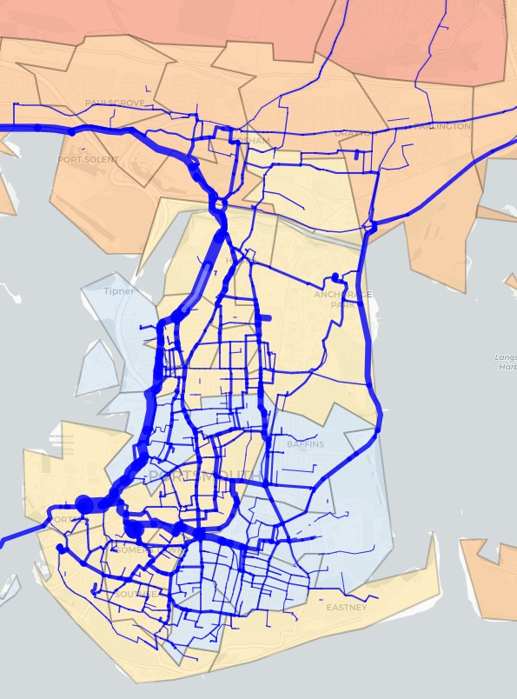
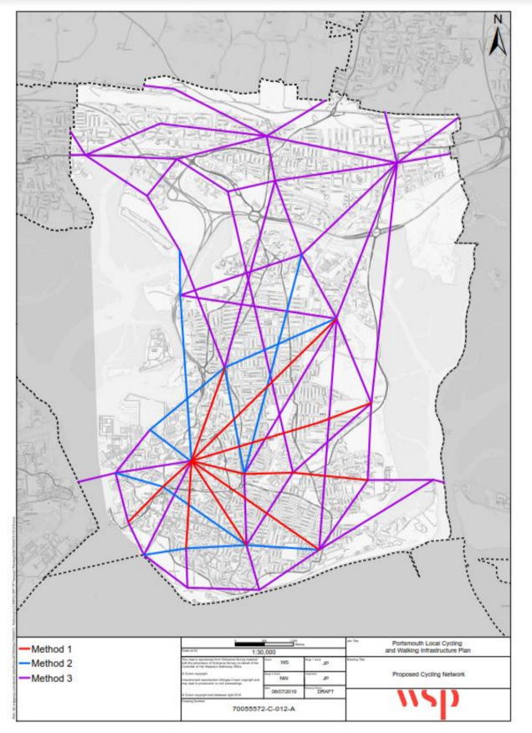
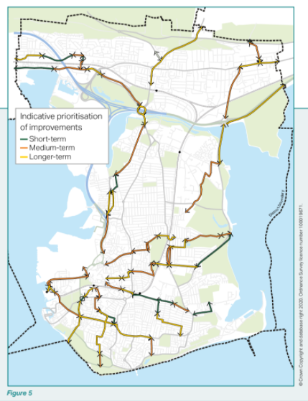
3. Add missing east-west routes
Notes:
Top 30% routes PCT
WSP OD map
10 year plan

Slide 14
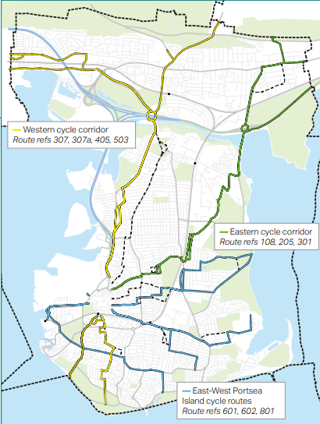
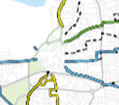

4. Provide for journeys outside the City Centre
Notes:
Missing – ferry to ferry, northern east-west routes, farlington to southsea, long long term plan is missing

Slide 15
What did we say?
36 page detailed response – ably assisted by the committee and new members – we’re very grateful for their help (Dick, Agata, Terence and Ben)
For every challenge, a way forward
We offered PCC our support in future engagement and involvement in delivering the plan
https://www.pompeybug.co.uk/wp-content/uploads/2021/01/PCF-LTP2036-Consultation-Response.pdf

Slide 16
Links
Cycling and Walking Investment Strategy (publishing.service.gov.uk)
Local cycling and walking infrastructure plans technical guidance (publishing.service.gov.uk)
Local Cycling and Walking Infrastructure Plan (LCWIP) - Travel Portsmouth

