Slide 1
Local Transport Plan (LTP4)

Slide 2
What is a Local Transport Plan?
Local Transport Plans are a statutory requirement
Sets the baseline
Outlines challenges and opportunities
Sets aims and objectives

Slide 3
Portsmouth’s new Local Transport Plan
It’s called “Portsmouth Transport Strategy 2020-2036”
Pretty succinct (<50 pages)
Pretty good, actually

Slide 4
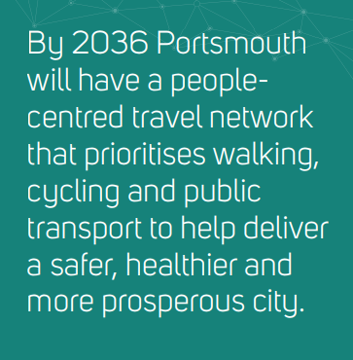
The Vision:

Slide 5
Identifies key issues:
Climate emergency
Dominance of cars
Obesity
Air pollution
Deprivation
Reallocation of road space needed

Slide 6
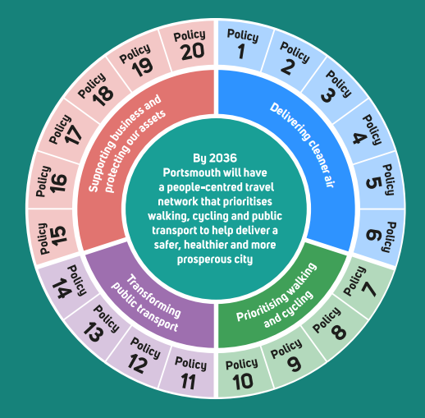
1 x vision 4 x objectives 20 x policies

Slide 7
Delivering cleaner air
1. Implement a government-directed city centre Clean Air Zone in 2021
2. Support infrastructure for alternative fuelled vehicles
3. Maintain the residents’ parking permit system while encouraging fewer, cleaner vehicles and supporting car clubs
4. Expand the Portsmouth Park & Ride to reduce pollution and congestion in the city centre
5. Explore private non-residential parking restrictions to encourage mode shift and help pay for improved walking, cycling and public transport infrastructure
6. Deliver residential and business behaviour change initiatives to encourage people to walk, cycle and use public transport

Slide 8
Prioritising walking and cycling
7. Reallocate road space to establish a cohesive and continuous network of attractive, inclusive and accessible walking and cycling routes accompanied by cycle parking facilities
8. Manage parking through parking controls and introduce a network of low traffic neighbourhoods that reduce ‘rat running’ traffic in residential streets
9. Improve the city centre, local and district centres by reducing or removing general traffic, with access focused on walking, cycling and public transport
10. Deliver innovations in micro-mobility to promote travel choices and active travel options

Slide 9
Transforming public transport
11. Develop a rapid transit network that connects key locations in the city with South East Hampshire, and facilitates future growth
12. Prioritise local bus services over general traffic to make journeys by public transport quicker and more reliable and support demand-responsive transport services
13. Deliver high quality transport interchanges, stations and stops
14. Work with public transport operators to deliver integrated, efficient and affordable services promoting local and regional connectivity

Slide 10
Supporting business and protecting our assets
15. Protect access to the ports and HM Naval Base, Portsmouth
16. Support businesses and other organisations to consolidate their operational journeys, including use of zero emission vehicles for last mile deliveries
17. Deliver micro and macro freight consolidation centres to serve Portsmouth’s businesses and residents
18. Introduce a lane rental scheme to maximise co-ordination of street works and roadworks, and review loading restrictions to minimise impacts on traffic sensitive routes during peak periods
19. Maintain our highway infrastructure
20. Proactively manage kerbside space to enable flexible use for essential access

Slide 11
PCF response
The new LTP is a good match for “A City to Share”
Concerned that actions speak louder than words (Elm Grove) and that residents might not be ready without significant work to explain and educate
Implementation Plan and Equalities Impact Assessment are missing
“Place making” is missing
As always, we’re open to working with PCC on future plans

Slide 12
Links
Travel Portsmouth - creating a greener, healthier, better connected city

