Slide 1
Air pollution in Portsmouth PCF open meeting 21 Jan 21
Mike Dobson
pompeycycle@gmail.com

Slide 2
Key points (1)
Air quality or air pollution?
PCC’s air quality modelling very detailed and precise but wrong
Inaccurate and unrepresentative readings of air pollution in hotspots
Contradictory assumptions about growth in motor traffic
Optimism bias
‘Playing tunes’ with modelling inputs to achieve bare minimum of compliance in hot spots
Number of motor vehicles keeps rising
30,000 extra homes?
Lack of political will to curb motor traffic
PCC has resisted a CAZ
Limited area Class B CAZ only for part of city
PCC’s AQ plans invalid
unlikely to achieve NAQOs across the city by 2022
Will not achieve clean air in breathing zone

Slide 3
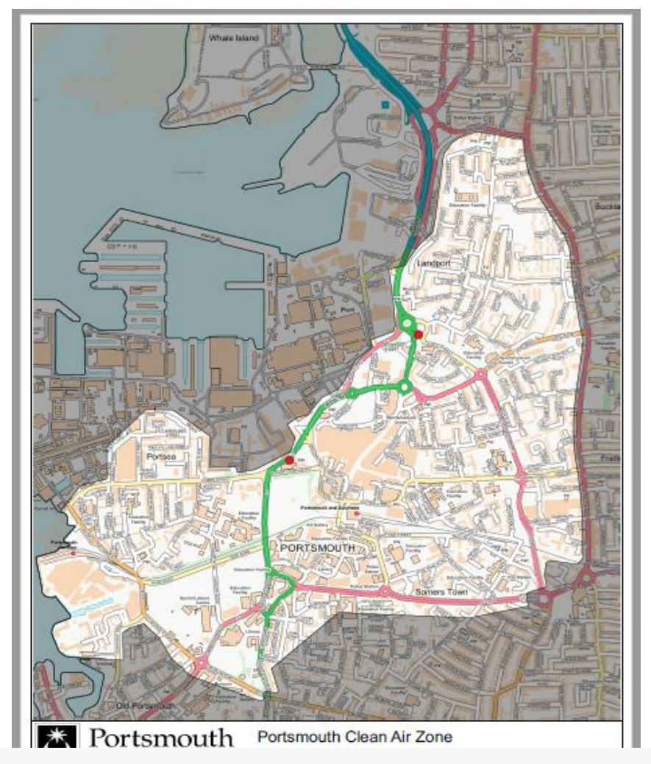
The limited area CAZ encourages displacement of traffic onto adjacent routes:
Kingston Crescent, Kingston Road, Fratton Road are excluded from the CAZ – expect more traffic and more air pollution on those roads
The Continental Ferry Port is excluded
PCC gave serious consideration to excluding the Isle of Wight Gunwharf terminal

Slide 4
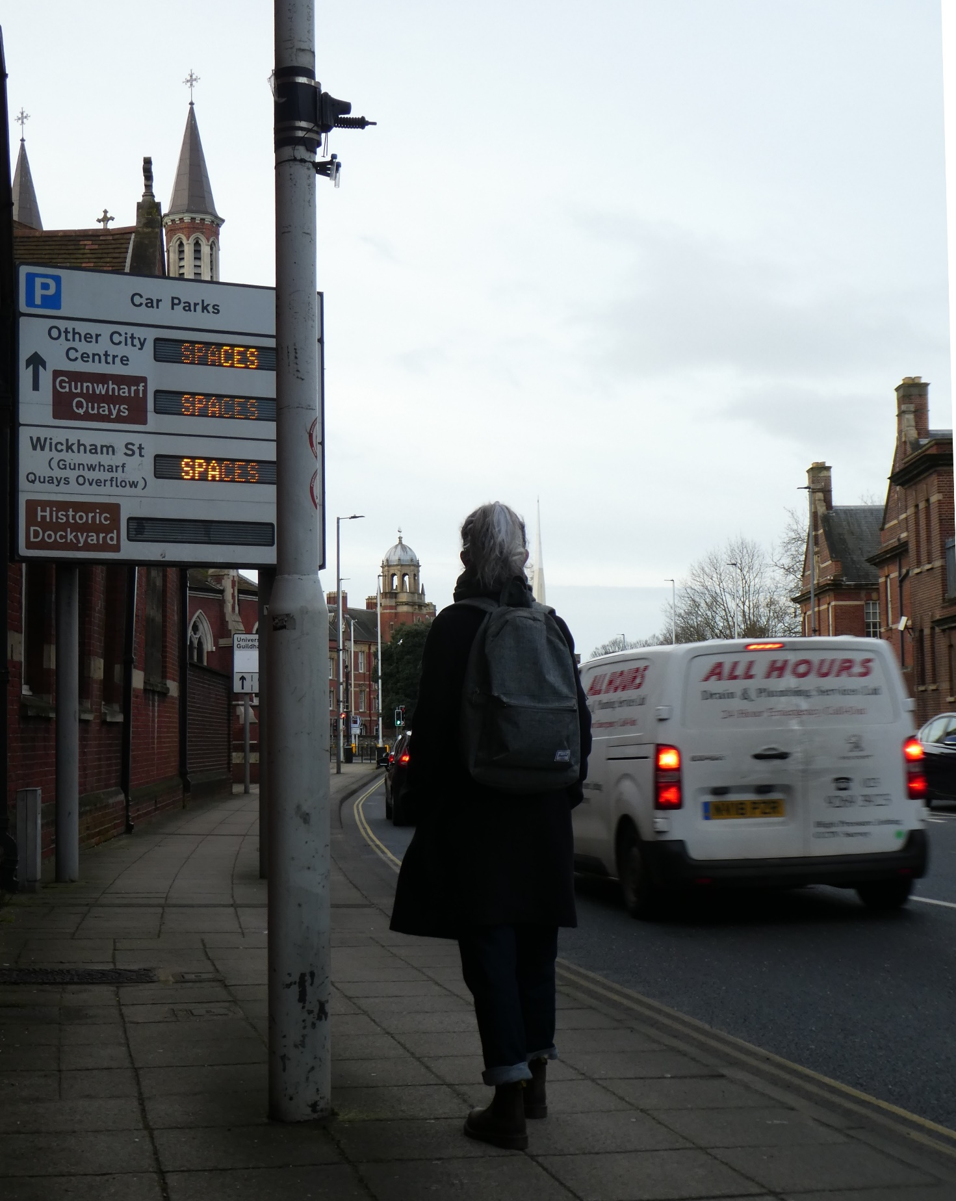
Alfred Road NO2 tube – height 2.55m one of JAQU targeted exceedance locations
DEFRA guidance:
“Ideally, samplers would be placed at breathing height, but in order to reduce theft of tubes, it is recommended that tubes are placed at a height of 2 to 4 m
Concentrations of NO2 typically decrease with height above street level, so tubes placed some metres above street level may under-estimate the actual concentrations to which the public are exposed.
“the inlet sampling point shall be between 1.5m (the breathing zone) and 4m above the ground. For security reasons, the inlet should be greater than 2m, though it is recognised that lower sampling heights better reflect the ambient conditions encountered by members of the public”
Comments
This receptor tube is located in an air pollution hot spot and a JAQU targeted exceedance location.
If this tube was mounted 55 cm lower at the recorded height of 2m, the NO₂ reading would be significantly higher than 50.38 μg/m3
AQ modelling using accurate readings at 2m height would give a more pessimistic assessment that would require more stringent measures e.g. a city-wide Class D CAZ
Why has PCC mounted this receptor much higher than the 2m stated in reports and used in AQ modelling? There is low footfall so minimal likelihood of vandalism. A plausible explanation:
Has this tube has been deliberately mounted much higher than declared by PCC (someone had to use a ladder!) in order to under-report the levels of air pollution?
Is PCC guilty of knowingly submitting false information to government?
Tube mounted ~1m higher than the breathing zone gives lower readings of air pollution
Site ID | Site Name | Pollutants Monitored | In AQMA | Height (m)
118 | Alfred Road, Column 12 (AR-Col 12) | NO2 | N | 2m
Notes:
Diffusion Tubes for Ambient NO2 Monitoring: Practical Guidance for Laboratories and Users Issue 1a Feb 2008 advises:
3.2 Selecting Diffusion Tube Sites
DEFRA Technical Guidance LAQM.TG(16) states
“the inlet sampling point shall be between 1.5m (the breathing zone) and 4m above the ground. For security reasons, the inlet should be greater than 2m, though it is recognised that lower sampling heights better reflect the ambient conditions encountered by members of the public”
2019 ASR Alfred Road, Column 12 (SL: 118, DC: 25%, AM: 50.38μg/m3,
Riccardo-AEA study in 2019
Assessing variations in roadside air quality with sampling height 9th June 2015
Study commissioned by the Scottish Government to investigate roadside air quality versus height:
investigate how Air Quality varies with height and aims to:
• Determine the relationship between height from pavement and Air Quality
Research indicates that a pollutant gradient does exist at heights below 3 m above ground level, but that the following factors will affect the vertical profile:
➢ Meteorology.
➢ Topography.
➢ Distance from emissions source.
• No study was found that incorporated mobile sampling with sampling at more than one height.
• Methodology outlined for the study was validated.
• Sampling heights defined as 168 cm above ground level for the average height of an adult above the age of 16 years in Scotland; and 80 cm for a child in a buggy
Nitrogen Dioxide 𝑁𝑂2 (1.68 𝑚) = 1.224 × 𝑁𝑂2 (0.80 𝑚) − 9.155
Results indicate that a concentration gradient does exist, but that this is dependent upon a number of factors including:
➢ Microenvironment.
➢ Met conditions.
➢ Pollutant sources.
➢ Pollutant.

Slide 5
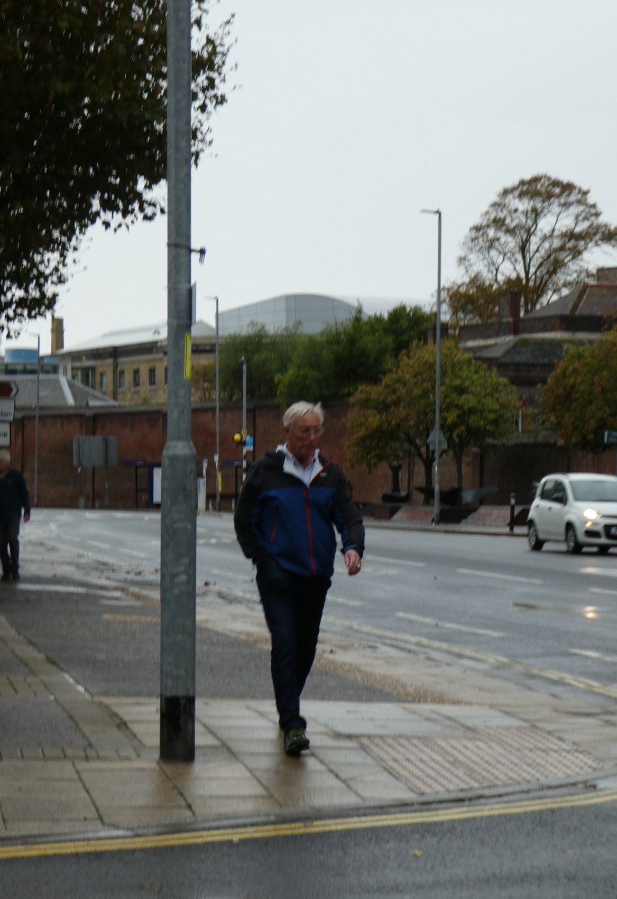
Queen Street NO2 tube ht 2.3m
DEFRA guidance:
“Ideally, samplers would be placed at breathing height, but in order to reduce theft of tubes, it is recommended that tubes are placed at a height of 2-4 m
Concentrations of NO2 typically decrease with height above street level, so tubes placed some metres above street level may under-estimate the actual concentrations to which the public are exposed.
“the inlet sampling point shall be between 1.5m (the breathing zone) and 4m above the ground. For security reasons, the inlet should be greater than 2m, though it is recognised that lower sampling heights better reflect the ambient conditions encountered by members of the public”
Comments
Unrealistic – this NO₂ diffusion tube is 80 cm higher than the breathing zone and 30 cm higher than declared in PCC reports and AQ modelling
Inaccurate assessment:
poor analysis techniques leading to
flawed conclusions and
bad recommendations
Tube mounted ~70 cm higher than the breathing zone gives lower readings of air pollution
Site ID | Site Name | Pollutants Monitored | In AQMA? | Height (m)
4 | Queen Street, Column 30 (QS-Col 30) | NO2 | N | 2m

Slide 6
Too many motor vehicles in Portsmouth – yet the numbers keep rising!
The number of motor vehicles registered in Portsmouth continues to increase. Where do all these vehicles go? Every concession made by PCC for more road space and more car parking reduces the space available for walking and cycling.
In 2019 the number of vehicles of all types increased by ~1600. The number of ULEVs increased by 370. Although the increase in the number of ULEVs is welcome, it is apparent that the overall increase in air polluting Internal Combustion Engine vehicles is over 3 times greater
https://www.gov.uk/government/statistical-data-sets/all-vehicles-veh01

Slide 7
The welcome reduction in the number of diesel cars is cancelled by the worrying increase in the number of diesel vans.
In June 2020, 92.5% of all Ultra Low Emission Vehicles registered in Portsmouth were company owned (and may be located anywhere in the UK)
Only 222 ULEVs in Portsmouth are privately owned
https://www.gov.uk/government/statistical-data-sets/all-vehicles-veh01

Slide 8
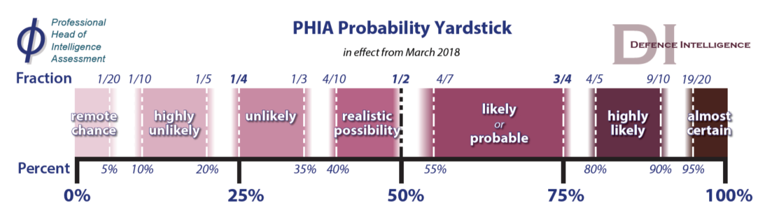
Optimism bias
Optimism bias –the proven tendency for appraisers to be too optimistic about key project parameters, including capital costs, operating costs, project duration and benefits delivery.
Treasury Green Book 2.16
AQLP considers optimism bias for costs
AQLP neglects optimism bias for project duration and benefits delivery
Naive approach: ‘we have complete confidence that it will work fully and on time’ ?
No estimates of uncertainty, errors, ballparks
No consideration of previous PCC failures
No plan B
Good analysis uses different ways of expressing uncertainty. PCC has no estimate of uncertainty in the overall success of the AQLP.

Slide 9
AQLP and cycling
2020 Air Quality Annual Status Report (ASR)
https://www.portsmouth.gov.uk/wp-content/uploads/2020/12/2020-Air-Quality-Annual-Status-Report_Accessible.pdf
Outline Business Case (OBC) submitted to JAQU 31 Oct 19, approved 25 Mar 20
Approved measures with funding
Class B CAZ covering concentrated area in the southwest of Portsea Island
Daily charge to the most polluting buses, coaches, taxis, private hire vehicles and heavy goods vehicles for driving within the zone
PCC assumes little displacement of polluting traffic onto other routes e.g. Eastern Road, London Rd-Kingston Rd-Fratton Rd
Review of car parking to consider availability and charges
Changes to traffic signal timings on Alfred Road
Tightening of taxi licensing requirements for taxi and private hire vehicles
Financial support towards upgrade or replacement of non-compliant vehicles (funded through a successful bid to the government's Clean Air Fund)
Not approved “considered not to be essential in achieving compliance … legal levels of nitrogen dioxide can be reached without these measures”.
Strategic cycling routes
No incentives to encourage use of public transport.

