Slide 1
Multiple Linear Regression Analysis
on Bank Data
Leveraging Data to Help Increase Sales Through Predictive Analytics
Presented By:
Mashiyat Alam Promi
Group: Solo 4

Slide 2
Project Goal:
Implement multiple regression models on the data to see which one performs well and find out the best one for this dataset.
Business Goal:
Based on the analysis, suggest strategies to target right customers, develop specially curated products and marketing strategies, and make informed decision to increase revenue.

Slide 3
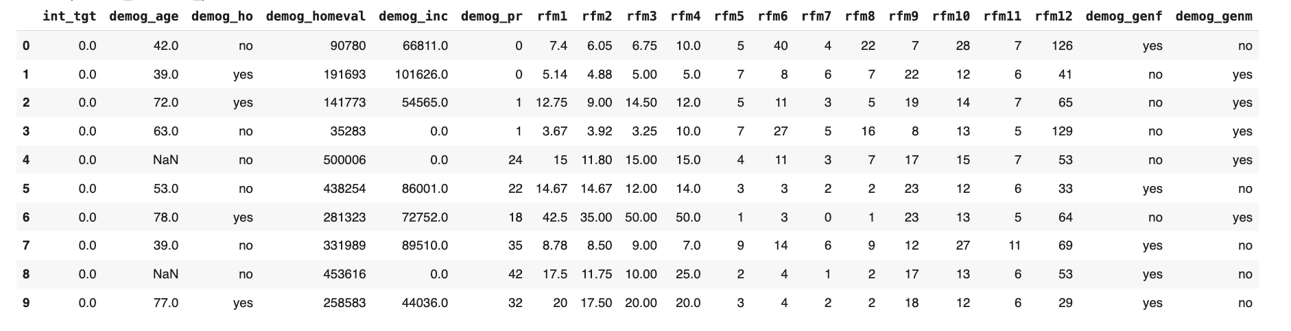
Our Dataset:
127,089 rows with 20 variables (initially)
1 Target Variable: “int_tgt”
12 Recency, Frequency, Monetary (RFM) Features
7 Demographic Variables (Customer Characteristics)

Slide 4
Challenges in Preparing Data:
Inconsistent data types across demographic and monetary fields
Missing values requiring appropriate imputation strategies
Outliers that could distort model performance
Binary variables needing standardization
Solutions:
String values converted to appropriate numeric values
Median imputation for numeric variables
IQR method to identify and handle outliers

Slide 5
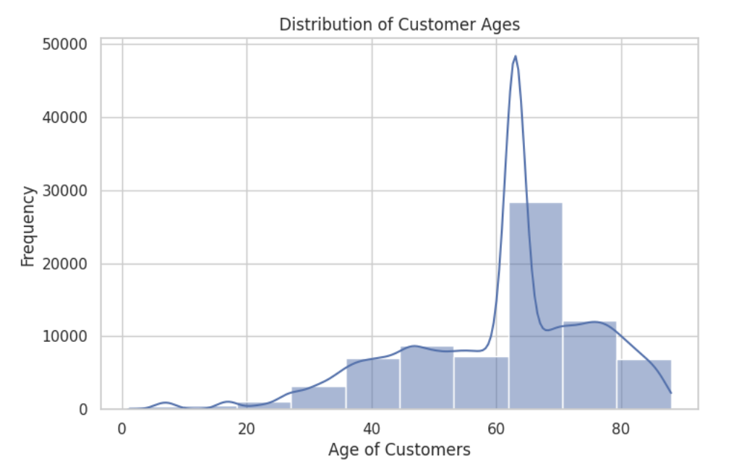
EDA: Customer Age Distribution

Slide 6
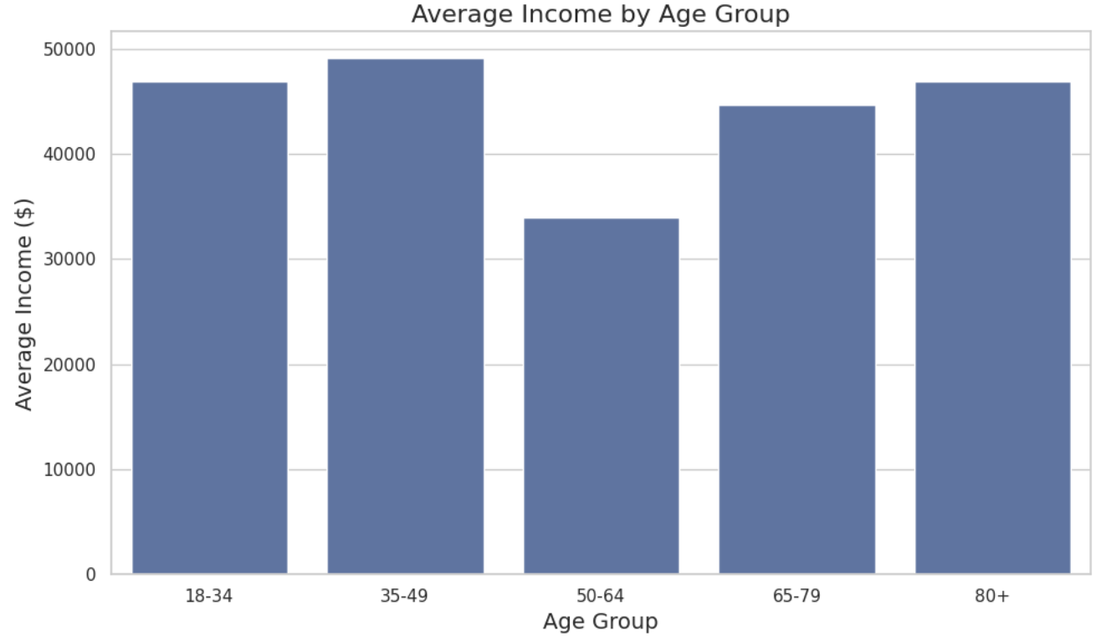
EDA: Age vs. Income Relationship

Slide 7
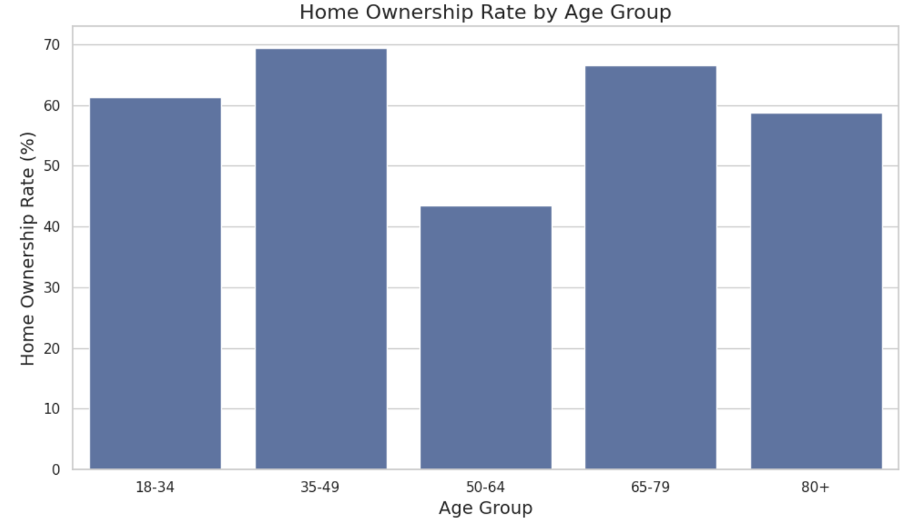
EDA: Home Ownership Patterns

Slide 8
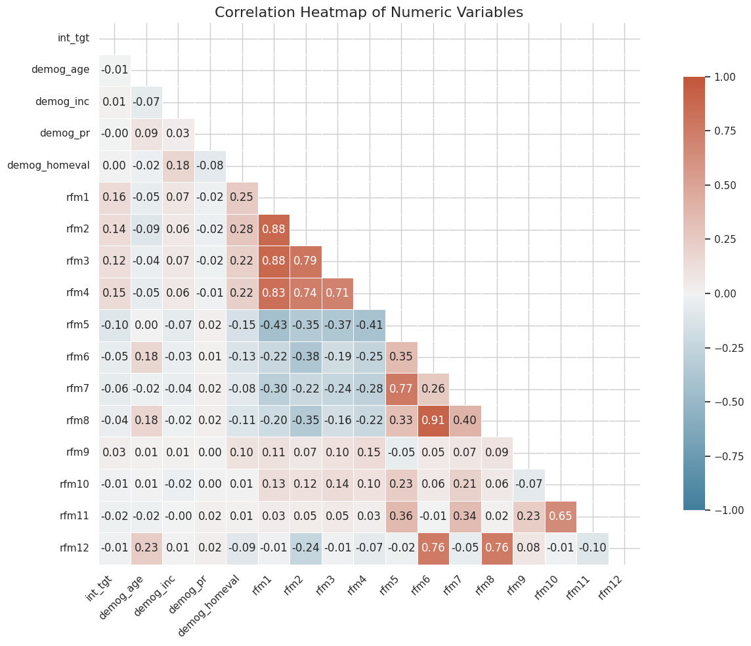
EDA: Correlation Analysis

Slide 9

List of Implemented Models:
Linear Regression
KNN
Random Forest
XGBoost

Slide 10
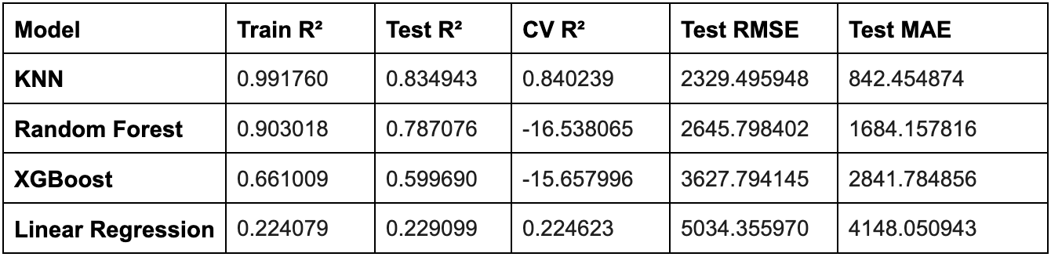
Model Selection and Performance

Slide 11
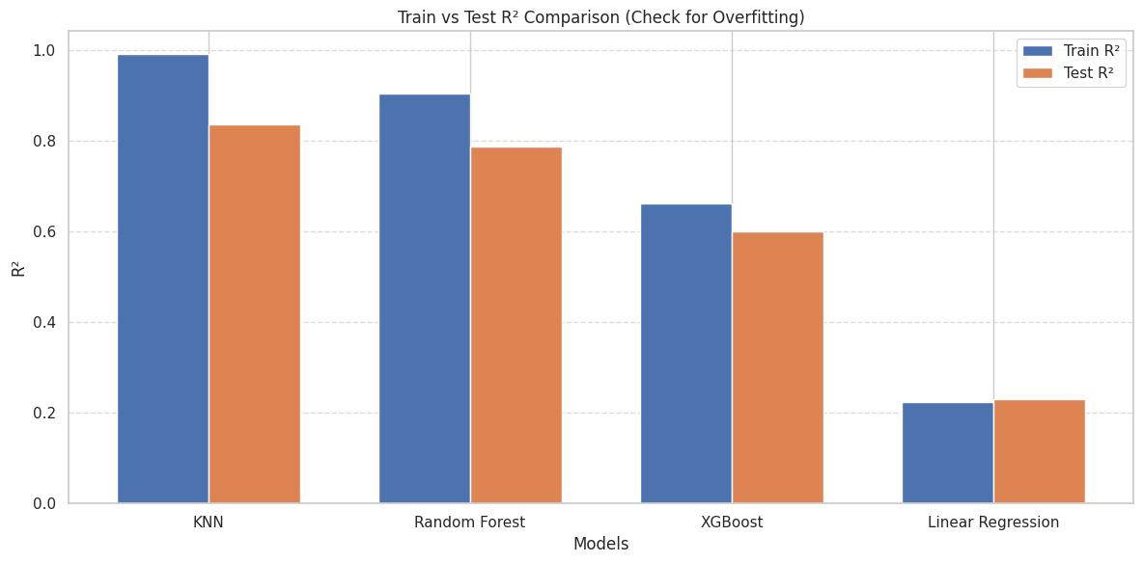
Model Selection and Performance

Slide 12
The Best Model:
K-Nearest Neighbors regression model demonstrates superior predictive performance for our banking sales potential analysis with a Test R² of 0.834
In Simple Terms:
Our model identifies which customers are likely to generate higher sales, allowing us to invest our limited resources on those with the highest return potential.

Slide 13
Lessons Learned and Contribution
Key Lessons:
Behavioral metrics outperform demographics in predicting sales
KNN is a superior predictor model for customer purchase predictions
Complex, non-linear relationships exist in customer purchasing behavior
Contribution:
Mashiyat Alam Promi: For Analysis, report writing, slides, strategy and presentation: $240,000 (80%)
AI Assistance: Data Prep, Code generation and debugging suggestion: $60,000 (20%)

Slide 14
THANK YOU!

