Slide 1
COOKIEGUARD
Interactive Cookie and Session Security Laboratory
Marco Ponce
Seton Hall University
M.S. Cybersecurity
ISCI 6301: App Security & Web Technology

Slide 2
MOTIVATION
Problem and motivation
Cookie and session security settings are easy to configure incorrectly and difficult to observe directly
CookieGuard makes browser cookie and session behavior observable rather than theoretical
It provides controlled XSS and CSRF experiments using dedicated lab cookies
Goal: demonstrate the actual effect of common cookie security protections
2

Slide 3
SYSTEM DESIGN
Architecture
Browser
Implementation facts
Frontend: Next.js + TypeScript
Backend: Node.js
Frontend runs at HTTPS localhost:3000
Backend runs at HTTPS 127.0.0.1:4443
Frontend proxy forwards /api/* to backend
Sessions are stored in memory
Local HTTPS uses mkcert
Next.js / TypeScript frontend
https://localhost:3000
API proxy -> Node.js / TypeScript backend
https://127.0.0.1:4443
Session / authentication + security labs
3

Slide 4
SESSION COOKIE
Cookie and session security
Secure
HttpOnly
SameSite
Cookie is sent only over HTTPS. Protects cookie transport
JavaScript cannot directly read the cookie. Reduces direct cookie theft via JS
Controls when cookies are sent with cross-site requests. Helps mitigate CSRF
cookieguard_session
These settings reduce specific risks; they do not make the application completely secure on their own
Secure = enabled
HttpOnly = enabled
SameSite = Lax
Path = /
4

Slide 5
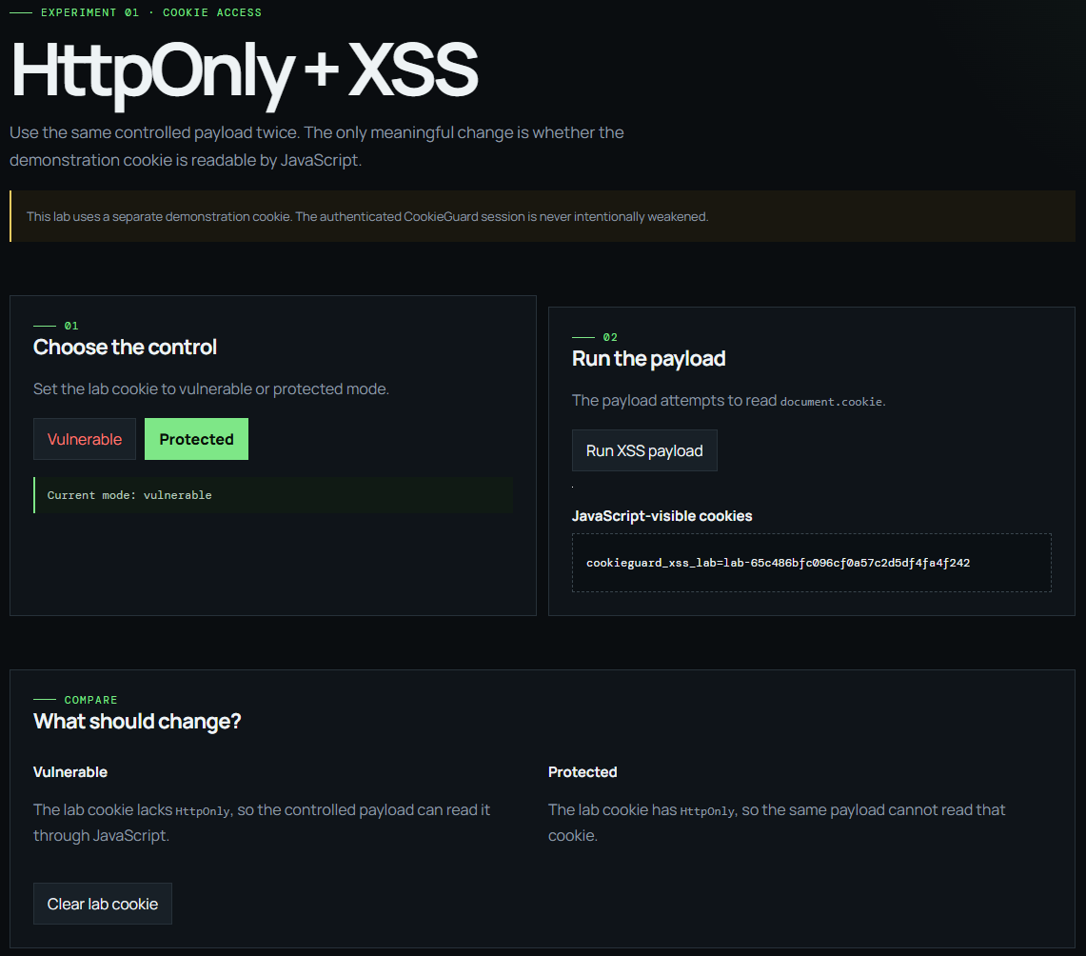

CONTROLLED EXPERIMENT 1
XSS lab
Vulnerable mode
Protected mode
Dedicated XSS lab cookie does NOT use HttpOnly
Controlled JavaScript can read it using document.cookie
Same controlled payload; HttpOnly is enabled
JavaScript cannot directly read the cookie value
Secure remains enabled in both modes; HttpOnly does not prevent XSS itself, only direct JavaScript access to the cookie
5

Slide 6
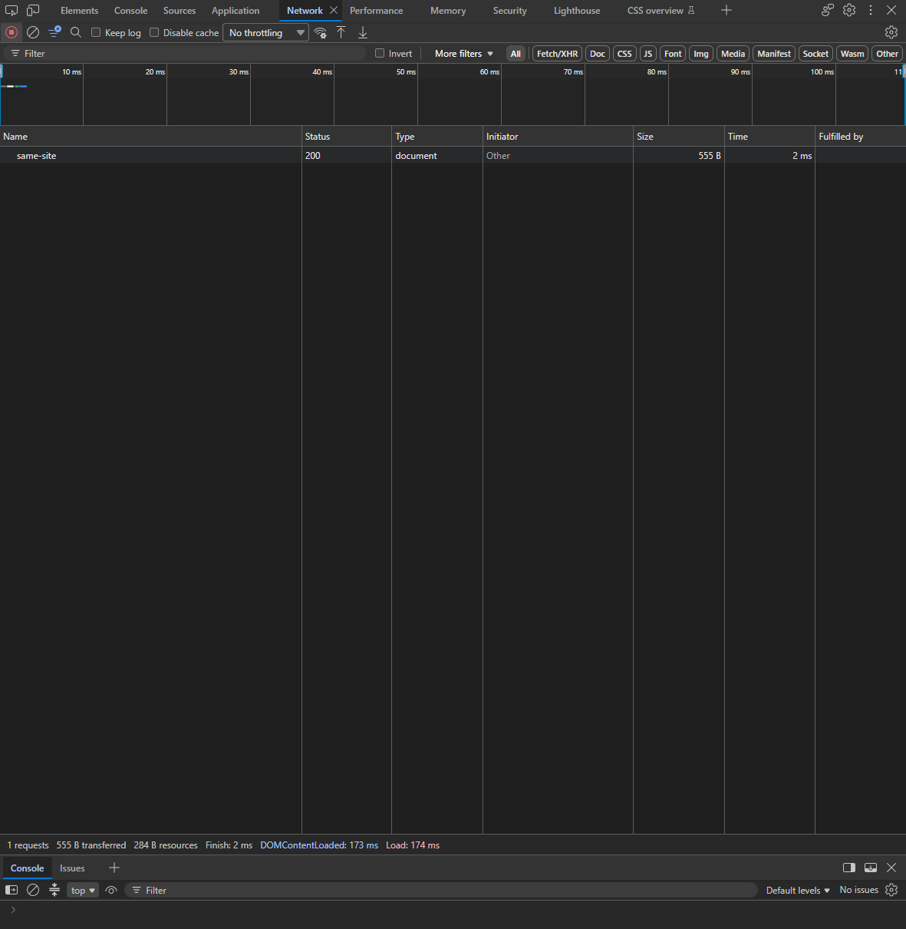
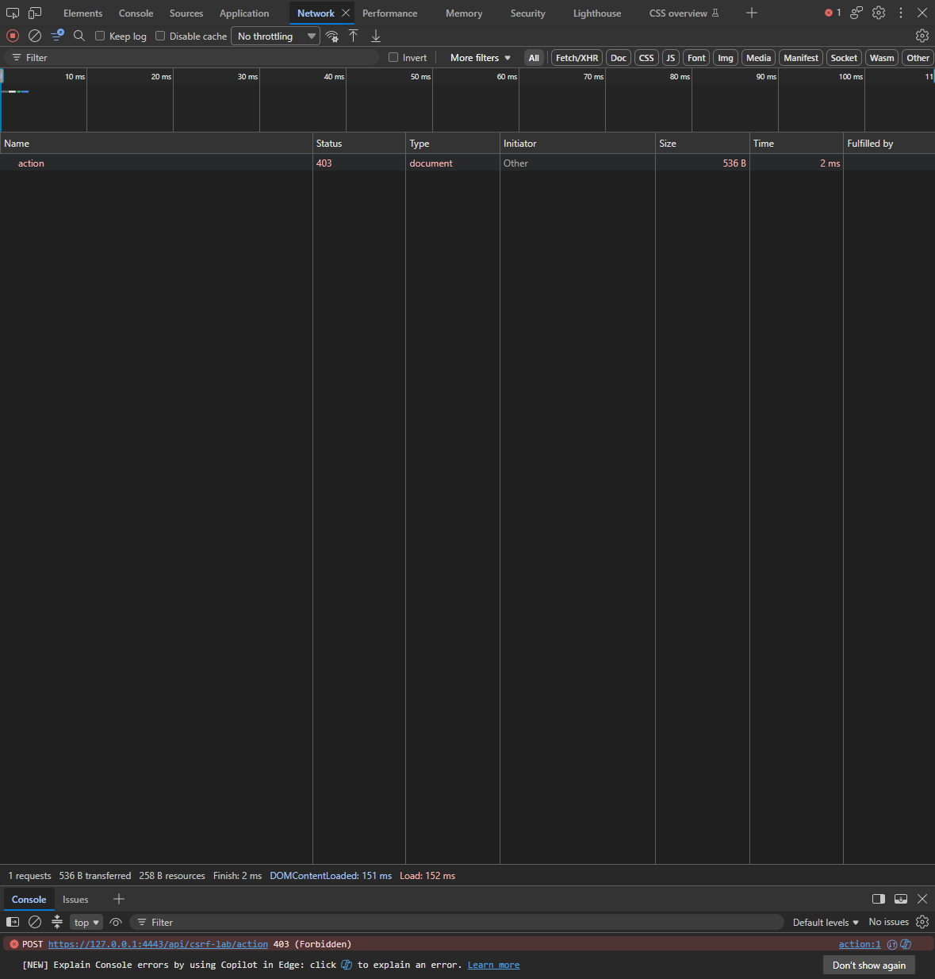
CONTROLLED EXPERIMENT 2
CSRF lab
Same-site POST -> cookie attached -> HTTP 200
Cross-site POST -> cookie withheld -> HTTP 403
Authenticated session cookie uses SameSite=Lax. The dedicated CSRF lab cookie uses SameSite=Strict for a deterministic blocked case; Lax does not block every possible CSRF scenario
6

Slide 7
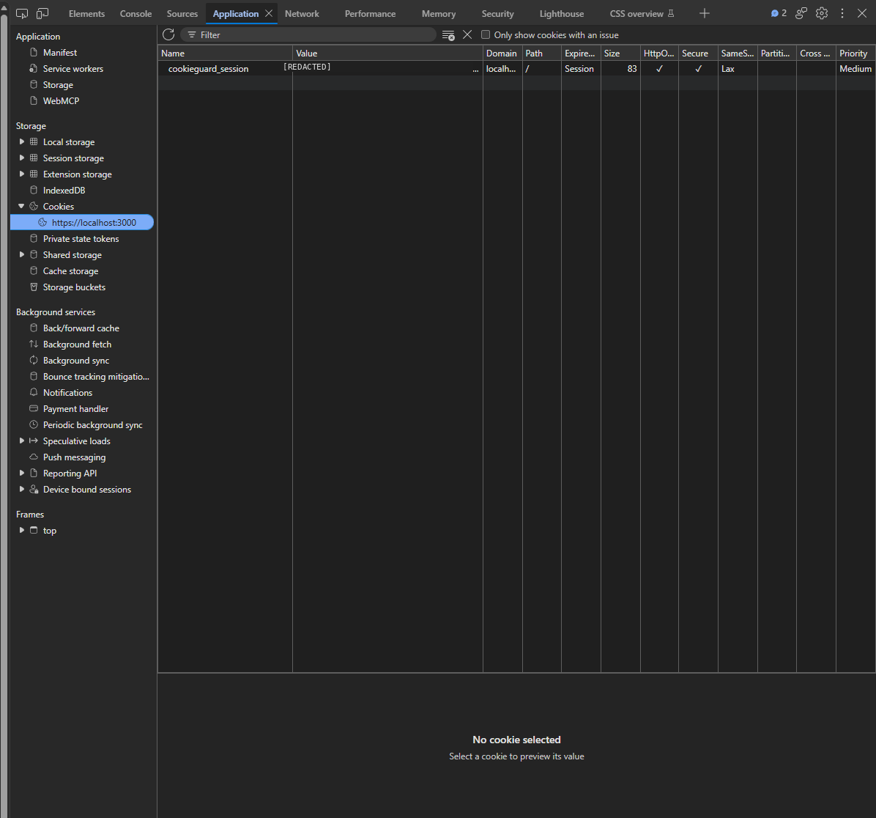
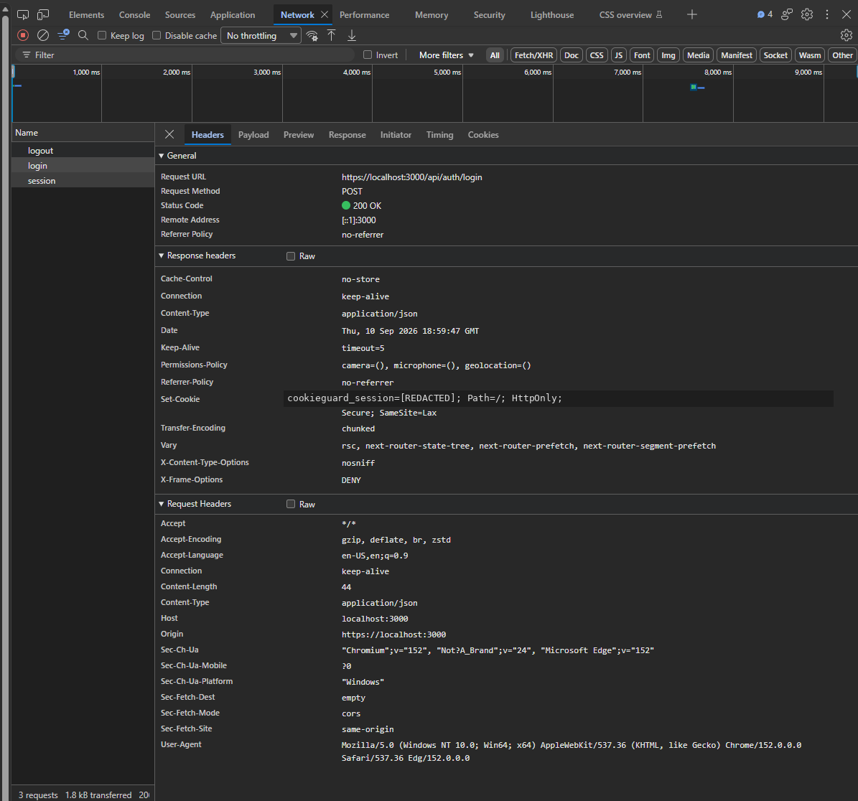
VERIFICATION
HTTPS, testing, and hardening
HTTPS
Testing
Hardening
Frontend and backend both use HTTPS
Backend health check returned HTTP 200
Local certificates generated with mkcert
TLS verification was not globally disabled
npm run verify
17 / 17 tests passed
Backend TypeScript build passed
Frontend production build passed
GitHub Actions verification passed
X-Content-Type-Options: nosniff
X-Frame-Options: DENY
Referrer-Policy: no-referrer
Cache-Control: no-store (where applicable)
64 KiB JSON body limit
Bounded request-body accumulation
7

Slide 8
WRAP-UP
Results, limitations, and takeaway
Results
Limitations
MVP completion criteria were met
Automated verification passed
Manual browser testing covered the main security labs
Fixed demo account
In-memory sessions
Local mkcert certificate
Intentional vulnerable XSS mode
Next.js 15.5.6 should be upgraded before production use
CookieGuard makes cookie and session security behavior observable through controlled browser experiments
8

