Slide 1
COOKIEGUARD
Interactive Cookie & Session Security Lab
Marco Ponce
M.S. Cybersecurity, Seton Hall University
App Security & Web Technology

Slide 2
SYSTEM DESIGN
Architecture & authentication
Browser
Fixed demonstration credentials (demo / cookieguard) for repeatable testing
Sessions are stored in memory, not persisted to a database
Frontend forwards /api/* requests to the backend over HTTPS via a proxy route
Local trusted certificates are generated with mkcert
Next.js frontend
https://localhost:3000
API proxy -> Node.js backend
https://127.0.0.1:4443
In-memory sessions + security labs
2

Slide 3
SESSION COOKIE
Cookie security
cookieguard_session
Secure
Enabled
Secure: Restricts the cookie to HTTPS transport.
HttpOnly
Enabled
SameSite
Lax
HttpOnly: Limits direct JavaScript access to the cookie value.
Path
/
Expiration
Session
Persistent
Disabled
SameSite: Controls whether the cookie is sent with cross-site requests.
Domain
Host-only (not set)
3

Slide 4
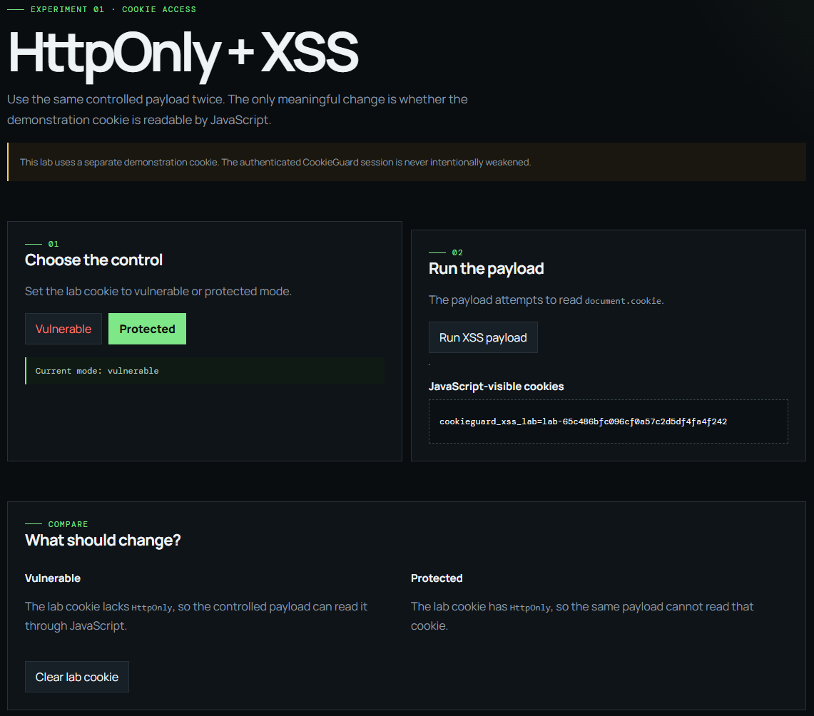

CONTROLLED EXPERIMENT 1
XSS and HttpOnly
Vulnerable mode
Protected mode
4
Notes:
Key takeaway: HttpOnly reduces the ability of injected JavaScript to directly access the protected cookie. It does not prevent XSS itself.

Slide 5

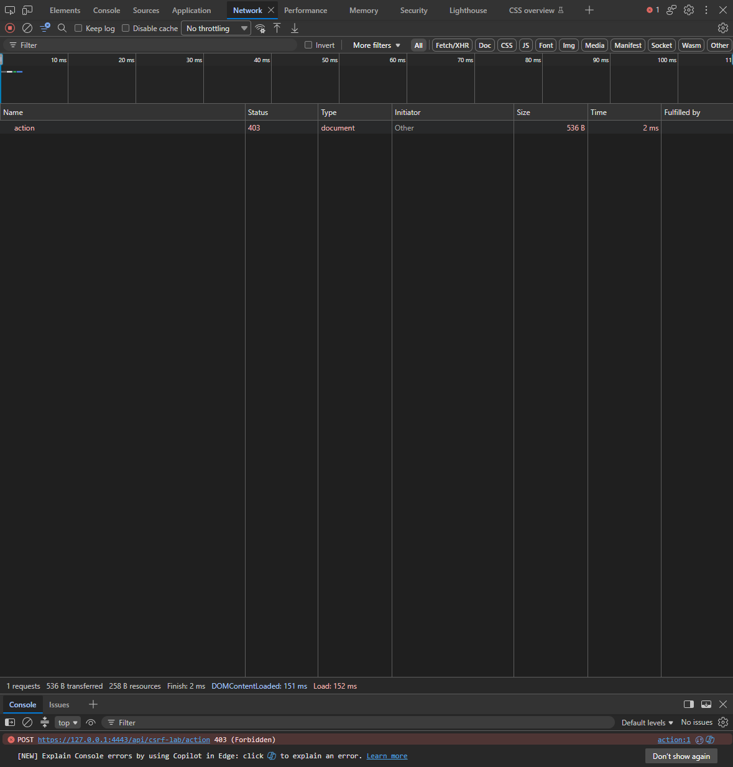
CONTROLLED EXPERIMENT 2
CSRF and SameSite
Same-site request -> 200 accepted
Cross-site request -> 403 blocked
5
Notes:
Network evidence, not just the cookie table, is what demonstrates the CSRF result: whether the cookie is attached to the request. Lax has browser-specific caveats for top-level navigation; Strict gives the deterministic blocked case used here.

Slide 6
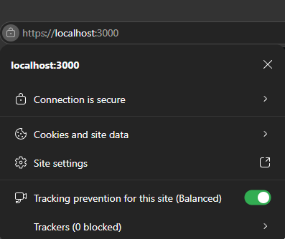
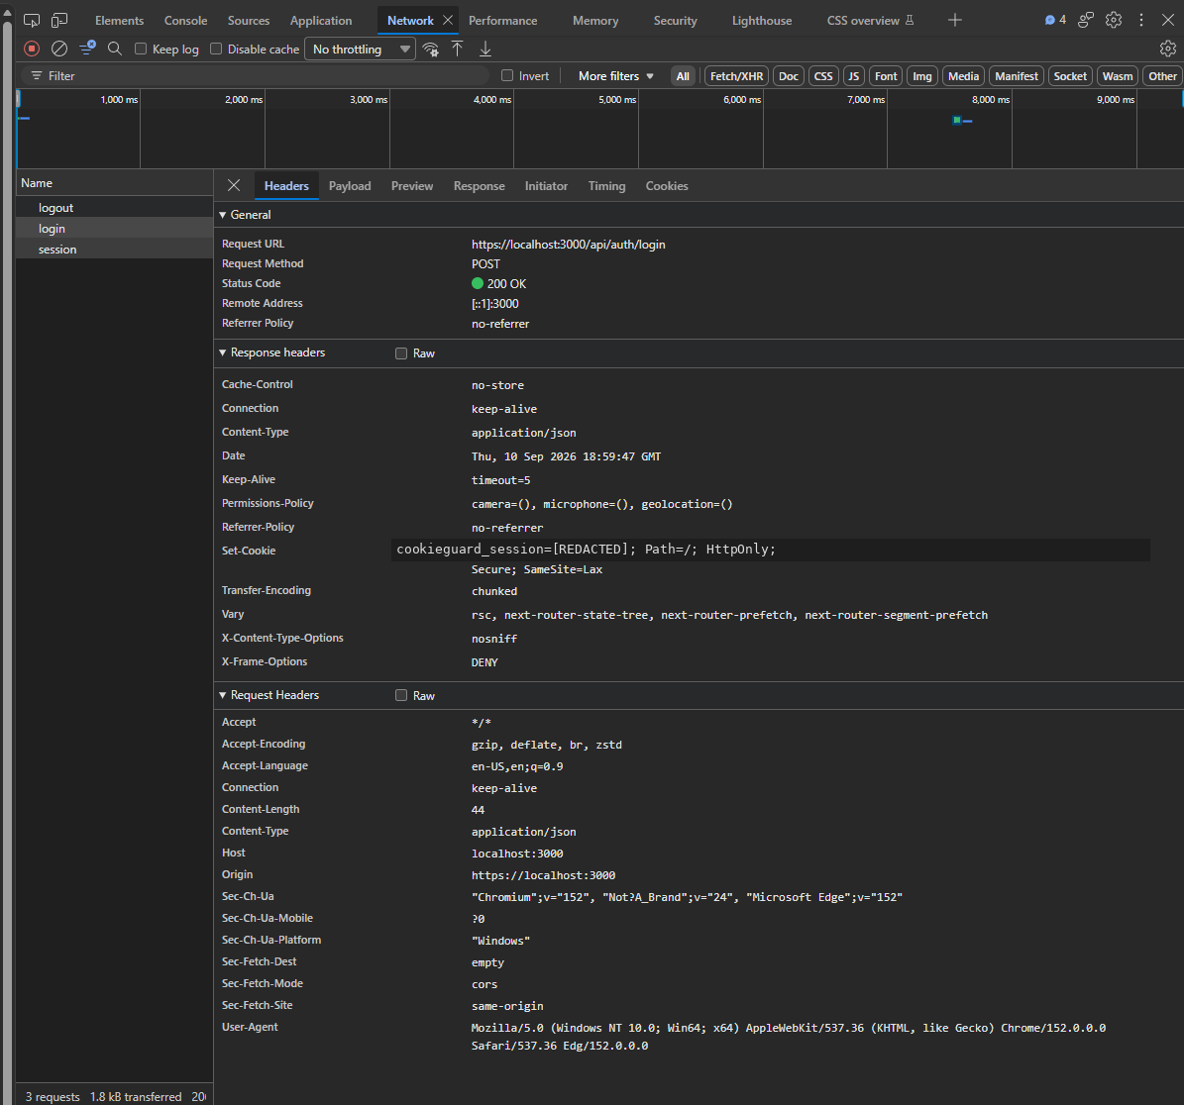
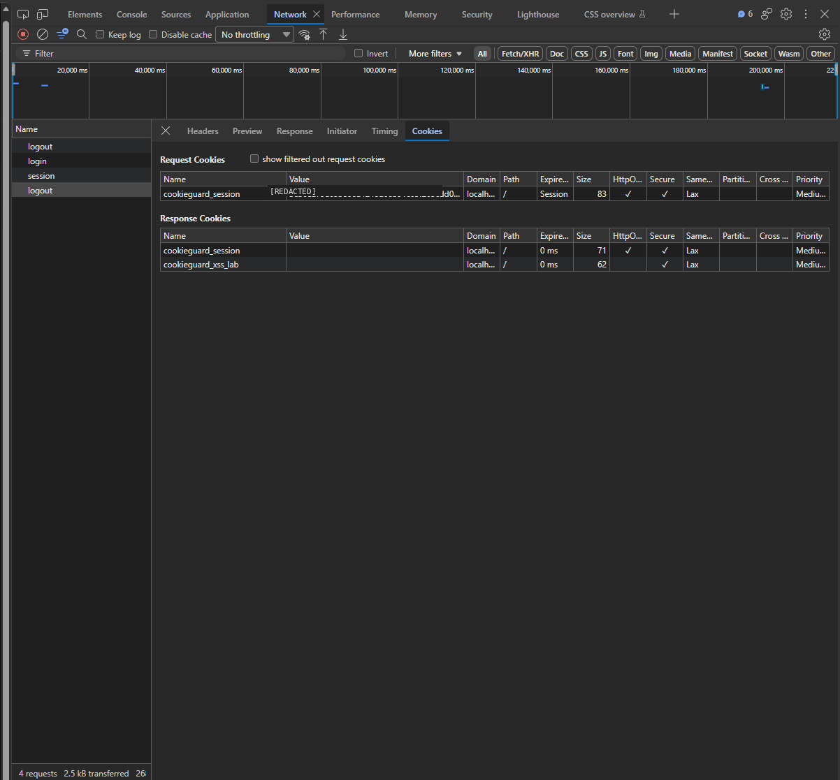
CONTROLLED EXPERIMENT 3
HTTPS and secure transport
HTTPS confirmed on the frontend origin
Login request Network evidence (Set-Cookie)
Logout clears the session cookie
6

Slide 7
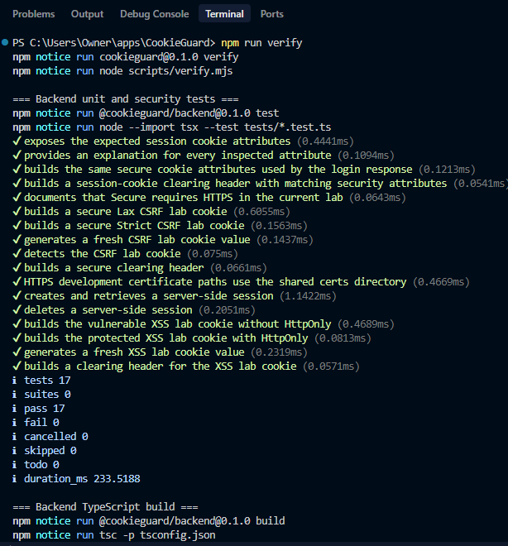
VERIFICATION
Results and security takeaways
Verification results
Limitations
Fixed demo credentials, not a real user database
In-memory sessions only
Local mkcert HTTPS certificate
Controlled vulnerable XSS mode is intentional
Dependency maintenance (Next.js) needed before any production use
17 / 17 backend tests passed, 0 failures
Backend TypeScript build passed
Frontend production build passed
GitHub Actions CI: Verify CookieGuard #64 - success
HTTPS, Secure, HttpOnly, SameSite verified
XSS and CSRF labs verified
Logout and session clearing verified
7

