Slide 1
AI, Machine Learning, Big Data, Algorithms & Intelligent Systems
ADVANCED TOPICS
CS 582 (Machine Learning), CS 435 (Algorithms), CS 425 –Software Engineering) Advanced Topics
Dr. Emdad Khan
Professor of Computer Science
April 2022
MIU

Slide 2

Following are Based on Some of my Papers & Plenary Talks - 2 Examples are
Paper on LifeLong Machine Learning at Int’l Conf on Artificial Intelligence at ICAI’2019
2) Plenary Talk at 17th International Conference on ARTIFICIAL INTELLIGENCE, KNOWLEDGE ENGINEERING and DATA BASES (AIKED '17), Feb 25, 2017, Cambridge University, UL
Dr. Emdad Khan
Prof., Dept. of CS
Maharishi International University
Iowa, USA, ekhan@miu.edu
Natural Language Computing

Slide 3
What is Machine Learning
Gives computers ability to learn from data & program themselves.
Programs can grow, reconfigure & change when exposed to new data.
Traditional Programming
Program
Output
Data
Computer
Machine Learning
Data
Program
Output
(desired)
Computer

Slide 4
Why Machine Learning?
Computers & Internet have significantly changed our lives & society.
Programming is the KEY for this.
Hence Improving & automating “How to program” is VERY important.
ML addresses this VERY important part.
We do NOT have good algorithms to solve Data Driven problems, for example, Regression and Classification:
Spam filtering
Detecting fraud transactions
Reliable Speech Recognition
Auto-driving of vehicles, …..
ML can successfully address all these problems.
ML is also the key for Big Data as the data size and complexity is very large; automation is a MUST for this.

Slide 5
Applications - 1
Many application areas - Software Engineering, Internet, Healthcare, Financing, Engineering, Automotive Industry, Physics, Biology, Bioinformatics, Meteorology, Economics, Education,……
Macy's Inc. and real-time pricing. The retailer adjusts pricing in near-real time for 73 million (!) items, based on demand and inventory, using technology from SAS Institute.

Slide 6
Applications - 2
Self driving Cars
Many sensors and many data.
Traditional Algorithm does / can NOT solve the problem.
ML approach Appropriately process the real-time data from sensors and make decisions as appropriate.
Google Self Driving Car -

Slide 7
What Is Big Data?
The amount of data has been exploding FAST!
2 Exa Bytes (10¹⁸) per day!
This Large data set is called Big Data
providing both challenges and opportunities
Notes:
Suggest go back to Internet centric. You do not have enough in this presentation to position the company as a gadget interface
Pls use another slide master. The current background is very distracting.

Slide 8
Key Problems With Big Data
Searching, Transferring, Sharing
Analyzing, Processing, Viewing
Deriving Meaning / Semantics
Summarization
Discovering Knowledge
Drawing Inference, Making Predictions
More (including mining)
Notes:
Suggest go back to Internet centric. You do not have enough in this presentation to position the company as a gadget interface
Pls use another slide master. The current background is very distracting.

Slide 9
Big Data Types
Unstructured
Texts on the Internet or other sources
Video
Images
Sound
Structured
Data in a Database
Unstructured Data Dominates with Wide Margin!
Notes:
Suggest go back to Internet centric. You do not have enough in this presentation to position the company as a gadget interface
Pls use another slide master. The current background is very distracting.

Slide 10
Issues Dealing with Unstructured Data
Semantic Meaning is needed
Context is very important
“John rides in a mustang” and “John rides on a
mustang”: (a) [2nd is riding on a horse] (b) O vrs. I might be a typo
World Knowledge is needed
Notes:
Suggest go back to Internet centric. You do not have enough in this presentation to position the company as a gadget interface
Pls use another slide master. The current background is very distracting.

Slide 11
Issues Dealing with Unstructured Data
Human brain can understand these instantly but computers cannot.
Keyword is not the answer.
Semantics using Predicate logic, Ontology and the like have issues – need to define semantics for almost everything!
Notes:
Suggest go back to Internet centric. You do not have enough in this presentation to position the company as a gadget interface
Pls use another slide master. The current background is very distracting.

Slide 12
Big Data – Key Ingredients
1. Infrastructure / frameworks / tools
[Map Reduce / Hadoop, Hive, Pig, Spark, Storm…]
2. Big Data Algorithms
3. Analytics (including emphasis on combining unstructured and structured data)
4. DB & Data Types (especially unstructured data and associated database e.g. NoSQL)
5. Natural Language Processing, AI, ML, UI
Notes:
Suggest go back to Internet centric. You do not have enough in this presentation to position the company as a gadget interface
Pls use another slide master. The current background is very distracting.

Slide 13
Some Future Applications – Intelligent Internet, Intelligent Search, Question Answering, Summarization,…

Slide 14
The Progression of the Internet
Internet Sort of Started with Portal (like Yahoo)
Then Moved to Search (e.g. Yahoo, MSN, Google)
Then Moved to Transaction (eBay, Amazon)
Then to Social Networks (Facebook, Twitter)
What’s Next?
Notes:
Suggest go back to Internet centric. You do not have enough in this presentation to position the company as a gadget interface
Pls use another slide master. The current background is very distracting.

Slide 15
What’s Next?
We See a Clear Trend that the future Internet is going to be something that can provide
Very Specific
More Precise and Direct Information
In a Very Easy Way so that
Anyone including an Illiterate Person can Access and Use it at Ease
Notes:
Suggest go back to Internet centric. You do not have enough in this presentation to position the company as a gadget interface
Pls use another slide master. The current background is very distracting.

Slide 16
What’s Next?
This Means
Much Smaller set of Search Results Instead of Millions of Hits (Usually Under 100)
Answer (a Small set of Answers) to a Question
Summarization of Articles
Drawing Inference from set of Documents
More Including Specific Request, Smart Transactions
Using Natural Language Dialogues
Notes:
Suggest go back to Internet centric. You do not have enough in this presentation to position the company as a gadget interface
Pls use another slide master. The current background is very distracting.

Slide 17
What’s Next?
Examples:
How many students graduated from MIU in CS in 2021 (today you won’t get a real answer!)
I would like to buy ML book by Stephen Marsland, please use my credit card on file and send it to my home address” (Would you receive the book today”)
Drawing Inference from set of Documents
A good summary of an article
More ……
Notes:
Suggest go back to Internet centric. You do not have enough in this presentation to position the company as a gadget interface
Pls use another slide master. The current background is very distracting.

Slide 18
The Next Generation Internet: Intelligent Internet (IINT)
Major Components
Big Data Handling Capability
Natural Language Capability
Intelligent Agent
Notes:
Suggest go back to Internet centric. You do not have enough in this presentation to position the company as a gadget interface
Pls use another slide master. The current background is very distracting.

Slide 19
Intelligent Internet (IINT): Architecture
Internet
W2
W3
Main Agent
(IA)
Sub Agent 1
Sub Agent 2
Agents of a Website, W1
Figure 1: Intelligent Internet (IINT) - showing a website with a main Intelligent Agent (IA) and 2 sub Agents. Sub Agents can perform functions like transactions or e-Learning etc. Such a website can have a Super Intelligent Agent (SIA) to handle more difficult tasks by collaborating with other websites. The Agents may reside on a different website(s).
Notes:
Suggest go back to Internet centric. You do not have enough in this presentation to position the company as a gadget interface
Pls use another slide master. The current background is very distracting.

Slide 20
Intelligent Internet (IINT): Key Algorithms
High Level Description as Each Can be a Separate Presentation
Delivering Requested Content
Calculating Some Functions – e.g. currency conversion
Performing Transactions – e.g. an e-Commerce application
Performing Networking Type Activities
Performing Teaching and Learning – e.g. an e-Learning application
Notes:
Suggest go back to Internet centric. You do not have enough in this presentation to position the company as a gadget interface
Pls use another slide master. The current background is very distracting.

Slide 21
Intelligent Internet (IINT): Key Algorithms
Conversational AI
Intelligent Information Retrieval
Intelligent Search (Covered in the Demo)
General Q&A (Covered under Sample Application)
Summarization
Drawing Inference
Complex Content Manipulation
Notes:
Suggest go back to Internet centric. You do not have enough in this presentation to position the company as a gadget interface
Pls use another slide master. The current background is very distracting.

Slide 22
Some Applications - Search
Today’s Search
Uses String Match (# of words, IDF,….) Plus Page Ranking – Millions of hits!
Example - "Auto body shops in San Francisco bay area", Google gave the following:
" About 1,200,000 results (0,45 seconds) ".
There are probably not 1.2M Auto body shops in the whole world! So, there are Key Issues!
Notes:
Suggest go back to Internet centric. You do not have enough in this presentation to position the company as a gadget interface
Pls use another slide master. The current background is very distracting.

Slide 23
DEMO on Intelligent Search
Intelligent Search Means Search That:
Uses Semantics and Deep Semantics (not just string matching) of NLP
Uses Meaning of Words to derive the Meaning of the (a) Input String / Sentence and (b) Title of the Results
Uses Semantic Matching of the Titles with Input Sentence to Derive Results
Demo Using SEBLA (Semantic Engine Using Brain-Like Approach)
“Low Price Thai Restaurant Silicon Valley”
Notes:
Suggest go back to Internet centric. You do not have enough in this presentation to position the company as a gadget interface
Pls use another slide master. The current background is very distracting.

Slide 24
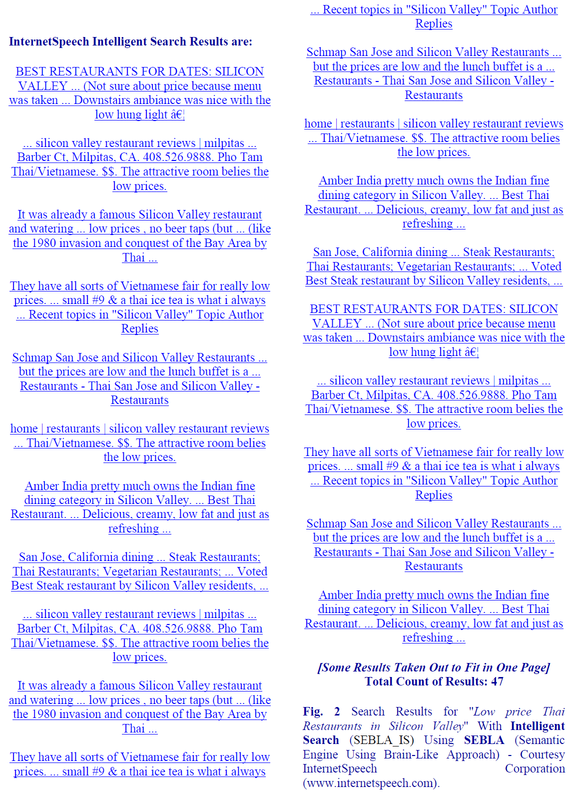
Courtesy: InternetSpeech, Inc
Notes:
Suggest go back to Internet centric. You do not have enough in this presentation to position the company as a gadget interface
Pls use another slide master. The current background is very distracting.

Slide 25
Conversational AI
Notes:
Suggest go back to Internet centric. You do not have enough in this presentation to position the company as a gadget interface
Pls use another slide master. The current background is very distracting.

Slide 26
ASR, NLP, ML, Conversational AI and Internet
We are basically talking about a Conversational System to talk to computers naturally!
For this we need ASR, NLP, ML, AI and more.
But it is getting there – it is one of the key trend:
Conversational AI / Intelligent Bots are growing fast in many industries
In fact, many researchers are thinking this as the “next generation Internet” after Yahoo (Portal) -> Search (Google) -> Amazon / e-Bay -> Facebook.
Notes:
Suggest go back to Internet centric. You do not have enough in this presentation to position the company as a gadget interface
Pls use another slide master. The current background is very distracting.

Slide 27
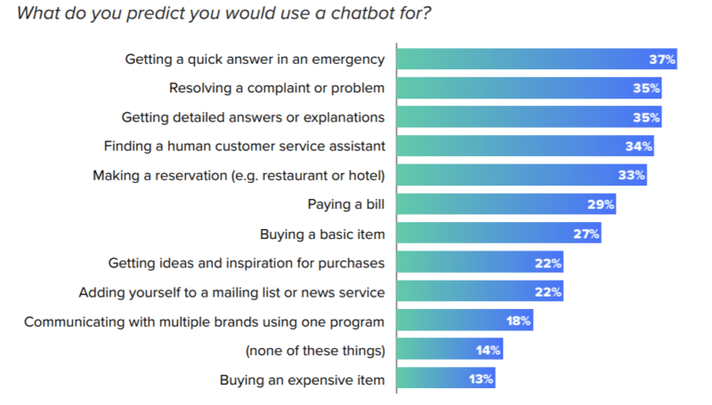
Conversational AI – Some Examples
Notes:
Suggest go back to Internet centric. You do not have enough in this presentation to position the company as a gadget interface
Pls use another slide master. The current background is very distracting.

Slide 28
Conversational AI Market & Opportunities
Global Conversational AI Market Report 2021
Estimated to be Worth $5.1 Billion in 2020
Expected to Reach $12.12 Billion by 2025
Growing at a CAGR of 18.9%
Expected to grow even at higher rate!
Notes:
Suggest go back to Internet centric. You do not have enough in this presentation to position the company as a gadget interface
Pls use another slide master. The current background is very distracting.

Slide 29
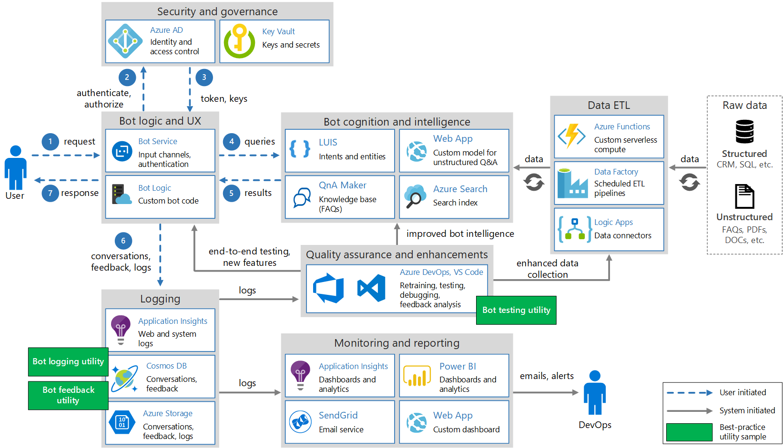
Conversational AI Example Architecture
Notes:
Suggest go back to Internet centric. You do not have enough in this presentation to position the company as a gadget interface
Pls use another slide master. The current background is very distracting.

Slide 30
Much More Complex Approach Needed for NLP
NLP helps in 2 broad ways
Natural dialogs and conversation with computing machine
Dealing with unstructured data (text, audio, video, image) associated in interacting with information source (e.g. Internet).
80% of the content is unstructured data. NLP is essential to deal with such data.
The key is to use NLP based computing with a highly capable and efficient Semantic Engine.
Notes:
Suggest go back to Internet centric. You do not have enough in this presentation to position the company as a gadget interface
Pls use another slide master. The current background is very distracting.

Slide 31
Example with Existing Methods for Semantics
“Maharani serves vegetarian food.”
Semantics represented by existing methods, e.g. Predicate Logic, is
Serves(Maharani, Vegetarian Food) and
Restaurant(Maharani)
Now, if we ask
“is vegetarian dishes served at Maharani ?
– System will NOT be able to answer
[we need to define semantics for vegetarian dishes!
>> Mechanical Semantics]
Notes:
Suggest go back to Internet centric. You do not have enough in this presentation to position the company as a gadget interface
Pls use another slide master. The current background is very distracting.

Slide 32
SEBLA and its Key Concepts
Semantic Engine Using Brain-Like Approach (SEBLA).
Considers Each Word as Object.
Semantics of a sentence is calculated by using the semantics of words.
Semantics of a Paragraph is calculated using the Semantics of Sentences.
Natural Semantics as opposed to Mechanical Semantics.
Notes:
Suggest go back to Internet centric. You do not have enough in this presentation to position the company as a gadget interface
Pls use another slide master. The current background is very distracting.

Slide 33
Lifelong Machine Learning
Help Achieving Human Like Intelligence
Notes:
Suggest go back to Internet centric. You do not have enough in this presentation to position the company as a gadget interface
Pls use another slide master. The current background is very distracting.

Slide 34
Existing ML & Its Limitations
Existing ML approaches have 2 key issues:
Representing learned information (knowledge) in suitable form (Knowledge Representation)
Limited generalization capability
Lifelong Machine Learning Addresses such issues (Next Topic)
Notes:
Suggest go back to Internet centric. You do not have enough in this presentation to position the company as a gadget interface
Pls use another slide master. The current background is very distracting.

Slide 35
Achieving Human Like Intelligence
While achieving “Human Like Intelligence” is our ambition, the path to achieve is a very difficult one!
It is a complex multi-disciplinary area!
- AI, ML, NLP, Data Science, Knowledge, Experience, Cognitive Computing, Lifelong Machine Learning and many more!
Major Challenges Comes with Major Opportunities!
Notes:
Suggest go back to Internet centric. You do not have enough in this presentation to position the company as a gadget interface
Pls use another slide master. The current background is very distracting.

Slide 36
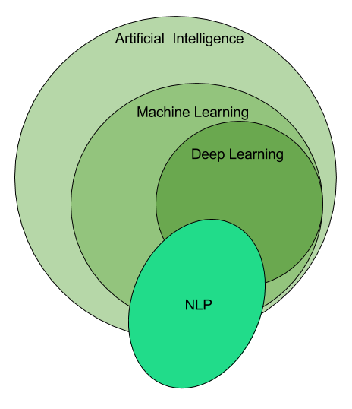
Human-Like Intelligent Robots/Softbots
Lifelong Machine Learning
Notes:
Suggest go back to Internet centric. You do not have enough in this presentation to position the company as a gadget interface
Pls use another slide master. The current background is very distracting.

Slide 37
Lifelong Machine Learning - 1
Machine Learning that can Accumulate Knowledge over time
Machine Learning that can Integrate Various Types of Knowledge
Learning that is Semantics & Logic Driven
Learning from one application can easily be used in other applications (Better Transfer Learning)
Notes:
Suggest go back to Internet centric. You do not have enough in this presentation to position the company as a gadget interface
Pls use another slide master. The current background is very distracting.

Slide 38
Lifelong Machine Learning - 2
Learning that has Better Generalization Capability
Learning that enables new knowledge creation
Learning that can convert Numerical (Structured data) Machine Learning into good “Knowledge representation”
Learning that can Integrate Existing Numerical Data Driven Learning with Unstructured Data Driven Learning
LML can significantly help to advance AI Growth
Notes:
Suggest go back to Internet centric. You do not have enough in this presentation to position the company as a gadget interface
Pls use another slide master. The current background is very distracting.

Slide 39
LML System using Natural Language, Semantics & Logic (LMLS_NL_SEM_LOGIC)
Notes:
Suggest go back to Internet centric. You do not have enough in this presentation to position the company as a gadget interface
Pls use another slide master. The current background is very distracting.

Slide 40
LMLS_NL_SEM_LOGIC – Application Example
Notes:
Suggest go back to Internet centric. You do not have enough in this presentation to position the company as a gadget interface
Pls use another slide master. The current background is very distracting.

Slide 41
Inference Drawn by LMLS_NL_SEM_LOGIC
On June 30, Sandy will be in San Francisco
Shelly will be in Australia
Bob will be in Indonesia
Ron will most possibly in Australia
The inference for the Ron is the most difficult one. But the conversation #3 in meeting 2, implies with some confidence that Ron has seen China enough
Notes:
Suggest go back to Internet centric. You do not have enough in this presentation to position the company as a gadget interface
Pls use another slide master. The current background is very distracting.

Slide 42
Software for Intelligent Systems
Industry Needs and growth
Many data driven applications need ML today
So, software have Frontend, Backend, AI-ML-NLP, Big Data …
This trend will continue
Impact on S/w life cycle
Req, dev, test etc.
A great Opportunity for you to Grow and Shine!
A great opportunity to help underdeveloped and developing nations; thus help minimize rich-poor gap and help prosperity!

Slide 43
How AI -ML Relates to Your Future?
You will be working on Software and Programming.
Many data driven applications need ML today.
With the rapid growth of Big Data / Data Science, applications needing ML is growing very rapidly!
Thus, ML will help you in the following ways:
Higher chance to get jobs more quickly
Higher salary
Broader range of industries and companies
Rapid Future growth, especially when you also take S/W Engg., WAP, WAA, EA,..
Enable yourself to become an entrepreneur & innovator
ML, Big Data, AI & Natural Language Processing are hot areas
“A breakthrough in machine learning would be worth ten Microsofts” (Bill Gates, Microsoft)

Slide 44
References / Further Reading
[1] E. Khan, “Lifelong Machine Learning with Logic, Semantics and Natural Language Processing”, International Conference on Artificial Intelligence (ICAI 2019), July 29 -Aug 1, Las
Vegas, USA.
[2] E. Khan, “Natural Language Processing: Key for Next Generation Big Data and Data Science” Plenary talk at 15th International Conference on Applied Computer and Applied Computational Science, March 18-20, 2016 http://www.wseas.org/wseas/cms.action?id=12693
[3] E. Khan, "Next generation web - intelligent search, question answering, summarization and more", INTERNATIONAL JOURNAL of COMPUTERS AND COMMUNICATIONS, (NAUN & UNIVERSITY PRESS), Vol. 9, June 2015.
[4] E. Khan, " Intelligent Internet: Natural Language and Question & Answer based Interaction”, INTERNATIONAL JOURNAL of COMPUTERS AND
COMMUNICATIONS, (NAUN & UNIVERSITY PRESS) Oct. 2013.
[5] E. Khan, "Natural Language Processing, Big Data, Bioinformatics and Biology”, INTERNATIONAL JOURNAL OF BIOLOGY AND BIOMEDICAL ENGINEERING (NAUN & UNIVERSITY PRESS), June 2014.
[6] C. Eaton et al, “Understanding Big Data: Analytics for enterprise class Hadoop and Streaming Data”, http://public.dhe.ibm.com/common/ssi/ecm/en/iml14296usen/IML14296USEN.PDF
[7] P. Ryan et al, “The Problem of Analyzing Unstructured Data”, Grant Thoronton, 2009,
http://www.grantthornton.ie/db/Attachments/Publications/Forensic_&_inve/Grant%20Thornton%20-The%20problem%20of%20analysing%20unstructured%20data.pdf
[8] E. Khan, "Processing Big Data with Natural Semantics and Natural Language Understanding using Brain-Like Approach”, INTERNATIONAL JOURNAL
of COMPUTERS AND COMMUNICATIONS, (NAUN & UNIVERSITY PRESS) January 2014.
[9] E. Khan,: Natural Language Understanding Using Brain-Like Approach: Word Objects and Word Semantics Based Approaches help Sentence Level
Understanding, US Patent filed on July, 2011
[10] Khan, E., (2011): Internet For Everyone: Reshaping the Global Economy by Bridging the Digital Divide” published in Aug, 2011; 978-1-4620- 4251-7 (SC
ISBN)
[11] E. Khan etal, “Intelligent Agent Based Mapping of Software Requirement Specification to Design Model”, Journal of Software Engineering and Applications, 2013, 6, 630-637
Published Online December 2013
Notes:
Suggest go back to Internet centric. You do not have enough in this presentation to position the company as a gadget interface
Pls use another slide master. The current background is very distracting.

