Slide 1

UFC HISTORY 1994 - 2021

Slide 2
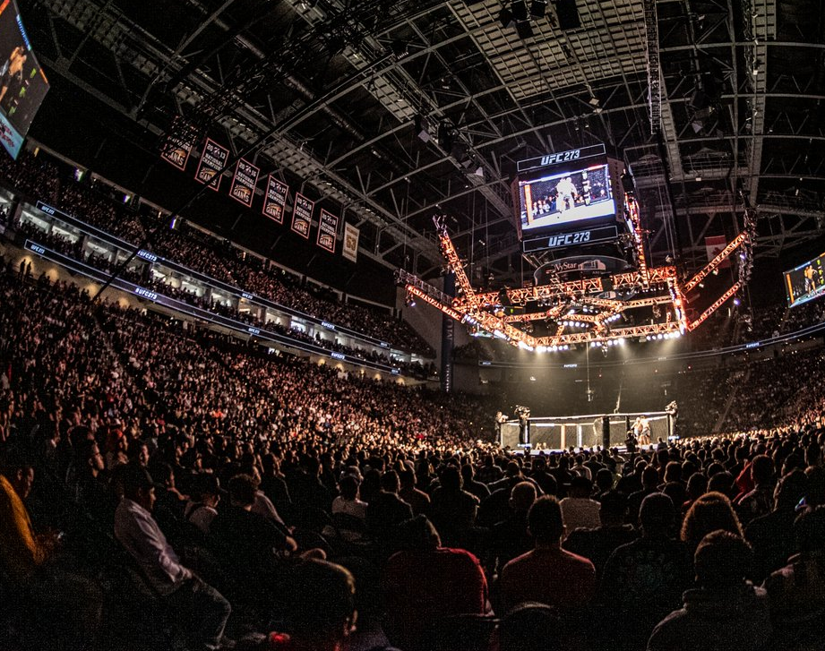
UFC quick summary
Number of fighters: 2122
Number of events: 555
Country with the biggest event number (373): USA
The biggest event number (152): Las Vegas

Slide 3
The oldest fighter
Ron van Clief
51 years old
The youngest fighter
Sean Daugherty
18 years old
Fighters with the most fights
Jim Miller, Donald Cerronne
35 fights
Referee with the most helded fights
Herb Dean
801 fights

Slide 4
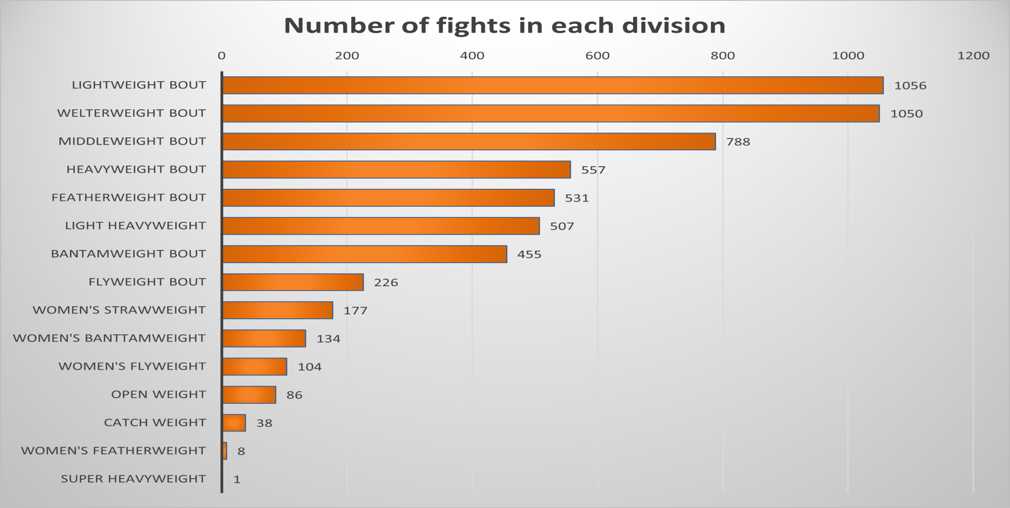
How many fights took place in each division?

Slide 5
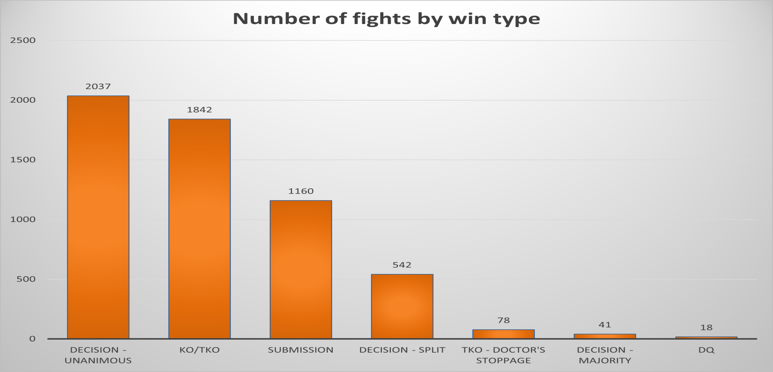
What is the most common way to win a fight…
Percentage of fights ended with KO/TKO: 32.21%

Slide 6
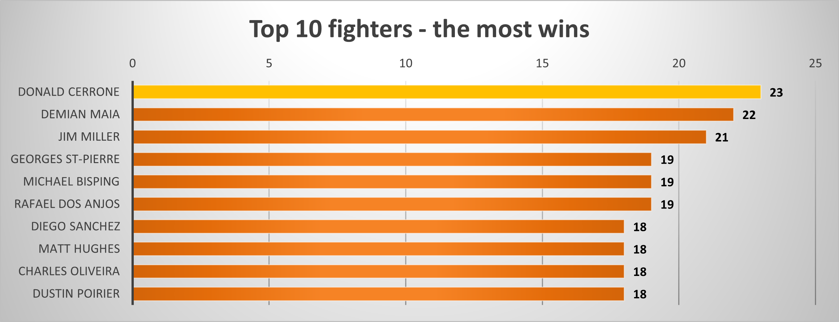
… and who is the best fighter?

Slide 7
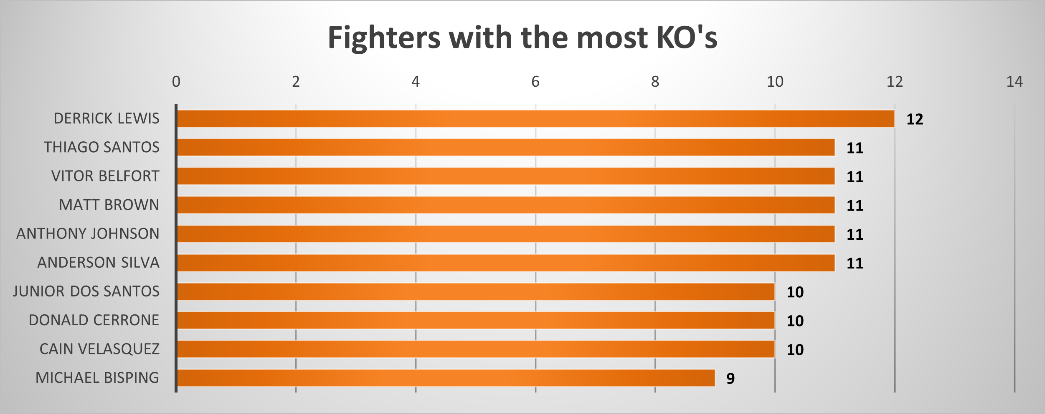
The most dangerous STRIKERS in UFC

Slide 8
Thank you for your attention!

