Slide 1
Laser Propulsion of Nanosat from Earth to Low Earth Orbit (LEO)
Sakshi Shrivastava (AU1401090)
Project Mentor: Dr Harshal Oza
Project Site: School of Engineering and Applied Sciences, Ahmedabad University

Slide 2
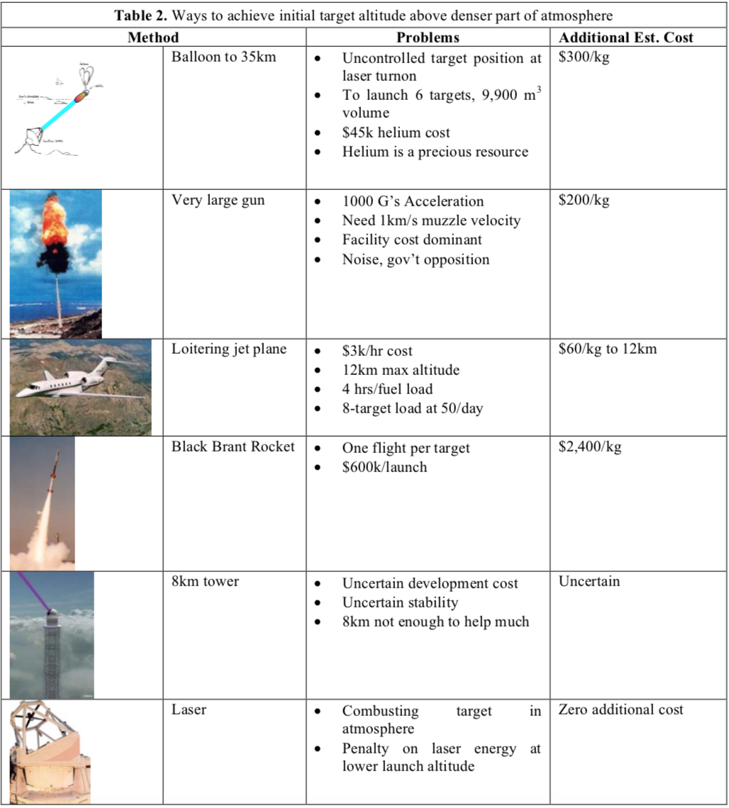
Motivation
Since 1957 to 2018, there has been a 750% in spacecraft speed.
Still we have only reached 0.02% of light speed.
Due to major technological advancements in the last decade, photonic propulsion has become a feasible idea for propulsion system.

Slide 3
Literature Survey
1923 - 24 | Russian pioneers Fridrikh Tsander, Konstantin Tsiolkovsky and, independently, the German Hermann Oberth | mentioned the idea of propulsion by light pressure, leading to the concept of solar sail.
1930s | Oberth in Germany and Goddard in US | 1930s, rocket technology developed through the independently in West.
1953 | Eugene Sänger, Germany | envisioned photonic propulsion based on the continuum radiation of a hot plasma generated by a fission reactor placed at the focal point of a large reflector
1966 | Georgii Marx, Budapest | arrived at a surprising conclusion in his paper, that though the instantaneous and total efficiencies of laser energy transfer start at zero, they reach around 42 and 67%, respectively, at half the speed of light and reach 100% at the speed of light itself
1967 | J.L Redding | a correction factor must be included that would reduce the Marxian efficiencies by half at c=2 and to zero at the speed of light itself.
1970s | Arthur Kantrowitz and | Arthur Kantrowitz demonstrated the existence of suitable lasers and popularized laser propulsion.

Slide 4
1972, 75 | Wolfgang Moeckel | Moeckel devised the basic equations for non-chemical propulsion and was the first scientist to promote the idea that, while almost unlimited exhaust velocities are possible for laser propulsion, the highest exhaust velocity is not necessarily the best. Most of the energy might go into the plume rather than the spacecraft
1993 | Simmons and McInnes | Proved Marx’s right and rederived one of Marx’s most valuable equations. The relativistic velocity attained depends on the Marxian energy quotient Pt = Mc^2, which is the ratio of laser output energy to the spacecraft mass expressed as Mc^2.
2000 | Laser-Hardened Materials Evaluation Laboratory facility | tested an advanced lightsail material with high-power CO2 lasers
2000 | DLR German Aerospace Center | Developed a large solar sail.
2002 | Carlo Rubbia | revisited the photonic propulsion scheme using a nuclear-pumped gas laser using a few kilograms of Americium 242 as the energy source for a 3 GW laser.
2008 | LuxSpace, a Luxembourg company | was awarded a A two year project, by ESA, to develop solar sail materials.

Slide 5
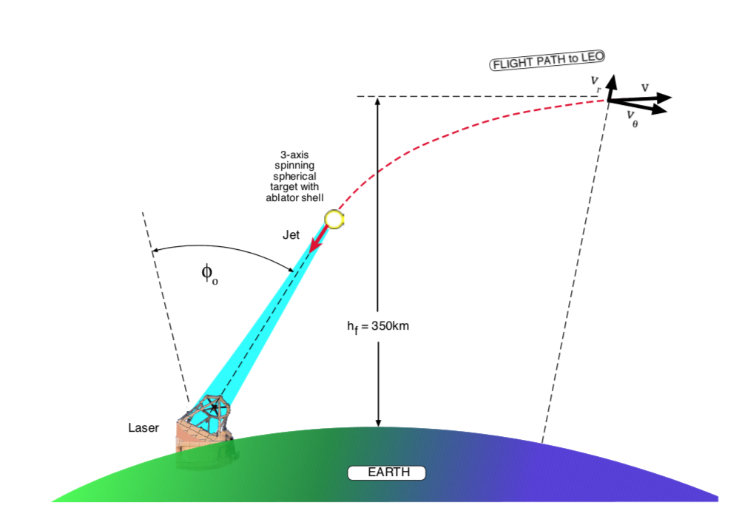
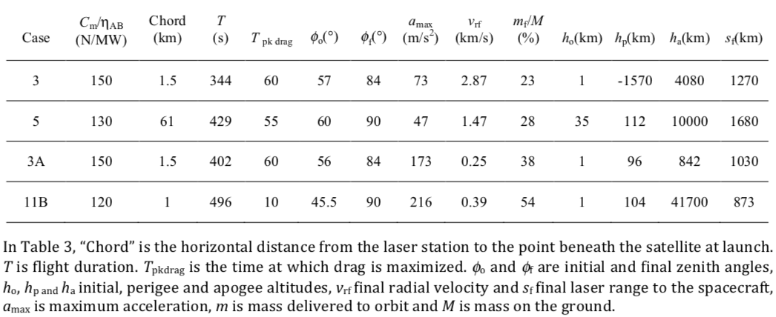
Laser Propulsion Theory

Slide 6

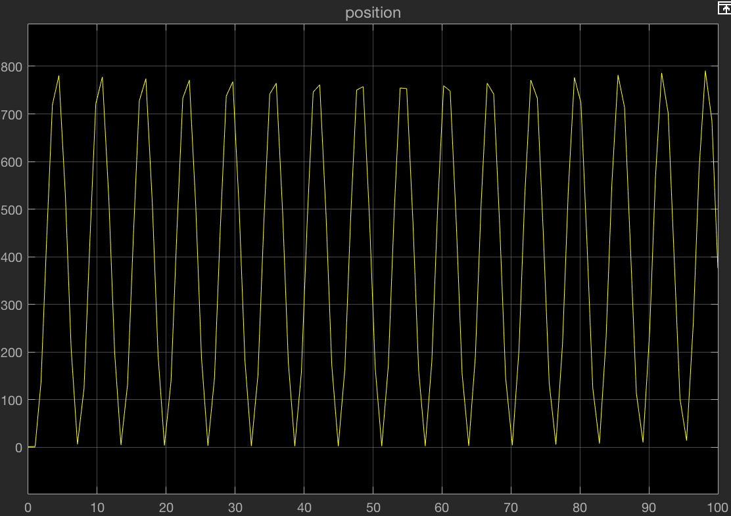
The Control Problem
Test case values:
Cm = 4
m = 100
Power (P) = step signal

Slide 7
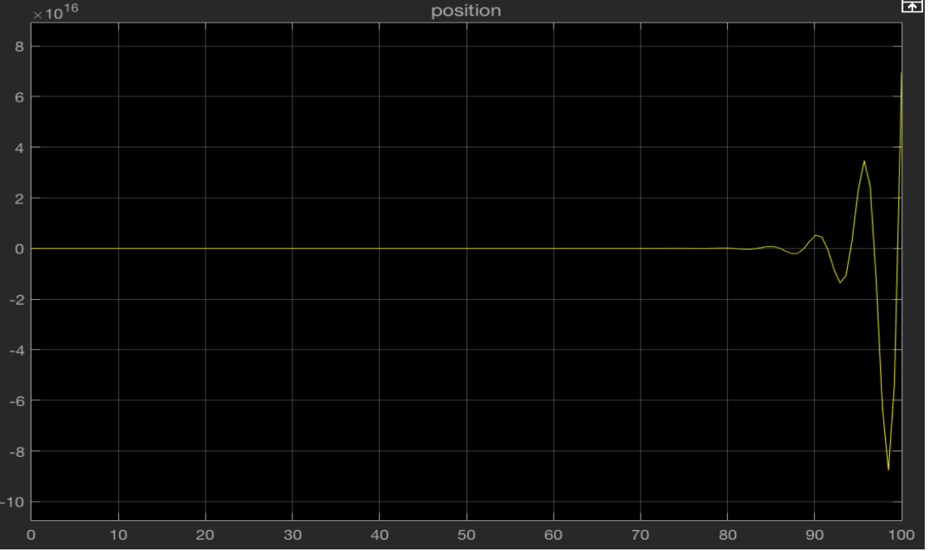

Slide 8
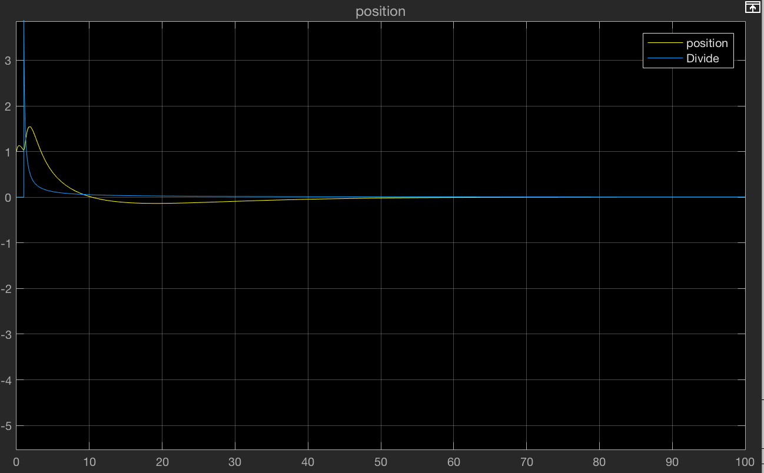

Tuned PID controller values:
Proportional (P): 0.18567
Integral (I): 0.00869
Derivative (D): 0.97392
Filter Coefficient (N): 5.45397

Slide 9
Conclusion & Future Scope
Modeled motion equations and control parameters were identified.
Using MATLAB software synthesised control variables to control the trajectory of the spacecraft.
Stabilized the spacecraft’s trajectory using a PID controller.
Future scope: trajectory planning for spacecraft.

Slide 10
References
Tsander, F., “Flight to Other Planets,” Development of Russian Rocket Technology, edited by Y. Moshkin, Mashinostroyeniye Press, Moscow, 1973 (in Russian).
Tsiolkovsky, K., “Plan of Space Exploration,” Exploration of the Universe with Reaction Machines: Exploring the Unknown, NASA History Series. NASA SP 4407, Washington, D.C., 1995 (English translation).
Oberth, H., “Die Rakete zu den Planetenräumen,” Oldenbourg Verlag, Munich, 1923.
Goddard, R., “A Method of Reaching Extreme Altitudes,” Smithsonian Miscellaneous Collections, Vol. 71, No. 2, 1919
Sänger, E., “Zur Theorie der Photonenraketen,” Probleme der Weltraumforschung, International Astronautical Federation, Zürich, 1954.
Moeckel W.E. (1972). Comparison of advanced propulsion concepts for deep space exploration. J. Spacecraft and Rockets 9, 863–868.
Moeckel W.E. (1975). Optimum exhaust velocity for laser driven rockets. J. Spacecraft and Rockets 12, 700–701.
Rubbia, C., “A Nuclear Propulsion Concept,” 6th International Symposium on Propulsion for Space Transportation of the 21st Century, Association Aéronautique et Astronautique de France, Paper S24.0, Versailles, France, 14–17 May 2002.
Myrabo, L., Knowles, T., Bagford, J., Seibert, D., and Harris, H., “Laser-Boosted Light Sail Experiments with the 150 kW LHMELII CO2 Laser,” High-Power Laser Ablation IV,Proceedings of SPIE: The International Society for Optical Engineering, Vol. 4760, SPIE, Bellingham, WA, 2002, pp. 774–798.

Slide 11
Herbeck, L., Eiden, M., Leipold, M., Sickinger, C., and Unckenbold, W., “Development and Test of Deployable Ultralightweight CFRPBooms for a Solar Sail,” Proceedings of the European Conference on Spacecraft Structures, Materials and Mechanical Testing, European Space Research and Technology Centre, Noordwijk, The Netherlands, 2001, pp. 107–112.
Marx, G., “Interstellar Vehicle Propelled by Terrestrial Laser Beam,” Nature, Vol. 211, No. 5044, 1966, pp. 22–23. doi:10.1038/211022a0
Redding, J. L., “Interstellar Vehicle Propelled by Terrestrial Laser Beam,” Nature, Vol. 213, No. 5076, 1967, pp. 588–589. PHIPPS ET AL. 633 doi:10.1038/213588a0ica. 146. 10.1016/j.actaastro.2018.02.018.
Simmons, J., and McInnes, C., “Was Marx Right? Or How Efficient are Laser Driven Interstellar Spacecraft?,” American Journal of Physics, Vol. 61, No. 3, 1993, pp. 205–207. doi:10.1119/1.17291
Mansell, Justin & Spencer, David & Plante, Barbara & Diaz, Alex & Fernandez, Michael & Bellardo, John & Betts, Bruce & Nye, Bill. (2020). Orbit and Attitude Performance of the LightSail 2 Solar Sail Spacecraft. 10.2514/6.2020-2177
Phipps, Claude & Bonnal, Christophe & Masson, Fréderic & Boustie, Michel & Berthe, Laurent & Schneider, Matthieu & BATON, Sophie & Brambrink, Erik & Chevalier, Jean-Marc & Videau, Laurent & Boyer, Séverine. (2018). Transfers from Earth to LEO and LEO to interplanetary space using lasers. Acta Astronaut

