Slide 1
Amazon Price War
General Assemble: Data Science Remote

Slide 2
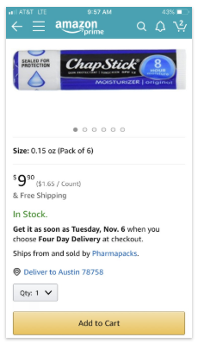
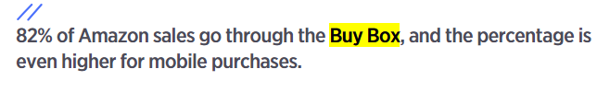
Hypothesis, Assumptions, and Goals
How win the Buy Box among multiple type of Amazon Reseller?
Lower the price?
Higher the ranking?
Use Amazon platform?

Slide 3
Data Set
Data: Amazon Ranking Analysis during summer 2016
ProPublica reporters examined Amazon’s shopping algorithm. We scraped data from the company's website to examine listings for 250 best-selling products across a wide range of categories, from electronics to household supplies, over a period of several weeks during summer 2016. We compared pricing and shipping costs for products offered by multiple vendors, including those sold by Amazon and sellers in the "Fulfilled by Amazon" program. In total, we examined 6,973 vendor listings.

Slide 4
Models
The data source has been split to training set (70%) and testing set (30%).
Tried out four different models, including:
Logistic Regression
K-Nearest Neighbors
Decision Tree Classifier
Random Forest

Slide 5
Results
Logistic Regression
Accuracy Score: 98%
Decision Tree (depth=6)
Accuracy Score: 97%
K-Nearest Neighbors (neighbors=7)
Accuracy Score: 97%
Random Forest (features=3)
Mean Accuracy Score: 80%

Slide 6
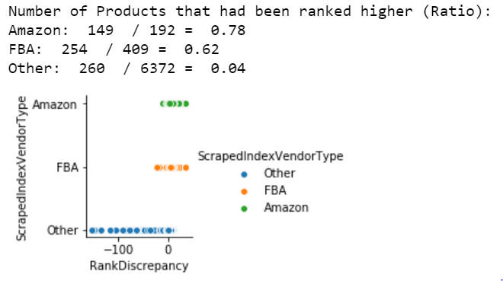
Current Statistic
The seller who use Amazon Platform has a higher chance to win the buy box.
The items that lacked a shipping price were sold by Amazon or sellers in the “Fultilled by Amazon” program
Amazon-linked products higher rankings in more than 80 percent of cases.

Slide 7
Current Statistic
Amazon = 179/192 = 93% FBA = 58 /409 = 14% Others = 105 / 6372 = 1%

