Slide 1
Airline reservation system
Pongruethai viriyothai

Slide 2
Project Details
Database HOST : microsoft azure
Server name : airlinedb.database.windows.net
Connection string : can be found in \AirlineReservationSystem.App\app.config
Log file : plain text file (path = \AirlineReservationSystem\AirlineReservationSystem.App\bin\Debug\log.txt)
Type of application : windows form
Nunit tests
NOTE: firewall access is set to specific ip from 0.0.0.0 to 255.255.255.255

Slide 3
Roles
Administrator
Create, update, delete Flights / assign crews to flights
Create, update, delete carriers
Create, update, delete crews / assign flights to crew’s roster
Book / unbook ticket
Search flights / view flight details
find booking
CREW
View crew’s roster
Book / unbook ticket
Search flights / view flight details
find booking
Passenger
Book / unbook ticket
Search flights / view flight details
find booking

Slide 4
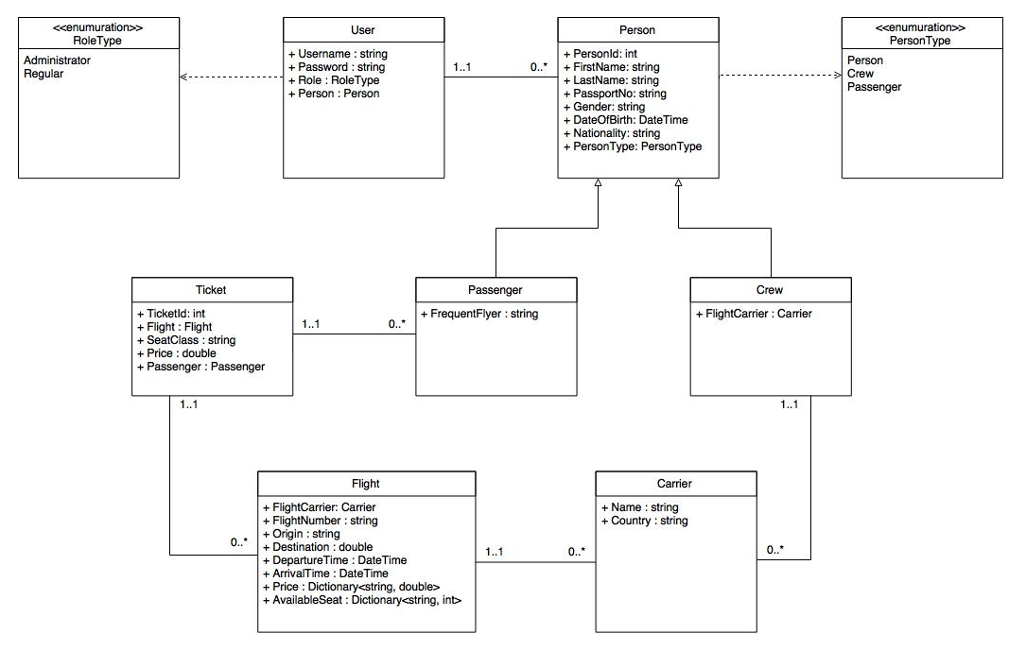
UML diagram

Slide 5
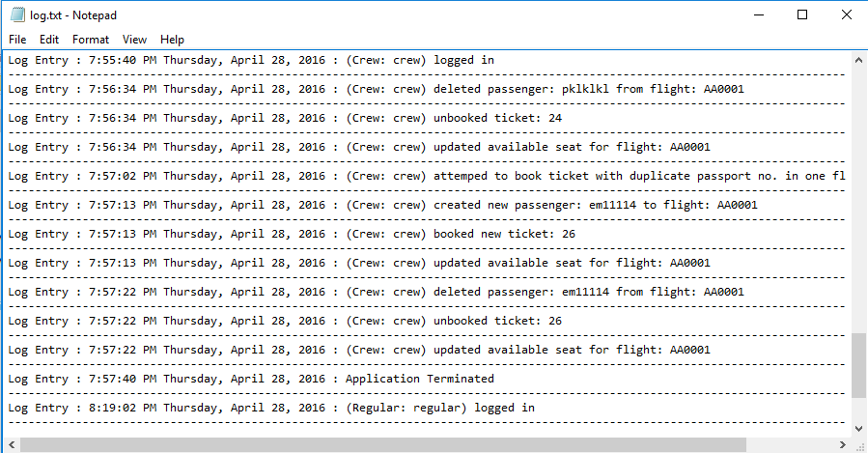
Log file example
Log entry provides date/time, role type, user account and actions

