Slide 1
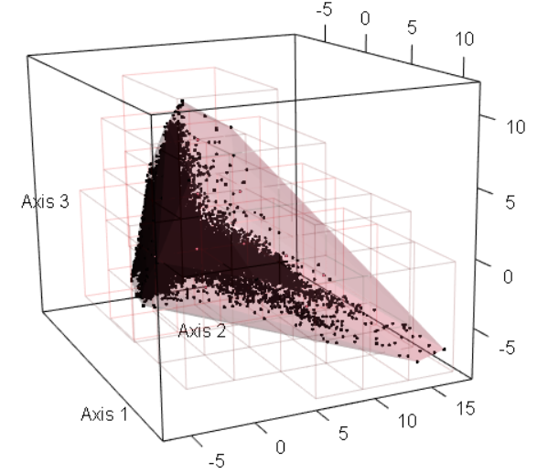

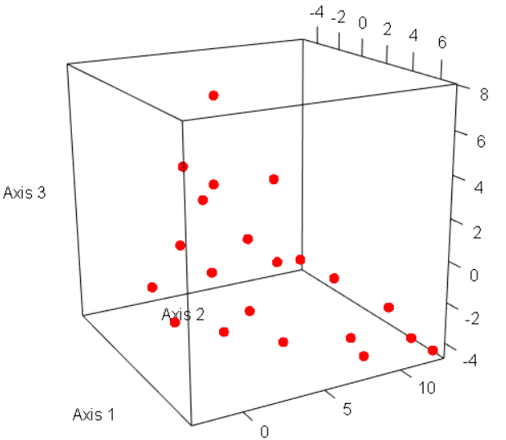

Environmental raster preprocessing
Initial samplings from environmental space
Final spatial selection
Step 1. Create raster stack at 10-m resolution
by including the most important environmental
variables (e.g., elevation, wetness index,
radiation, canopy cover).
Step 3. Select randomly half of the raster stack cells and run ordination analyses. Select the first three ordination axes.
Step 5. Sum up how many times each cell was selected in the repeated initial sampling rounds.
High
Low
Step 4. Take a systematic sample from the environmental space and save the selection. Repeat steps 3 & 4 e.g., 100 times.
Step 6. Use the summed cell values as weights in the final sampling when iteratively selecting cells until the wanted number of sampled cells is reached while also keeping a minimum distance between the sampled locations (e.g., 100m).
Step 2. Mask cells outside the study area or too
close to roads and buildings.

