Slide 1


Slide 2
Sime Darby Property
University Hackathon 2026

Slide 3
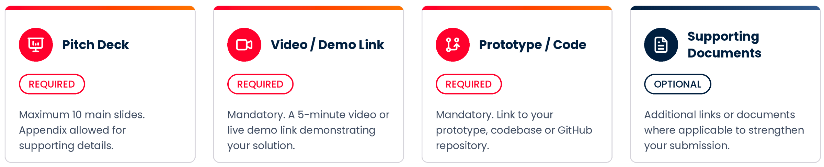
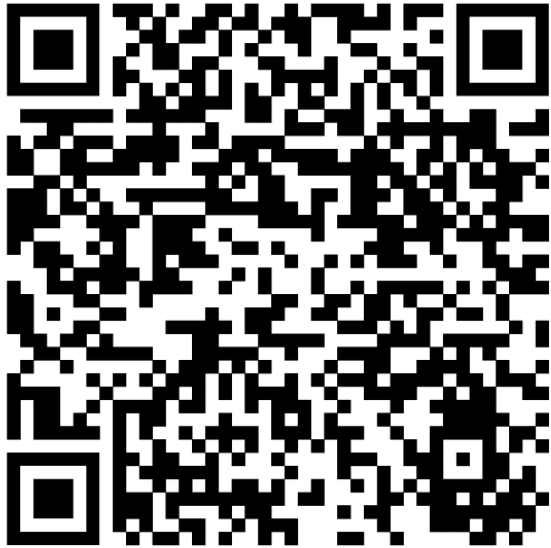
UNIVERSITY HACKATHON 2026
Submission Deadline
ALL teams must submit the following four components by 11:59 P.M., 23 October 2026.
Incomplete submissions will not be considered.
Scan here to submit

Slide 4


UNIVERSITY HACKATHON 2026
What Should Your Pitch Deck Cover?
The slides should cover 8 key areas:
The Story
The Proof
Problem
How it Works
1
5
Target User
Impact
2
6
Solution
Feasibility
3
7
Innovation
Implementation
4
8
Keep your core pitch deck to 10 slides and moving secondary details to the appendix.

Slide 5
UNIVERSITY HACKATHON 2026
Example: Pitch Deck Walkthrough
SCENARIO: Finding parking at a mall
Shoppers circle crowded parking levels looking for a vacant bay, wasting time and adding stress to their visit.
The Story
1
Problem
2
Target User
3
Solution
4
Innovation
Shoppers circle full parking levels at peak hours hunting for a bay, wasting time and adding stress.
Weekend and peak-hour mall visitors, especially families, plus mall operators managing car park traffic.
A mobile app and LED signs that show live vacant bays per level and guide drivers straight to a free spot.
AI on existing CCTV detects free bays in real time, with no costly sensor per bay, and predicts availability.
The Proof
5
How it Works
6
Impact
7
Feasibility
8
Implementation
Camera detects bay status → data sent to cloud → app and signs update live → driver follows guided route.
Less time circling, shorter ramp queues, lower fuel use and emissions, and a better shopping experience.
Uses proven tech and existing cameras; low setup cost; revenue from operator subscription or bay pre-booking.
Pilot one car park level for 3 months, measure search time saved, then roll out mall-wide and to other malls.
Tip: Carry one clear problem through every slide. Keep your core pitch deck to 10 slides and move secondary details to the appendix.

Slide 6
Presentation Template
Title

Slide 7
Team Information
Team Name
Team Leader
University
Team Members Details (2–5 members)
Email
Contact Number

Slide 8
1. The Problem
What related problem are you trying to solve?
Who is affected and why is it important?

Slide 9
2. Target User
Who will benefit from your solution?
Describe the users and their challenges.

Slide 10
3. Your Solution
What is your proposed solution?
Explain how it works and helps.

Slide 11
4. Innovation
What makes your idea unique?
How is it different from existing approaches?

Slide 12
5. How it Works
Explain in detail how your idea + solution works according to theme selected.

Slide 13
6. Impact
What positive impact can your solution create?
Who benefits and what outcomes can be achieved?

Slide 14
7. Feasibility
Can your idea realistically be implemented?
Resources, stakeholders and deployment approach.

Slide 15
7. Implementation
How would you implement your idea and solution according to your theme selected in detail.

Slide 16
7. Visual Concept
Insert sketches, mockups, diagrams, screenshots or AI-generated visuals.

Slide 17
8. Why Your Team Should Win
In 100 words or less, explain why your solution deserves recognition.

Slide 18
Thank You

