Slide 1

Chef-Workshop

Slide 2
Agenda
Chef Architecture
Mongo DB Installation
Tomcat Installation
Bonus Application

Slide 3
What is chef
Chef is Powerful automation platform that transform complex infra into code, chef automates how application are configure, deployed and managed across your network, no matter its size.

Slide 4
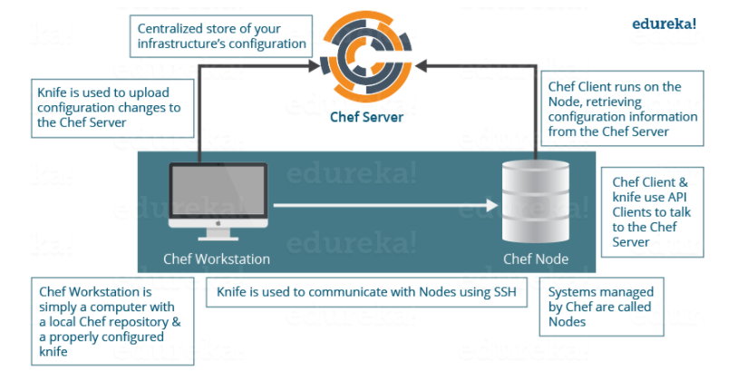
Chef Architecture

Slide 5
Mongo DB Installation

Slide 6
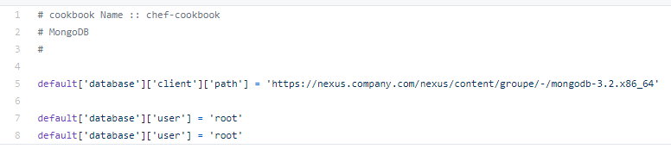

Attributes

Slide 7
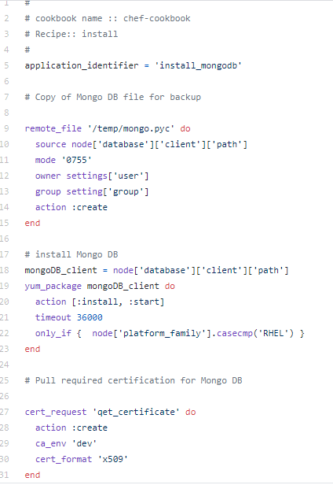
Recipe

Slide 8

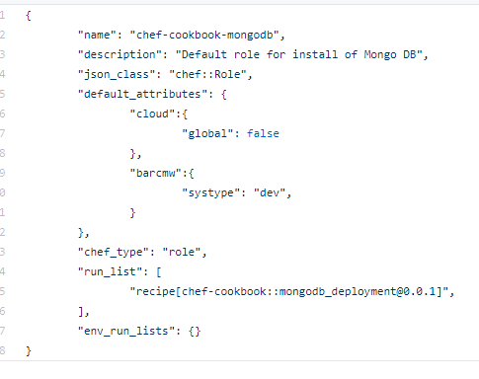
Role

Slide 9
Tomcat Installation

Slide 10
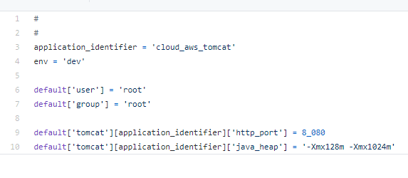
Attributes

Slide 11
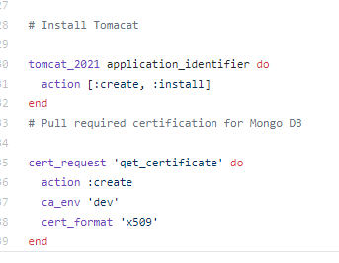
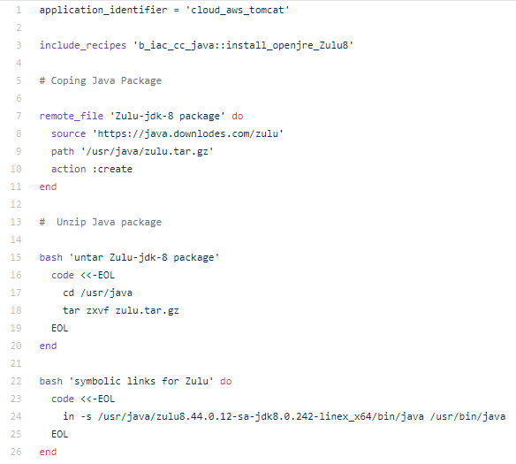
Recipe

Slide 12
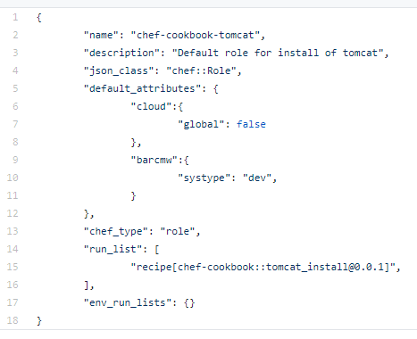
Role

Slide 13
Bonus Application

Slide 14
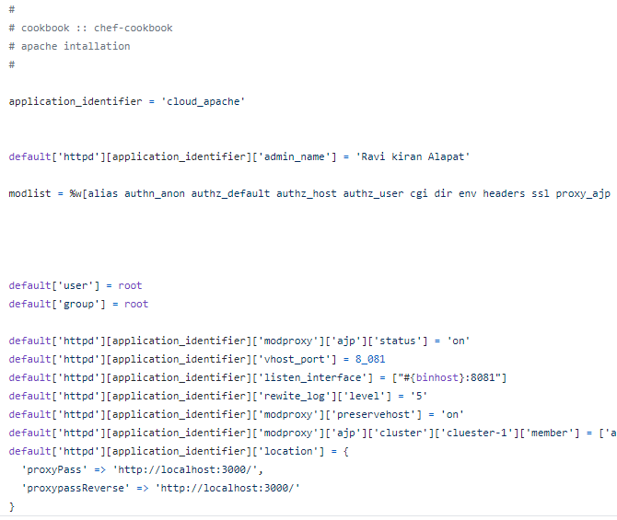
Attributes

Slide 15
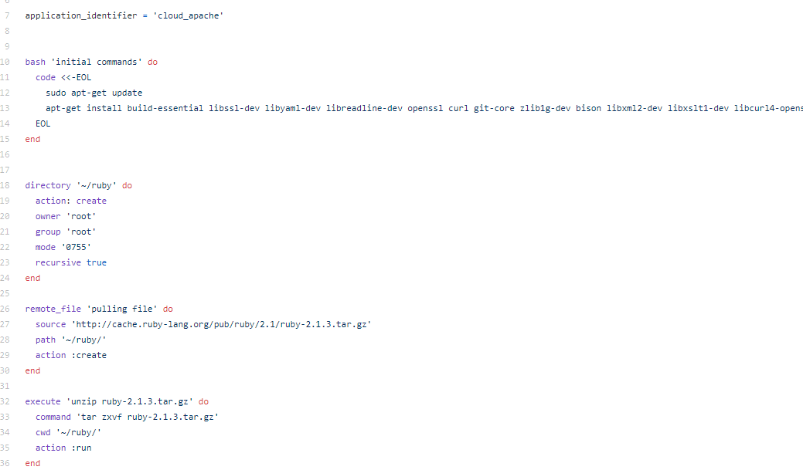
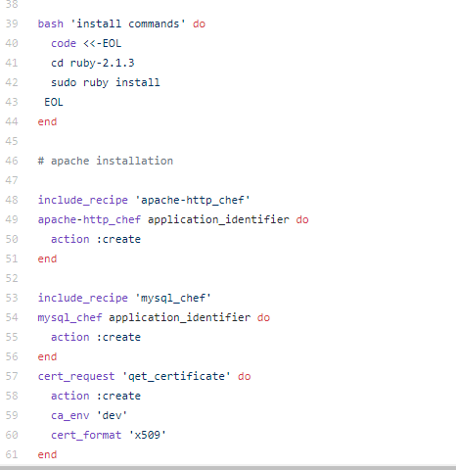
Recipe

Slide 16
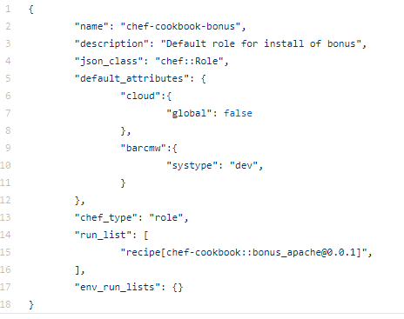
Role

Slide 17

Any Questions

Slide 18


Thank You

