Slide 1
Stock Brokerage Web App
Supraja Ponnur

Slide 2
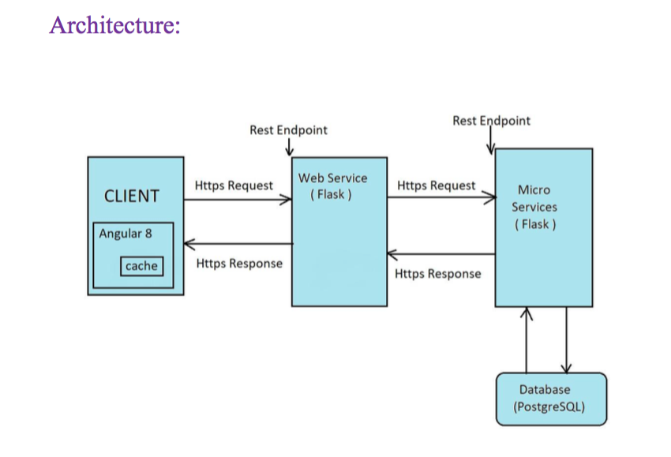
Architecture

Slide 3
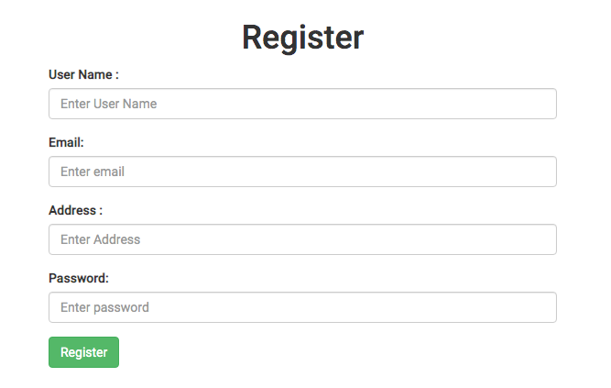
Functionalities:
Registration:

Slide 4
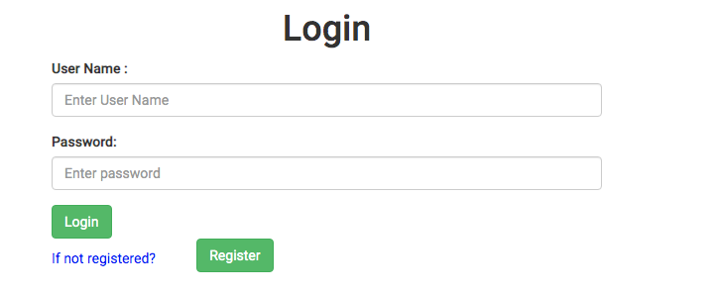
Login

Slide 5
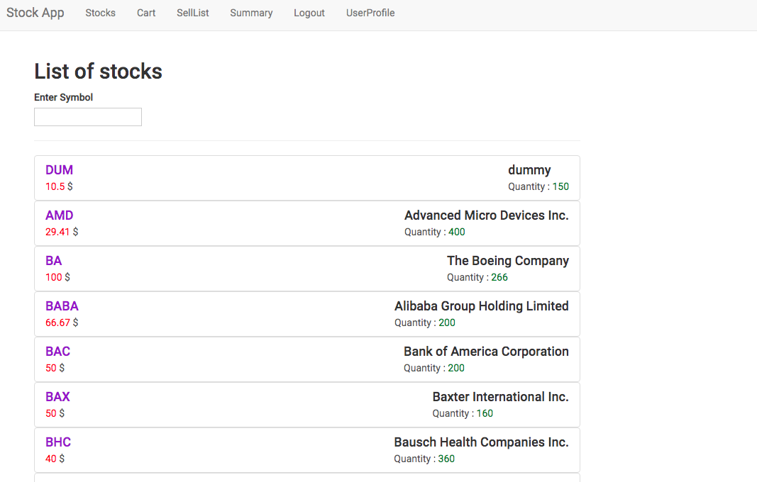
Display All Stocks

Slide 6
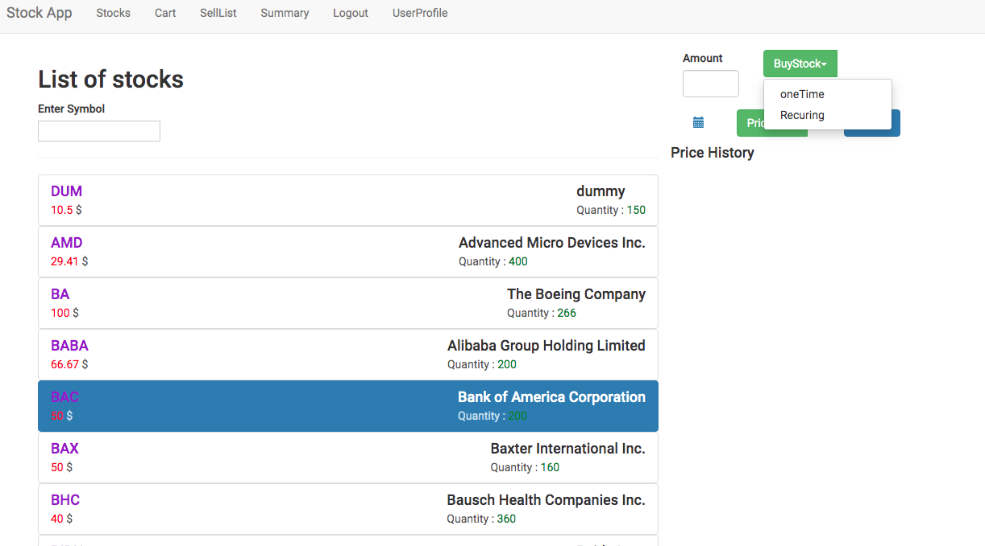
Select Stock

Slide 7

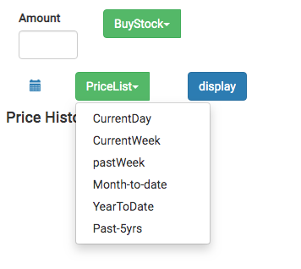
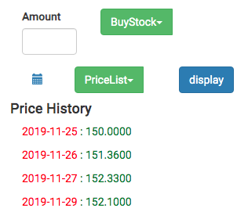
Price History

Slide 8
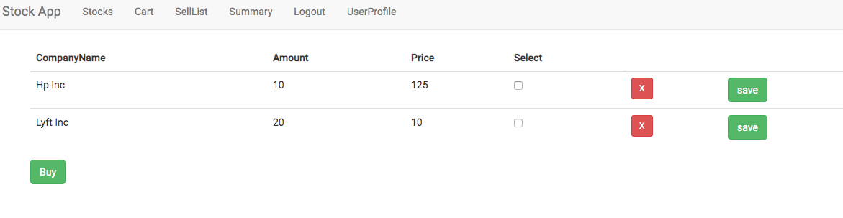
Buy/sell Cart

Slide 9
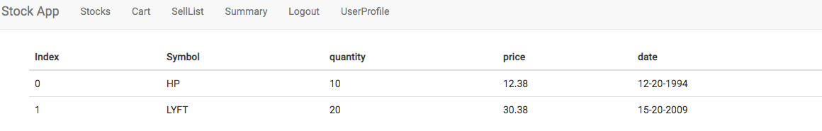
User stock summary

Slide 10
Webservices:
The stockbrokerage website should make a webservice call to stock brokerage web application for any user required Db access.
All webservices should require authentication/authorization.
Other Features:
1. Request/Response Compression : Gzip
2.High Performance : Cache

